Slide 1
Paper 1

Slide 2
21-25 CCBBD 26-30 BADDC
31-35 CCDDB 36-40 BGFAC
41-45 DBBAD 46-50 BCDDB
51-55 CADBC 56-60 ACBDA
61. a 62. ordered 63. was drunk 64. quietly 65. why 66. agreement 67. us 68. surprised 69. with 70. drinking

Slide 3
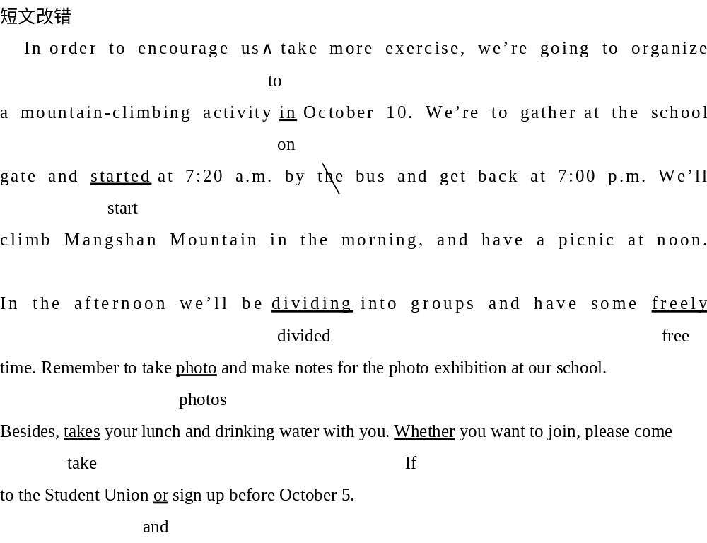

Slide 4
1. Chen Hui is one of my best friends, who is concerned about / for his classmates.
2. He likes learning English; he said that the English novels he had read added up to more than 60 and he always sets down some good sentences in his notebook.
3. In order to keep healthy, he joined the school football team three months ago.
4. He gets along well with his classmates, but sometimes he does disagree with his classmates.
5. I’m grateful to him because he always does everything in his power to help me with my studies.

