Slide 1
Paper 3

Slide 2
61. subjects
62. how
63. studying
64. determined
65. will put
66. actually
67. leaves
68. them
69. for
70. to do
21-25 CDCBC
26-30 BDCDD
31-35 ACADD
36-40 ABDFG
41-45 DBCAD
46-50 BCADB
51-55 CDABA
56-60 CBACD

Slide 3
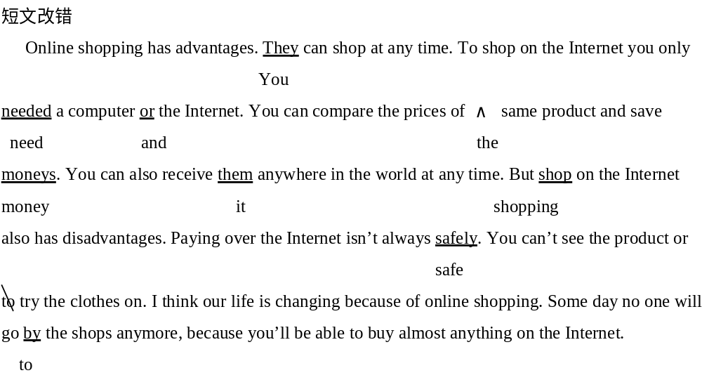

Slide 4
选做题一
1. Wang Lin, a boy, who is very fond of traveling, graduated from middle school in July.
2. Last week he determined to go to Lhasa for a visit but finally he gave up because the journey is too long.
3. In fact / Actually it was his mother that / who persuaded him to change / into changing his mind.
4. After thinking over his mother’s words / what his mother had said, he made up his mind to visit Xi’an and made a schedule for it.
5. As for the means of transport, he prefers traveling by train, because in this way he can enjoy the view along the way.

