Slide 1
Unit 1 warming up
Difficult sentences & language points

Slide 2
1
2
3
4
5
6
7
8
9
10
11
12
13
1.Add up your score and see how many points you get.(P1)
把你的分数加起来看能得多少分。
★考点:add up合计;加起来
①I’m going to add up all the money I have.
我要合计一下我所有的钱。
②You haven’t added the figures up right.
你没有加对这些数字。

Slide 3
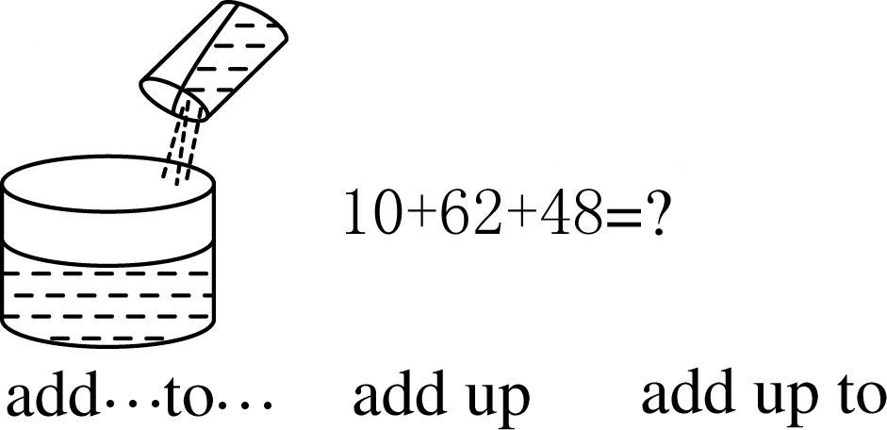
add to
增加;增添
add sth.to sth
把…加到…里
add sth.up
把…加起来
add that...
补充说……
add
返回导航页
结束放映

Slide 4
1
2
3
4
5
6
7
8
9
10
11
12
13
add up 合计;把……加起来
add up to 总计为
add A to B 把A加到B中
add to 增添/增加
add (that)…补充说

Slide 5
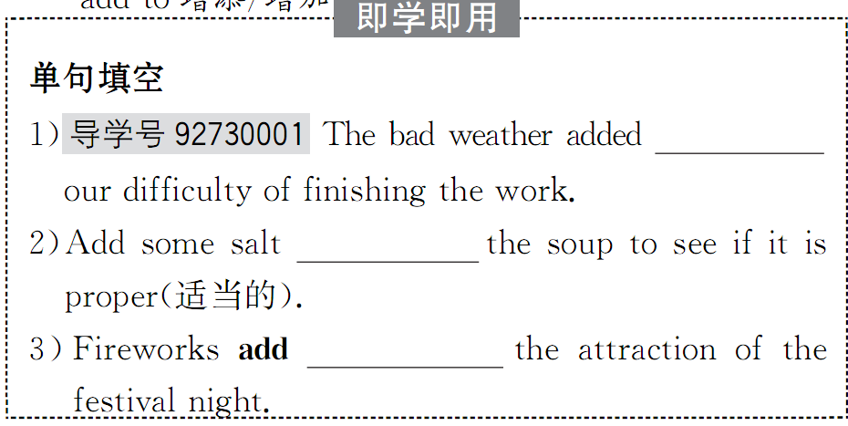
1
2
3
4
5
6
7
8
9
10
11
12
13

Slide 6
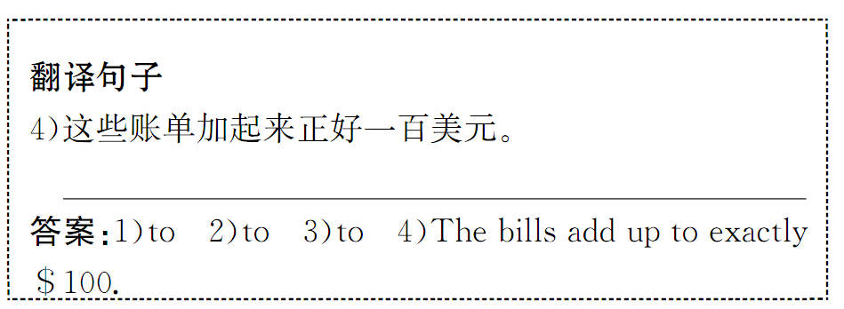
1
2
3
4
5
6
7
8
9
10
11
12
13

Slide 7

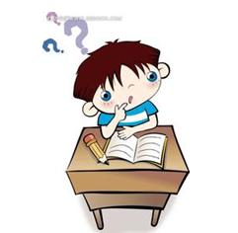
巧 学 活 用
1．完成句子①Last year，my total income，with my reward added________，added ____________15,000 yuan.
②(2014·江西高考书面表达)________addition，we should learn how to get along well with others.
2．单句改错①The money he spent within a month was added up to more than 1,000 dollars.
②The official expressed great concern ouver the food safety，added that the government would take more measures to prevent such case happening again.
去掉
to
up to
adding
In

Slide 8
2.Your friend comes to school very upset.(P1)
你的朋友来上学时心情很不好。
1)这里upset是形容词,来描述主语的状态的.是主补.很多时候,主补用表语形容词充当.
2） very upset是状语,表示状态／状况
3）国外一些语法学家如M.Ganshina,他们认为这种现象叫做“双重谓语”（double predicate）.双重谓语既是动词性谓语（verbal predicate）,又是名词性谓语（nominal predicate）.比如在The moon rose red.（月儿红彤彤升起来）这个句子里,一方面rose是一个表意动词（notional verb）,用作动词性谓语,另一方面,形容词red用来修饰主语moon,说明moon的特征.
表意动词如果起连系动词的作用,它的词汇意义通常弱化,以致最后完全变成连系动词.如：The well ran dry.（井干涸了）,ran已经没有了它原来的词汇本意,而完全变成连系动词了.（注：例句系作者添加）
国外语法家认为,表意动词基本上保持原有的词汇意义,这时就构成了“双重谓语”

Slide 9
He went to bed cold and hungry.
2. Long and untidy, his hair played in the breeze.

Slide 10
用作伴随状语的几种方式
1．形容词
They all rushed up，eager to help．
She returned to work，unhappy．
The thief hid himself in the corner, afraid of being caught.
小偷躲在角落里,怕被人抓住.
We watched the houses being destroyed by the storm, helpless.
我们看着房子正在被暴风雨摧毁,无能为力.
2．现在分词
I don't like to sit here doing nothing．
He rushed out，even forgetting to take his overcoat．
3．过去分词
Accompanied by the professor，he spent several days doing experiments one after another．
4．介词短语
He cried in surprise.
5．独立结构和with结构
He lay on his back，his hands crossed under his head．
The teacher came in，book in hand．
With the old man leading，they two started toward the mountain．
Now he could walk only with his brother supporting him．

Slide 11
用形容词作状语翻译下列句子:
1.饥寒交迫，那个小女孩不住地哭泣。
2.长途国外旅行之后，他精疲力竭地回到了家。
3.他谦逊、开朗，使大家很快就一点也不紧张了。
4.在我回家的途中，我看到一个中年男子躺在路边，烂醉如泥。
5.回答不出老师的问题，学生们都保持沉默。
6.又怕又冷，时光旅游者踏上了回到现在的旅程。

Slide 12
1.Cold and hungry, the little girl kept crying.
2.After the long journey from abroad, he got home , tired/ tired out/worn out.
3.Modest and easy-going, he soon put everyone at ease.
4. On my way home, I saw a middle-aged man lying by the roadside , blind drunk./ very drunk.
5.Unable to answer the teacher’s question, all the students kept silent.
6.Scared and cold, the Time Traveller starts back towards the present.

Slide 13
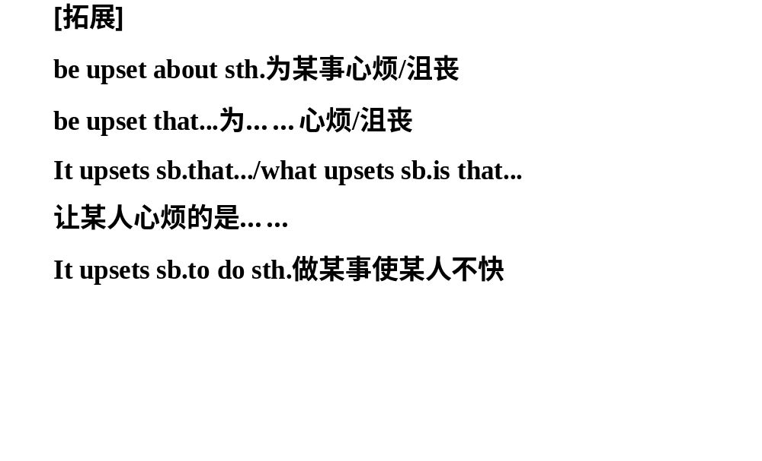

Slide 14
1
2
3
4
5
6
7
8
9
10
11
12
13
3.You will ignore the bell and go somewhere quiet to calm your friend down.(P1)
你就不去上课,找个安静的地方安慰你的朋友。
★考点一:ignore vt.不理睬;忽视
①【高考典句】(2015·安徽高考)Ignoring the difference between the two research findings will be one of the worst mistakes you make.
忽视这两项研究发现的不同将是你犯的最严重的错误。
②Either she didn’t see me wave or she ignored me on purpose.
要么她没看见我招手,要么就是故意不理我。

Slide 15
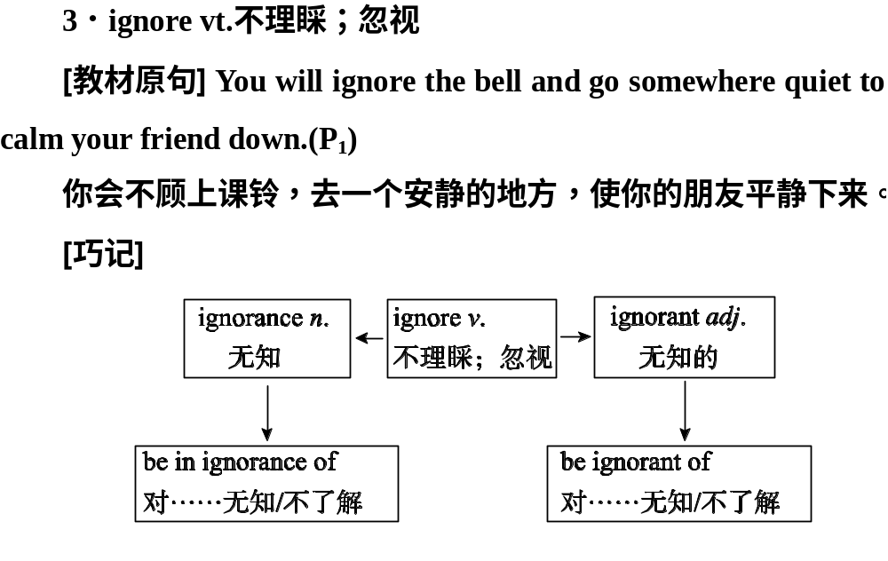

Slide 16
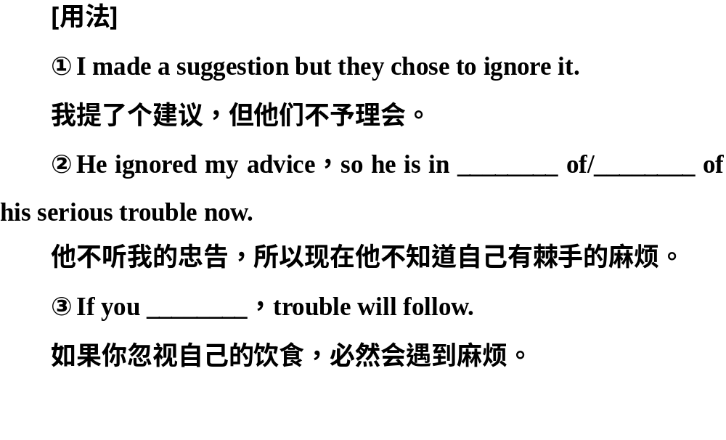

Slide 17


vt.& vi.(使)平静;(使)镇定;adj.平静的;镇静的;沉着的
stay/keep/be calm保持镇静
Adj.
You will ignore the bell and go somewhere quiet and calm your friend down.
你不理会上课铃,而
是去安静的地方安慰你的朋友。
calm
教材
原句P1
calm down
(使某人)平静下来，镇静下
v.
返回导航页
结束放映

Slide 18
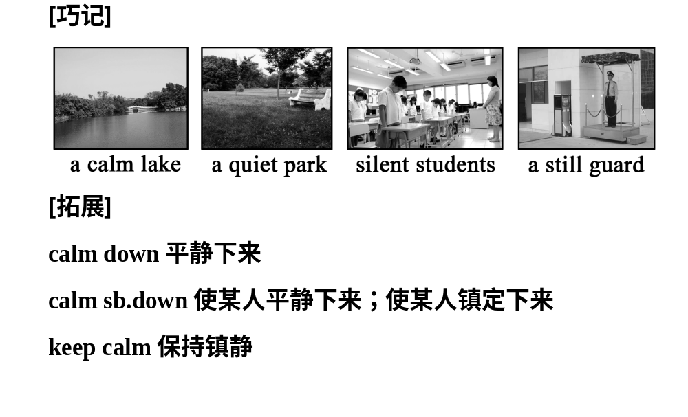

Slide 19

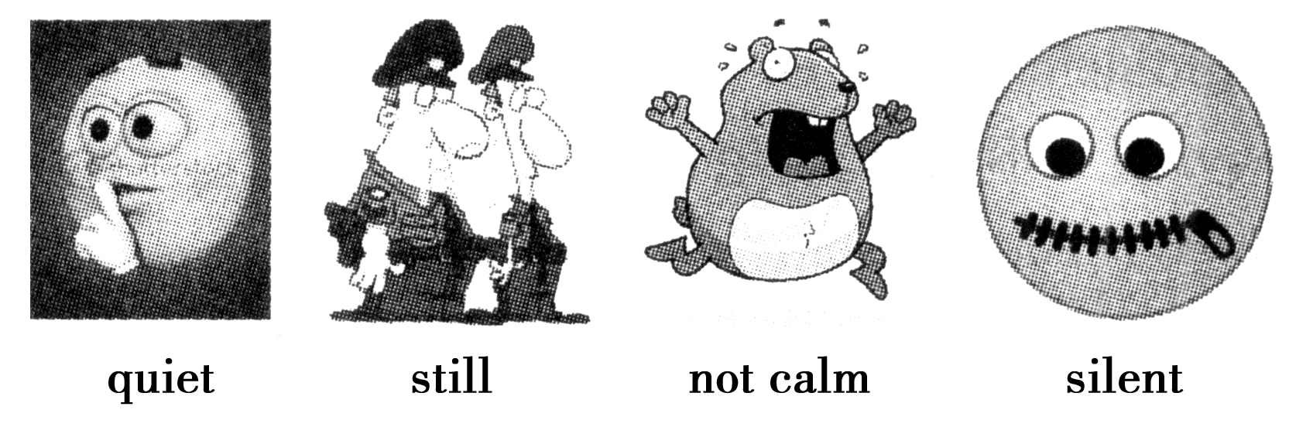
比 较 网 站
quiet: 宁静的,安静的;指没有声音、不吵闹或心里没有烦恼、焦虑
still: 静止的,不动的;指(人体等)无运动的
calm: 平静的;沉着的,指无风浪或人的心情不激动
silent: 寂静的，沉默的；指不说话或没有声音
返回导航页
结束放映

Slide 20

巧思妙解
用calm，quiet，silent，still完成下列语段
When facing danger，one should keep (1)________(冷静)；when taken photos，one should keep (2)________(静止不动的)；when someone else is asleep，one should keep (3)________(安静的)；in class，one shouldn’t keep (4)________(沉默的)about the teacher’s questions.
calm
still
quiet
silent
返回导航页
结束放映

Slide 21
1
2
3
4
5
6
7
8
9
10
11
12
13
Everything was quiet except that the heavy rain beat the window.The frightened child stood there still,not knowing what to do,but the old woman remained calm and she took him in her arms.The child kept silent though he was asked some questions.
除了大雨拍击着窗子,一切都很安静。那个害怕的孩子一动不动地站着那儿,不知道该做什么,但那位老太太仍旧很镇定,她把他搂在怀里。虽然被问了一些问题,但那个孩子保持沉默。

Slide 22
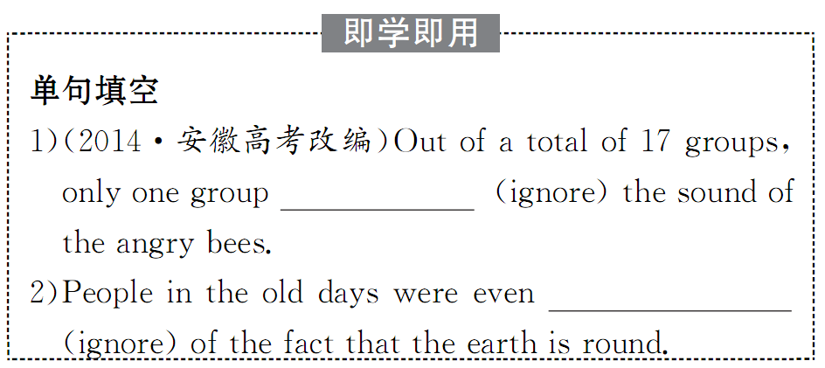
1
2
3
4
5
6
7
8
9
10
11
12
13

Slide 23
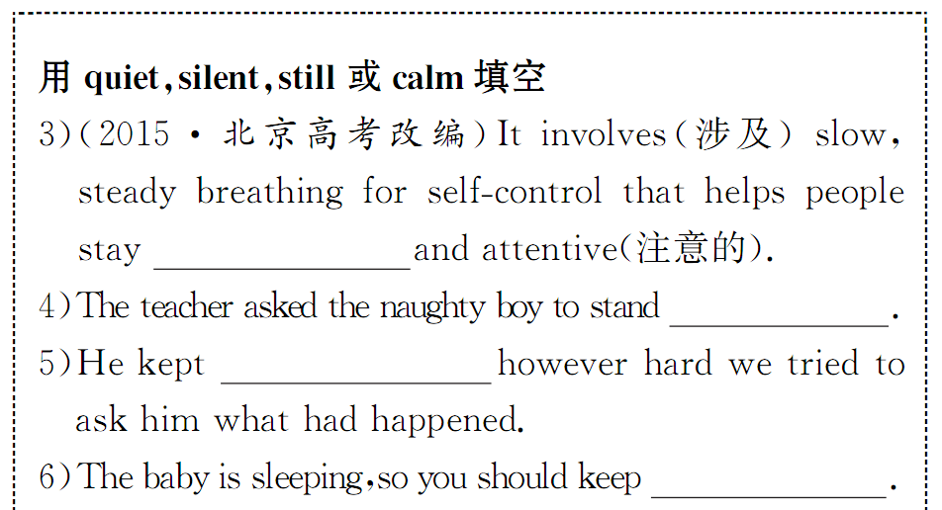
1
2
3
4
5
6
7
8
9
10
11
12
13

Slide 24
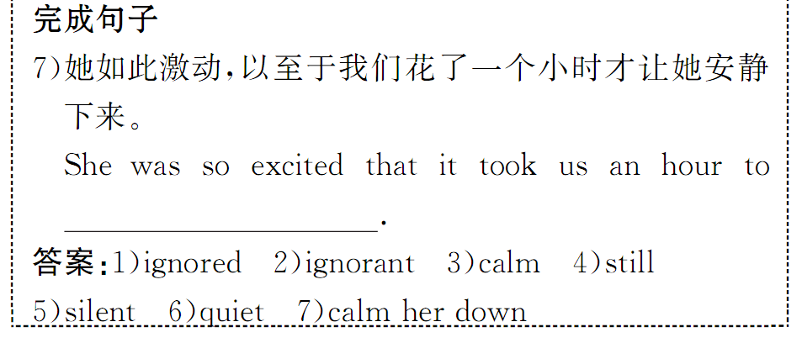
1
2
3
4
5
6
7
8
9
10
11
12
13

Slide 25
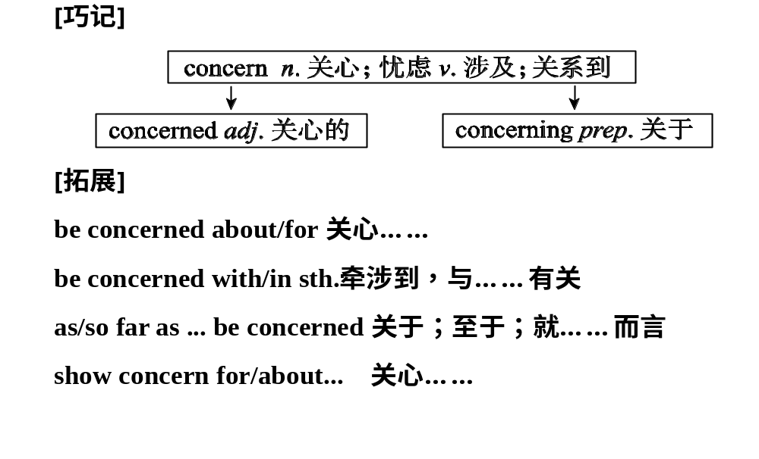
4..You will tell your friend that you are concerned about him/her and you will meet after class and talk then.(P1)
你会告诉你的朋友你很关心他/她,下课后你们会见面交谈。
★考点:be concerned about 关心;担心;挂念

Slide 27
concern vt. (使)担忧；涉及；关系到
n. 担心；关注；(利益关系)
... you are concerned about him/her…….你关心他/她。 (P1—L17)
[熟读深思] 阅读下列句子, 指出划线单词的词性和意义。
⑴ There’s a growing concern about the effects of the nuclear pollution in Japan.
(词性: ____；意义: __________ )
n.
关心; 关注

Slide 28
⑵ They all seem to be concerned about my security.
(词性: _____；意义: _____________ )
⑶ Recently we have read many reports concerning Shenzhou VII.
(词性: _____；意义: _____________ )
adj.
担心的; 关心的
prep.
关于

Slide 29
【归纳总结】
be concerned about/for ... 为……担心
as far as sb. be concerned 就某人而言

Slide 30
[灵活运用] 用concern的适当形式填空。 As far as I am 1___________, parents show too much 2 ________about the future of their children. In other words, they are too 3 _________ about their children’s future.
concerned
concern
concerned

Slide 31
1
2
3
4
5
6
7
8
9
10
11
12
13
6.While walking the dog,you were careless and it got loose and was hit by a car.(P1)
遛狗时,由于你的粗心,狗脱离了你的手被车撞了。
剖析:While walking the dog是一个省略句,其完整形式为:While you were walking the dog。
①While (we were) watching the film,I thought of my parents.
看电影时,我想起了我的父母。
②If (it is) necessary,you should turn to your friends for help.
如果有必要,你应该向朋友求助。

Slide 32
1
2
3
4
5
6
7
8
9
10
11
12
13
当while,when,until,if,unless,though引导的状语从句中的主语和主句的主语一致,或状语从句中的主语是it,并且又含有be动词时,常可以省略从句中的主语和be动词。

Slide 33
1
2
3
4
5
6
7
8
9
10
11
12
13
6.You will tell him/her that he/she should have studied,so you don’t let him/her look at your paper.(P1)
你会告诉他/她,他/她本应好好学习的,所以你不会让他/她看你的卷子。
剖析:should have done过去本应该做某事(但实际上没做,含有责备、批评或后悔之意),shouldn’t have done本不应该做某事(但实际上做了)。

Slide 34
1
2
3
4
5
6
7
8
9
10
11
12
13
与should用法相类似的还有:
ought to have done (过去)本应该做某事
oughtn’t to have done (过去)本不应该做某事
must have done sth一定做过某事
could have done sth本来能够做某事,而实际上未做
can’t/couldn’t have done sth不可能做过某事
needn’t have done sth本来不必做某事

Slide 35
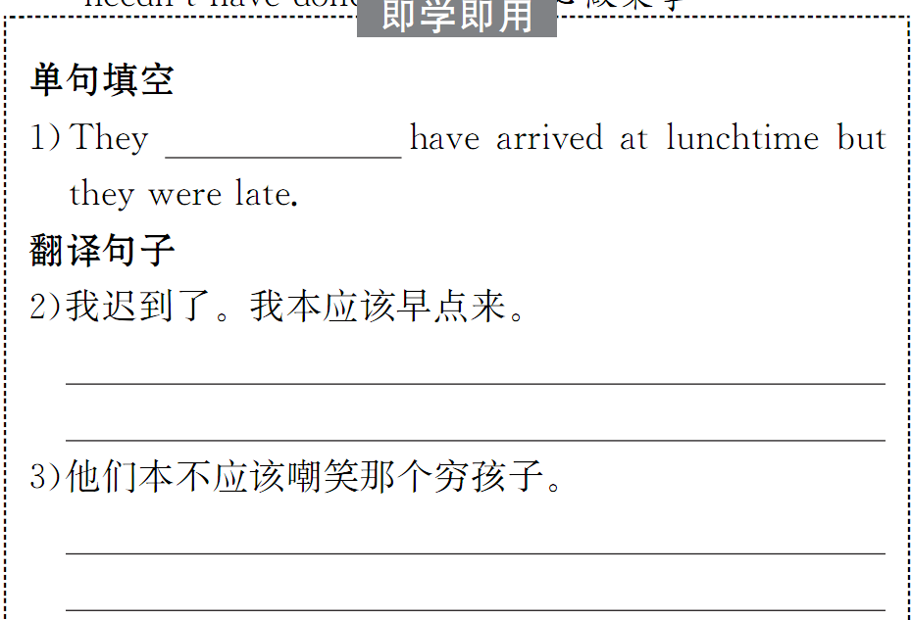
1
2
3
4
5
6
7
8
9
10
11
12
13

Slide 36
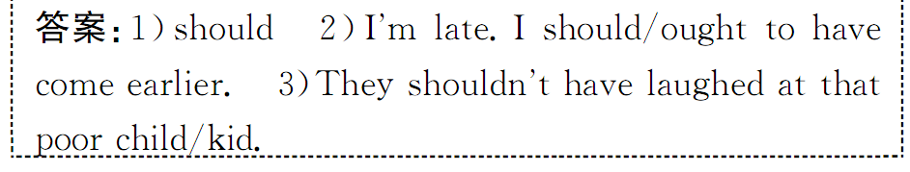
1
2
3
4
5
6
7
8
9
10
11
12
13

