Slide 1

外研新标准
第二册 必修2

Slide 2
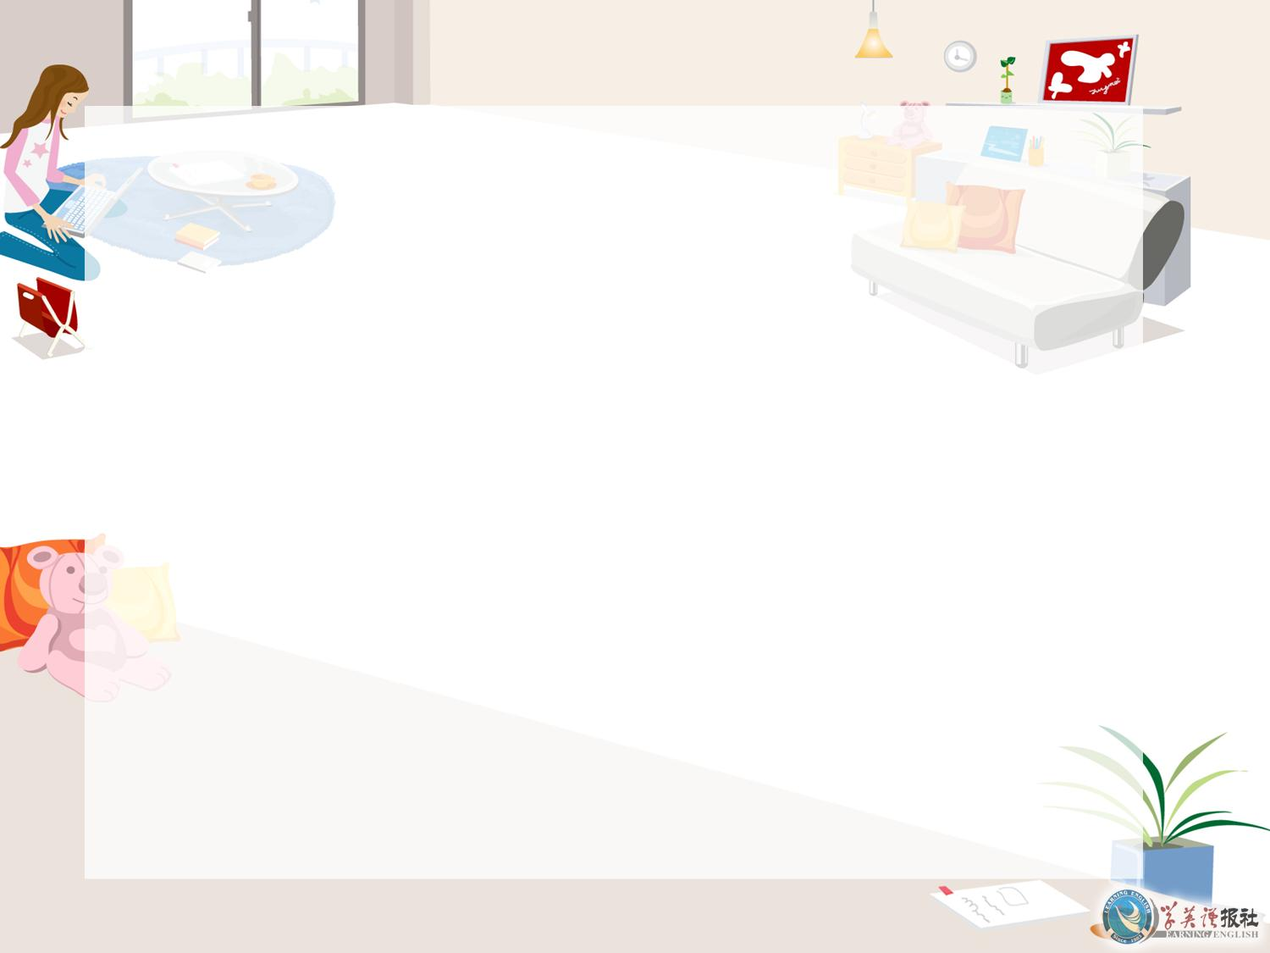
Module 3
Listening

Slide 3


Objective
能识别听力中新学的词汇、短语并正确理解其含义。能听懂听力材料中主要内容并提取信息。

Slide 4


Listen to the passage.

Slide 5


Listen again and fill in the blanks.
The Beatles were the most successful _____ in the history of popular music. The band ________ ___ John Lennon, Paul McCartney, George Harrison and Ringo Starr. Starr played ______, the other three played guitar. Lennon and McCartney wrote most of the songs. All the Beatles were born in Liverpool in the north of ________.
band
consisted of
drums
England

Slide 6
During the early 1960s, the Beatles were __________ by American rock singers, such as Chuck Berry and Elvis Presley. They had their first ___ in 1962 with a ______ song called Love Me Do (1962). In 1964, after they had become stars in their own country, the Beatles ______ the United States and were ____ _______.
influenced
hit
catchy
toured
huge success

Slide 7
During the mid-1960s, the Beatles were one of the bands which gave rock music a new direction. Some of their songs were quite ______ , such as Nowhere Man; there were ______ such as Yesterday and more _______ songs such as Strawberry Fields Forever.
By the late 1960s, their music had ________ __________. They had stopped writing simple songs with catchy tunes.
serious
ballads
complex
changed completely

Slide 8
The _____ and the _____ had become more interesting and they had begun to use new __________, too. For example, after visiting India, they started using Indian instrument.
Some of their albums changed pop music completely. Their ____ ______ was Let It Be in 1970.
tunes
lyrics
instrument
last album

Slide 9
After they had finished _________ Let It Be, they ____ ___. By the time they stopped working together, they had sold more albums than any other band ___ ______. After the group had _______ ___, all the Beatles performed as ____ artists or started other bands.
John Lennon died in New York in _____. George Harrison Died in _____.
recording
split up
in history
broken up
solo
1980
2001

Slide 10

Thank you.

