Slide 1


全新课标理念，优质课程资源
外研版
高一 (2)
Module 3

Slide 2
外研版
高中英语
第二册
MODULE 3
Music

Slide 3
Vocabulary
violin drum
piano saxophone
guitar erhu
choir composer

Slide 4
Show some pictures of the musical instruments

Slide 5
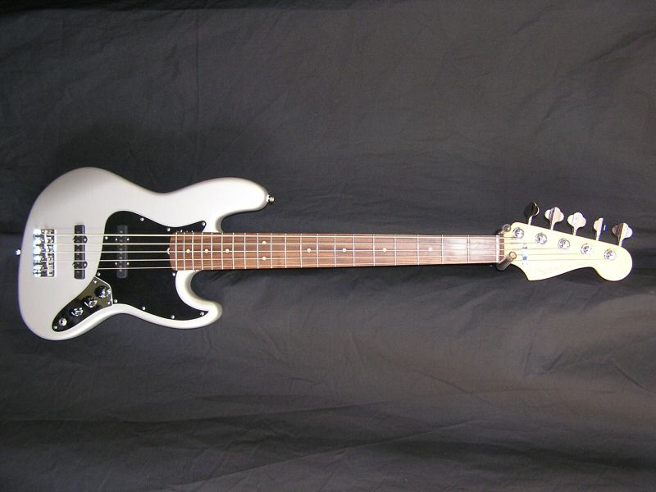
guitar

Slide 6
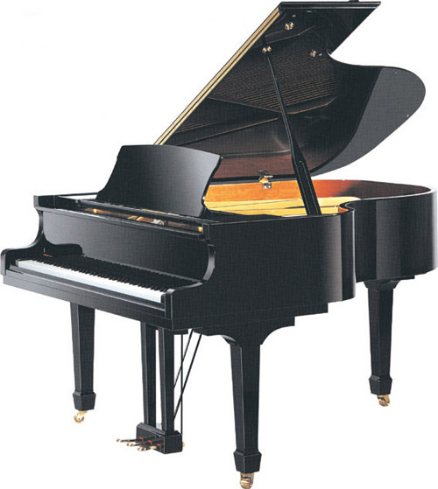
piano

Slide 7
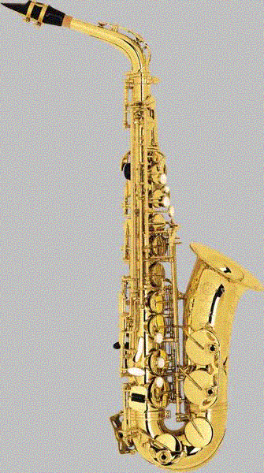
saxophone

Slide 8
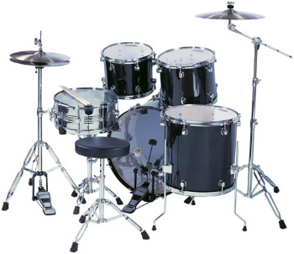
drum

Slide 9
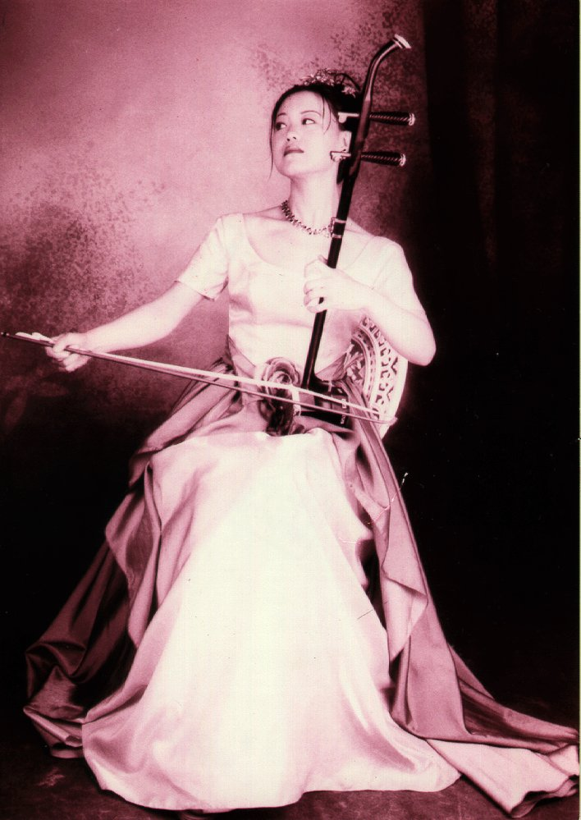
erhu

Slide 10
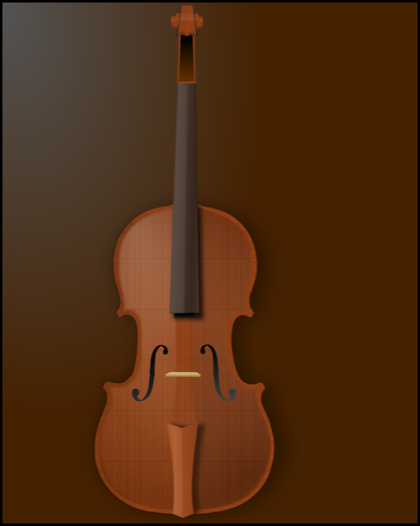
violin

Slide 11
Which word means someone who writes music?
Which word means a group of people who sing together?
Which instruments are used in pop and rock music?

Slide 12
Which instruments are used in classical music?
Which instruments are used in jazz?
Which instruments are used in traditional music?

Slide 13
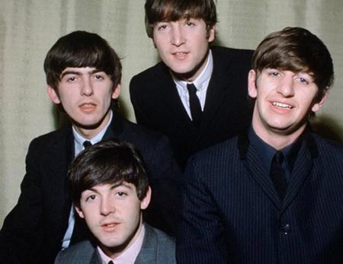


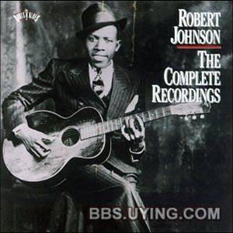
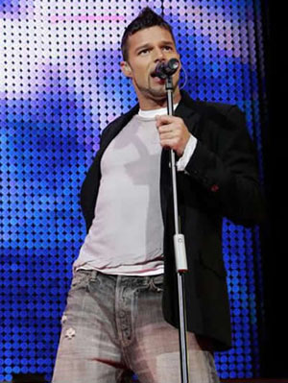
Warming up by showing some pictures and discussing

Slide 14

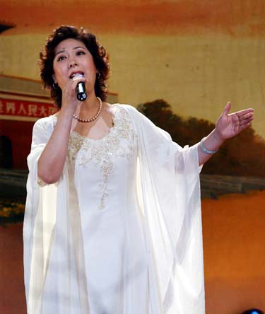


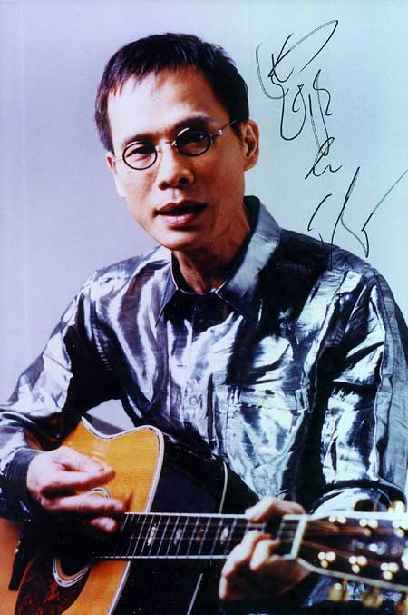

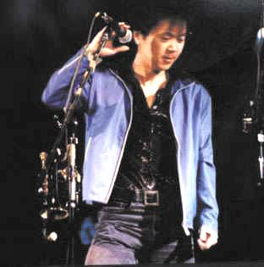

Slide 15
Which kind of music do you like best?
classical jazz symphony ballad rock pop

Slide 16
Fast reading to get general understanding
Read the text and think how many composers the text refers. (Three. ) How many parts do you think the text should be divided? (Three again. )

Slide 17
Keys:
Part 1: paragraph 1 and 2
Part 2: paragraph 3,4 and 5
Part 3: paragraph 6,7 and 8

Slide 18
Type of writing
Main idea
Topic of part 1
Topic of part 2
Topic of part 3
The story is an instructive style.
biographies of the three great Austrian composers: Haydn, Mozart and Beethoven.
A biography of Joseph Haydn.
A biography of Wolfgang Amadeus Mozart
A biography of Ludwig Van Beethoven.

Slide 19
FUNCTION
Talking about likes and dislikes

Slide 20
I love ________.
I (really like) ________.
________ is great!
________ is wonderful!
I hate ________.
I can’t stand ________.
________ is awful!
________ is dreadful!

Slide 21
  1. Try to instruct your favorite musician to your class orally.
  2. Try to repeat the text.
  3. Learn the new words again, using the dictionary if necessary.
Homework

