Slide 1

Reading Tips
略读(skimming)与扫读(scanning)

Slide 2

certain
information
a general
idea
Reading strategy
skimming
scanning
titles and headings
Scan the text for
key words and phrases, dates, etc.
the first and last
sentences of paragraphs
the first and last paragraphs
Do not need to
read the whole
text.
pictures and charts

Slide 3

Skimming for general idea

Slide 4

Skim the passage and answer the questions.
Who is Anne’s best friend?
Kitty, Anne’s diary.
Why did Anne make it her best friend?
Because Anne wanted a friend whom she could tell everything to, like her deepest feelings and thoughts.

Slide 5
Scanning for specific information

Slide 6

Fill in the form below.
The place of the story
The heroine of the story
Anne’s best friend
The length of time they hid away
The date of the diary
Netherlands
Anne
her diary---Kitty
nearly 25 months
Thursday 15th June, 1944

Slide 7
What did Anne write in her diary? Please read this diary and tell us what Anne’s tone is. Is she angry, sad, happy or thrilled?
“I’ve grown so crazy about everything to do with nature”
I can well remember that…
For example…
Sadly…

Slide 8



Anne was Jewish.
Anne and her family hid away for nearly twenty months.
This diary was written in July, 1944.
Anne was so crazy about everything to do with nature that she opened a window and had a good look at the moon.
twenty-five
June
She didn’t dare open a window.

Slide 9

P3 2
Answer the following questions.
1. How did Anne feel about nature before she and her family hid away?
2. Why do you think her feelings of nature changed?
3. Why did Anne no longer just like looking at nature out of the window?

Slide 10
Guess the implied meaning of those words and phrases according to the context.
words/phrases | what it implied
nature
outdoors
crazy
thundering clouds, entirely power
relaxed, peaceful, freedom
freedom
anxious, eager, thirsty
helpless, depressed, lonely, the worship and love for nature

Slide 11
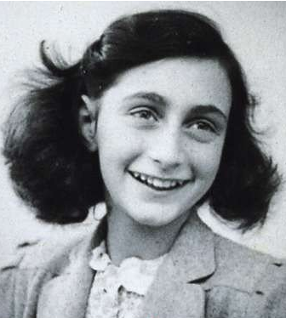
Discussion
1. If you were Anne, what would you write in your diary?
2. how to deal with these things
a. that you don’t have
b. that you lost
c. that you already have

