Slide 1
Dictation

Slide 2


Words review
voyage
conquer
native
apartment
actually
base
gradual

Slide 3
Words review
gradually
enrich
vocabulary
spelling
latter
identity
fluent
fluently

Slide 4
Words review
Frequent
usage
Command
Request
Expression
Spanish
Eastern

Slide 5
Words review
Lightning
Straight
Block
Cab
Accent
Recognize

Slide 6
Match
because of
come up
at present
make use of
such as
Play a part （in）

Slide 7
Words review
voyage
conquer
native
apartment
actually
base
gradual
n. 航行；航海
vt. 征服；占领
adj. 本国的；本地的
n. 本地人；本国人
n. <美>公寓住宅；单元住宅
adv. 实际上；事实上
vt. 以…...为根据
n. 基部；基地；基础
adj. 逐渐的；逐步的

Slide 8
Words review
gradually
enrich
vocabulary
spelling
latter
identity
fluent
fluently
adv. 逐渐地；逐步地
vt. 使富裕；充实；改善
n. 词汇；词汇量；词表
n. 拼写；拼法
adj. 较后的；后半的；
（两者中）后者的
n. 本身；本体；身份
adj. 流利的；流畅的
adv. 流利地；流畅地

Slide 9
Words review
adj. 频繁的 常见的
n. 使用 用法
n. & vt .命令 指令 掌握
n. & vt. 请求 要求
n. 词语 表达 表示
adj. 西班牙（人）（语）的
adj. 东方的；东部的
Frequent
usage
Command
Request
Expression
Spanish
Eastern

Slide 10
Words review
Lightning
Straight
Block
Cab
Accent
Recognize
n. 闪电
adv. 直接 挺直
Adj 直的 笔直的 正直的
n. 街区 块 木块 石块
n. 出租车
n. 口音 强调
vt. 辨认出 承认 公认

Slide 11
Match
因为; 由于
走近; 上来; 提出
现在; 目前
利用; 使用
例如……; 像这种的
扮演一个角色 参与
because of
come up
at present
make use of
such as
Play a part （in）

Slide 12
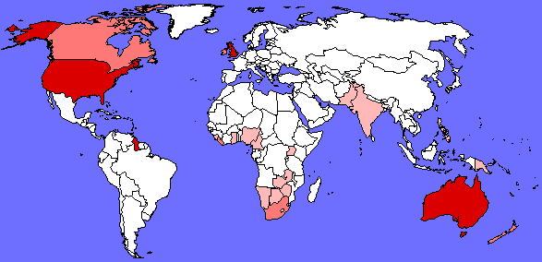
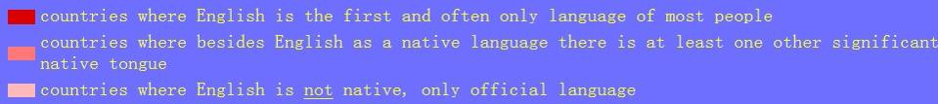
Unit 2 Reading
THE ROAD TO
MODERN ENGLISH

Slide 13

Skimming for general idea

Slide 14

Choose the best answer.
The text is developed mainly by ______.
A. place B. time C. people

Slide 15
Find the topic sentence for each paragraph
Many people all over the world speak English.
Native speakers can understand each other even if they don’t speak the same kind of English.
Why has English changed over time?
Finally by the 19th century the language was settled.
English is now spoken widely in South Asia.
paragraph 1:
paragraph 2-4:
paragraph 5:
paragraph 6:
paragraph 7:

Slide 16

Scanning for specific information

Slide 17

Choose the best answers.
1. The text mainly tells us ________.
that old English is different from modern English
how Middle English formed
English and its history
that English will keep changing
Notes:
为方便教学，教师可提前将word页打印并在课前分发，给出scanning指令后，让学生带着任务阅读，最后看PPT对答案。节约时间，提高效率。

Slide 18
2. At the end of the ______ century, about five to seven million people spoke English.
A. 14th B. 15th C. 16th
3. When did English begin to be spoken in many other countries?
At the end of the 16th century
In the 17th century
In the 18th century
In the 19th century
Notes:
为方便教学，教师可提前将word页打印并在课前分发，给出scanning指令后，让学生带着任务阅读，最后看PPT对答案。节约时间，提高效率。

Slide 19
4. Why was Shakespeare able to make use of a wider vocabulary by the 1600s?
Because new settlers enriched English and especially its vocabulary.
Because Shakespeare made up many new words.
British settlers moved to different countries
A new dictionary was written
Notes:
为方便教学，教师可提前将word页打印并在课前分发，给出scanning指令后，让学生带着任务阅读，最后看PPT对答案。节约时间，提高效率。

Slide 20
5. What happened to American English in the 19th century?
It became more like British English.
It became more like German.
English began to be spoken in America.
Its spelling was given a separate identity.
6. Who gave American English its own identity?
Shakespeare B. George Washington
C. Noah Webster D. Newton
Notes:
为方便教学，教师可提前将word页打印并在课前分发，给出scanning指令后，让学生带着任务阅读，最后看PPT对答案。节约时间，提高效率。

Slide 21
7. Which of the following statements is not true?
A. English is one of the official languages in India.
B. English developed when new settlers and rulers came to Britain.
C. China has the largest number of English speakers.
D. Now more people speak English as their first, second or a foreign language.

Slide 22


True or False
P10 1
1 English had the most speakers in the
17th century.
2 English developed when new settlers and
rulers came to Britain.
3 Languages frequently change.
More people speak English now.
Languages change and develop when cultures meet and communicate with each other.

Slide 23
True or False
4 English is one of the official languages used in India.
5 Samuel Johnson wrote The American Dictionary of the English Language.
6 This reading describes the development
of the English language.
Noah Webster

Slide 24
Timeline of the development of English
P10 2
Time | Language development
During the 5th
century AD
English was based more on German.
Between about AD 800 and 1150
English was influenced by Danish and French invaders.
Shakespeare used a wider vocabulary than ever before.
By the 1600s

Slide 25
Time | Language development
British settlers moved to America.
1620
From the 18th century
British colonized Australia.
1765 - 1947
English was spoken in India.
By 19th century
Dictionaries standardized the spelling of English.

