Slide 1
动词不定式
1. 作主语
2. 作宾语
3. 作宾语补足语
4. 作定语
5. 作状语
6. 作表语
7. 作独立成分
8. 与疑问词等连用

Slide 2
结构 : to do
(否定) not/never to do
二. 时态与语态
不定式
 | 主动语态 | 被动语态
一般式
进行式
完成式
to do
to be done
to be doing
----------
to have been
done
to have done

Slide 3
(1).They pretended not to see us.
(一般式表示与谓语的动作同时/几乎/发生在
它之后.)
(2). He pretended to be sleeping.
(在谓语动词发生的同时,不定式的动作也正在进行)
(3).She pretended to have known it before.
(完成式表示动作发生在谓语动作之前)

Slide 4


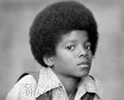
Marty says…
Have A L k
Unfortunately, the doctors
don’t know how to make
me better, but I am very
outgoing and have learned to adapt to
my disability.
2. Then I started to get weaker and weaker.

Slide 5
Marty says…
3. Even after all that, no one
could give my disease a name
and it is difficult to know
what the future holds.
4. Sometimes, too, I was too weak to go to
school so my education suffered.
5. My ambition is to work for a firm that
develops computer software when I grow
up.

Slide 6
Marty says…
6. Last year I invented…and a
big company has decided
to buy it from me.
7. I also have to do a lot of work, especially
if I have been away for a while.
8. Just accept them for who they are, and
give them encouragement to live as rich
and full a life as you do.

Slide 7

1.To do that sort of thing is foolish.
It's foolish to do that sort of things. (主语)
It would be better for you to go there.
2.All you have to do is to finish the job quickly.
What I want to do is to have a rest. (表语)
3.He promised not to tell anyone about it. (宾语)
He found it difficult to get up early.
4.He is the only person to know the truth.
Betty was the first girl to come. （定语）
5.She asked me to stay here. （宾补）
6.The boy is old enough to go to school. （状语）

Slide 8
1. 主语
To see is to believe.
It’s important to learn English well .
单个不定式作主语时,谓语动词用单数
若不定式太长,往往用it作形式主语,不定式置后.
It’s impossible for humans to fly
like a bird now.

Slide 9
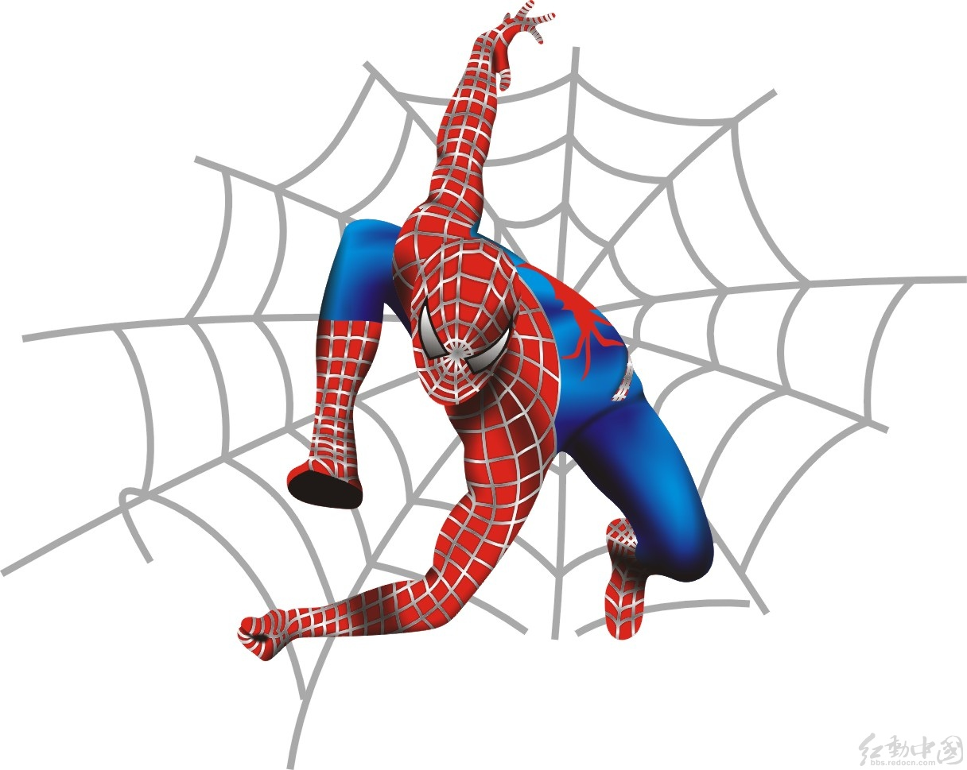
(2).不定式作表语
protect the world.
His job to________________.
Your task to_____________ .
is
is

Slide 10
(3) 不定式作宾语
play basketball
He likes to______________.

Slide 11
常接动词不定式作宾语的动词有：
agree, appear, ask, attempt；
decide, demand, determine；
expect, fail, get, hate, hesitate, hope,
intend, learn, manage,
plan, prepare, pretend, promise；
refuse, seem, tend, threaten；
want, wish 等+ to do。

Slide 12
常接动名词作宾语的动词有：
admit, avoid, consider, delay,
deny, feel like, finish, imagine, miss
risk, suggest 等+ doing。

Slide 13
既可以接不定式也可以接动名词做宾语的动词
like， love， hate， prefer， begin， start，
continue， bother ，intend， attempt， cease

Slide 14
既可接动词不定式也可接动名词作宾语(
意义有区别)的动词有：
go on, mean, regret, remember, stop,
try, forget

Slide 15
I want to go home.
The workers demanded to get better pay.
I found it necessary to talk to him again.
think/ consider/ find it + adj.+ to do

Slide 16
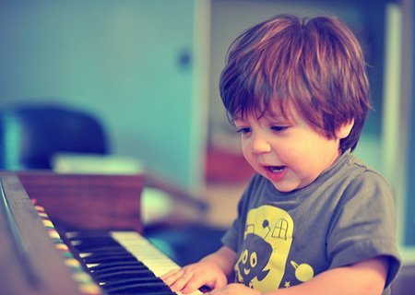
My mother ask me to____________ two hours every day.
(4). 不定式作宾补
play the piano

Slide 17

引导不定式作宾补的动词：
warn, tell, allow, help, ask, force等
+sb to do sth
The teacher told me to clean the blackboard.
I expect you to give me some help.

Slide 18
(5).不定式作定语
不定式作定语时，
应放在被修饰词的后面，
而且放在其他后置定语之后。
I have something to say,
but my brother has a lot of homework to do,
so I am looking for someone to help me.

Slide 19
He has a lot of homework to do .
He is looking for a room to live in .
There is nothing to worry about.
(如果不定式中的动词是不及物动词,
则不定式中要有介词.)
请给我一支写字的笔.
Please give me a pen to write with.

Slide 20
I got up early to______________.
I came here to___________.
(6) 不定式作状语
in order to ,
so as to ,
enough to ,
only to ,
too….to.,
catch the train

Slide 21
6 作状语
(1.) 表示目的: to
in order to
so as to
I came here to see you.
He spoke loudly (so as / in order)
to be heard.
He got up early to catch the train.

Slide 22
(2.) 表示原因:
不定式可以用在作表语的形容词后作状语, sorry, surprised, happy, glad, angry, right, wrong, disappointed等。
eg: I’m glad / pleased to see you.
We were surprised to hear the news.

Slide 23
(3.) 结果状语:
so + adj. / adv. + as to do…
such + adj. + n. +as to do…
adj. / adv.+ enough + to do
He was so foolish as to believe it.
= He was such a fool as to believe it.
= He was foolish enough to believe it.
注意:不定式往往表示与主观愿望相反的结果。
He hurried to the station, only to find the train
had left.

Slide 24
(7).独立结构
To tell the truth, I am not happy at the moment.
to be frank,
to be honest,
to tell the truth

Slide 25
(8) . 与疑问词等连用
He didn’t know
____________.
what to say

Slide 26
疑问词+不定式
疑问词 who,which, when, how, what等与不定式连用，在句中起名词作用，可充当主语、表语、宾语等。
He didn’t know what to say. (宾语)
他不知道说什么。
How to solve the problem is very important.(主语)
如何解决这个问题很重要。
My question is when to start. (表语)
我的问题是什么时候开始。

Slide 27
注意：
(1).不定式中的动词上文已出现过,下文要
省略该动词.
A: — Would you like to go with me ?
B: — I’d like to .
(2). 不定式是to be 结构, be 不可省.
A: — Would you like to be a teacher?
B: — I’d like to be.

Slide 28
exercise

Slide 29



My teacher was made _____ his teaching
because of poor health.
giving up B. to give up
C. give up D. given up
2.The sentence wants ____ once more.
explained B. to explain
C. being explained D. explaining
3.The Arctic is considered ____ the northern part of the Atlantic.
having been B. to have been
C. to be D. being

Slide 30



4.The Emperor ordered the wonderful cloth
_____ for him without delay.
to have woven B. to be woven
C. to be weaving D. to weave
5. ____ late in the afternoon, Bob turned off the alarm.
A. Having sleep B. Sleeping
C. Sleep D. To sleep
6.—The light in the office is still on.
--- Oh, I forgot ______.
turning it off B. turn it off
C. to turn it off D. having turned it off

Slide 31


7.---How do you deal with the disagreement
between the company and the customers?
---The key ____ the problem is to meet
the demand ____ by the customers.
to solving, making B. to solving, made
C. to solve, making D. to solve, made
8. ---What do you think of the school?
----It is a very good _____.
school to study in
B. school for children to study
C. studying school
D. school to study

Slide 32



9. ---Did you get a job?
--- No, I ___ , but it’s no use.
expected B. tried to
C. managed to D. planned
10.We find it impossible for us ___ the work
ahead of time.
to be finished B. finishing
C. being finished D. to finish
11.---I usually go to Shanghai by train.
----Why not ___ there by boat for a
change?
to try to go B. try going
C. to try going D. try to go

Slide 33



12.___ a living, she had to work from
morning till night.
To make B. Made
C. Making D. To have made
13. I would rather starve to death than ___
for food.
beg B. begging C. begged D. to beg
14.The boy pretended ___ when his teacher
entered.
reading B. to read
C. to be reading D. being read

Slide 34

15. The boy wanted to ride his bicycle in the street, but his mother told him ____.
A. not to B. not to do
C. not do it D. do not to

