Slide 1
Celebrating self-expression

Slide 2
When you’re out with a friend and take a
photo of yourselves, do you know that you are
also creating a work of art? Or that you are
competing with Vincent van Gogh himself?
Probably not. Your idea might be to show off
your selfie (自拍照) on WeChat or QQ, but
you probably don’t think of the internet as a
gallery or of yourself as an artist.
What’s the main idea of the first paragraph?

Slide 3
But the chief executive of London’s Saatchi
Gallery, Nigel Hurst, thinks that the casual
pictures we take of ourselves do have
something in common with self-portraits by
the great masters. In support of the idea, the
Saatchi Gallery has a new exhibition called
From Selfie to Self-Expression, which is
running now until May 30.
What does the exhibition consist of?

Slide 4
It features well-known self-portraits from
artists including Dutch painters Van Gogh
(1853-1890) and Rembrandt (1606－1669).
It also has selfies on show that have
“quickly become icons (标志) of the digital
era.” These include one taken by US
celebrity Kim Kardashian and another of
former US President Barack Obama with
former UK Prime Minister David Cameron,
according to the BBC.

Slide 5
Hurst is perhaps not being 100 percent serious.
He isn’t claiming that a snap (快照) you take of
yourself in your favorite restaurant can be
compared with a self-image painted by Van
Gogh. But he does make a serious point. Once
upon a time, it was only artists who could make
images of themselves. They were the only ones,
as Hurst told The Guardian, who “had the skills,
materials and tools to create self-portraits.”
Today, however, we “all have that [ability]
through our smartphones.”

Slide 6
The popularity of the selfie has rocketed
(急速上升) since smartphones have
become widely used. In 2013, Oxford
Dictionaries named “selfie” as its word of
the year. As Pamela Rutledge, a professor
at the Massachusetts School of
Professional Psychology, told Vogue
magazine: “the cult of (对……的狂热) the
selfie celebrates regular people.”

Slide 7
And Hurst described the smartphone selfie as
an example of “a shift (转变) in society using
technology as a means of self-expression”.He
told The Guardian: “The selfie generation is
becoming the self-expression generation as
each of us seeks to explore and share our
Inner creativity through the one artistic
tool to which we all have access – the
smartphone.”

Slide 8
Singaporeans speak out (P4)

Slide 9
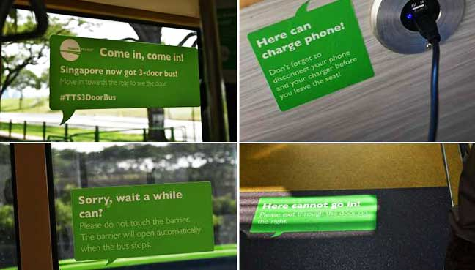
While-reading
Fast reading
Read the article quickly, and answer the question:
What’s the main idea of the passage?
Singlish has drawn world’s attention due to a sign and the attitude towards it differs among Singaporeans.

Slide 10
While-reading
Careful reading
Part 1
Read Para.1 carefully, and fill in the blanks:
As an Asian country, Singapore ___ ___ ____________ ___ being _____ ___________(高度西方化的), with English among the country’s four______ __________. But a couple of signs found on local buses that have recently ____ _____ ______(在网上流行) may say otherwise.
has a
reputation for
highly Westernized
official languages
gone
viral online

Slide 11
While-reading
Careful reading
Part 2
Read Para2-6 carefully, and answer the following questions:
1. What is Singlish, according to the passage?
2. Why does the New York Times call Singlish a “patchwork (拼凑品)”?

Slide 12
While-reading
Careful reading
Part 3
Read Para7-11carefully, and complete the table with different opinions.
Singapore’s government
Young Singaporeans
a sign of being cool and a way to identify themselves as a Singaporean
the dialect is lowering the country’s English standards and may affect the country’s relationship with foreigners .
They are good at code-switching and can speak both languages

Slide 13
Fighting fake news (P5)

Slide 14

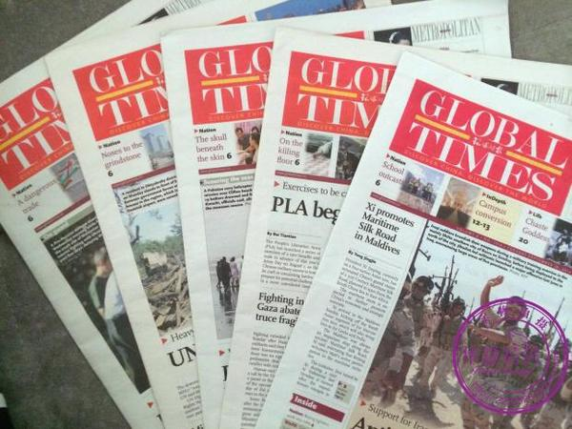
Lead-in
Here are two storytellers:
Your favorite social media star
a world famous newspaper
Whose words would you believe?

Slide 15
Lead-in
A recent study found that people’s trust in a piece of content on Facebook was stronger if they trusted the person who shared it, regardless of which organization published it.

Slide 16
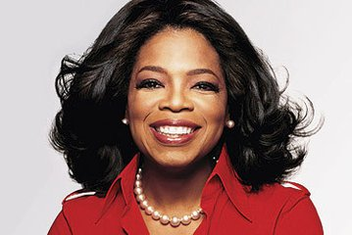
While-reading
Half of them got the post (n.帖子) from a sharer they said they trusted - a public figure (人物) such as TV star Oprah Winfrey. The others got it from a sharer they didn’t trust.

Slide 17

Half of them were shown that the article was published by the news agency(新闻出版社), the Associated Press (AP), while the other half was shown a made-up news provider, Daily News Review.

Slide 18
While-reading
What mattered most according to the result?
Activity 2 Question （para 4）
Whether the story was posted by someone that people trust.

Slide 19
While-reading
Activity 3 Words& Phrases （para 5-6）
participant (participate v.)
(sb)be likely to do sth
engage with sb
diverse point of view
be skeptical of
参与者
更可能做某事
和...互动
多样的观点
对...怀疑
F
F
F

Slide 20
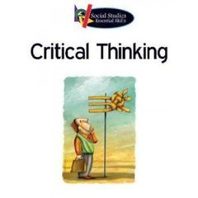
While-reading
“As citizens of information and consumers of information, we have to learn how to be critical (批判的) of the information that we consume (消费).

Slide 21
While-reading
Journalists have an important role to play in helping audiences navigate the news ecosystem (生态系统), ” Claire Wardle, a digital media researcher from First Draft News said in an ABC TV debate on the rise of fake news.

