Slide 1
Seeing all that US has to offer
1. ___(get) away from all the schoolwork, I
decided to go to New York.
2. I decided to go to New York _____(get) away
from all the school work.
3. I decided to go to New York, ____(get) away
from all the school work.
4. I decided to go to New York, and____(get)
away from all the school work.
1. To get 2. to get 3. getting 4. got

Slide 2
____(walk) along the lake, I had a feeling of quietness ____ wasn’t expected in the busy and fast-paced Big Apple.
2. ___(get) a view of New York, I went up to the
observation deck of the Empire State Building.
3. ____(look) over the city from the 86th Floor, I was
amazed at the structure of it.
1. Walking, that 2. To get 3. Looking

Slide 3
1. Walking around Times Square made me feel
like I _____(travel) across the globe…
2. I ____(not have) such a real taste of New
York without this unexpected encounter.
1. had traveled 2. wouldn’t have had

Slide 4

for Senior 2
2016-2017学年第33期总第 669期
Second languages bring many benefits for all (P4)

Slide 5

Lead-in
Do you like to learn languages?
What languages do you like to learn?

Slide 6
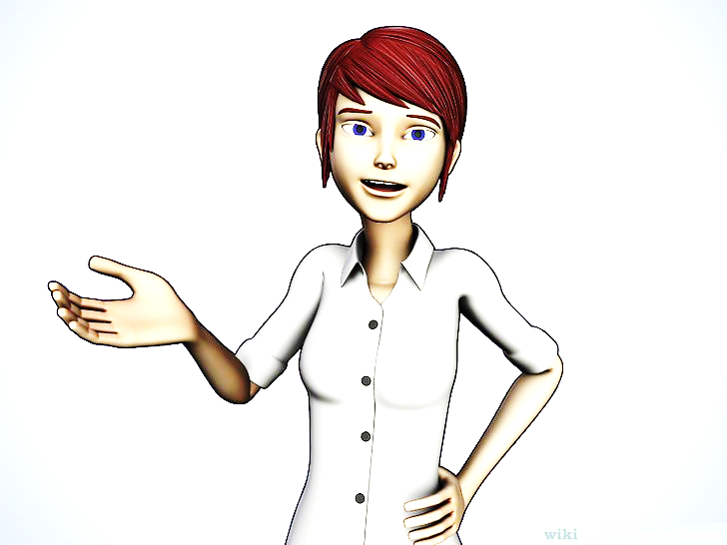
Lead-in
Do you often hear these words?
“Languages are important.”
“I know they’re hard but don’t give up!”
“They’ll help you in life.”

Slide 7
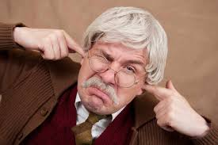
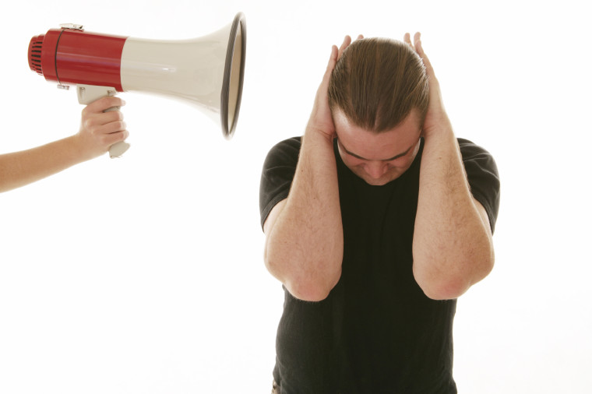
Lead-in
What’s your feeling toward these?

Slide 8
While reading
Read and match the main idea of each part.
The author’s attitude to studying languages and her suggestions to others.
The author’s reaction to languages in the past.
Foreign languages the author learned and the benefits she gained by learning them.
Para. 1&2
Para.3-5
Para. 6&7

Slide 9
While reading
Read the article carefully and answer the following questions.
1. When did the author begin to learnGreek?
2. Did she learn Greek easily?
3. What benefits did she gain by learning Greek?
4. What other languages did the author learn?
Why didn’t the author give up learning
German?
6. What did the author learn from her own
experiences of learning languages?

Slide 10
While reading
Read the article carefully and answer the following questions.
5. Why didn’t the author give up learning German?
6.What did the author learn from her own experiences of learning languages?

Slide 11
While reading
3. What is “a wonderful chain of events”? Can you draw a mind-map?
My family and I moved to Greece…I began learning Greek aged 10—I made friends by speaking Greek in England—I took up German—applied to the University of Manchester to study Spanish—I worked in Spain as an English language assistant

Slide 12
In touch with nature (P6)

Slide 13
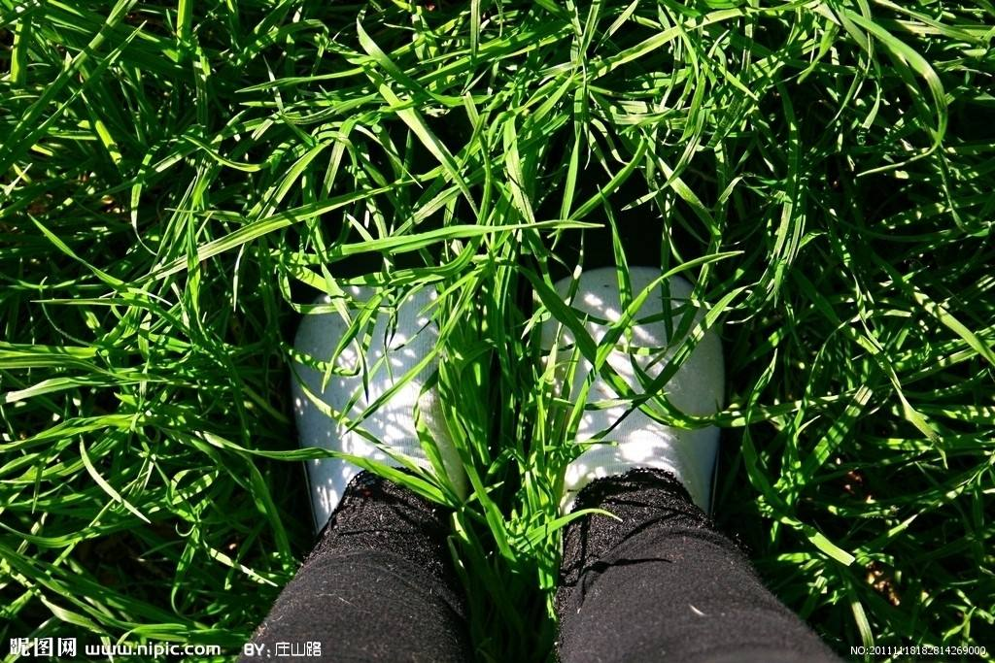
Lead-in
Suppose you have one day off, what would you do to relax?
Stay at home on the computer all day or go out to breathe some fresh air?

Slide 14
While reading
Scanning:
Read the article and answer the following questions.
Why did the author go to the campus greenhouse often?
What is Scott Sampson worried about?
What do the author and her daughter
have in common?

Slide 15
While reading
Why did the author go to the campus greenhouse often?
Because when she missed home, the campus greenhouse made her think of the farm where she grew up.

Slide 16
While reading
What is Scott Sampson worried about?
"If sustainability depends on transforming the human relationship with nature," he wrote, "the present-day gap between kids and nature is one of the greatest and most overlooked dangers of our time."

Slide 17
While reading
What do the author and her daughter have in common?
Like the author, her daughter is only
able to relax when she finds nature.

