Slide 1

Listening

Slide 2

Listening on page 48
Doctors know that there are illnesses that you may get if you do not eat properly. Emma has got a problem and is going to the doctor for advice.

Slide 3

Before listening, look at the list of illnesses below caused by not eating properly. Then listen to the whole text and find which illness Emma has.
rickets
obesity
anorexia (厌食症）
indigestion（消化不良)

Slide 4
Listen to Part 1 again and answer the questions.
1. What does Emma usually have for
breakfast, lunch and supper?
2. What is wrong with Emma’s diet?
3. Why is the doctor concerned about
much Emma eats?
4. How does Emma feel after the doctor
tells her about the result of not eating
properly?

Slide 5
1. What does Emma usually have for breakfast, lunch and supper?
She has on orange and a banana for breakfast, a roll for lunch, and half a bowl of rice and a dish for supper.

Slide 6
2. What is wrong with Emma’s diet?
3. Why is the doctor concerned about how much Emma eats?
She is not eating enough food and particularly energy-giving foods.
He thinks she is too thin.

Slide 7
4. How does Emma feel after the doctor
tells her about the result of not eating
properly?
She is happy to get the advice on how to eat a more balanced diet.

Slide 8

Listen to Part 2 again and fill in the chart below.
Red food: (only a little every day) | Orange food: (some every day) | Green foods: (some every meal)
All vegetables (e.g. potatoes,
cabbage, carrots,
tomatoes)
All fruits (e.g.
watermelons, apples, oranges, pineapples)
butter, cheese cream, nuts
cakes, foods
fried in fat
bread, noodles
Spaghetti rice
meat, fish
eggs, tofu

Slide 9

Listening text
Emma is visiting Doctor Pan’s surgery.
E=Emma D=Doctor Pan
Part1
D: Hello. What’s the matter?
E: I don’t feel well. I keep feeling
dizzy and I get tired very easily.

Slide 10
D: Oh dear! You look a bit thin
to me. Are you eating well?
E: Oh, yes. I have an orange and a
banana for breakfast and a roll
for lunch. I eat half a bowl of
rice and a dish of vegetable in the
evening.

Slide 11
D: Well, in fact you are too thin! It seems
that you are not eating enough. You
need more energy-giving food.
E: But, doctor, if I eat too much I feel sick.
D: Now, young lady, you must listen to me.
Your diet is not giving you enough
energy, and if you carry on this way
you’ll become seriously ill.

Slide 12
E: Oh, my goodness!
Part2
D: Let me tell you how to eat well but still stay thin. There are three types of food. They work like traffic lights. The first type of food is “red” and you mustn’t eat too much of it, because this food contains a lot of fat, sugar and salt.

Slide 13
E: Really? Can you give me some examples?
D: Butter, cheese, cream, cakes, foods fried
in fat.
E: OK.
D: The second type of food is “orange” and you should eat some every day. It includes bread, noodles, spaghetti, rice, meat, fish, eggs and tofu.

Slide 14
E: Well, I eat some of those things.
D: The last type of food is “green” and
you should eat some at every meal. It
includes all fruit and vegetables.
E: Thank you. Doctor Pan. Does anybody
else put food into colour groups as you
do?

Slide 15
D: Yes. Many scientists do, and all food
in the supermarkets in England now is
coloured in this way.
E: That’s very interesting. I’ll follow your
advice.

Slide 16
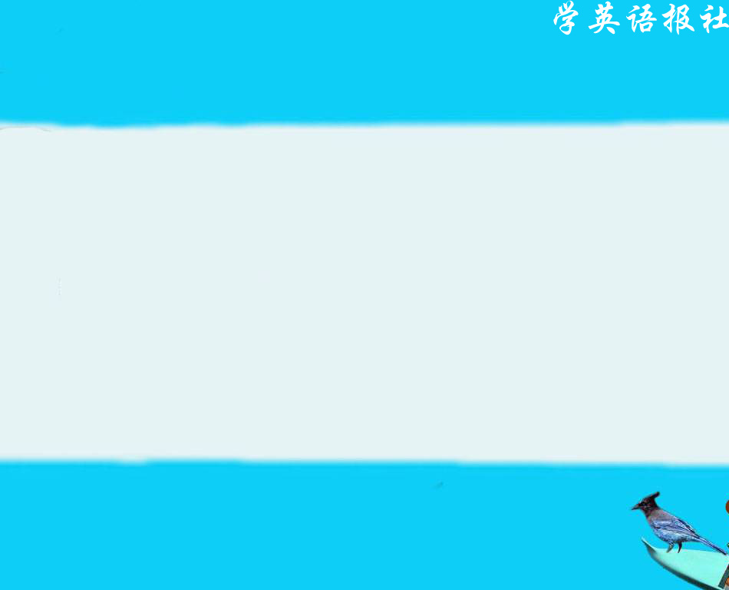
Talking

Slide 17

Now in pair imagine that one of you is worried about being too fat or too thin and has gone to consult the doctor. The other student will be the doctor, who gives advice on how to change his/her diet. The expressions below can help you.

Slide 18

DOCOTR
What’s the matter?
What’s wrong with you?
What seems to be the trouble?
How long have you been like this?
It’s nothing serious, only…
I suppose you had better...
I think you ought to...

Slide 19
PATIENT
I’ve got a pain in… It comes and goes.
I’m suffering from…I feel tired all the time.
I’ve got a bad cough/cold/fever/headache/...
I’ve lost my voice.
I have a pain in my chest/shoulder/back/…
It hurts when I touch it.
I’ll follow your advice.

Slide 20

Sample dialogue:
( D = doctor; P = patient )
D: Now what’s the matter today?
P: I think I’m too fat and I would like
to be thinner. But when I eat less I
find that I feel tired all the time.
What should I do, doctor?

Slide 21
D: It’s nothing serious, only you ought to eat well and exercise more. You need to do some running every morning before breakfast. Then you’ll be sure to lose weight. How long have you been like this?
P: For several weeks. But what should I eat?

Slide 22
D: Every day I think you ought to eat plenty of fruits and vegetables. Don’t forget to eat some meat and fish as well and only eat a little sugar and fat.
P: What about cola and ice-cream?
D: No. they contain a lot of sugar and fat, so try and do without them.

Slide 23
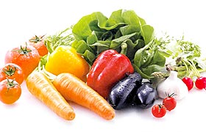
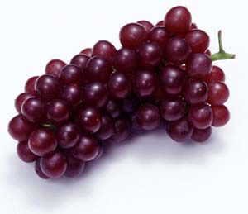
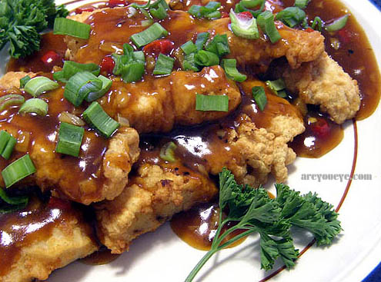
Come back in a week and I hope I shall see you’ve become a little thinner!
P: Thank you, doctor! I will follow your advice！

Slide 24
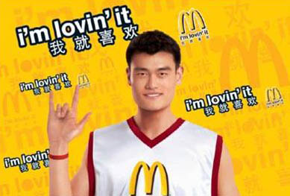


Listening on page 51

Slide 25
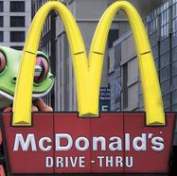
Do you know how the McDonald’s started and develop?
In 1939 two brothers, Mac and Dick McDonald, started a drive-in restaurant in San Bernadino, California. They carefully chose a busy
corner for their location.
They had run their own

Slide 26
businesses for years, first a theater, then a barbecue（烤肉）restaurant, then another drive-in. But in their new operation, they offered a new, shortened menu: French fries, hamburgers, and sodas. To this small selection they added one new idea: quick service, no waiters or waitresses, and no tips.

Slide 27
Their hamburgers sold for fifteen cents. Cheese was another four cents. Their French fries and hamburgers had a remarkable uniformity(一致性),for the brothers had developed a strict routine (程序)for the preparation of their food, and they

Slide 28
insisted on their cooks’ sticking to their routine .Their drive-in became new surprisingly popular, particularly for lunch. People drove up by the hundreds during the busy noontime. The self-service restaurant was so popular that the brothers had allowed

Slide 29
ten copies of their restaurant to be opened. They were content with this modest success until they met Ray Kroc.
Kroc was a salesman who met the McDonald brothers in 1954, when he was selling milkshake-mixing machines.

Slide 30
He quickly saw the special attraction of the brothers’ fast-food restaurants and bought the right to franchise(特许经营) other copies of their restaurants. The agreement struck included the right to duplicate (复制) the menu, the equipment, even their red and white buildings with the golden arches (拱门) .

Slide 31
Today McDonald’s is really a household name. In 1976, McDonald’s had over $ l billion in total sales. Its first twenty-two years in one of the most surprising success stories in modern American business history.

Slide 32

Listening on page 51
McDonald’s is a large fast food chain of restaurants that can be found all over the world. One day you hear that your quite hometown is to have a large new McDonald’s restaurant. It will replace a Chinese restaurant that serves the traditional food of your area.

Slide 33
Think about whether you would like to have such a restaurant or not, and give your real opinion and a reason to support your idea.
I would / would not like to have such a restaurant in our hometown because ______________________________________________________________.

Slide 34
Name | For or against | Reasons
Tina
Li Qian
1 An old part of town will
be improved.
2 They will have more jobs.
For
1 She hates all that
expensive tasteless food.
2 She loves local dishes.
3 McDonald’s serves a
terrible diet for young
children.
Against

Slide 35

Listening text
THE PROBLEM OF THE MCDONALD’S RESTAURANT
Tina is talking to Li Qian about whether a
new McDonald’s restaurant should be built.
T=Tina LQ=Li Qian
T: Well, what do you think? McDonald’s
is going to build a new restaurant in
our hometown.

Slide 36
LQ: Surely not! I hate all that expensive,
tasteless food. Where are they going
to build it?
T: Over there where that old restaurant is.
LQ: But where are we going to eat our
local dishes? I love to eat them there.
It’s so friendly. Why are they closing?

Slide 37
T: McDonald’s offered that old restaurant
a lot of money, so they wanted to sell.
I think we will all benefit. An old part
of town will be improved and we shall
have more jobs.
LQ: Don’t you believe it! I’ve read about
these kinds of restaurants. They
provide a terrible diet for young
children.

Slide 38
How do McDonald’s know that we
want their restaurant here? Nobody
has asked our opinion.
T: Well, since you are against it, why not
take part in a meeting to vote on
whether we want McDonald’s or not?
You may give the reasons why you
don’t want it to be built.

Slide 39
I’ll give the reasons for building it.
LQ: That seems a very good idea. Let’s
do that.

Slide 40

writing

Slide 41
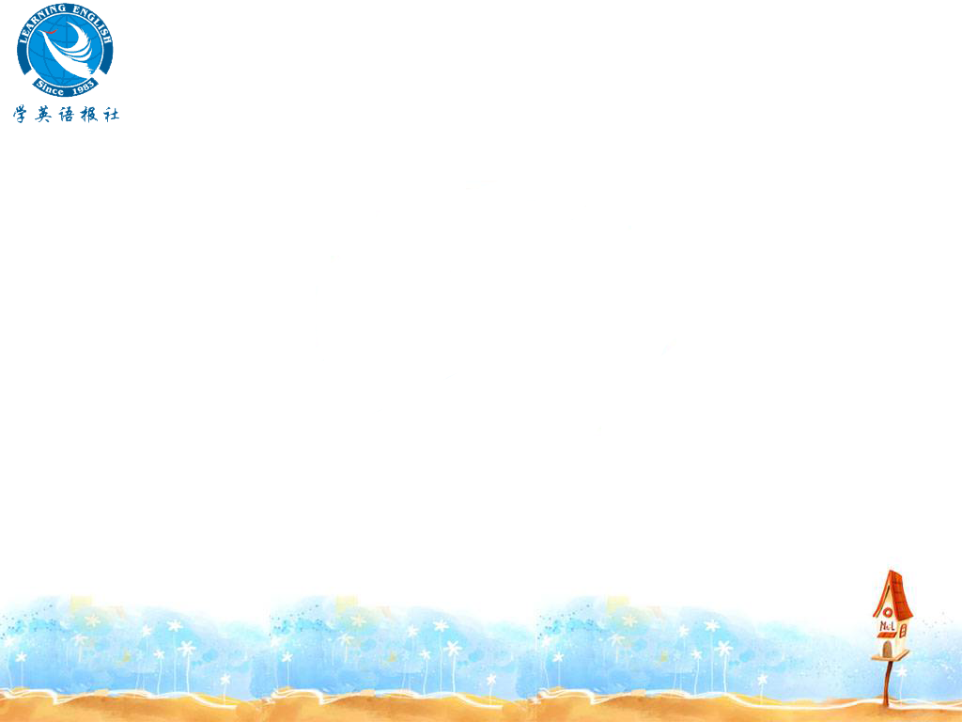
Writing on page 53
Imagine the old local restaurant has gone. You are asked to write an article describing what you think should be built on the land instead of a McDonald’s restaurant. You may choose whatever you like.

Slide 42
Describe it fully in words and draw a
plan. Remember the order of your article:
1 describe the new design
2 draw a plan
3 explain the advantages of your idea

Slide 43
Sample writing:
An idea for a new library
My idea is to build a new library for our community. It will need one large room for the books and one for the librarians to rest, have tea and eat their lunch in. It could be a place where people sit and relax and read some of the books if they want to.

Slide 44
This is how I think the library should be designed to let people see the largest number of books. There should be shelves all round the room for people to keep books and some free-standing shelves in the middle of the room to hold even more.

Slide 45
These shelves should be divided into sections so that each book shelf holds a certain kind of books. For example, all history books should be organized by date so that people can easily find books they want.

Slide 46
My idea will help improve the education of the students in our community. It will also give the adults an interest and keep their minds active.
I hope you will support my idea.

Slide 47

Homework
1. Find the rules of word formation: Adj-Verb, Adj-Noun, Verb-Adj, Verb-Noun, Noun-Verb, Noun-Adj.
2. Distinguish the meanings of modal verbs.
3. Make suggestions or giving advice on diet.

