Slide 1

Using Language

Slide 2

Words preview
debt
glare
spy
limit
n. 债；债务
vi. 怒目而视；闪耀
n. 怒视；炫目的光
vi. & vt. 窥探；秘密监视
n. 间谍；侦探
vt. 限制；限定
n. 界限；限度

Slide 3
Words preview
limited
benefit
breast
garlic
sigh
combine
adj. 有限的
n. 利益；好处
vt. 有益于；有利于；受益
n. 胸部；乳房
n. 蒜
vi. 叹息；叹气
n. 叹息；叹息声
vi.&vt. （使）联合或结合

Slide 4
Expressions preview
earn one’s living
in debt
spy on
cut down
before long
put on weight
谋生
欠债
暗中监视；侦查
削减；删节
不久以后
增加体重

Slide 5

Listening on page 14
Listen to the whole dialogue between Wang Peng and an expert. Write down the main idea of the dialogue.

Slide 6
Wang Peng is doing research to find out how an unbalanced diet can affect your health, so you need to eat a balanced diet if you are to stay healthy.

Slide 7
Listen to the tape again and join the names of the illness to their causes.

Slide 8

Illnesses | Cause
Scurvy | too much rice, noodles, sugar and fat
Rickets | not enough vitamin C
Obesity | not enough protein and vitamin D

Slide 9

After listening, work in pairs and discuss what problems Wang Peng and Yong Hui have and what suggestions you would give them.
Owner of restaurant | Problems with food offered | What food is needed
Wang Peng
Yong Hui

Slide 10
Owner of restaurant | Problems with food offered | What food is needed
Wang Peng
Yong Hui
too much fat
and energy-giving food
more fruit and vegetables
too much fruit and too many vegetables
more meat. fish cheese and eggs as well as rice and noodles

Slide 11

Listening text
How An Unbalanced Diet Can
Affect Your Health
Wang Peng went to the library, where he happened to meet an expert on diets. He asked him for help.
WP= Wang Peng E= Expert

Slide 12
WP: Hello. Can I help me, please? I want to find out more about balanced diets.
E: Of course. A balanced diet needs energy food like rice and noodles, body-building food like fish and meat for protein and fat, and protective food like fruit and vegetables for fibre and vitamins.

Slide 13
WP: Yes, but does it matter how much rice, noodles and sugar I eat?
E: Yes. If you eat too much , you may become obese. This means you are too fat and it may lead to other illnesses. However, if you don’t eat enough rice, noodles or sugar, you’ll get tired easily.

Slide 14
WP: I see. I’ll be careful about that. Does it matter how much fish, meat or cheese I eat?
E: Too much can also make you fat, but if you don’t eat enough, your bones won’t grow strong. A long time ago, children who didn’t eat enough vitamin D and body-building food didn’t grow straight legs. They got an illness called rickets.

Slide 15
WP: Oh dear! Do people still have the problem?
E: Sometimes.
WP: Then what about fruit and vegetables? How much should I eat?
E: You ought to eat about five big spoonfuls of different fruit and vegetables every day.
WP: Really? I didn’t know that.

Slide 16
E: Yes. In the 18th century sailors at sea used to find that their teeth fell out and they had bad spots on their skin. They got it because they didn’t eat enough fruit and vegetables. The illness is called scurvy.
WP: Goodness! What about now?

Slide 17
E: It’s very rare now. People eat more
fruit and vegetables. You need
protective food like that for clear skin
and bright eyes.
WP: Thank you very much. You have
given me a lot to think about.

Slide 18

Reading
COME AND EAT HERE（2）

Slide 19

Pre-reading
Learn these proverbs.
You are what you eat.
人如其食。
First wealth is health.
健康是人生的第一财富。
-----Emerson

Slide 20
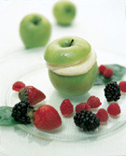
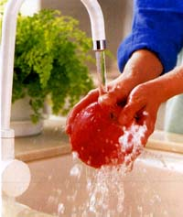
An apple a day keeps the doctor away.
一天一个苹果，医生不来找。

Slide 21
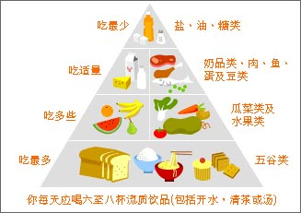

Slide 22

In pairs discuss these questions after
reading the passage.
1 How did Yong Hui feel when she came to Wang Peng’s restaurant? Why?
2 How did they solve their problems and become good friends?
3 Why was their cooperation a success?

Slide 23
1 How did Yong Hui feel when she came to Wang Peng’s restaurant? Why?
She felt angry because she thought Wang Peng had come into her restaurant to spy on her.

Slide 24
2 How did they solve their problems and
become good friends?
(a) Wang Peng showed that he wanted to cooperate and not compete with Yong Hui.
(b) They succeeded in finding a menu that provided a balanced menu.

Slide 25
3 Why was their cooperation a success?
They cooperated successfully in
business.
(b) They liked each other.

Slide 26

Fill in the chart below.
What did they do? | Result
Combine their menu and
provide a balanced one
raw vegetables with hamburgers
the boiled potatoes, not fried
fresh fruit with ice cream
cut down the fat
increase the fiber
a big success

Slide 27
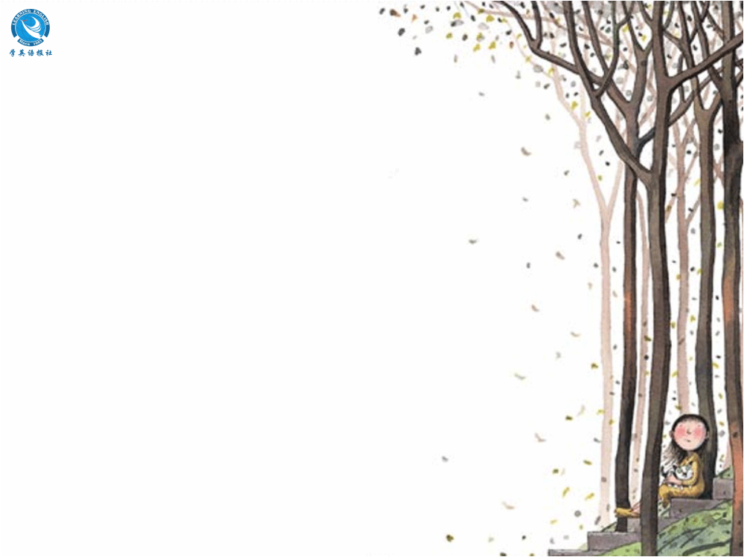
Read the passage again
and underline all the
different words that are
used instead of “said”.

Slide 28

Language points
Perhaps he would be able to earn his living after all and not have to close his restaurant.
1) earn one’ living by...=live by...=make a living by...
He earned his living by begging from door to door.

Slide 29
表示“谋生”的短语：
earn a living
earn one’s living
make a living
make one’s living

Slide 30

2. He did not look forward to being in debt because his restaurant was no longer popular.
他可不希望由于餐馆不受欢迎而负债。
debt: sum of money owed to sb. that has not yet been paid 债务; 欠款

Slide 31
(1) be in debt: owe a lot of money 欠债
(2) be out of debt: not owe a lot of money 还清债务
(3) be in sb’s debt: feel grateful to sb. for his help, kindness, etc. 欠某人之情
You saved my life, I am forever in your debt.
他救了我的命,我永远感恩不尽。

Slide 32
no longer=not ...any longer 不再
He no longer loves here.
I can’t wait any longer.
1) no more/no longer
no more表示数量上或程度上“不再”
no longer 表示时间上“不再”延续
He is no more a student.
He is no longer young.

Slide 33
2) no more...than/not more...than
no more...than ......和......一样不（两者都否定）
not more...than 不如...(前者不如后者)
Xiao Li is no more diligent than John.
小李不勤奋，约翰也不勤奋。
Xiao Li is not more diligent than John.
小李不如约翰勤奋。

Slide 34
3. She didn’t look happy but glared at him as she moved round the customers.
她绕过顾客走进来，双眼直瞪着他，看上去很不高兴。
glare vi. 怒目而视
glare at sb. 怒目注视某人

Slide 35
glance/glimpse/glare/stare/watch的区别：
glance:
glance (at, over) 看一眼
glimpse:
catch／get a glimpse of 瞥见
to look at something quickly and briefly.
to see by chance, just for a moment.
瞥见，一瞥

Slide 36
glare:
glare at sb. 怒视某人
stare:
stare at／into 盯着
to stare angrily, freely. It emphasizes hostility.
怒视，瞪眼
to gaze intently esp, with wide-open eyes.
盯，凝视

Slide 37
--- What is the boss like?
--- I can’t describe him well, I only
caught a ___ of him as he drove by.
A. glance
B. look
C. stare
D. glimpse
D

Slide 38
4. I thought you were a new customer and now I find you came only to spy on me and my menu.
我本来以为你是一为新顾客，现在我才发现你知识过来打探我和我的菜谱的。
only to spy... 在句中做目的状语

Slide 39
only to do sth. 和 only doing sth.
only to do sth. 表示一个与主语愿望相反的或出乎主语医疗的结果，或用来暗示最初的未能实现的动作。
only doing sth. 表示谓语动词本身的动作造成的结果。

Slide 40
spy on暗中监视;窥探
Jack was paid by the police to spy on his colleagues.
杰克受雇于警察在暗中监视他的同事们。
He is paid by the police to spy on other students.
警察收买他去监视其他学生。

Slide 41

5 In this way they cut down the fat and increased the fiber in the meal.
cut down: 削减;删节
Do not cut down the tree that gives you shade.
【谚】遮荫之树不可砍。

Slide 42
6 Their balanced diets became such a success that before long Wang Peng became slimmer and Yong Hui put on more weight.
他们的平衡食谱非常有效，王鹏很快就瘦了，而雍慧确胖了。
before long 不久以后

Slide 43
put on weight: 体重增加
He has put on weight since I last saw him.
自从我上次见到他以来，他又长胖了。
He is putting on weight.
他的体重在增加。

Slide 44

Homework
Collect eating attitudes from the Internet.
Practice presenting reasons to support your ideas.

