Slide 1

M3 Unit2 Healthy Eating
Using Language

Slide 2
There are some proverbs for you !
You are what you eat.
人如其食
An apple a day keeps the doctor away.
一天一个苹果，医生不来找我
First wealth is health.
健康是人生的第一财富

Slide 3
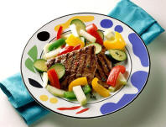
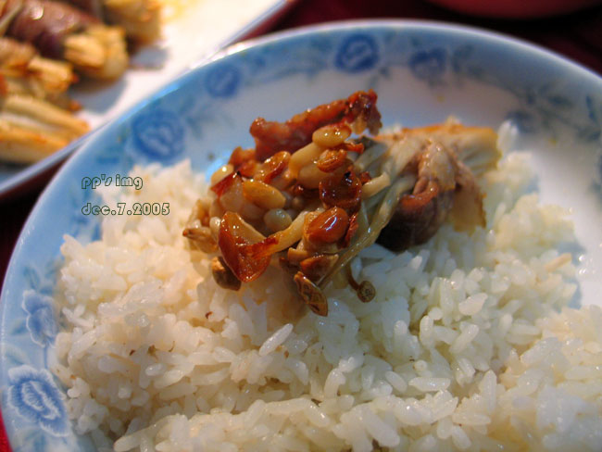

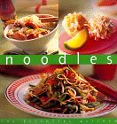

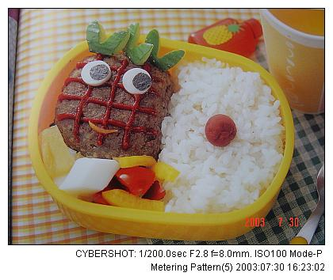
Energy-giving or body-building or
protective-Food?

Slide 4
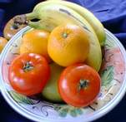
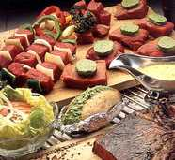
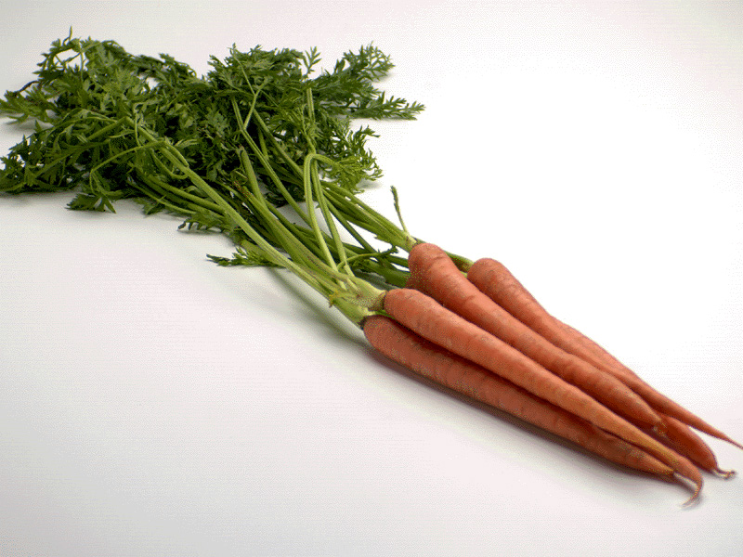
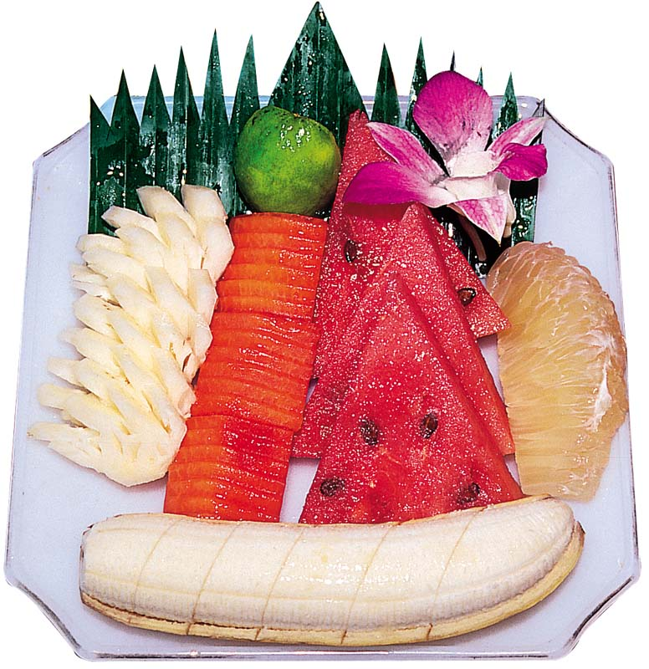
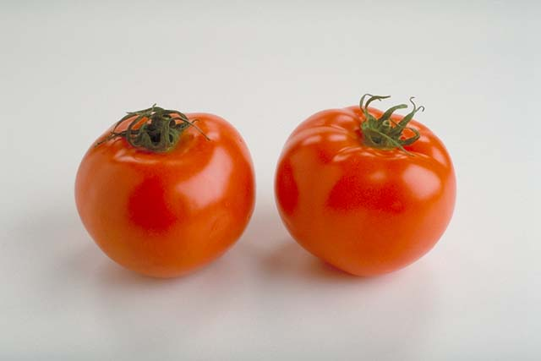
Energy-giving or body-building or protective-Food?

Slide 5
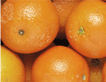
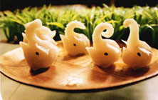

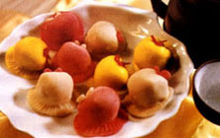

fruit
dumplings

Slide 6
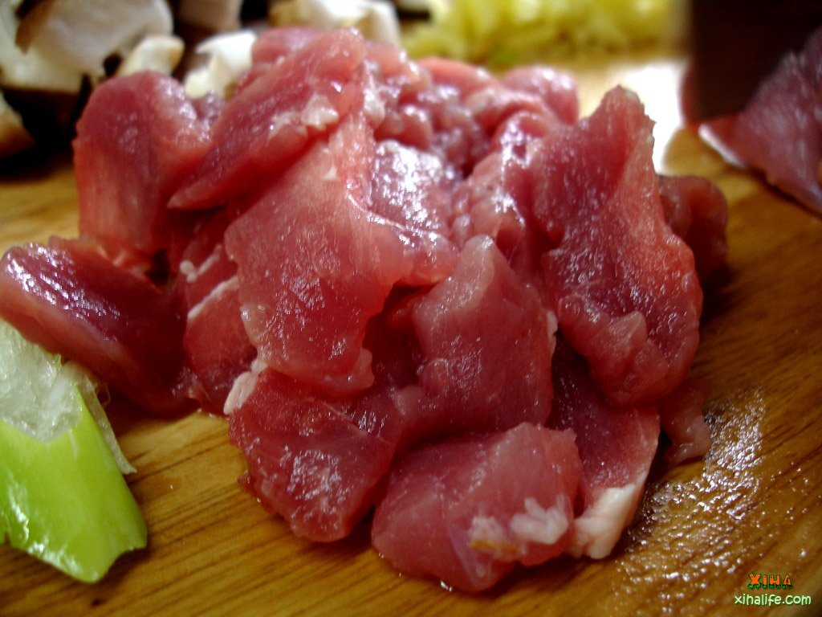
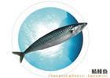

Which kind of food?

Slide 7

Listen to the tape for the first time
Energy-giving foods | Body-building foods | Protective foods
rice
meat
fresh fruit
noodles
fish
vegetables
nuts
tofu
butter

Slide 8
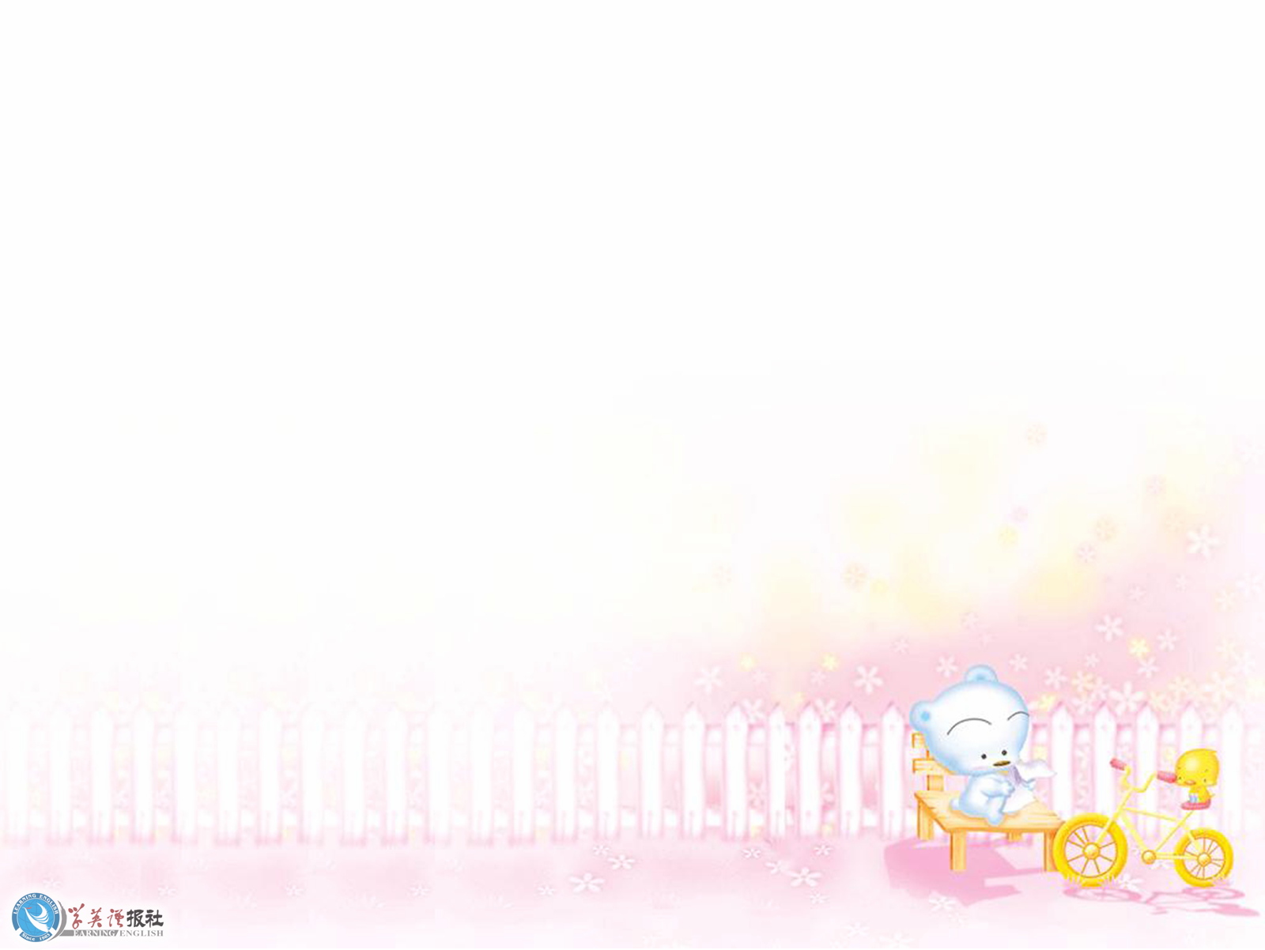


Listen again!
set out for
Pengwei closed his restaurant and____________
the Library. There he started reading the books
on_______________. He _____________find one
needed __________________food to stay healthy.
They are energy-giving, body-building and
protective foods.
healthy eating
was amazed to
three main kinds of

Slide 9
what are energy-giving, body-building and
protective foods.
Energy-giving foods_______________________
_________They are rice, noodles, nuts, butter
and etc. Body-building foods________________
____________and they are meat, fish and tofu.
Protective foods__________________________
__________________. They are fresh fruit and
vegetables.
help you work and play
all day.
make strong bones
and muscles
help a person digest food and
keep the body healthy

Slide 10

Listen carefully !
Owner of restaurant | Problems with foods offered | Foods to be offered
Wang pengwei
Yonghui
More protective foods
Too much fat
More body building and energy giving foods
Not enough fat

Slide 11
Wang Pengwei realized very quickly that his menu
had energy and body-building foods, but little
protective food. Yong Hui, on the other hand,
offered plenty of protective foods on her menu but
little energy or body-building foods. Neither of them
was providing a balanced diet. It seemed both of
them were wrong. Pengwei began to wonder. Was
that why he was so fat? Was that why Yong Hui
was so thin? If he ate only raw fruit or vegetables
and drank water, he would certainly get thin. But
then would he have enough energy to run his business?

Slide 12
What is his suggestions for solving the problem?
Then he thought about Yong Hui. She was very
thin and she did not seem to have a lot of energy.
Maybe she would not mind being a little fatter
and stronger. Clearly, it was as bad to be too thin
as to be too fat. How was this problem to be solved?
Maybe they could join together to make a better
menu. “That’s it,” he thought. “We must work
together to offer healthy foods.”

Slide 13
Pengwei closed his restaurant and set out for the
Library. There he started reading the books on
healthy eating. He was amazed to find one needed
three main kinds of food to stay healthy. They are
energy-giving, body-building and protective foods.
Energy-giving foods help you work and play all day.
They are rice, noodles, nuts, butter and etc. Body-
building foods make strong bones and muscles and
they are meat, fish and tofu. Protective foods help a
person digest food and keep the body healthy. They
are fresh fruit and vegetables.

Slide 14
Wang Pengwei realized very quickly that his menu
had energy and body-building foods, but little
protective food. Yong Hui, on the other hand,
offered plenty of protective foods on her menu but
little energy or body-building foods. Neither of them
was providing a balanced diet. It seemed both of
them were wrong. Pengwei began to wonder. Was
that why he was so fat? Was that why Yong Hui
was so thin? If he ate only raw fruit or vegetables
and drank water, he would certainly get thin. But
then would he have enough energy to run his business?

Slide 15
Then he thought about Yong Hui. She was very
thin and she did not seem to have a lot of energy.
Maybe she would not mind being a little fatter
and stronger. Clearly, it was as bad to be too thin
as to be too fat. How was this problem to be solved?
Maybe they could join together to make a better
menu. “That’s it,” he thought. “We must work
together to offer healthy foods.”

Slide 16

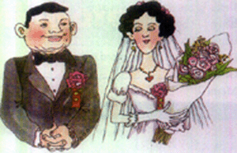
Pre-reading and listen to the tape
Guess: what happened?

Slide 17
Make choices!
1.Pengwei was worried when he thought his
restaurant would no longer be popular
because__________.
A. he would be in debt
B. he could no longer earn his living
C. he would lose his job
D. his friends would not visit him

Slide 18
2. Yong Hui was very angry when she came to
Pengwei’s restaurant because________.
A. she thought he was a new customer
B. she thought he had spied on her restaurant
C. she was told he was a spy
D. he was too fat

Slide 19
3. Pengwei’s research showed__________.
A. his menu was balanced
B. both menus were balanced
C. Yong Hui’s menu was balanced
D. neither menu was balanced

Slide 20
4. He suggested they provide a combined
menu because_________.
A. he liked Yong Hui
B. he didn’t want to lose his customers
C. he thought her menu was better
D. this would provide a balanced diet

Slide 21
True or false
Pengwei can earn his living now, but he will be
in debt.
2. Yonghui thought Pengwei spied on her menu.
3. Yonghui didn’t like the food in Pengwei’s restaurant.
4. Pengwei would miss his dumplings and fatty pork
even if in his own restaurant.
F
T
F
T

Slide 22
Eating healthily means that no food in itself is good or
bad. Eating properly depends on eating the right variety
of foods in the right amount. Let’s read paragraph 3
quickly and say what they did with their menu.
What did they do? | Result
Combine their menu and
provide a balanced one
1. raw vegetables with
hamburgers
2. the boiled potatoes, not fried
3. fresh fruit with ice cream
  1. cut down the fat
  2. increase the fibre
  3. a big success

Slide 23

Thank you.

