Slide 1


3
MODULE
The Violence of Nature

Slide 2
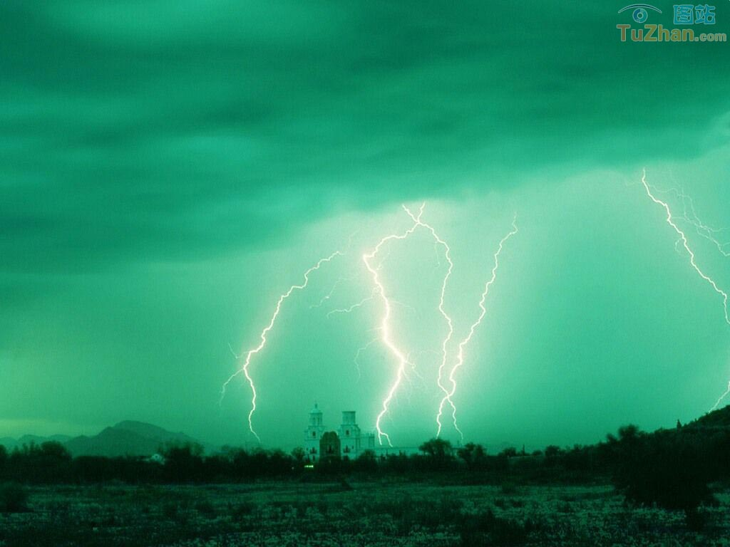
CULTURAL CORNER
Earthquakes Around the Pacific

Slide 3
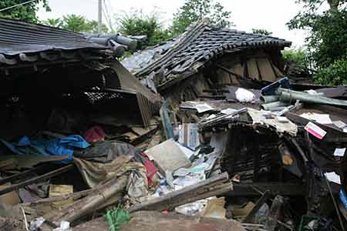

Slide 4
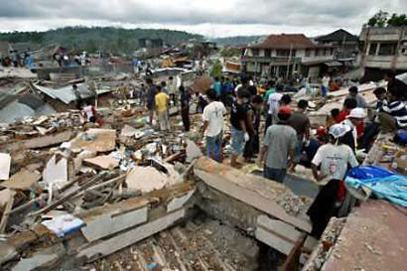

Slide 5
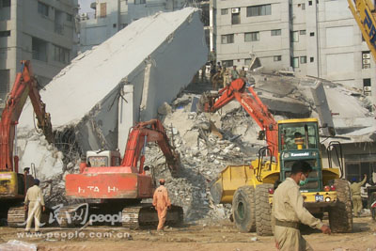

Slide 6
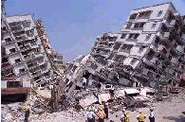

Slide 7
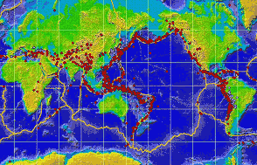

Slide 8
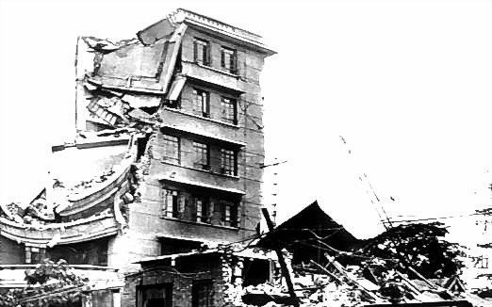
唐山大地震

Slide 9
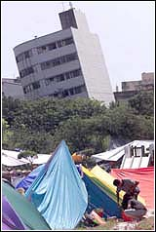
台湾大地震

Slide 10
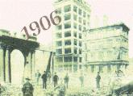
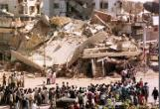
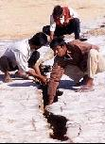
1906 California Earthquake

Slide 11
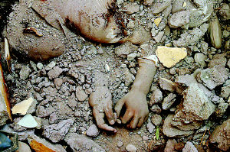
2005年10月8日南亚地震后被埋在废墟中的儿童

Slide 12
Now we can know that the earthquake is very destructive. About 400 earthquakes occur every day ,more than a hundred thousand in a year.
China is situated in one of the most active earthquake regions in the world and there have been many terrible earthquakes.

Slide 13
Pre-reading:
1. 位于___________________
2. 活跃的地震区_________________________
3. 60%的人口_________________________
4. 丧失生命_________________
5. 发生_________________
6. 对...造成损害__________________________
be situated in
active earthquake region
60 percent of the population
lose one’s life
take place
do damage to

Slide 14
Main idea of each paragraph
Para.1: earthquakes happen frequently
Para.2: In China’s history happened the worst earthquake (Hua County Earthquake in1556)
Para.3: In America’s history happened the worst earthquake (California Earthquake in 1906)
Para.4: Cause of California Earthquake

Slide 15
Read carefully and fill in the chart
 | China | the US
when
where
damage
result
In 1556
In 1906
Hua County
California
covered an area of 800 k㎡ affected 8 provinces
Fire burned for three days
25,000 buildings
destroyed
500 people killed
250,000 homeless
60％ …killed
830,000 people lost their lives

Slide 16

Discussing :
Why do earthquakes happen frequently around the Pacific?

Slide 17

Self-learning:
课堂互动:
He is a good student and always take ______ part in school affairs.
A. an active B. active
C. activity D. actually

Slide 18

1.The field is ______________________ (被水淹没)
2.The Red Army __________________ (走完了25,000里)
3. He’s not looking ______ well.
他的气色看起来很糟糕。
covered with water
covered 25,000 li
at all

Slide 19

He was worried about money. He had ______ $ 20 then.
A. not more than
B. no less than
C. much more than
D. many more than

Slide 20
Post-Reading
Have you ever experienced an earthquake?
What would you do if there was an earthquake in your town?
Do you know how the earthquake happens?

Slide 21
Earthquake
The process known as plate tectonics(地质板块构造学)occurs during the continental(大陆的)drift(漂移). The example shows two large segments(段)of continental crust(外壳)colliding(碰撞) very slowly over millions of years. One land mass(大的团块)is forced underneath(在...的下面)the other. To relieve(减轻, 缓解)the stress, mountain rages are often formed in the overriding(叠压的)land mass fault(断层). Earthquake close(密集的)zones are formed below.

Slide 22
Homework
Write a newspaper article about
a natural disaster

