Slide 1
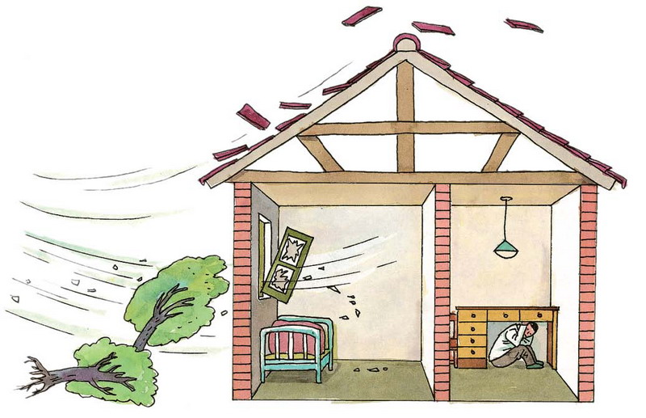

高中第三册
Module 3
The Violence of Nature

Slide 2
Language Points

Slide 3
1. experience
vt. 经历
Our country has experienced great changes in the past thirty years.
n. 经验，体验(不可数)
经历，经历过的事(可数)
Please tell us of your experiences while in
Africa.
She has no experience in cooking.
have experience in/at…
be experienced in/at…

Slide 4
2. nearly, almost 几乎
当表示“接近”或“就要到了”时最好用nearly。当想表达“不足”或“差一点儿”时最好用almost。
He's only forty-one years old, and he has already been to nearly every country in the world.
I almost fell down. 我差一点儿没跌倒。
注：句中有no, none, nothing, never等词时，不可以用nearly，但可以用almost。

Slide 5
3. put down
1. 写下；记下
Put down you name and address.
2. 放下
Put those heavy bags down for a minute.

Slide 6
4. take off
1. 脱掉: to remove something, especially clothes:
He took off his clothes and got into the bath.
2. 起飞: If an aircraft, bird or insect takes off, it leaves the ground and begins to fly:
The plane took off at 8.30 a.m.

Slide 7
Parents are advised to take pressure off a child and give him some encouragement before an exam.
They are taking 50% off all goods in that shop.
The plane took off very smoothly though there was a terrible storm.
When in Japan, you have to take your shoes off before you enter people’s houses.
去掉
打折
起飞
脱掉

Slide 8
5. … leave the furniture inside exactly where it was.
leave vt. 让(继续处于某种状态)，可以接形容词、副词、分词、介词短语等作补语。
Leave the book on the desk.
Leave the door open.
Leave me alone.
Don’t leave him waiting outside in the rain.
I’m sorry I have left some of your questions unanswered.

Slide 9
6. affect, effect, influence 影响
affect vt.对……产生不利影响
Smoking affects health.
effect n. have an effect on
The drug had an immediate effect on the pain.
influence n. vt. 指“对行动、思想、性格等产生潜移默化的影响”
My teacher influenced my decision to study science.

Slide 10
7. by the time 到……的时候
1.by the time 后接从句为一般过去时，主句动词用过去完成时
By the end of last term, we had finished learning Book 2.
2.by the time 后接从句为一般现在时，主句动词用将来完成时
The task will have been completed by the time you come back.

Slide 11
8. beat, strike, hit
(1) beat—beat—beaten
1) 接连地打/敲(某物); 猛击(某人)
Someone is beating a drum outside.
2) (比赛, 竞赛, 战斗中)打败；战胜
We beat the enemy at last after the eight-year-long war.
3) (心脏、脉搏) 跳动
His heart beat fast when the teacher called his name.

Slide 12
(2) strike 打, 击; (钟)敲响; 罢工(课,市); (疾病, 痛苦, 灾害等)侵袭
He struck the table with his fist.
The clock has just struck 5.
The little girl struck a match.
A good idea struck me.
He was struck with a bad cold.
It was not long before the typhoon struck again.
They strike for better working conditions.

Slide 13
(3) hit 打,击(仅只一次的); 袭击；撞击
He hit the boy on the head/ in the face.
He hit the bird with the first shot.
The district was hit by a violent earthquake on November 30th.

Slide 14


选择填空
1. He stopped the car, ______ the injured old man and sent him to the hospital.
A. took up B. got up
C. picked up D. put up
2. You should make it a rule to leave things ___ you can find them again.
A. when B. where
C. then D. which

Slide 15
3. The car ran so fast that it ____ on the wall at the corner.
A. was driven B. strikes
C. beat D. hit
4. While working in the countryside, the students _____ a great deal of knowledge on plant life.
A. looked up B. picked up
C. put up D. called up

Slide 16
5. The clock has just _____ five. All the students should get up and do morning exercises.
A. hit B. beaten
C. struck D. knocked
6. John ___ the thief ___ the nose before he could draw out his knife.
A. hit; in B. beat; on
C. hit; on D. stricken; on

Slide 17
7. Under good treatment, Linda is beginning to ____ and will soon recover.
A. pick up B. wake up
C. grow up D. show up
8. The precious picture was hopelessly _______ by long exposure in the cold, damp air.
  damaged B. destroyed
  C. harmed D. ruined

Slide 18
9. Four hundred people a year die of this disease ____ average.
A. above B. on
C. about D. below
10. At first they hated each other, but they ended up _____.
A. got married
B. getting married
C. gotten married
D. being married

Slide 19
11. At the dinner, we started with soup and ended up _____ fruit.
A. with B. in C. for D. at
12. While you are at home alone, please don’t leave the door ____.
A. opened B. open
C. opening D. to open

Slide 20
Word-spelling:
rotating
violent
旋转的___________ 猛烈的_________
飓 风___________ 龙卷风_________
雷 暴___________ 火 山_________
经 历___________ 袭 击_________
墓 地___________ 摧 毁_________
平 均___________ 放 下_________
捡 起___________ 去 掉_________
hurricane
tornado
thunderstorm
volcano
experience
hit/strike
cemetery
destroy
on average
put down
pick up
take off

Slide 21
Fill in the blanks with proper phrases.
Ash and lava ___________ (倾泻) the
mountain, ____________ (使……起火)
hundreds of houses.
Hundreds of houses __________ (着火了) when the lava reached them.
poured down
setting fire to
caught fire

Slide 22
3. We __________ (设法) get half the population to another island.
4. We _________________ (把火都扑灭了).
5. When Mr. Smith got the message that his house __________ (着火了) , he rushed home as quickly as he could.
managed to
put all the fires out
was on fire

Slide 23
Fill in the blanks with proper words.
1. Thousands died in that natural
_______.
2. Smoking can _____ lung cancer.
3. The river had burst its banks
and _______ the valley.
4. Tom never __________ any
natural disasters.
disaster
cause
flooded
experienced

Slide 24
5. We bought some ________ (家具)
to go with the new house.
6. He was ______ (埋葬) with his
wife.
7. When did the accident _______
(发生)?
8. An hurricane is a very ______ (强烈)
wind or storm.
furniture
buried
occur
violent

Slide 25
根据汉语完成句子。
1. 这是我有过的教育意义最大的一次经历。
It was the most educational _________ I had ever had.
2. 她跌倒了, 险些跌断了脖子。
She fell and ____________ broke her neck.
3. 我喜欢把最好的留到最后。
I like to ____ the best till last.
experience
almost/nearly
leave

Slide 26
4. 是什么使他生病？
What ______ his illness?
5. 空难在起飞几分钟后就发生了。
That plane crash ________ only minutes after take-off.
6. 气候影响了他的健康。
The climate _______ his health.
caused
occurred
affected

Slide 27
7. 他的祖父母都葬在这里。
Both his grandparents were _____ here.
8. 他们把国家带入了经济灾难中。
They had led the country into economic _______.
9. 河中央的水流最急。
The ______ is strongest in the middle of the river.
buried
disaster
current

Slide 28
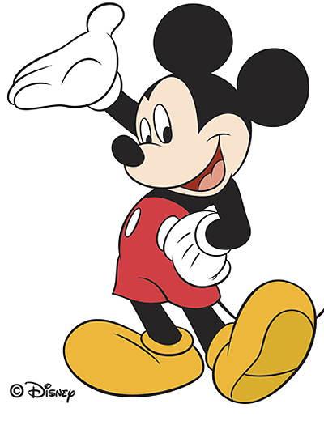
Thank you!

