Slide 1

英语课标教学课件
选修6

Slide 2

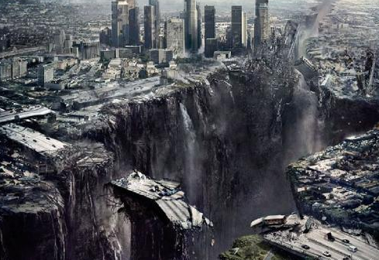
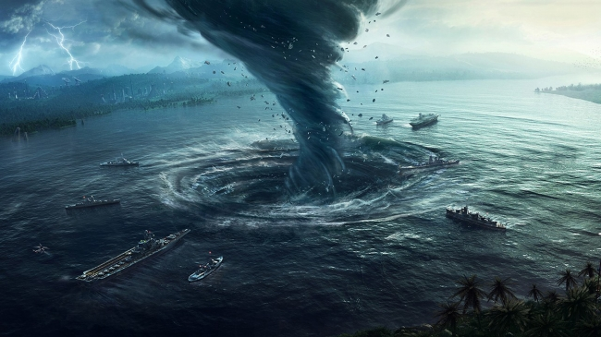
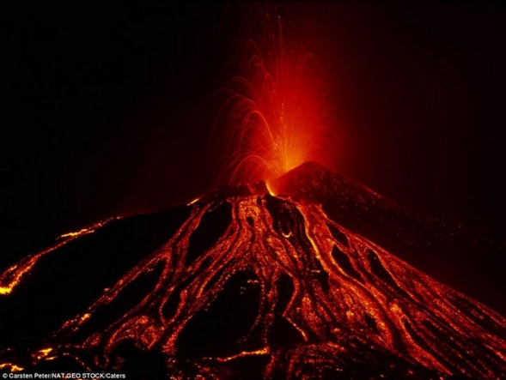

Slide 3

【写作任务】
近年来，地震频繁发生。请根据下面信息写一篇短文呼吁公众关注防震减灾。

Slide 4
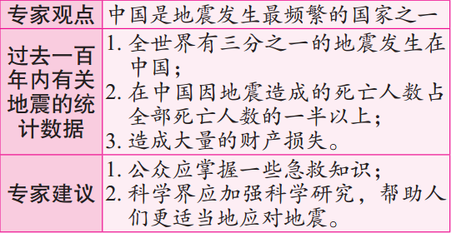
【写作要求】
只能用5个句子表达上面所给的信息。

Slide 5

【写作分析与指导】
1. 写作思路：本篇习作给出了三个要点，这些要点的排列具有很强的逻辑性。因此，我们只要准确地将这些信息转化为英语，不漏掉相关的要点即可。在写作的过程中，我们还应具体注意如下几点：(1) 合理使用简单句、并列句和复合句，做到“长短结合”。这样，写出来的文章才不至于单调。(2) 在文章中合理运用所学的词汇知识、语法知识和句型。(3) 根据句子间的逻辑关系，合理地使用关联词语和过渡词汇，使上下文的联系更加紧密，过渡更加自然。(4) 本文在陈述统计内容时，由于涉及的是发生在过去的事情，因此，这部分的时态应以一般过去时为主。

Slide 6
二、词句储备
1. 写作中可能使用的词语有：
(1) 发生 _______________
(2) 频繁的 ____________________
(3) 大量
______________________________
(4) 财产损失 _________________
(5) 全部的 _________________________
(6) 公众 _______________________
(7) 急救知识 ____________________
(8) 科学研究 _______________________
occur / take place
frequently
a great deal of / quantities of
property loss
total
the public
first-aid knowledge
scientific research
Notes:
make a difference to

Slide 7
(1) 科学家们认为，中国是地震发生最频繁的国家之一。
Scientists believe that China is among the countries in which earthquakes occur most frequently.
(2)全世界有三分之一的地震发生在中国，造成大量的财产损失。
One third of the earthquakes took place in China, causing a great deal of property loss.

Slide 8

(3)中国因地震造成的死亡人数占地球上全部死亡人数的一半以上。
The deaths related to earthquakes in China took up more than half of the total deaths on the earth.
(4)专家提倡，公众应掌握一些急救知识。
Experts advocate that the public should have a good command of some first-aid knowledge.
(5) 科学界应加强科学研究，帮助人们更适当地应对地震。
The scientific world is supposed to strengthen scientific research so as to help people face earthquakes more properly.

Slide 9

三、下笔成文
Scientists believe that China is among the countries in which earthquakes occur most frequently. In the past one hundred years, one third of the earthquakes took place in China, causing a great deal of property loss. Besides, the deaths related to earthquakes in China took up more than half of the total deaths on the earth. Therefore, experts advocate that the public should have a good command

Slide 10
of some first-aid knowledge. Furthermore, the scientific world is supposed to strengthen scientific research so as to help people face earthquakes more properly.

Slide 11

【点评】
本篇习作思路清晰，信息整合到位，涵盖了所有的要点，而且行文流畅，句与句之间过渡自然。同时，作者恰当地使用了多种复合句等较复杂的句式，避免了句式单一的问题，提高了文章的层次。

