Slide 1
Period 3 Language Points
1. have you ever considered how weak
humans are compared with a volcano,
hurricane or earthquake?
你是否想过， 和火山，飓风或地震
相比人类是何等脆弱。

Slide 2
consider 思考, 主要用于： consider +名词/-ing形式:
He is considering studying abroad.他正在考虑出国留学。

Slide 3
Consider + wh-:
We considered how we should help them.
我们仔细考虑应该如何帮助他们。
Consider + 副词：
Consider carefully before you decide.
要慎重考虑后再作决定。

Slide 4
2. Do you enjoy taking risks ?
risk n. 风险，危险：
he was taking a risk by overtaking
on a bend. 他在转弯处超车是在冒险。
The house is a fire risk.
这房子有起火的危险

Slide 5
短语联想：
at risk 在危险中:
You are at risk if you don’t wear a seat belt. 不系安全带真的会有危险。
at the risk of 冒……危险：
At the risk of seeming rude, I must refused your request, I’m afraid.
尽管似乎无理，恐怕我还是必须拒绝你的要求。

Slide 6
3.Many houses have been covered with
lava or burnt to the ground.
许多房屋被熔岩覆盖或烧毁。
burn to the ground 指楼等被烧毁。例如：
He has no place to live in because his
house has been burnt to the ground. 他无
处栖身因为他的房子被烧掉了。

Slide 7
短语联想：
burn away 烧掉：
The wood had burnt away to nothing.
木头已烧成灰烬。
burn down (建筑物) 烧毁：
The cinema burnt down last year.
电影院去年被烧毁了。
The school was burnt down by vandals.
学校被人纵火烧毁了。

Slide 8
Burn off 烧掉：
He was badly injured in the accident, and
His hair was burnt off. 他在事故中严重受伤，头发也被烧掉了。
Burn out 烧坏:
The engine had burnt out. 引擎给烧坏了。

Slide 9
Burn up 烧毁，燃得更亮/旺：
The rocket burnt up when it
reentered the earth’s atomasphere.
火箭重入地球大气层时烧毁。
He put more wood in the fire to
make it burn up. 他往火上加木材
想让他烧的更 旺。

Slide 10
4. We slowly made our way to the edge of the crater. 我们慢慢向走
火山口的边缘。
make one’s way （向某地）走
（去）：

Slide 11
She hesitated, but made her way
forward. 她犹豫了一下，但向前走去。
She hastily left the room, and made her
way to her bed. 他迅速离开房间，
朝她床边走去。

Slide 12
短语比较：
make one’s way 还表示“有出息” ：
If you want to make your way in the world, you must learn to work hard
while you are still young. 你若想要有
出息，趁年轻的时候要学会发奋。

Slide 13
make way (for) 让路，让位：
All the traffic has to make way for a fire engine. 所有的车辆都得给救火车让道。
I shall make way for a younger man.
我将把职位让给更年轻的人。

Slide 14
5. Today , I am just as enthusiastic about my job as the day I first started. 如今， 我和开始从事这项工作时一样满怀热情。
enthusiastic (about) 感兴趣的，
热心的：

Slide 15
She seemed enthusiastic about the idea.
她好象对这个主意很感兴趣。
We got an enthusiastic response from
our customers. 我们得到了顾客们的
热情反应。

Slide 16
6. She made an effort to be nice to her
boss.她努力对老板好些。
effort 可用做不可数名词，表“力气”：
It took a lot effort to lift the boxes.
抬起那些箱子要花很大的力气。

Slide 17
effort 可用做可数名词，
表“费劲的事” “尝试”：
It was an effort to get up this morning.
今天早晨起床很费劲。
Despite all our efforts, we failed.
尽管我们尽了力，我们还是失败了。

Slide 18

make an effort to do sth
努力做某事：
He made an effort to
arrive on time
他尽量准时到达。

Slide 19
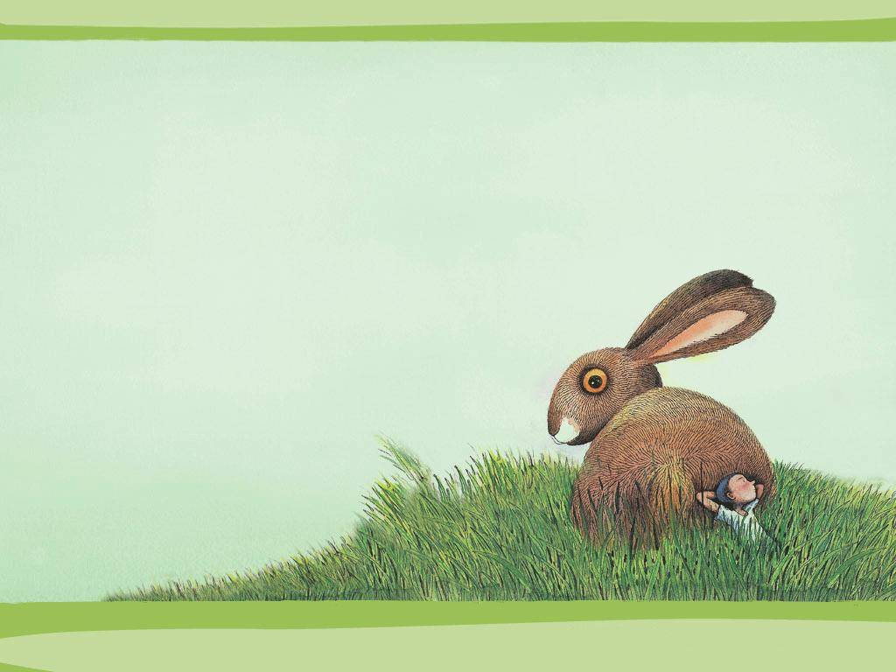
exercise
Find suitable words or expressions
from reading passage in the unit to
fill in the blanks.

Slide 20
1.I went to a tea house with two friends last weekend but all they talks about was volcanoes. I was so _______ that I fell asleep.
2.A tourist very foolishly took a risk by walking right to the edge of an active _______ .
3.I carefully ______________ over the fallen rocks and returned to the car.
bored
volcano
made my way

Slide 21

Nothing can ____________ the experience of standing close to an active volcano for the first time.
Can volcanologists predict when a volcano will _______ ?
The sight of hot lava entering the dea at dawn was ___________.
compare with
erupt
impressive

Slide 22
complete the text with the words below in their proper forms
fountain burn to the ground ash
lava absolute fantastic
eruption unfortunately amaze

Slide 23
The eruption of Mount Vesuvius in 79AD
took people in Pompeii by surprise. It was
so quick and so severe that the town was soon covered in _____ and ______. Many houses in the town were ______________________.
It was an ____________ disaster for many people who could not get away in time. A writer named Pliny, who was there during the __________, described how lava was thrown into the air like a ____________.
_____________ many of the townspeople
ash
lava
burned to the ground
absolute
eruption
fountain
Unfortunately

Slide 24
________ at the _________ sight of Vesuvius
eruption , stayed too long and failed to
escape in time.
amazed
fantastic

Slide 25
Homework
Finish exercise 1 &2 on P71.
Underline sentences in the reading
passage that use the –ing form.

