Slide 1



Unit 5 Workbook
Listening

Slide 2

Christine is talking to a group of
high school students about a cyclone
she experienced when she was a
young girl. Listen and write 1-7
beside the events on page 69 to
show the order in which they
happened.

Slide 3
Answer
1 c 2 e 3 g 4 d
5 a 6 f 7 b

Slide 4
Listen to the tape again.
Write the names of the family
members in the correct place
on the floor plan to show where
they were during the storm.

Slide 5
father
mother
Brain and Christine
toilet
bath
shower
basin

Slide 6


Talking
Think of a powerful natural force
(such as an earthquake, flood, typhoon,
storm) that you have experienced.
You can use your imagination if you
have not experienced any of these
things. Tell your partner about your
experience and how you felt.

Slide 7

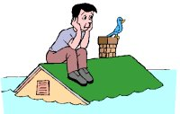
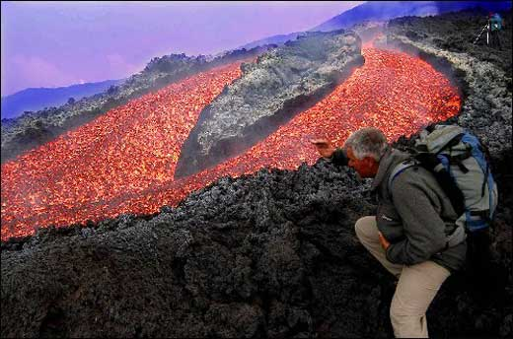
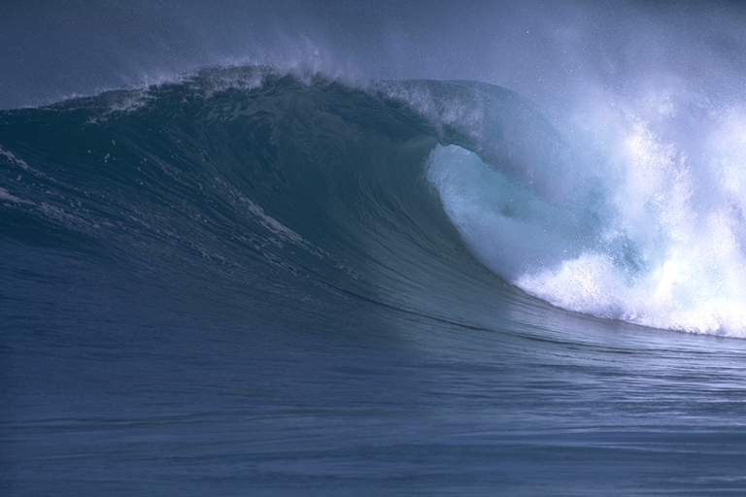
flood
volcano eruption
tsunami

Slide 8
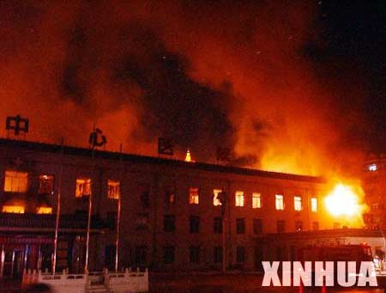
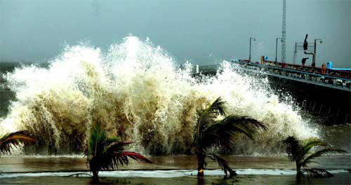
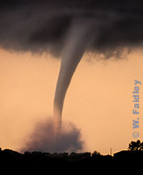
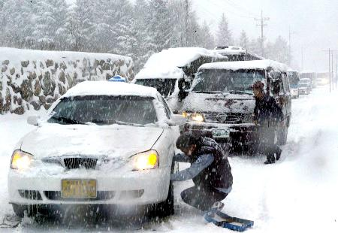
fire
hurricane
snowstorm
tornado

Slide 9


Listening task
A few days after Sara was rescued from the flood she told her mother about her experience. Listen and make notes about the main event in the story. Then use your notes to make a timeline.

Slide 10
9:40 am
9:50 am
9:57 am
Sara climbed onto the roof of the car
climbed onto the roof of the house
found a place to sit and took James out of her backpack

Slide 11
10:45 am
5 pm
6 pm
Rosie climbed up the house roof to join Sarah
saw a helicopter coming
arrived at hospital

Slide 12


Writing task
Imagine you were caught in a terrible natural disaster, but you are now safe. Write a diary entry describing how you felt during and after the disaster.

Slide 13
Choose one of the natural disasters on the list or any other disaster you know about.
fire flood earthquake volcano typhoon/cyclone/hurricane snowstorm

Slide 14
Make a timeline to show the order in which the events happened. For example:
10 am 12 noon 12:30 pm 1 pm | left holiday house to walk in the mountains saw dark clouds in the sky, started to go back snowstorm started we were completely lost …

Slide 15
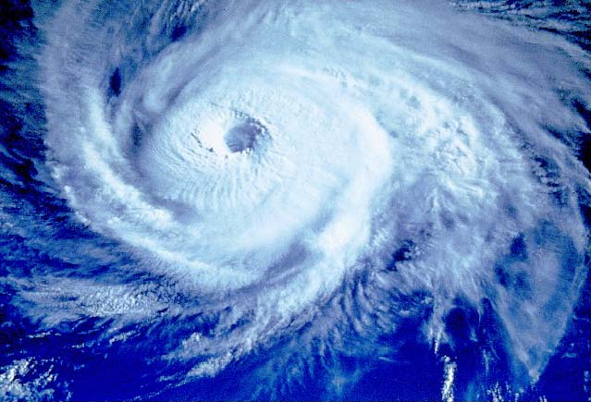
Work with your partner. Take turns to
tell your story. When you listen to your
partner’s story, ask questions about how
he/she felt at different times.

Slide 16
Spend a few minutes on your own
imagining your experiences and how
you felt. Now imagine you are safely
back home. Write a
dairy entry about
your experience.

Slide 17
Sample writing
Jane and I had been waking in
the mountains when we noticed some
dark clouds coming down the
mountain. We decided to turn around
and go home.
As we walked the clouds got nearer
and nearer and the day grew darker.

Slide 18
Then all of a sudden it began to
snow. It was soon snowing so hard
we couldn’t see very far in front
of us. Holding each other’s hands
so we couldn’t get separated, we
continued down the mountain.

Slide 19
But the snow got deeper and deeper. Walking became harder and harder. We began to get very tired and very frightened.
After a while the path became
buried under the snow and we
didn’t know which way to go.
We were completely lost.

Slide 20
We found some shelter behind a big rock. Hugging each other for warmth, we stayed like that until the storm was over. Luckily it only lasted an hour or two. Then the sun came out again and we could see our house in the distance. We were so relieved we both burst
into tears.

Slide 21

Thank you!

