Slide 1

英语课标教学课件
选修6

Slide 2
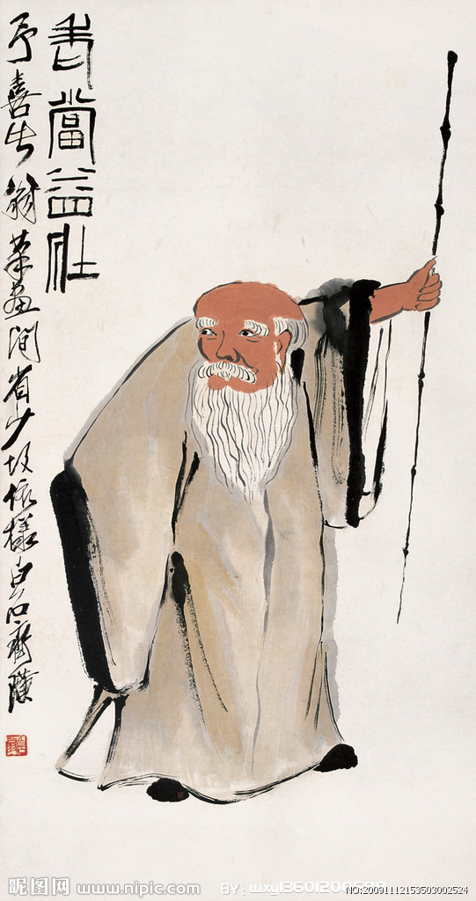
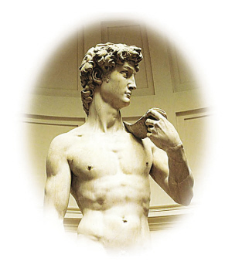
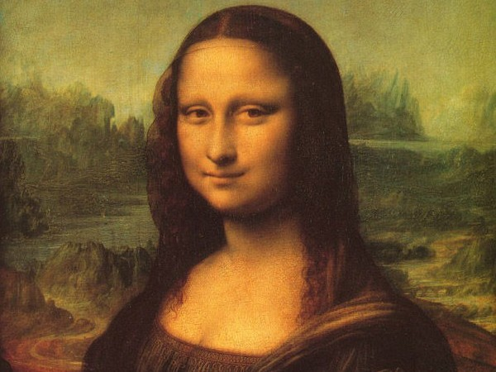
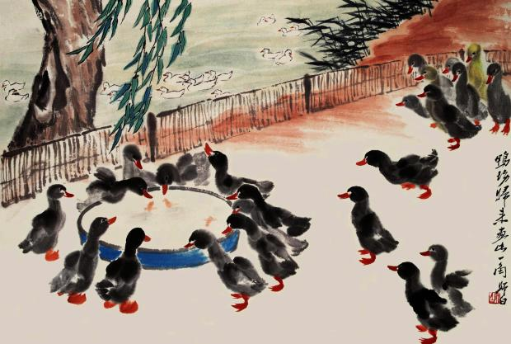
艺术
Art

Slide 3
trust in sb's ability or knowledge; trust that sb./sth. will do what has been promised
n. 信任; 信心; 信念
faith
in a loyal way or a way that can be trusted
adv. 忠实地
faithfully
what sb. is trying to achieve; the purpose of doing sth.
n. 目标; 目的
to point or direct a weapon towards someone or sth. that you want to hit; to try or plan to achieve sth.
vi. & vt. 瞄准; (向某方向)努力
aim

Slide 4
traditional and ordinary; tending to follow what is done or considered acceptable by society in general
conventional
adj. 常规的; 传统的; 因循守旧的
having the usual qualities or features of a particular type of person, thing or group
adj. 典型的; 有代表性的
typical
easily seen or understood; obvious
adj. 明显的; 明白的
evident

Slide 5
to accept or start to use sth. new; to choose or take as your own; to take another person's child into your own family and legally look after him or her as your own child
vt. 采用; 采纳; 收养
adopt
to have or own sth., or to have a particular quality; (of a wish or an idea) to take control over a person's mind, making that person behave in a very strange way
vt. 拥有; 具有; 支配
possess

Slide 6
sth. that you own or that you are carrying with you at any time
possession
n. (尤作复数)所有; 财产
of excellent quality; very great
adj. 卓越的; 杰出的; 极好的
superb
a way of doing an activity which needs skill
n. 技术; 方法; 技能
technique
an occasion when two or more similar things happen at the same time, esp. in a way that is unlikely and surprising
coincidence
n. 巧合(的事); (事情、口味、故事等)相合

Slide 7
an area of darkness, caused by light being blocked by sth., which usually has a similar shape to the object that is blocking the light and which appears to be joined to it
n. 阴影; 影子
shadow
stupid or unreasonable and deserving to be laughed at
adj. 荒谬的; 可笑的
ridiculous
causing disagreement or discussion
adj. 争论的; 争议的
controversial

Slide 8
when you try to do sth., esp. sth. difficult
n. 努力; 尝试; 企图
to try to do sth., esp. sth. difficult
vt. 尝试; 企图
attempt
to say that an event or action will happen in the future, esp. as a result of knowledge or experience
vt. 预言; 预告; 预测
predict

