Slide 1

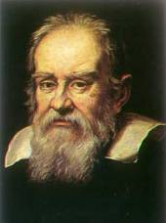
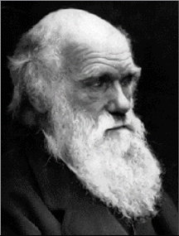
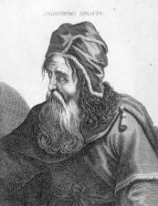
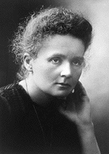
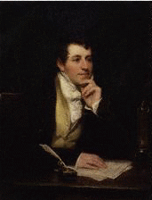
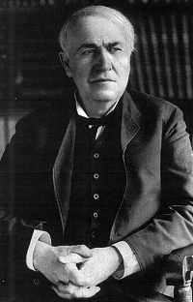
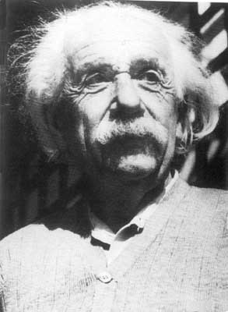
Unit 1
Great
scientists

Slide 2
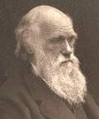
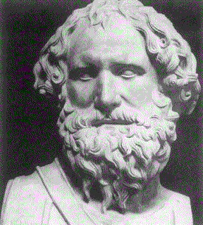
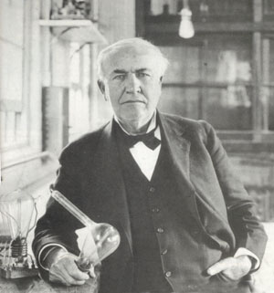

1. Which scientist discovered that objects
in water are lifted up by a force that
helps them float?
A. Charles
Darwin
B. Archimedes
C. Thomas
Edison
Archimedes (287-212 BC), an ancient Greek mathematician & physicist

Slide 3
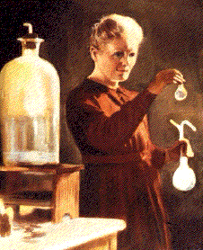
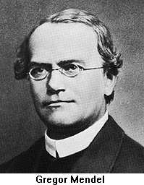
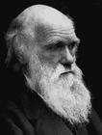
2. Who wrote a book explaining how
animals and plants developed as the
environment changed?
Marie
Curie
B. Gregor
Mendel
C. Charles
Darwin
Charles Darwin (1808-1882), British author
of The Origin of Species

Slide 4

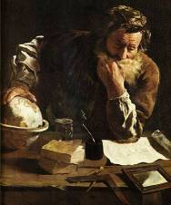
3. Who invented the first steam engine?
Thomas
Newcomen
B. Archimedes
C. Thomas
Edison
Thomas Newcomen (1663-1729), British,
improved the first steam pump and turned
it into a steam engine for taking water out
of mines in 1712

Slide 5
4. Who used peas to show how physical
characteristics are passed from parents
to their children?
Thomas
Edison
B. Gregor
Mendel
C. Archimedes
Gregor Mendel (1822-1884), Czech,
developed ideas on heredity (遗传学) and inherited (继承, 承传) characteristics

Slide 6
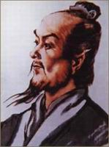

5. Who discovered radium?
A. Zhang Heng
B. Newton
C. Marie Curie
Marie Curie (1867-1934), Polish and French, won two Nobel prizes

Slide 7
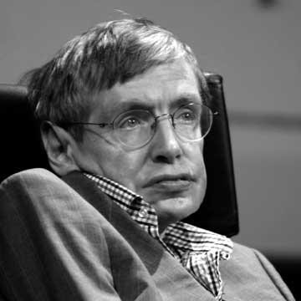
6. Who invented the way of giving electricity
to everybody in large cities?
Stephen
Hawking
B. Archimedes
C. Thomas
Edison
Thomas Edison (1847-1931),
American inventor

Slide 8
7. Who was the painter that studied dead
bodies to improve his painting of people?
Gregor
Mendel
B. Leonardo
da Vinci
C. Marie
Curie
Leonardo da Vinci (1452-1519), Italian artist

Slide 9
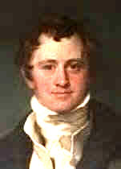

8. Who invented a lamp to keep miners safe
underground?
Sir Humphry
Davy
B. Thomas
Newcomen
C. Faraday
Sir Humphry Davy (1778-1829), British,
discovered the medicinal value of nitrous oxide (一氧化二氮) as an anaesthetic (麻醉剂)

Slide 10
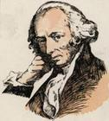
9. Who invented the earliest instrument to
tell people where earthquakes happened?
Charles
Darwin
B. Zhang
Heng
C. Watt
Zhang Heng (78-139), Chinese, invented the first seismograph

Slide 11
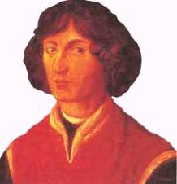
10. Who put forward a theory about black
holes?
Stephen
Hawking
B. Archimedes
C. Copernicus
Stephen Hawking (1942- ), British scientist,
worked in astronomy and studied black holes in space

Slide 12
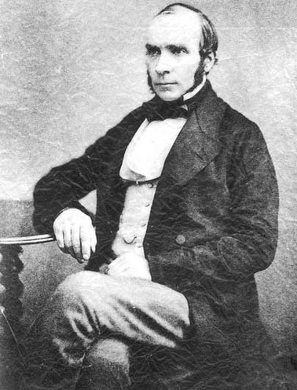
He is an English physician and a leader in the adoption of anaesthesia (麻醉) and medical hygiene(医疗卫生). He is considered one of the fathers of modern epidemiology(传染病学), in part because of his work in tracing the source of a cholera outbreak in Soho, London, in 1854. His findings inspired fundamental changes in the water and waste systems of London, which led to similar changes in other cities, and a significant improvement in general public health around the world.
Do you know him?
John Snow

Slide 13
cholera
Cholera is the illness caused by a bacterium (细菌) called Vibrio cholerae. It infects people’s intestines (肠), causing diarrhea (腹泻), vomiting and leg cramps(腿抽筋). People even die quickly from a loss of liquid. The most common cause of cholera is by someone eating food or drinking water that has been infected with the bacteria.

Slide 14
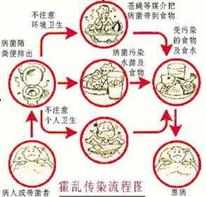
Unit 1 Reading
JOHN SNOW DEFEATS
“KING CHOLERA”

Slide 15

Scanning for specific information

Slide 16
Read and answer the questions?
How does cholera kill people?
John Snow suspected that the second theory was correct. And when another outbreak hit London, he was ready to begin his enquiry.
Idea 1
Cholera multiplied in the air. A cloud of dangerous gas floated around until it found its victims.
Idea 2
People absorbed this disease into their bodies with their meals.

Slide 17
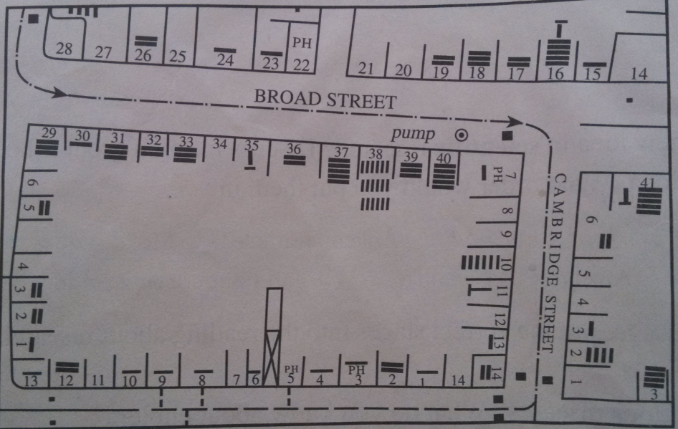
John Snow’s Cholera Map
★
★
★
It seemed the water from the pump was to blame.

Slide 18
Retell the story
Cholera London 1854
John Snow cause Two theories
suspect investigate two streets
mark the death found pump polluted water had handle removed slow down
announce with certainty suggest
not expose people to polluted water
defeated

Slide 19
Next, John Snow looked into the source of the water for these two streets. He found that it came from the river polluted by the dirty water from London.
Here John Snow had shown that cholera was spread by germs and not in cloud of gas.
He immediately told people in Broad Street to remove the handle from the pump so that it could not be used.

Slide 20
What was another supporting evidence?
A woman, who had moved away from…liked the water from…had it delivered to her house…she and her daughter died of cholera.
Here John Snow was able to announce with certainty that polluted water carried the virus.

Slide 21
Complete the passage with proper words, which will help you retell the text.
Seeing that many people _______ cholera, John Snow, a famous doctor, decided to help them. Cholera was a deadly disease of its day. John Snow spent a lot of time ________ to find its cause and its cure. When another outbreak ____ London in 1854, he ________ that most of those who died of cholera lived near a water pump.
died of
trying
hit
found out

Slide 22
He _________ that the water was polluted and told people not to drink it any more. One woman in another part died of cholera after drinking the water. With this extra evidence John Snow was able to announce ______ certainty that polluted water carried the virus. To prevent this ______________ again, John Snow _________ that the source of all the water supplies ____________ (examine) and that no polluted water be drunk. In this way cholera ___________ in the end.
suspected
with
from happening
suggested
be examined
was defeated

Slide 23
COPERNICUS’ REVOLUTIONARY THEORY
Only if you put the sun their did the movements of the other planets in the sky make sense

Slide 24
Yet he could not tell anyone about his theory as the powerful Christian Church would have punished him for even suggesting such an idea. They believed God had made the world and for that reason the earth was special and must be the centre of the solar system.

Slide 25
The problem arose because astronomers had noticed that some planets in the sky seemed to stop, move backward and then go forward in a loop. (Para 2)
rise
raise
arise
arouse
vi. rose ,risen
vt raised， raised
vi. arose arisen
vt.aroused aroused
上升，增加
上升，增加
抚养；
募集；
提出
出现
唤起，激发

Slide 26
rise & raise & arise& arouse
1. Last year, the advertising rate ______by 20 percent.
2. They’ve ______up to 200，000 yuan for the Hope Project.
3. He______ his hat to me as a sign of respect.
4. The birds also attacks crops when the opportunity _______.
5. The people’s living standard has been greatly_________.
6.His lecture was so fascinating that it ________ my
great interest in learning English well.

Slide 27
He placed a fixed sun at the center of the solar system with the planets going round it and only the moon still going round the earth.

Slide 28
高考中with 的考察
1. John received an invitation to dinner, and with his work _______, he gladly accepted it.（2007 安徽）
A. finished B. finishing C. having finished D. was finished
2.----Come on, please give me some ideas about the project.
----Sorry. With so much work _______ my mind, I almost
break down. (2007 福建)
A. filled B. filling C. to fill D. being filled
3. The girl sat there quite silent and still with her
eyes_______on the wall.
A. fixing B. fixed C.to be fixing D. being fixed
4. They pretended to be working hard all night with their
lights____.
A. burn B. burnt C. burning D.to burn

Slide 29
He did not want to be attacked by the Christian Church , so he only published it as he lay dying in 1543. (Para 3)
The book lay open on the table.
lie
lie
lay
lied lied lying
lay lain lying
laid laid laying
撒谎
躺；
位于；
处于（某种状态）
下蛋；
搁置

Slide 30
lie & lay
1.If only he _____quietly as the doctor instructed, he would not suffer so much now.
A. lies B. lay C. had lain D. should lie
2.The girl ______ on the ground _____ to me
that she had _____ the purse on the desk.
A. lying, lay, laid B. lying, lied, laid
C. lie, lied, lay D. lay, lied, lain

Slide 31
3. When she came several days later, she found that all things still ______where she had ______them.
A. lay; laid B. laid; laid
C. lay; lain D. lying; lain
4. A man ______ a hen on the table. The hen _______ on the table quietly. After a while the hen _____ the egg. But the man _____to his wife that the egg was bought in the shop _______in the center of the town.
A. lay B. laid C. lied D. lying

Slide 32
The Christian Church rejected his theory, saying it was against God’s idea and people who supported it would be attacked it. Yet Copernicus’ theory is now the basis on which all our ideas of the universe are built.
赞成者:
赞成：
反对：
be for
applaud
approve of
favor
be in favor of
People in favor of it
People for it
be against
argue against
disapprove of
be opposed to
object to
反对者
People against it
opponent

Slide 33
主张，声称，认为
think
believe
consider
hold the view that
state
maintain
claim
advocate

Slide 34

2002年高考题
最近，你校同学正在参加某英文报组织的一场讨论。讨论的主题是：公园要不要收门票？请你根据下表提供的信息，给报社写一封信，客观地介绍讨论情况。
注意：
1、信的开头已为你写好。 2、词数：100左右。
3、参考词汇：门票：entrance fee
Dear Editor,
I’m writing to tell you about the discussion we’ve had about whether an entrance fee should be charged for parks.
60%的同学认为 | 40%的同学认为
1、不应收门票 2、公园是公众休闲的地方 3、如收票，需建大门、围墙， 会影响城市形象 | 1、应收门票，但票价不宜高 2、支付园林工人工资 3、购新花木

Slide 35
Dear Editor,
I'm writing to tell you about the discussion we've had about whether an entrance fee should be charged for parks(提出问题).
Opinions are divided on the question. 60％of the students are against the idea of entrance fee. They believe a public park should be free of charge. People need a place where they can rest and enjoy themselves. Changing entrance fees will no doubt keep some people away. What is more, it will become necessary to build gates and walls, which will do harm to the appearance of a city.
过渡句
观点一
论据一
论据二

Slide 36
论据一
观点二
On the other hand, 40％ think that fees should be charged because you need money to pay gardeners and other workers, and to buy plants and young trees. They suggest, however, fees should be charged low.
Yours truly
Li Hua
可以看出，这类文章的写作，首先要提出问题，即双方讨论的问题。接下来提出观点一，并用一系列论据进行阐明。说明完观点一之后，再提出观点二，继续用论据进行说明。如果需要说明自己的观点，可接下来说明自己的观点。
论据二

