Slide 1

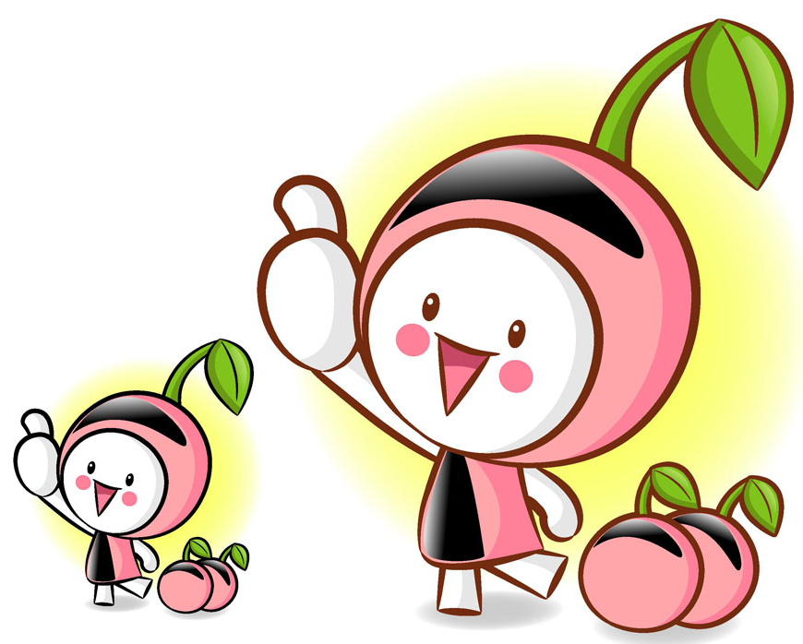
主谓一致

Slide 2
知识网络(见书P229)

Slide 3
熟读深思
My seatmate James, whose parents have been teaching^{［1］} English in Guangzhou for ten years, comes^{［2］} from the United States, which is^{［3］} one of the most developed countries in the world. He as well as his parents enjoys^{［4］} living in Guangzhou because neither James nor his parents find^{［5］} it difficult to adapt to the life in China. In their opinion, many a custom here is^{［6］} easy to understand and ten years is^{［7］} enough for them to get used to all the customs.

Slide 4
I, together with James, extremely like^{［8］} English but physics seems^{［9］} rather difficult for us. Besides, both he and I are^{［10］} very fond of reading story books, and the Arabian Nights is^{［11］} one of the most interesting books that have been read^{［12］} by us. Our class is^{［13］} united as a big family. Now the class are^{［14］} preparing for the coming sports meet, so large quantities of our recent time have been spent^{［15］}on it.

Slide 5
What we need is^{［16］} a qualified coach because being trained properly is^{［17］} of great importance. We each are all aware that each of us plays^{［18］} an important role in our class. We have decided to hold a celebration if getting a good result but when and where we are going to hold it hasn’t been decided. ^{［19］}
汉语译文:我的同桌詹姆士来自世界上最发达的国家之一的美国，他的父母在广州教英语长达十年了。他和他父母一样在广州生活得很开心，因为不管是詹姆士还是他的双亲都不觉得难以适应中国的生活。

Slide 6
他们认为这里的许多风俗习惯都很容易懂，十年的时间足以让他们习惯这里所有的风俗习惯。
我和詹姆士都特别喜欢英语，但是物理对我们而言是相当难的。他和我都喜欢读故事书，《天方夜谭》是我们读过的一本最有趣的书。我们班团结得像一个大家庭。现在，全班同学正在准备即将到来的运动会，所以我们最近的大量时间都花在这上面了。我们需要的是一个合格的教练，因为恰当的训练十分重要。我们大家都认识到我们每一个人都在班集体里扮演着重要的角色。我们决定如果取得好成绩的话就开一个庆祝会，但庆祝的时间和地点还未确定。

Slide 7
熟思深思
1. 语法一致原则，复数主语用复数动词。
2. 语法一致原则，单数主语用单数动词。
3. 意义一致原则，若主语形式上为复数，而意义上是单数，动词要用单数。本句中的the United States虽然形式上是复数，但指的是一个国家，替代它的which作主语，谓语用单数。
4. 语法一致原则， “A as well as /together with /with B”结构在主语位置时，主语是A，因此，谓语动词与A保持一致。

Slide 8
5. 就近原则，由or，either…or，nor，neither… nor，not only…but also，not…but连接的并列主语，通常按照就近一致原则，谓语动词的单、复数形式依照靠近它的主语而定。
6. 语法一致原则，many a(很多)/more than one(不只一个)+单数名词作主语时，谓语动词用单数形式。
7. 意义一致原则，表示时间、距离、金钱、重量、度量、容量、温度等的复数名词做主语，通常看作一个整体，谓语动词用单数形式。
8. 语法一致原则，主语后面接说明主语的修饰语together with，谓语动词不受修饰成分的影响，仍保持同主语一致的关系。

Slide 9
9. 意义一致原则，以-ics结尾表示学科的名词做主语，通常表示单数意义，谓语动词用单数形式。
10. 语法一致原则，当主语是both…and连接的并列结构，如果主语指的是两个或两个以上的人或物，则谓语动词用复数。
11. 意义一致原则，复数形式的专有名词（表示国家、城市、机构、组织以及书籍、报纸、杂志等）作主语，通常作为整体看待，谓语动词用单数。

Slide 10
12. 语法一致原则，one of+复数名词十定语从句”之前有the only，the very，the等限定词时，定语从句的谓语动词用单数形式, 如没有这些限定词和修饰语，定语从句的谓语动词采用复数形式。
13. 意义一致原则，集体名词class如果作整体看待，谓语动词用单数形式。
14. 意义一致原则，集体名词class如果作个别成员看待，谓语动词用复数形式。

Slide 11
15. 当“(large) quantities of+可数或不可数名词”作主语时，谓语动词用复数。
16. 当what引导主语从句，或由 and连接两个动词不定式或动名词作主语时，谓语动词的数应根据意义一致的原则来决定。
17. 语法一致原则，非谓语动词 (动词的ing形式、不定式)作主语时，谓语一般用单数形式。
18. 当“each + of+名词/代词”作主语时，谓语动词用单数形式。
19. 语法一致原则，从句作主语时，谓语一般用单数形式。

Slide 12
主谓一致与高考
1.语法填空中所给动词作谓语时，要考虑主谓一致。
2.短文改错中也常有主谓一致错误。

Slide 14
灵活运用
一、单句填空
1. Either you or the headmaster __ (be) to hand out the prizes to those gifted students at the meeting.
is
谓语与the headmaster一致，故be用第三人称单数is, “be + to do”表示安排好的事。

Slide 15
2. The teacher, with 6 girls and 8 boys of her class, ____________(visit) a museum when the earthquake struck.
was visiting
谓语与the teacher一致，又根据惯用句型结构was /were doing...when...可知，用过去进行时态。

Slide 16
3. Two fifths of the land in that district ___(be) covered with trees and grass.
is
谓语与the land一致，用单数。

Slide 17
4. Nowadays, a large number of women, especially those from the countryside, _____ (work) in the clothing industry.
work
因a large number of(许多)短语作主语，谓语用复数；由nowadays可知，用一般现在时。

Slide 18
5. With more forests being destroyed, huge quantities of good earth ______________ (wash) away each year.
are being washed
因quantities of作主语, 谓语用复数；又需要用被动式，指近些年或近阶段正在发生的事，用现在进行时。

Slide 19
6. He is the only one of the students who _________(be) a winner of scholarship for three years.
谓语应与the only one一致，又由for three years可知用完成时。
7. Every possible means _____________(use) to prevent the air pollution, but the sky is still not clear.
由every可知means是单数, 由语境可知用完成时。
has been
have been used

Slide 20
8. When and where to go for the on-salary holiday _________________ (not, decide) yet.
不定式作主语，谓语用单数；由yet可知用完成时。
9. She has set a new record, that is, the sales of her latest book _____________(reach) 50 million.
主语是复数sales；又由前句的has set可知用现在完成时态。
has not been decided
have reached

Slide 21
10. Professor Smith, along with his assistants, ___________(work) on the project day and night to meet the deadline.
is working
主语Professor Smith是单数，又由语境可知用现在进行时。

Slide 22
was pretending
11. He _______________ (pretend) that a tiger toy was real and giving it a voice.
在主格he后，pretend是谓语动词，又由与之并列的giving可知，是过去进行时，主语是第三人称单数，故填was pretending。

Slide 23
12. “Your father has at last decided to stop smoking.” Jane ______________ (inform).
was informed
在主语Jane后的inform应是谓语动词，Jane与inform是被动关系，要用“be +过去分词”；由语境可知是一般过去时，主语是第三人称单数，故was informed。

Slide 24
二、语篇填空
Our school library, along with many other buildings, is very different from other schools’. There 1 _____(be) two computer rooms, three art rooms, a meeting room and a reading room in the library building. The number of the books 2 ___(be) large, and maybe there are 100,000 books in it. It is said that all the books cost our school 200,000 dollars. Maybe 200,000 dollars 3 ___(be) large to every student.
are
is
is

Slide 25
In the era of knowledge explosion, the number of the students who 4 _____ (have) a thirst for knowledge is increasing day by day. Nowadays, our library has been developed into a multifunctional building. There are 50 computers in it. Many a student 5 _____(like) to surf the Internet at weekends here, and now you can see that my classmates, Mike and John 6 __________ (play) computer games there.
have
likes
are playing

Slide 26
When you turn to another room, you will find that a professor and writer 7 ________ (deliver) a speech. Each boy and each girl 8 __________(focus) on his interesting speech. Every time there is a wonderful speech, the audience always 9 ________(cheer) up. You are entering our art exhibition. A teacher with his students is at the room. On the wall 10 ___(be) 100 pictures, which attract many students. An expert and teacher is explaining something important to us.
is delivering
is focusing
cheer/cheers
are

Slide 27
本文主要介绍学校图书楼功能室以及周末学生在里面的活动情况。
1. are 因there be……句型中be动词常与离其最近的主语保持一致。
2. is 主语是the number of+名词的复数时，谓语动词用单数形式。
3. is 时间、金钱、距离，重量等的复数当一个整体来作主语时，谓语动词用单数。
4. have 关系代词who，that，which等在定语从句中作主语时，谓语动词的数应与句中先行词的数保持一致。
5. likes 因many a+名词作主语时，尽管意义上是复数，但因中心词是单数形式，谓语动词也用单数形式。

Slide 28
6. are playing 两个名词由and连接作主语时, 谓语动词一般用复数。
7. is delivering 当and连接的两个名词是指同一人时，谓语动词应该用单数形式。“a professor and writer”意思是“一个教授作家”。
8. is focusing 用and连接的单数主语，前面有each, every, no等修饰时, 谓语动词要用单数形式。
9. cheer/cheers 集体名词group, class, family, army, audience等作主语时，如果强调集体，谓语动词用单数形式；如果强调个体，谓语动词用复数形式。
10.are 在主谓倒装的句子中，谓语动词的数应与其后的主语保持一致。

Slide 29
三、单句改错
1. Tom have been reading that book all the morning so he is tired now.
have→ has 主语为第三人称单数，与all the morning连用，应为现在完成进行时。
2. As everybody knows, politics are now taught in all schools.
are→ is 以-ics结尾的学科名词，如politics, physics, mathematics等作主语时，谓语动词用单数。

Slide 30
3. Kate, one of my good friends, come from Guangzhou.
come→ comes 主语Kate为第三人称单数，谓语为一般现在时，用comes。
4. As we all know, people speaks English all over the world.
speaks→ speak 因people作“人，人们”讲时，总是以单数形式表示复数概念，因而谓语动词用speak。

Slide 31
5. The teacher, together with his students, are planting trees on the street.
are→ is 当主语后面有as well as, with, along with, together with, but, like, rather than, except等介词或短语介词连接的名词时，谓语动词要与最前面的主语保持一致。因为在英语里，介词短语是不能作主语的，作主语只能是名词、代词，或相当于名词的短语或句子充当。

Slide 32
6. Not only the students but also the teacher wish for a holiday.
wish→ wishes 在not only… but also …, either… or …，neither… nor …等结构中，谓语动词的人称和数常常与动词离得最近的那个主语保持一致。

Slide 33
7. It is the parents and their son that wants to buy the bicycle.
wants→ want 此句为强调句，强调的是主语 the parents and their son，为复数。
8. Many a student have been sent to plant trees.
have→ has 因“many a +单数可数名词”作主语时，从意义上看是复数，但谓语动词常用单数，以便与名词的数一致。

Slide 34
9. Bill was standing at the side of the car, talking to two men who was helping him to repair it.
who was→ who were 因先行词 two men 是复数，从句的主语who是代表先行词的，也是复数，所以定语从句的谓语动词也用复数。
10. To read English aloud every morning do you a lot of good.
do→ does 不定式、动名词，以及从句作主语时应看作单数，谓语动词用单数。

