Slide 1

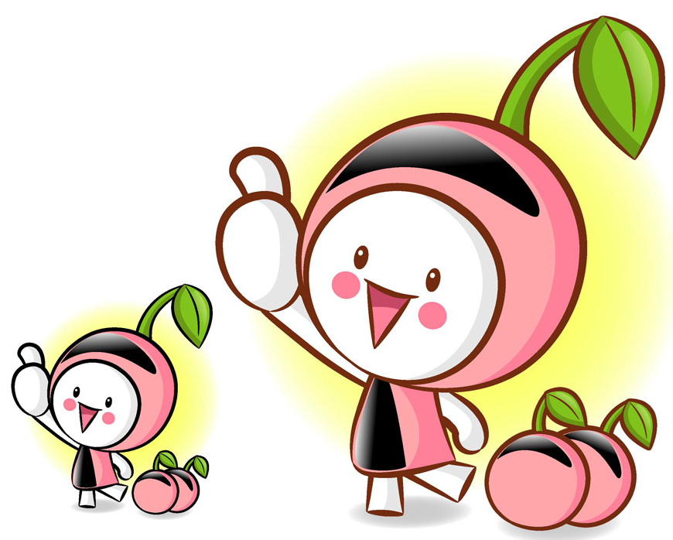
时态语态

Slide 2
注意：
1.不知道或没有必要说明动作的执行者是谁，或者需要突出或强调动作的承受者时，就要用被动语态。
2.只有及物动词才有被动语态。但cost， have, own， lack，agree with，suffer from，belong to，consist of等及物动词或及物的短语动词也没有被动语态。

Slide 3
3.像happen， occur, come about, take place等不及物动词是没有被动语态的。
4.带有介词的短语动词的被动语态，不
要漏掉介词。如：
The children will be looked after well here.这些孩子在这里将受到很好的照顾。

Slide 4
5.以下情况常用主动形式表示被动含义：
⑴ 系动词feel， look， seem， appear， taste， sound， smell， prove， remain等用主动形式表示被动意义，主语通常是事物。如：
The material feels very soft.这种料子摸起来很柔软。

Slide 5
⑵ write， read， clean， sell， wash， cook， open， close， lock等的否定式或与well， badly， easily等副词连用，主语由内在品质或性能使谓语得以实现或不能实现时。如：
The book sells well.那本书很畅销。
⑶ cook， bake， make， print， pack， work out等动词用于进行时态时。如：
The fish is cooking.鱼正在煮。

Slide 6
熟读深思
My dear classmates,
I am Lin Fan, chairman of student union. I am writing^{［1］} to draw your attention to some improper behaviour in our campus: littering and scribbling. It has been making^{［2］} our school dirty and unpleasant. I always feel ashamed^{［3］} whenever I see this. It is clearly not appropriate for a student to litter and scribble about. Last week, the student union held^{［4］} a meeting to seek some solutions to these problems.

Slide 7
We were having^{［5］} a heated discussion when our headmaster came and joined us. After the meeting, the headmaster said that the school had made^{［6］} efforts to improve this situation and more dustbins would be placed^{［7］} around. Recently, the student union has set up^{［8］} specific rules against such behaviour. At the same time, all of us should develop good habits and better behave ourselves. We believe that, with the joint efforts of both teachers and students, our school will become^{［9］} a more enjoyable place in the near future.
Yours faithfully,
Lin Fan

Slide 8
汉语译文：大家好，我是学校学生会主席李帆，今天写信的目的是希望大家对校园的一些乱扔垃圾以及随意涂写等不文明行为引起关注。这些行为严重影响大家的学习环境。显然，作为一名学生在校园乱扔乱涂是不对的，我也经常对某些同学的不文明行为感到羞愧。上周, 学生会开会探讨一些可行措施，期间，校长也抽空加入我们。会后，校长表示学校已经就改善校园环境做出努力，并承诺将在校园设置更多的垃圾箱。近期，学生会也制定了一些相关规章。同时，大家必须做好自己并养成良好的习惯。我们相信，在全体师生的共同努力下，我们的校园环境一定会变得更好。

Slide 9
熟读深思
1.现在进行时，表示现在正在发生的动作。
2.现在完成进行时，表示过去就开始一直延续到现在并有可能继续下去的动作。
3.一般现在时。经常性或习惯性动作。
4.一般过去时。在过去某个时间里（last week 上周）所发生的动作。
5.过去进行时，在过去某一时间正在进行的动作。

Slide 10
6.过去完成时，表示在过去某一时刻或动作之前已经完成了的动作，即“过去的过去”。
7.过去将来时，表示从过去某一时间来看将要发生的动作或将要存在的状态。另外此处主语dustbins为动作的承受者，所以用被动语态。
8.现在完成时，表示过去发生的某一动作对现在造成的影响或结果。
9.一般将来时，表示在将来某一时刻要发生的动作或存在的状态。

Slide 11
时态语态与高考
1. 在语法填空中，动词的时态是必考内容。其中，最有可能考的是一般过去时或者是主语是第三人称单数的一般现在时态，以及现在进行时、过去进行时和一般将来时。
被动语态是可能要考的内容，特别是一般现在时或一般过去时的被动语态。

Slide 12
2.短文改错最可能考查上下文时态不一致，也可能考被动语态漏掉be或过去分词拼写错误。
3.若掌握好被动语态，在写作中适当运用，可使句子更加多样化，有时甚至会令句子更加自然、生动。
注意，在语法填空中，如括号中所给词是动词，可能是考时态语态，可能是考非谓语动词，也可能是考词类转换，要根据句子成分去判断。

Slide 13
在确定谓语动词的时态时，我们可从三个方面来进行判断：
⑴ 看句子中的时间状语或时间状语从句。
⑵ 看上下文的谓语动词的形式。

Slide 14
⑶ 看是否是特殊的句型。如：
① was/were about to do…when…did
② It is/has been +时间段+since 从句(一般过去时)
③ It had been +时间段+since 从句(过去完成时)
④ It will be +时间段+before 从句(一般现在时)

Slide 15
⑤ It/This/That is the first time that… have/ has done…
⑥ It/This/That was the first time that…had done…
⑦ Hardly had +主语+done…when…did…
⑧ No sooner had +主语+done…than…did…
这样的句型还有很多，平时要注意积累。

Slide 16
灵活运用
一、单句填空
1. The sun was setting when my car ______ (break) down near a remote village.
broke
该空是when 引导的时间状语从句主语my car的谓语。从句中没有时间状语或时间状语从句, 但主句的谓语动词was setting用了过去进行时, 同时此句也是一个特殊的句型：...was/were doing... when... did...此句型中的when 意为at that time, 因此可判断此谓语应用一般过去时。此外, 主语my car 与谓语之间的关系是主动关系, 同时主语也是单数。综合考虑可得此题答案为broke。

Slide 17
2. This proverb is saying we have to let things go in their natural course. Being too anxious to help an event develop often _______ (result) in the contrary to our intention.
results
空格处是主语Being too anxious to help an event develop的谓语, 本句的状语是often, 上句的谓语is saying是现在进行时, 可知此句谓语应用一般现在时。此外, 主语与谓语result in(导致)之间的关系应为主动关系, 同时, 主语是动名词短语,谓语动词应用单数。因此, 此题答案应为：results。

Slide 18
pushed
3. People stepped on your feet or ________ (push) you with their elbows, hurrying ahead to get to a bargain.
3. 主语people的谓语, 上文的并列谓语是stepped, 可知时态, 语态与主谓一致。因此, 此题的答案应为：pushed。

Slide 19
4. Her mother was excited. “Your father has at last decided to stop smoking, ” Jane ____________ (inform).
was informed
后空是主语Jane的谓语,上文的谓语was
是一般过去时, 此外, 主语Jane与谓语inform(告知)之间的关系是被动关系(被
告知), 同时主语Jane是单数。因此, 此题
答案应为：was informed。

Slide 20
5. I got on the bus and found a seat near the back and then I noticed a man sitting
at the front. He ______________ (pretend) that a tiger toy was real and giving it a voice.
was pretending
该空是主语 He 的谓语, 上句谓语是got, found和noticed, 本句后有并列谓语动词giving, 可知本句谓语应用过去进行时。主语与谓语应为主动关系, 主语也是单数。因此, 此题答案应为：was pretending。

Slide 21
6. I’ll go to the library as soon as I finish what I ________ (do).
am doing
句意是：我一完成我做的工作就去图书馆。由于“去图书馆”用的是一般将来时,说明要完成的工作是“现在”正在做的事情, 故用现在进行时。

Slide 22
7. It is the most instructive lecture that I ____________(attend) since I came to this school.
have attended
当一个受最高级形容词修饰的名词受到定语从句的修饰时，该定语从句既可用一般过去时，也可用现在完成时，但由于其后接了一个since引导的时间状语从句，故空格处应填现在完成时。

Slide 23
8.In the last few years thousands of films __________________(produce) all over the world.
have been produced
时间状语in the last few years通常要与现在完成时连用。

Slide 24
9. By the time Jack returned home from England, his son _____________(graduate) from college.
显然，儿子大学毕业在先, 杰克返回家在后。而“返回”家用的是一般过去时（returned）, 故儿子大学毕业要用过去完成时（had graduated）。
had graduated

Slide 25
10. Barbara is easy to recognize as she’s the only one of the women who _____ (wear) evening dress.
wears
根据句意, 此处谈的是一般情况, 要用一般现在时; 由于one of the women前有only修饰, 说明其后的定语从句是修饰one的, 而不是修饰women的, 所以定语从句中的谓语动词要用单数; 故填wears。

Slide 26
11. All visitors to this village ______ (treat) with kindness.
are treated
根据句意可知, visitors (游客) 与treat(对待)之间为被动关系, 故用被动语态; 由于句中没有相应的过去时间, 故用一般现在时。句意为: 所有来访这个村庄的客人都会受到友好对待。

Slide 27
二、语篇填空
How have you managed not to take a drink for almost 20 years? It 1 _____ (take) me almost 20 years to have the courage to even ask my father this very personal question. When Dad first quit drinking, the whole family was on pins and needles every time he got into a situation that, in the past, 2 _________________ (start) him drinking again. For a few years we were afraid to bring it up for fear the drinking 3 ________ ______(begin) again.
took
would have started
would
begin

Slide 28
“I had this little poem that I would recite to myself at least four to five times a day,” was Dad’s reply to my 18-year-old unasked question. And then he 4 _______(share) the poem with me.
About a month after this talk with my father, when I 5 __________(have) a rest, I received a gift in the mail from a friend of mine. It was a book of daily affirmations with one affirmation listed for each day of the year.
shared
was having

Slide 29
It 6 ________ (be) my experience that when you 7 ____ (get) something with days of the year on it, you 8 ________(turn) to the page that lists your own birthday.
I hurriedly opened the book to November 10 to see what words of wisdom this book had in store for me. There, on my birthday, was the exact same poem that 9 __________ (help) my father for all these years! It 10 __________(call) the Serenity Prayer.
has been
get
will turn
had helped
is called

Slide 30
本文讲述一位十八岁的儿子鼓起勇气问出了近二十年来怀揣的关于父亲如何戒酒成功近二十年的问题，最后从一本朋友送的书上在自己生日对应的那一页看到了父亲戒酒期间鼓励自己的祷告，体现了父亲为了儿子而戒酒的浓浓的父爱。
1. took 从下文“For a few years we were afraid to…”的“were”可知，此处应该用一般过去时。
2. would have started 从上文 “every time he got into a…”的谓语动词的过去式可知，此处表达的是过去肯定将会已经发生的事情。整句大意为：“当父亲初戒酒时，每当他陷入一种过去会让他再次喝酒的情景时，整个家庭就会坐立不安。”

Slide 31
3. would begin 从句无谓语动词，且从上文“we were afraid to bring it up for fear” 谓语动词were可知，此处缺少一个表示过去将来的谓语动词。
4. shared 本句无谓语动词，从上文的时间副词 “then” 可知，此处应为一般过去时。
5. was having 由when 引起的时间状语从句中从句部分无谓语动词，故have在本句应做谓语动词，又从主句的谓语动词received可知，当时作者应该是正在休息时，收到礼物，综合以上，故此处应该填动词的过去进行时，表示过去正在进行的动作。

Slide 32
6. has been 此句为it引导的形式主语从句，be在主句中做谓语动词；由下文的 “ my experience”可知这样的事情已经发生多次，已成经验，故用完成时态。
7. get 由when引起的从句缺少谓语动词，再从原文可知，这里表达的是一件经常发生的事情，故用动词的一般现在时。
8. will turn 由when引起的时间状语从句中，从句的谓语动词get用一般现在时，主句就会用一般将来时，表示将要发生的动作。

Slide 33
9. had helped 由于主句there+ be 句式的谓语动词be用过去时，而以the poem为先行词的定语从句中的从句无谓语动词，需要一个表示发生在主句谓语动作发生前的动作，动作发生在过去的过去，故用过去完成时。
10. is called 句子无谓语动词，故call应作句子的谓语；而it与call之间是被动关系；文中讲的是书名，应为客观存在的事实，故答案为is called。

Slide 34
三、单句改错
1. It is the first time that he talked with his father face to face.
talked→ has talked 在It is the firs/ second/ third time that sb. have/has done sth (某人第几次做某事)句型中，that后面的谓语动词用现在完成时。
2. The vase isn’t belong to him.
isn’t →doesn’t 因belong to 短语是行为动词，其否定式是在其前面加doesn’t；该短语也不能用于被动结构。

Slide 35
3. She insisted that she organized the trip on her own.
organized →organize 因insist 表示“坚持要求”时，其后that从句的谓语用 “(should) do sth”。
4. In the last twenty years, great changes have been taken place in our country.
去掉have后的been 因表示“发生”的take place, happen, occur, come about等都不能用于被动语态。

Slide 36
5. As time go by, online shopping is becoming more and more popular.
go→ goes 主语是time，为第三人称单数，谓语动词go也用第三人称单数goes。
6. Ever since middle school, my sister Wang Wei and I dreamed about taking a great bike trip.
在dreamed前加上have 因Ever since 短语作状语，句子的谓语动词用现在完成时。

Slide 37
7. Hardly I sat down when I heard the shocking news.
在I前加had 因hardly had sb. done… when sb. did.(刚……就……)是固定句型。
8. The book has translated into thirty languages since it came on the market in 1973.
在translated前加been 因主语the book 与translate之间是被动关系，用被动语态。

Slide 38
9. In the last few years, thousands of films have produced all over the world.
在have后加been 因in the last few years 常与现在完成时连用，而films与produce是被动关系，故用现在完成时的被动语态。
10. Last month, the Japanese government expressed their thanks for the aid they received from China.
在received前加had 因“接受援助”在“表达感谢”之前，即“接受”是过去的过去，要用过去完成时。

Slide 39
11. The old man is happy because he is well taken care.
在care后加of 因take care of才能表达“照顾”之意，注意，这类含介词的短语在被动语态中不要漏掉后面的介词。
12. The new teaching building was builded last year.
builded→ built 因为build的过去分词是built，不规则变化。

