Slide 1
take part in
take part in 意为“参加，参与（某事物或某活动，如movement, revolution, meeting, conference, conversation, war等）”。
强调集体性的事业、工作或活动，突出参加者在其中发挥一定的作用。
1. Switzerland didn‘t take part in this war.
2. How many countries will take part in the World Cup? 有多少个国家要参加世界杯？

Slide 2
join
join意为“参加（某组织），加入（某处任职），参加到某个人群中去，从而成为其中一员”。
She joined a health club.
她参加了一个健身俱乐部。
We both joined the Labor Party.
我们俩都加入了工党。

Slide 3
join in
join in sth. / doing sth.意为“参加”，后接宾语一般表示竞赛、娱乐、游戏等活动的名词或V-ing。
Can I join in the game?
我可以参加这个游戏吗？
They all join in singing the song.
他们一起唱这首歌。

Slide 4
participate in
participate ：正式用词，特指参加团体活动，暗示以一个积极的角色参加。
Several experts will participate as technical advisers．
几位专家将作为技术顾问参加。
How many people participated in the opening ceremony?

Slide 5
attend
attend 表示在某种比较正式的场合出现。
例如，上课，会议等。
attend a meeting/ party/wedding /attend school/university
①He did not attend the meeting yesterday.
② Our teacher suggested that he attend a technical school.

Slide 6
attend〓侧重参加或出席会议或学术活动
join〓普通用词，指加入党派、团体或游戏活动
participate〓正式用词，特指参加团体活动，暗示以一个积极的角色参加。
take part in〓侧重参加某项群众性、集体性的事业、工作或活动，突出参加者在其中发挥一定的作用。

Slide 7
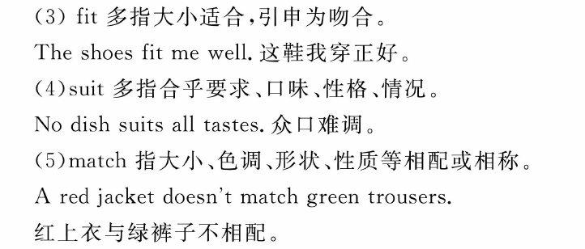

Slide 8
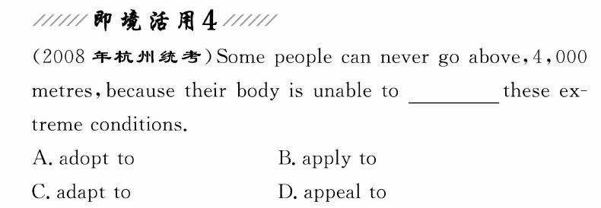
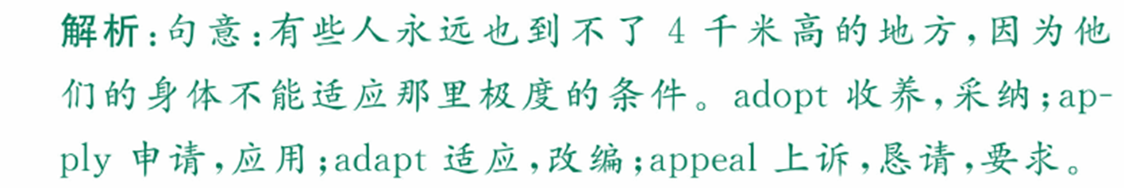

Slide 9

(sb.)
prefer sth.
-----Would you like meat or fish?
-----I'd prefer meat.

Slide 10
prefer sb. to do sth.
｛
prefer doing sth.
I prefer to go swimming in hot summer.
I prefer going swiming in hot summer.

Slide 11
prefer A to B
eg:
I prefer apple to mango.

Slide 12
prefer doing A to doing B
eg: 比起上课， 我更喜欢看电视。
I prefer watching TV to having classes.

Slide 13
prefer to do sth. rather than (to) do sth.
She prefers to die rather than become traitor.
她宁死也不做叛徒。
rather than 也可以至于句首：
Rather than buy a car of his own, he prefers to rent one.

Slide 14
than 后也可用动名词：
I prefer to stay at home rather than
go / going to see a film.
prefer that
eg:我觉得还是让别人来做比较好
I prefer that someone else should do this.

