Slide 1
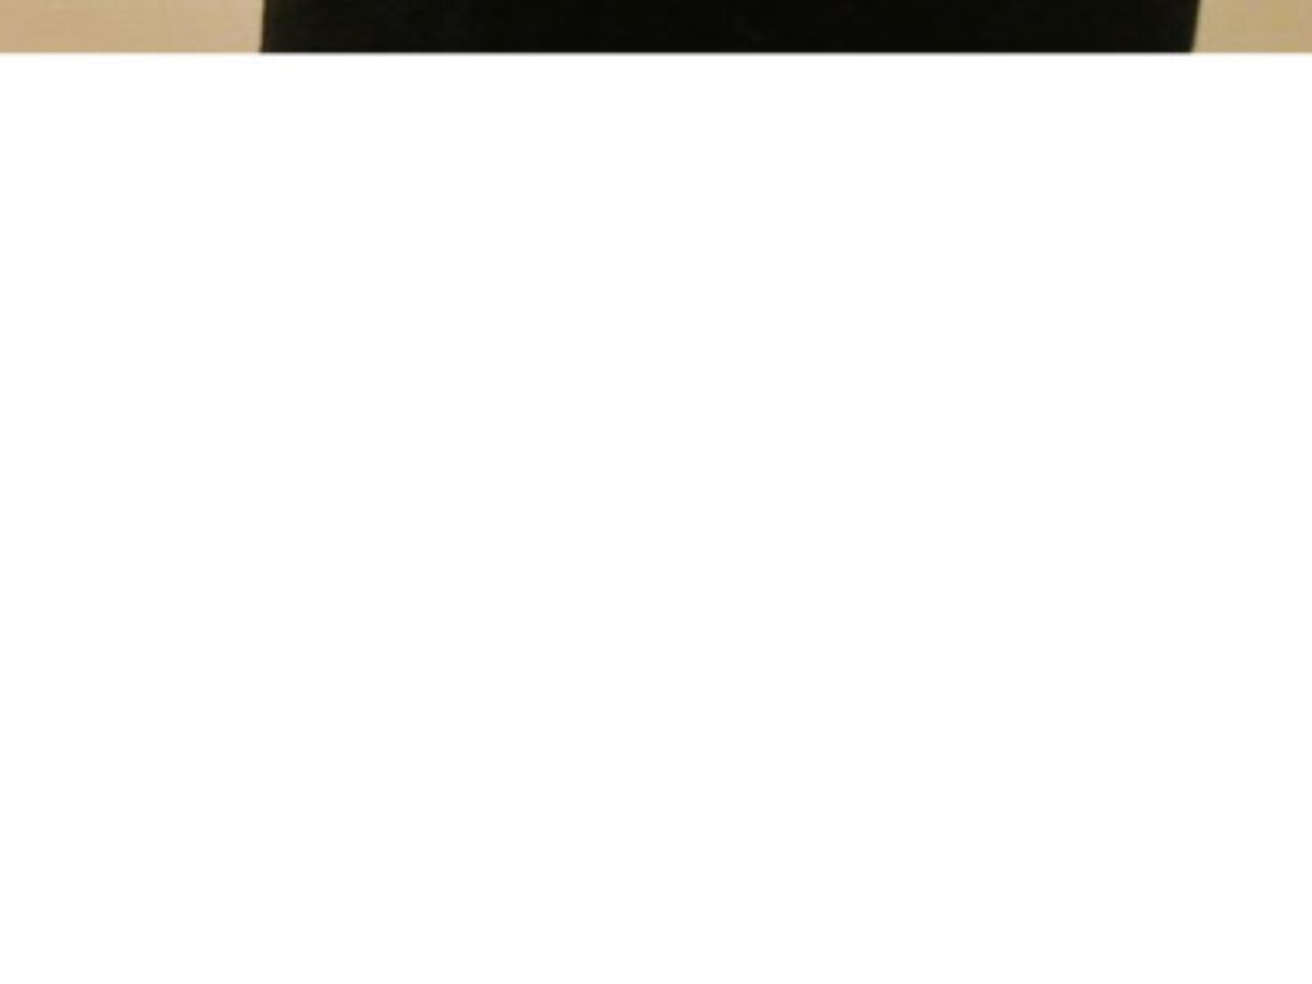
be supposed to do sth
被期望做……; 应该……
you're supposed to tell the teacher if you want to leave the classroom.
be supposed to be sth
被相信是；被认为……
The castle is supposed to be haunted (闹鬼的).
suppose (that)
猜测；认为
Do you suppose (that) Gillian will marry him?
suppose…
假定；假设
Look, suppose you lost your job tomorrow, what would you do?
supposed adj. 据说的，假定的

Slide 2
delighted with sth
We're delighted with our new house.
我们对新房子非常满意。
delighted by/at sth
I was delighted at/by your news.
你带来的消息让我很高兴。
delighted that…
I'm absolutely delighted that you can come.
你能来我特别高兴。
delighted to do sth
We'd be delighted to come to dinner on Friday.
我们很愿意来参加星期五的晚宴。

Slide 3
assist (sb) with/in
You will be expected to assist the editor with the selection of illustrations for the book.
希望你能帮助编辑为本书挑选插图。
The army arrived to assist in the search.
军队赶到协助搜寻。
assistant
n. 助手；助理；售货员
assistance
n. 帮助；援助

Slide 4
be concentrated on/in/around
Italian industry is concentrated mainly in the north of the country.
意大利的工业主要集中在该国北部。
concentrate on
集中；全神贯注于
The company is concentrating on developing new products.
公司正在集中力量开发新产品。
concentrated
adj. 浓缩的；全神贯注的
He made a concentrated effort to improve his work.
他集中精力改进自己的工作。

Slide 5
assess what/how etc + clause
We need to assess whether the project is worth doing.
我们需要评估一下这个项目是否值得去做。
assess sth at
They assessed the cost of the flood damage at £1500.
他们估定洪水造成的损失为1500英镑。
assessment
n. 评估；估价
Would you say that is a fair assessment of the situation?
你认为那是对形势的合理评估吗？

Slide 6
inform sb (of/about sth)
Why wasn't I informed about this earlier?
为什么不早点儿将这事通知我？
Please inform us of any change of address as soon as possible.
地址如有变更，请尽早通知我们。
inform sb that…
I informed my boss that I was going to be away next week.
我告诉老板下周我不在。

Slide 7
accuse sb of (doing) sth
Are you accusing me of lying?
你是在指责我撒谎吗？
He's been accused of robbery/murder.
他被指控犯有抢劫／谋杀罪。
stand accused of sth
被正式指控
The government stands accused of eroding freedom of speech.
政府受到侵犯言论自由的谴责。

Slide 8
demand sth
I demanded an explanation.
我要求给我一个解释。
demand to do sth
I demand to see the manager.
我要求见经理。
demand that…
She demanded that he return the books he borrowed from her.
她要求他把从她那里借走的书还回来。

Slide 9

Quiz I: Fill in the blanks.
1. I was _________ (very pleased) at/by
your news.
2. I think you showed __________ (值得赞
扬的) self-control in your answer.
3. It's un_____ to have an adult conversation
like that with such a young child.
4. The army arrived to _____ (help) in the
search.
5. You must ________ (offer) your
application before January 1st.

Slide 10
6. Chris, you're a nurse, so can I ask your
___________ (专业的) opinion on
bandaging ankles?
7. She sounded very ______ (热切的) to
meet you.
8. Most of the country's population is
___________ (聚集) in the north.
9. This tennis tournament is open to both
a________ and professionals.
10. We should ________ (取得) more
firsthand information.

Slide 11
11. Examinations are not the only means
of as_______ a student's ability.
12. There's no way I can meet that
________ (最后期限).
13. "It wasn't my fault." "Don't worry,
I'm not ________ (指责) you."
14. I'm sure he says these things
__________ (intentionally) to annoy me.

Slide 12
15. Many experts remain _________
(doubting) about/of his claims.
16. I feel so ______ (内疚的) about
forgetting her birthday.
17. She faces the di______ of disobeying
her father or losing the man she loves.
18. She was only 19 when her first novel
was _________.

Slide 13
Quiz I: Fill in the blanks.
delighted
1. I was _________ (very pleased) at/by
your news.
2. I think you showed __________ (值得赞
扬的) self-control in your answer.
3. It's un_____ to have an adult conversation
like that with such a young child.
4. The army arrived to _____ (help) in the
search.
5. You must ________ (offer) your
application before January 1st.
admirable
unusual
assist
submit

Slide 14
6. Chris, you're a nurse, so can I ask your
___________ (专业的) opinion on
bandaging ankles?
7. She sounded very ______ (热切的) to
meet you.
8. Most of the country's population is
___________ (聚集) in the north.
9. This tennis tournament is open to both
a________ and professionals.
10. We should ________ (取得) more
firsthand information.
professional
eager
concentrated
amateurs
acquire

Slide 15
11. Examinations are not the only means
of as_______ a student's ability.
12. There's no way I can meet that
________ (最后期限).
13. "It wasn't my fault." "Don't worry,
I'm not ________ (指责) you."
14. I'm sure he says these things
__________ (intentionally) to annoy me.
assessing
deadline
accusing
deliberately

Slide 16
sceptical
15. Many experts remain _________
(doubting) about/of his claims.
16. I feel so ______ (内疚的) about
forgetting her birthday.
17. She faces the di______ of disobeying
her father or losing the man she loves.
18. She was only 19 when her first novel
was _________.
guilty
dilemma
published

