Slide 1
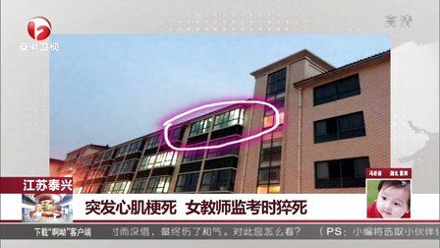
What’s on the news?
A middle school invigilator (监考人) in Taixing, East China's Jiangsu province, died of a heart attack while she was watching over an examination.

Slide 2
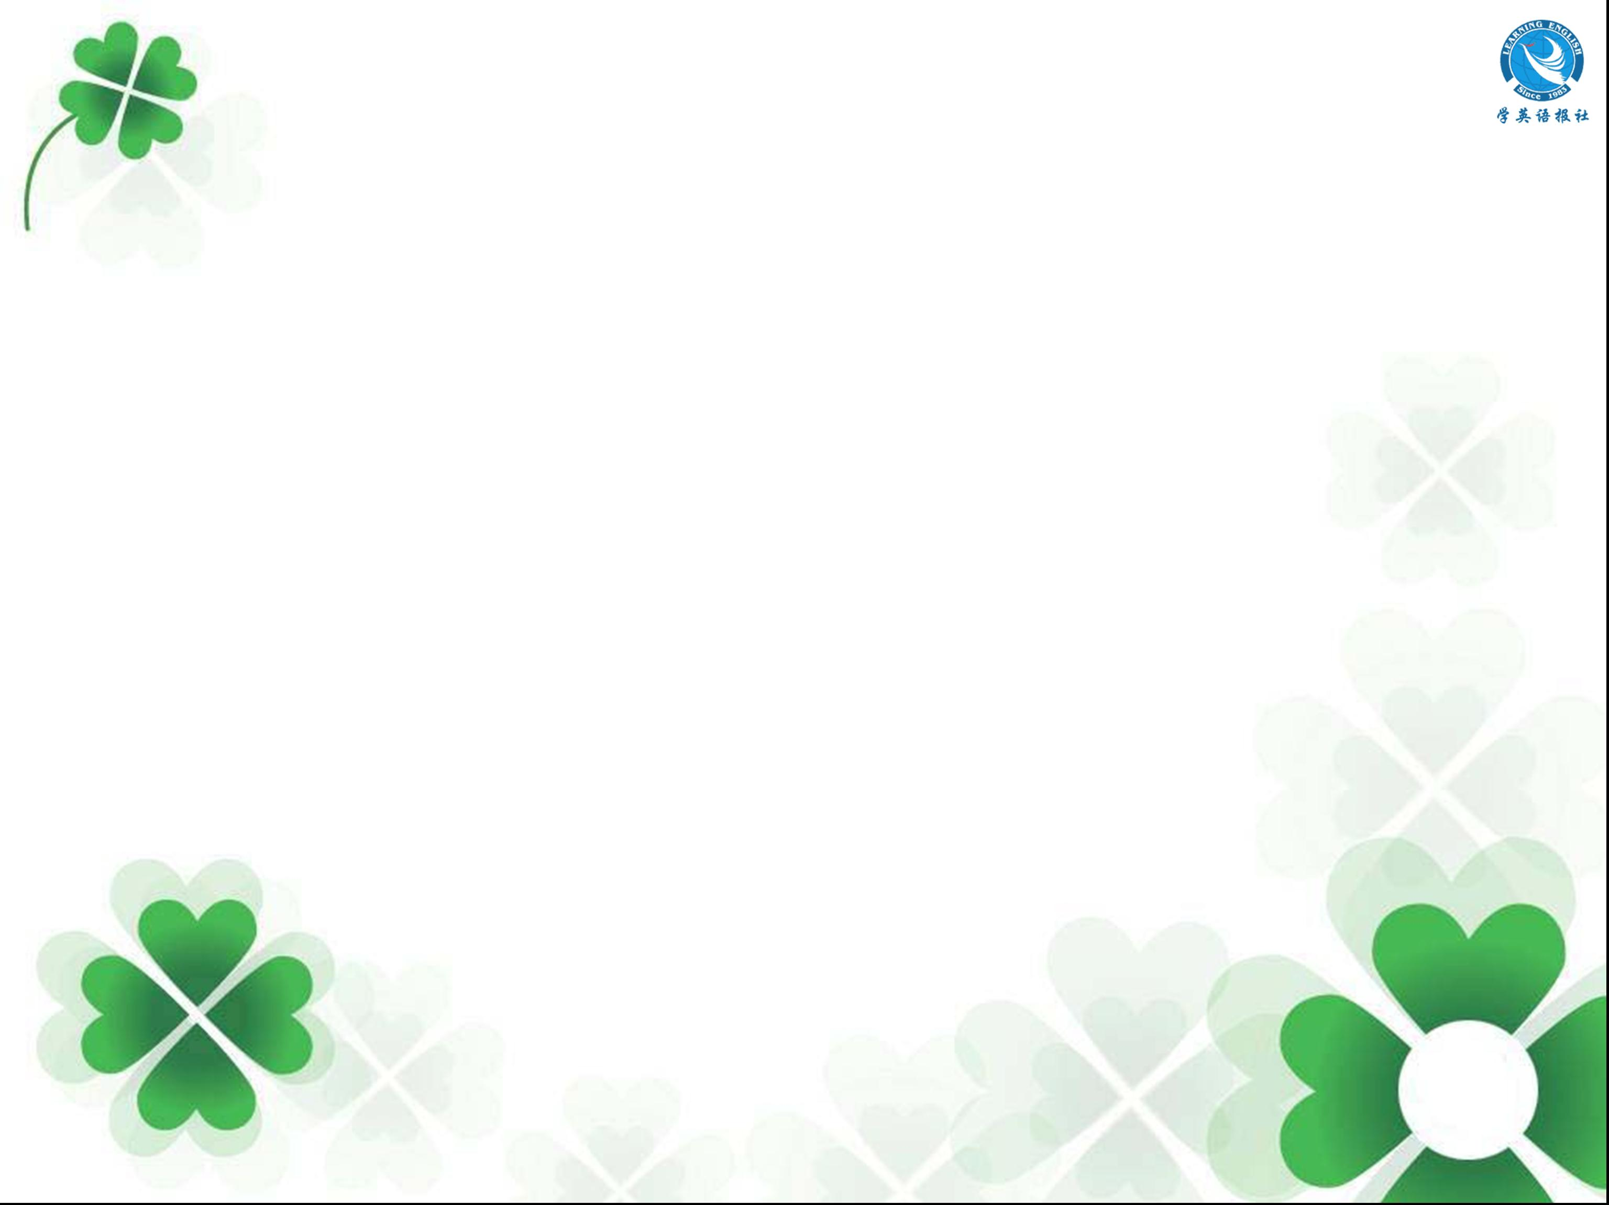
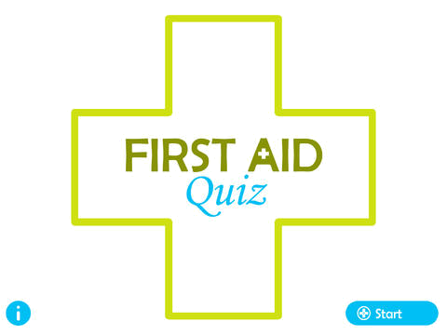

First Aid Quiz

Slide 3

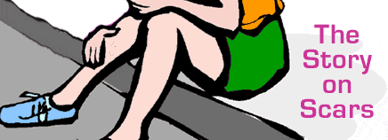


The best way to treat a sprained ankle is to __________.
A. put an ice pack on your ankle
B. put a heating pad (垫子) around your
ankle
C. keep on walking and jumping

Slide 4
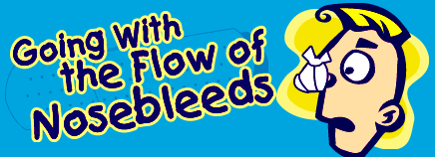
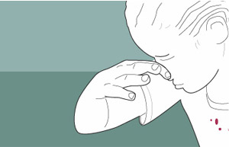
2. If you get a nosebleed, gently let your
head back to stop the bleeding.
A. True.
B. False.
This may make blood run down the throat and cause choke.

Slide 5
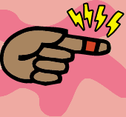
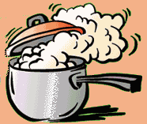
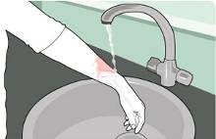
3. To treat a burn, you should _______.
A. rub (擦) some butter on it
B. hold the burnt part under cold
running water
C. put salt on the burnt part

Slide 6
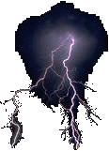
4. You should wait at least five minutes
before touching somebody who has
been struck by lightning, or you might
get a shock (打击).
A. True.
B. False.
The human body does not store electricity, so it is perfectly safe to touch someone who has been struck by lightning. You cannot be electrocuted (触电致死) when administering first aid or CPR to a lightning-strike victim.

Slide 7
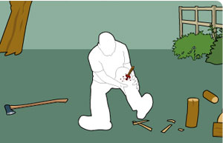
5. What will you do first for the casualty
(伤者)?
A. Remove the wood from his leg as
soon as possible.
B. Stop the bleeding.
C. Get him to hospital straight away.

Slide 8
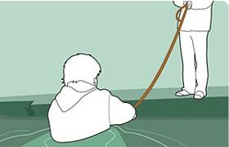
6. If someone is drowning and calling for
help, which of the following is your
priorities?
A. Jump in the water to rescue them.
B. Throw them a line from the bank.
C. Wait for an ambulance to arrive.
Jumping in the water to rescue them may put you at risk. You should throw them a line from a bank as this ensures that you don't become a casualty yourself.

Slide 9
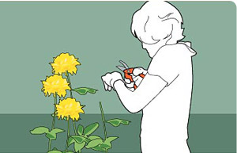
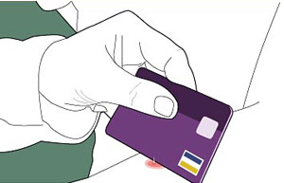
7. Your friend is stung by a wasp (黄蜂).
The sting is visible on her skin. What
would you use to remove the sting?
A. A blunt-edged object.
B. A pair of tweezers (镊子).
C. A needle.

Slide 10
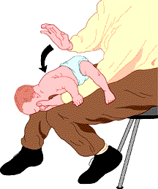
8. To treat a choking baby, you should
make him/her spit by slapping (拍打)
him/her on the back.
A. True
B. False

Slide 11

Assessment of results
All correct: Congratulations! You have a good knowledge of first aid. You may become a first aid expert in the near future.
4～7: You have some knowledge of first aid, but you should work harder and learn more about it.
0～3: It seems that you are not interested in first aid. If an emergency happens to the people around you, you will have some trouble in helping them.

