Slide 1


Check your answer!
What’s the main purpose of the passage?
A. To explain the three types of burns.
B. To show the symptoms of burns.
C. To tell us the causes of burns.
D. To tell us what to do if someone gets
burnt.

Slide 2


True or False.
1. Our skin has three layers.
2. We will never get burned by the sun.
3. Burns are divided into three degrees according to the degree of pain.
4. Third degree burns are the most painful ones.
5. We need to cool burns with icy water.
6. Don’t rub the burns.
7. Under certain circumstances we can put
butter oil or ointment on burns.
8. If burns are on the face, the victim should
sit up.
depending on which layers of the skin are burned.
have little or
no pain if nerves are damaged.
cool
Never

Slide 3

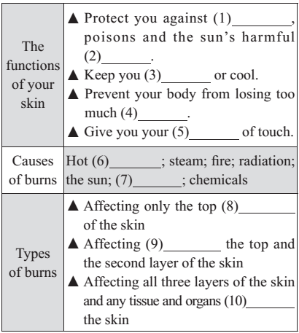
Quiz: Task-based reading.
diseases
rays
warm
water
sense
liquids
electricity
layer
both
under

Slide 4
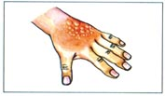

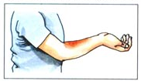

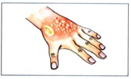
Types of burns
Characteristics of burns
First degree burns
black and white and charred;
swollen; often tissue under them can be seen;
little or no pain
the top and the second layer
Second degree burns
rough, red and swollen; blisters;
watery surface;
extremely painful
the top layer
Third degree burns
dry, red and mildly swollen;
mildly painful
all three layers

Slide 5

First aid treatment
Dos
Take off
1. ________ clothing and jewellery near the burn.
2. _____ burns immediately with cool but not icy
water.
3. ______ cool, clean wet cloths on the burns.
4. ____ the burned area gently.
5. ______ the burned area with a dry clean bandage.
6. If burns are on arms or legs, _____ the burned
area ______ than the heart, if possible. If burns
are on the face, the victim should ______.
7. _____ the victim ___ the doctor or hospital at once,
if the injuries are second or third degree burns.
Cool
Place
Dry
Cover
keep
higher
sit up
Get
to

Slide 6
Don'ts
Do not _______ the clothing that is
stuck to the burns.
2. Do not cool the burns with _____ water.
3. Do not put cold water on _____ degree burns.
4. Do not ____ the burns, it may break the blisters.
5. Do not ____ butter, oil or ointment on burns.
remove
icy
third
rub
put

Slide 7
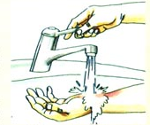
Jigsaw Retelling
Each group need to retell one part according to the mind map.
hot liquids, steam, fire, …
1 act as …
against …
2 keep …
warm or
cool
3 prevent …
from
4 Give …
sense of
touch
if your skin
gets burned
2.
Causes of burns
1.
The functions of the skin
3.
Types of burns
First degree burns …
Second degree burns
…
Third degree burns
…
First Aid for Burns
5.
First aid treatment
4.
Characteristics of burns
remove, cool, place, squeeze, dry, cover, keep, get …

Slide 8
Answer the questions.
p35 3
Because the cold water stops the burning
process, stops the pain and reduces the
swelling.
1. Why should you put cold water on a
burn?
2. Why doesn’t a third degree burn hurt?
3. Why do you think clothes and jewellery
near burns should be removed?
4. If someone has a third degree burn,
why might you see tissue?
Because in a third degree burn the nerves
have been damaged. If there are no
nerves, there is no pain.
Because bacteria from the clothes and
jewellery could infect the burns.
Because all the layers of the skin have been
burnt showing the tissue underneath.

Slide 9

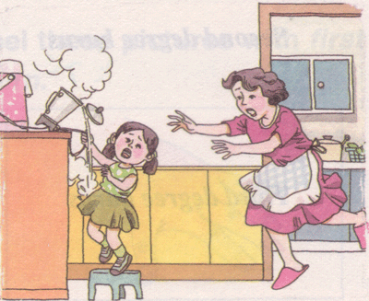
Steam rose from the boiling kettle.
Look at the picture and then answer the questions.
1. What can we see in this
picture?
running towards the girl
looking anxious
and horrified
pull an electrical cord (电线)
stand on a stool
water pouring out of the kettle onto the girl
a seat without any support for the back or arms: 凳子

Slide 10
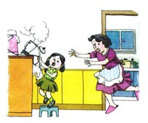
2. What has happened to the little girl?
3. What sort of injuries will the child have?
4. What kind of first aid would you
perform in this situation?
The child has pulled boiling water onto herself.
She will have bad burns.

Slide 11

1. For second degree burns, keep cloths cool by putting them back in a basin of cold water, squeezing them out and placing them on the burned area over and over again
for about an hour until the pain is not so bad.
in relation to sb. or sth.
对于，关于；
by后接三个v-ing短语作方式状语
to get liquid out of something by pressing or twisting it hard 挤出
happening or done many times 反复；多次
used to show an amount of time
(表时间)达，计
时间状语从句
对于二度烧伤，要保持湿布清凉，需把湿布放回冷水盆中，拧出水后再放在烧伤面上，这样要反反复复地做一个小时左右，直到不太痛时为止。

Slide 12
条件状语从句
2. If the injuries are second or third degree
burns, it is vital to get the victim to the doctor or hospital at once.
it is + adj. + to do sth. 结构
immediately 立刻，马上
it是形式主语，真正的主语是to get the victim to the doctor or hospital at once。
如果属于二度或三度烧伤，就必须立即把患者送去看医生或送往医院。

Slide 13
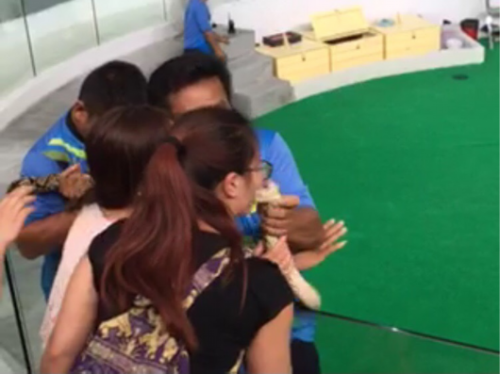
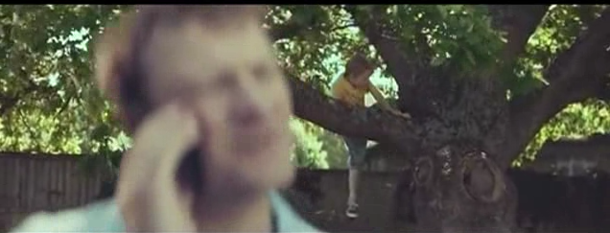

Accidents will happen.
Snake bite hurts Chinese tourist
You can be the difference between life and death.
It is of great importance to learn about some knowledge of first aid in daily life.

