Slide 1
First Phase test

Slide 2
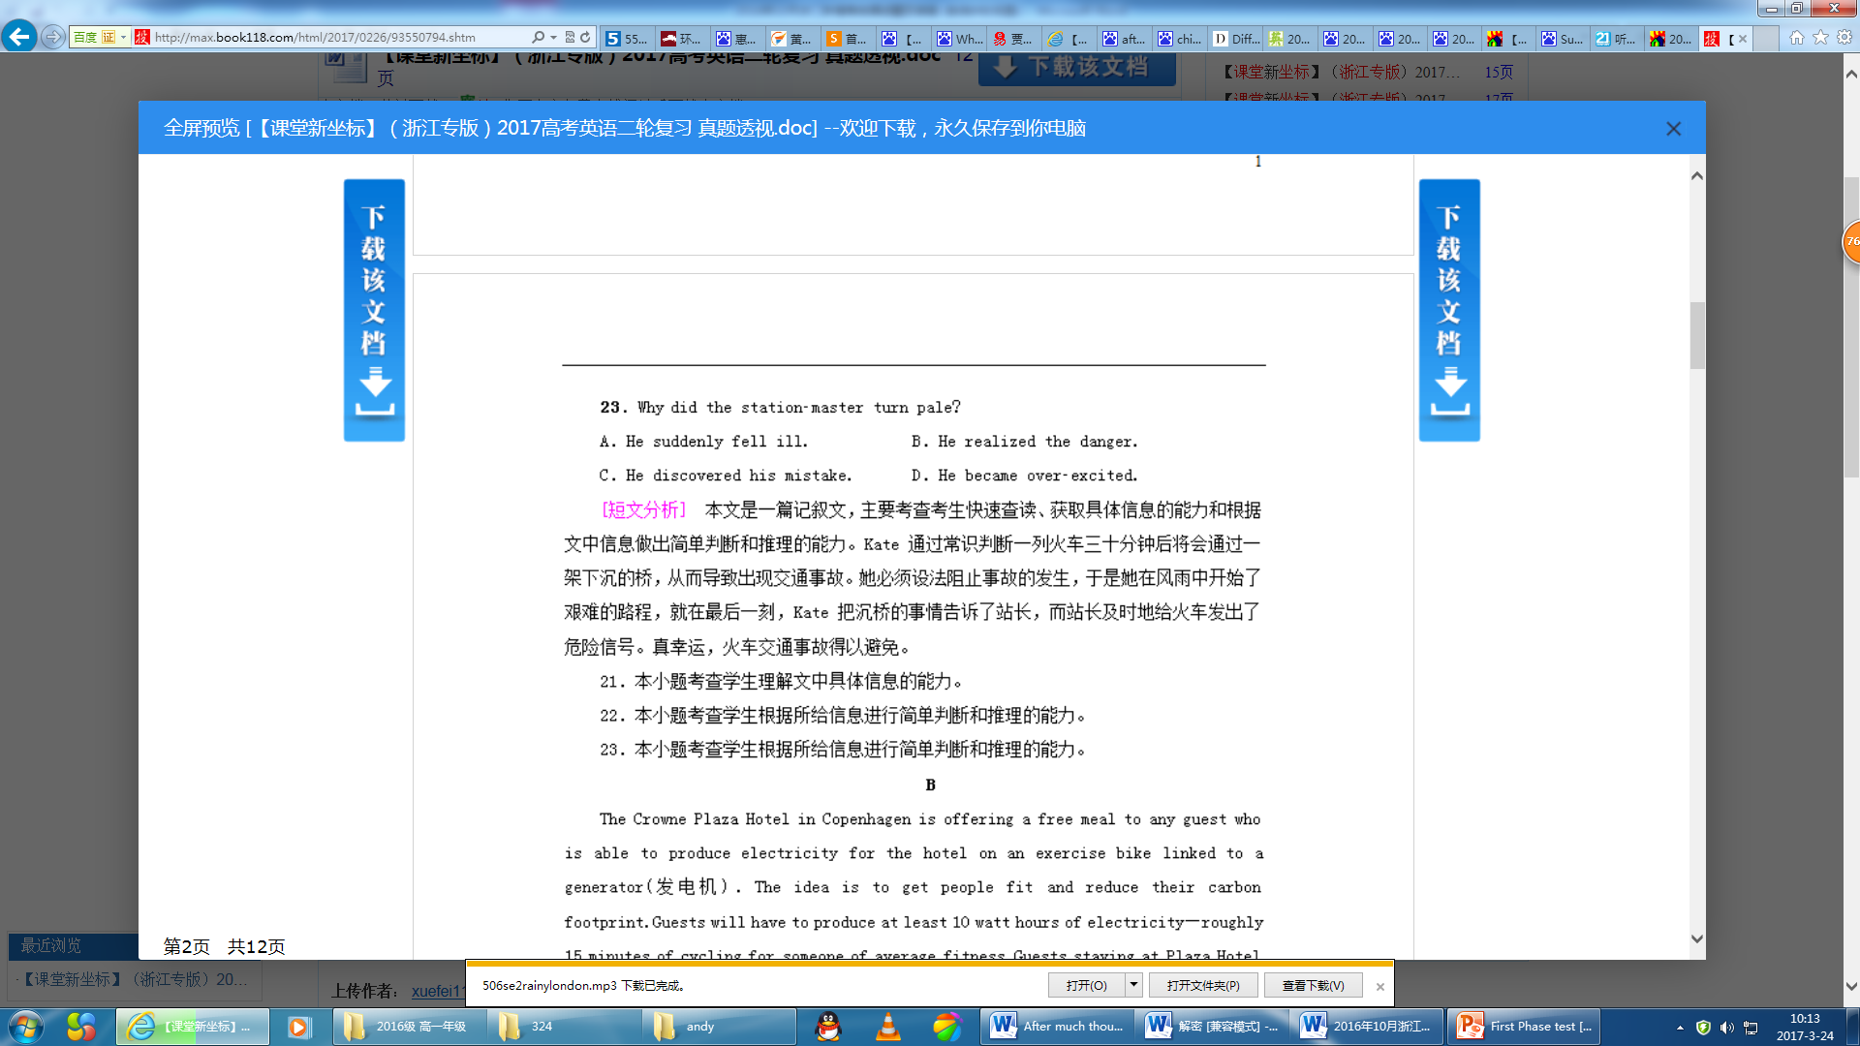

Slide 3
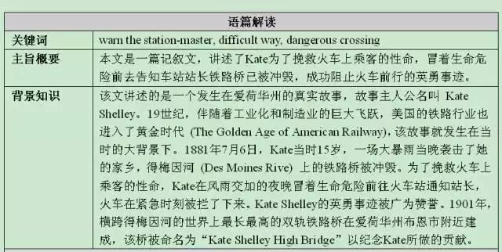

Slide 4
36．B
【解析】细节理解题。由文章前两段和第三段的“This would never have happened in Britain.”可知，英国人比中国人更习惯雨天。故选B。
37．D
【解析】推理判断题。根据第三段的句子“I found myself soaked(浸透)from head to foot, my poorly-chosen skirt and T-shirt now totally see-through.”可知，this指的是浑身湿透的尴尬经历。故选D。
38．A
【解析】词义猜测题。根据第五段的句子“Trains stop, drains(下水道)block, and buses break down”可知“chaos”指的是“无序，混乱”。故选A。
39．D
【解析】推理判断题。根据倒数第二段的句子“Nor do you ever have to be afraid of robbers-your umbrella doubles as a defensive weapon.”可知，本文语气幽默风趣。故选D。
40．B
【解析】主旨大意题。根据文章和最后一段的句子“How fitting that my No. l symbol of Brutishness”可知，本文介绍了为什么雨伞是英国的象征，故选B。
【备注】伦敦阴雨连绵，出行必备雨伞。本文介绍了雨伞是英国的象征。

Slide 5
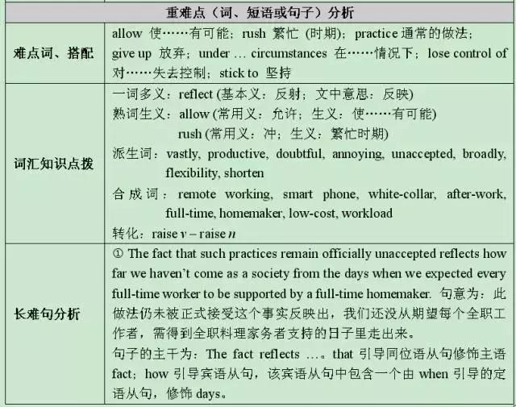

Slide 6
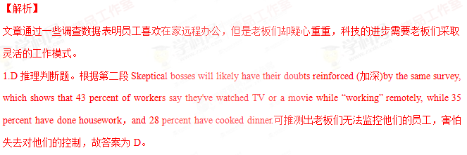
2.A推理判断题。根据最后一段Sixty-four percent of those survey participants who haven't worked remotely would rather give up some bonus in order to get even one day a week working from home.可知大多数的员工还是喜欢远程办公，故答案为A。
3.C推理判断题。根据最后一段Under such circumstances, smart firms need to find ways to let their employees have enough ability to change or be changed easily to suit a different situation to manage their time efficiently.可知答案为C。
考点：考查议论文阅读

Slide 7
【分析】本文主要讲述了我带着我的中国男友回家见家长所发生的事，由于不同国家的文化差异，在晚餐上出现了很多意料之外的事，因此我没有机会跟妈妈说我要结婚了．本文用幽默的语句写出了不同国家的文化差异带给我们的影响．
【解答】65．C 细节理解题，根据And even though I was hoping throughout the dinner that my mother would somehow see Rich's kindness，his sense of humor and boyish charm．I knew he had failed miserably in her eyes．可知我希望妈妈看到他的孩子气和幽默，但是妈妈并没有这么感觉，故选C．
66．C 细节理解题，根据When I offered Rich a fork，he insisted on using the slippery ivory chopsticks．Halfway between his plate and his open mouth，a large chunk of redcooked eggplant fell on his brand new white shirt．可知是他没有夹住茄子所以掉在了他的新白衬衫上，不是因为文化差异，故选C．
67．D 理解推断题，由划线句子He thought he was being polite by refusing seconds，when he should have followed my father's example，who made a big show of taking small portions of seconds，thirds and even fourths，always saying he couldn't resist another bite and then groaning he was so full he thought he would burst．可知我的父亲已经为他做了示范，但是他并没有跟着父亲做，故选D．
68．C 理解推断题，根据When we got home，I was still shuddering， remembering how Rich had firmly shaken both my parents'hands with that same easy familiarity he used with nervous new clients．及"I never had a chance，"I said，which was true．How could I have told my mother I was getting married．可知我在犹豫什么时候告诉妈妈我要结婚了，故选C
69．A 主旨大意题，本文主要讲述了里琦见我妈妈的过程中发生的一系列事情，故选A．
【点评】本文考察学生的故事类阅读理解，抓住题干关键词，采用寻读的方法查找细节，能根据已知结果推测导致结果的可能原因．

Slide 8
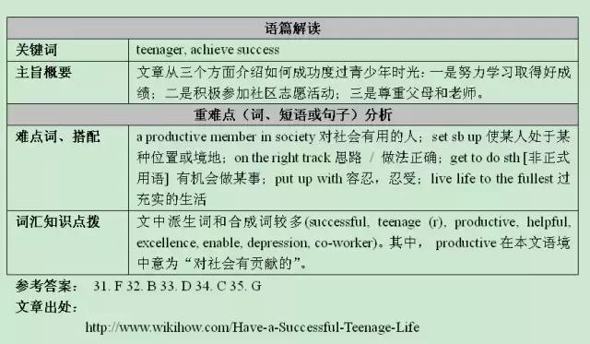

Slide 9
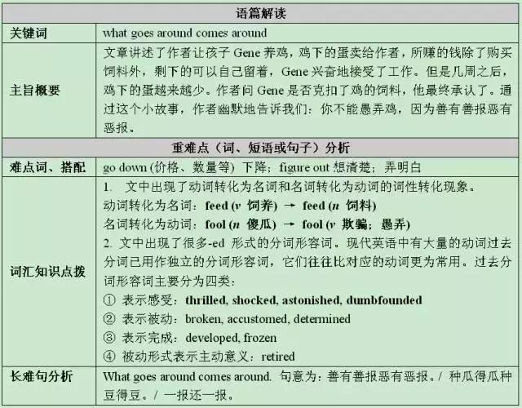

Slide 10
let something/somebody stay [transitive always + adverb/preposition]REMAIN/BE LEFT to make or allow something or someone to stay in a place when you go away
He left Ruth to find her own way home.

