Slide 1
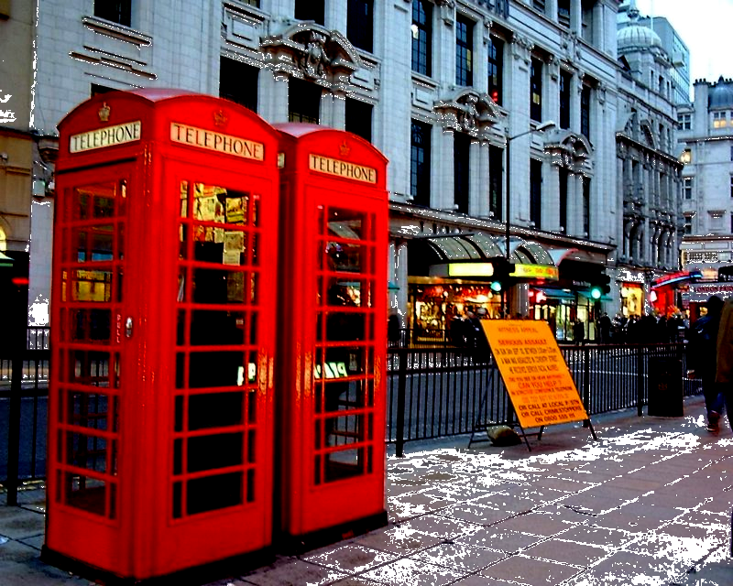
Lesson 6 Smash-and-grab
Objective: Master the usage of the simple past tense and the past continuous tense.
        Piccadilly

Slide 2
II New words & Expressions
smash: v. break to pieces, crash 打破, 碰撞, 粉碎
eg. He got drunk and began to smash things.
The car smashed into the wall.
crash: v. 碰撞，坠落
eg. The car crashed into the wall.
The plane crashed 5 minutes after its take-off.
shatter: v. destroy 损坏；摧毁；粉碎
eg. The explosion shattered every window in the building.
Our hopes were shattered.

Slide 3
II New words & Expressions
grab: v. snatch sth selfishly or rudely 抓住；掠夺；攫取
eg. He just grabbed the bag from my hand and ran away.
He grabbed at the opportunity to go abroad.
snatch: v. seize sth quickly, sometimes rudely 攫取，抢
eg. She snatched the letter from me.
He just snatched the bag from my hand and ran away.
grasp: v. seize sth firmly with hands; understand 抓住；掌握，领会
eg. He grasped my hand warmly.
She never could grasp the secret of this job.
clutch: v. seize, take hold of tightly with hands 抓住；攫取

Slide 4
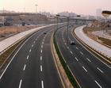
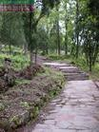
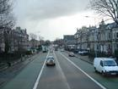
II New words & Expressions
arcade 有拱廊的街道
lane 小巷
path 小道，小路
street 街道
avenue 林荫大道
road 道路
highway 公路，大路
expressway / freeway 高速公路

Slide 5
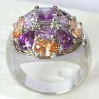
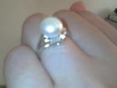
II New words & Expressions
ring 戒指
the thumb 拇指
the first finger, the forefinger, the index finger 食指
the middle finger 中指
the ring finger, the third finger 无名指
the little finger 小指

Slide 6
II New words & Expressions
staff: collective n. usu. followed by single action verb
全体工作人员，做主语常跟单数谓语动词
eg. The staff is working efficiently. (stress the collectivity)
I have a staff of 10.
The staff are working efficiently. (stress the individuality)
The staff in this shop are very helpful.
crew: staff on a ship or a plane (全体)船员; (全体)乘务员
faculty: the teaching staff in a university 全体教员

Slide 7
II New words & Expressions
fantastic: adj.
(1) very big, very large, enormous 大得惊人的
eg. a fantastic house, an enormous house
a fantastic amount of money, an enormous amount of money
(2) very good, marvelous 极好的，极妙的
eg. a fantastic view of the city from the mountain top,
a marvelous view of the city from the mountain top
a fantastic book, a marvelous book
(3) very strange, hard to believe 奇异的；古怪的；怪诞的
eg. My dreams are fantastic.
She had some fantastic idea that he was going to kill her.

Slide 8
III Text Study
Please close your text books. Listen to the tape of the text carefully and try to answer the following question:
How did Mr. Taylor try to stop the thieves?
(He threw things at them.)
Read the text by yourselves and pay attention to the usage of the past continuous tense(过去进行时 ).

Slide 9
Open 用法
When do you open /close?
We are open /closed.
Opening hours
The store has been open for over a hundred years.

Slide 10
III Text Study
Explain the text:
After gazing at the display for several minutes, Mr. Taylor went back into his shop.
(1) Structure: “After gazing at the display for several minutes”: prep. “after” + gerund “gazing at…” is used as an adverbial of time. It can be changed into an adverbial clause of time “After he gazed at the display for several minutes”.

Slide 11
III Text Study
Explain the text:
(1) Phrases: gaze at sb/sth: look steadily for a period of time 盯着看
eg. He sat there gazing at the fire.
She gazed at the news for several minutes then burst into tears.
stare at sb/sth: look fixedly with open eyes, as in wonder, fear or deep thought 盯着看，瞪大眼睛看着
eg. Staring at the blackboard, she fell into deep thought.
He was snoring in class. The teacher and the class stared at him in amazement.
glare at sb/sth: look at angrily 怒视着
eg. She didn’t shout or swear, but just glared at him silently.

Slide 12
III Text Study
Explain the text:
The silence was suddenly broken when a large car, with its headlights on and its horn blaring, roared down the arcade.
The silence was suddenly broken when a large car roared down the arcade with its headlights on and its horn blaring.
(1) Structure: The whole sentence is a complex statement which contains an adverbial clause of time introduced by “when”; the prepositional phrase “with its headlights on and its horn blaring” is used as an adverbial of accompanying state. 全句为一个含有“when”引导的时间状语从句的复合句；介词短语“with its headlights on and its horn blaring”做伴随状语。

Slide 13
With +n+prep /adj/p.p 伴随状语
The lady with a baby in her arms is my sister.
He likes to sleep with the window open.
A large car roared down the arcade with its horn blaring.
Don’t talk with your mouth full
They had got away with thousands of pounds worth of diamounds.
She left sadly with tears in her eyes.

Slide 14
III Text Study
Explain the text:
It came to a stop outside the jeweller’s.
(1) Phrases: come to ＋ n.
come to a stop 停止
come to a halt 停止
come to a standstill 停止
come to an end 结束
come to a conclusion 得出结论
come to a decision 做出决定
come to a climax 达到高潮
come to fame 成名
come to success 取得成功

Slide 15
III Text Study
Explain the text:
It came to a stop outside the jeweller’s.
Phrases:
eg. Don’t open the door until the car comes to a complete halt.
The lecture has come to an end.
I might have come to a wrong conclusion.
They have finally come to a decision about the child’s future.
The performance came to a climax when she sang.
The young singer has come to fame overnight.
Our project has come to success.

Slide 16

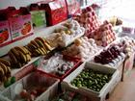

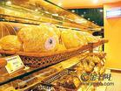
III Text Study
Explain the text:
(1) Phrases: the jeweller’s 珠宝店
the profession’s …店，…院，…所
eg. the hairdresser’s 美发店
the barber’s 理发店
the baker’s 面包店
the butcher’s 肉店
the grocer’s 杂货店
the greengrocer’s 生果店
the photographer’s 照相馆
the stationer’s 文具店
the doctor’s 医院
the dentist’s 牙科诊所

Slide 17
III Text Study
Explain the text:
One man stayed at the wheel while two others with black stockings over their faces jumped out and smashed the window of the shop with iron bars.
Structure: The whole sentence is a complex statement which contains an adverbial clause of time introduced by “while”; in the adverbial clause of time “and” connects a compound statement; the prepositional phrase “with black stockings over their faces ” is used as an adverbial of accompanying state; the other prepositional phrase “with iron bars” is used as an adverbial of manner.
全句为一个含有“while”引导的时间状语从句的复合句；时间状语从句中又出现一个由“and”连接的并列句；介词短语“with black stockings over their faces ”做伴随状语；另外一个介词短语“with iron bars”做方式状语 。

Slide 18
III Text Study
Explain the text:
One man stayed at the wheel while two others with black stockings over their faces jumped out and smashed the window with iron bars.
While this was going on, Mr. Taylor was upstairs.
(1) Structure: while: as, when, a subordinating conjunction 当…时候
eg. Write while I dictate. 当我口述时请你记下。
I met her while I was at school.
He fell asleep while doing his homework.
Tom was doing homework while his mother was cooking.

Slide 19
III Text Study
Explain the text:
One of the thieves was struck by a heavy statue, but he was too busy helping himself to diamonds to notice any pain.
Structure: the whole sentence is a compound statement connected by “but”. 全句为一个由“but”连接的并列句。

Slide 20
III Text Study
Explain the text:
(2) Phrases: be busy (in) doing sth 忙着做…
be busy with sth 忙着…
too + adj/adv. + to do sth 太…而不能…
help oneself to sth 自己动手拿…，擅自取…
eg. Tom was busy preparing for the meeting this morning.
Tom was busy with the meeting.
I am too tired to do any more work.
Please help yourself (to some fish).
He helped himself to some candy without asking.
The thief was caught on the spot when he was helping himself to the money from the safe in the shop.

Slide 21
III Text Study
Explain the text:
They had got away with thousands of pounds worth of diamonds.
(1) Structure: The whole sentence is a simple statement; the prepositional phrase “with thousands of pounds worth of diamonds” is used as an adverbial of accompanying state.
全句为一个简单句；介词短语“with thousands of pounds worth of diamonds”做伴随状语。
(2) Phrase: money + worth of + sth 价值…的…
eg. five yuan worth of apples
$ 100 ,000 worth of books

Slide 22
IV Drills & Exercises
Read the text after the tape. Pay attention to the stress and intonation and where to stop.
Try to ask each other the comprehension questions in pairs without looking at the text.
(P35 Summary writing)

Slide 23
Topic for discussion
Tell your partner about a robbery you know about.
What measures can we take to prevent or reduce crime in modern society?
Form into groups of 2-4 and discuss on the above topic. Time limit: 10 minutes
Invite volunteers to give their opinion before the class.

Slide 24
Retell the story
Silence broken---large car---down the arcade
Stop ---jeweller’s
One man---two others---out---the window
Mr. Taylor ---upstairs
He—staff---furniture
One of the thieves--- heavy statue---too busy---to notice any pain
Raid---three minutes---moved off
Mr. Taylor rushed out---impossible---stop the thieves
Got away---thousands of pounds worth of diamond

Slide 25
Key to Vocabulary
expensive: dear, high in price
almost: nearly
assistants: helpers, clerks, salesmen
gazing: staring, looking steadily
several: some, a few, a number of
stayed: remained
smashed: broke to pieces, shattered, crashed

Slide 26
Key to Key structures B
Just as Mary was cooking, the telephone rang.
Peter used to work in a Computer Company before he came to Guangzhou.
While I was waiting for the bus, a friend saw me and offered me a lift in his car.
I was doing my homework while Mum was preparing supper.

Slide 27
Key to Special Difficulties
impolite
disagree
illegible
inaccurate
unlocked
irregular

Slide 28
Key to multiple choice questions
b, a, c, d, b, a
a, d, a, a, b, c

Slide 29
V Assignments
Read the new words and the text fluently. To be questioned through retelling next lecture time.
Finish exercises on your text book. Check together next lecture time.
Review the new words and expressions learned in the previous 6 lessons. Get prepared for next Monday’s dictation.
Write a composition about “how do you study New Concept English 3”.
Prepare for lesson 8. Go through new words and expressions and look for the usage of “rashly”; read the text of lesson 8 for three times.

Slide 30
Thanks!

