Slide 1
Speaking for China
TFBoys成员王源为中国青年发声

Slide 2
be up for the challenge勇敢地迎接了这一挑战
2. polishing (润色)
3. It aimed to “eradicate (消除) poverty and
promote prosperity (促进繁荣) across the world,”
4. talk about sth. comfortably
5. not to mention
6. are more familiar with
7. a sense of relief (如释重负)
8. gothrough the entire speech in his mind
to recall whether he had made a mistake or
where he could have done better
9. Personally
10. bury oneself in …

Slide 3
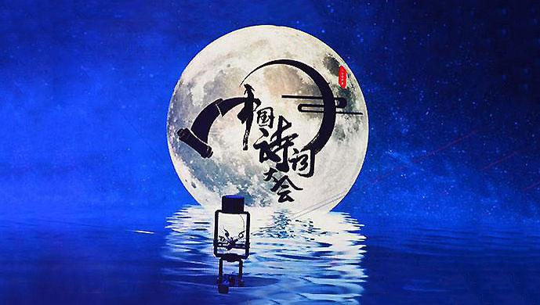
Enjoying beautiful poetry (p4-5)

Slide 4

武艺姝

Slide 5
II. Language barrier
poetry
poet
poem
finale
episode
entitle
recite
fulfill
line
artistry
n. [u] 诗歌
n. 诗人
n. [c] 诗
n. 最后一场
n. 一集；一出
v. 给…命名
v. 背诵；吟诵
v. 完成；实现
n. 诗行，诗句
n. 艺术性，艺术效果

Slide 6
wow: vt. to make people admire you very much 使称赞/佩服
Wu’s performance left the audience in awe.
shape: to have a great influence on the way it develops 塑造

Slide 7
wow <俚>使惊叹，使佩服; 使热烈叫好;
come out on the top
be impreaased by
fulfill all my fantasies for…
As the old saying goes,…
When it comes to…,
academic advisor
lose oneself in…
emotional

Slide 8
Complete the sentences without referring to the article.
1. To ___ people (使想起) those (经典的) Chinese poems and to cultural heritage, CCTV has produced a TV show.
2. Wu Yishu . (夺冠)
3. I really (钦佩,仰慕) her knowledge and poems.
4. (第一次) I saw her (wear) traditional Han clothing on TV, I was very (印象深刻) by her (古典的) looks.
5. What’s more, she always (显得) so calm throughout the show, which is very (usual) for her age.
6. The power of poetry (在于) shaping one’s view of life and developing one’s inner world.
7. (当提到…) teaching people about poetry, the show’s academic advisor suggested that teachers (解释) more about the beauty of the poetry…, and guide the students to (沉浸于) the poems’ lines.

Slide 9
V. Language focus
Complete the sentences without referring to the article.
of
classic
1. To people (使想起) those (经典的) Chinese poems and to cultural heritage, CCTV has produced a TV show.
2. Wu Yishu . (夺冠)
3. I really (钦佩,仰慕) her knowledge and poems.
(第一次) I saw her (wear) traditional Han clothing on TV, I was very
(印象深刻) by her (古典的) looks.
remind
promote
came out on top
admire
The first time
wearing
impressed
classical

Slide 10
V. Language focus
5. What’s more, she always (显得) so calm throughout the show, which is very
(usual) for her age.
6. The power of poetry (在于) shaping one’s view of life and developing one’s inner world.
(当提到…) teaching people about poetry, the show’s academic advisor suggested that teachers
(解释) more about the beauty of the poetry…, and guide the students to
(沉浸于) the poems’ lines.
appears
unusual
lies in
When it comes to
(should) explain
lose themselves in

Slide 11

VI. Post reading: Discussion
Do you agree with the two statements below? Choose one and share your thoughts about it.
The power of poetry lies in shaping one’s view of life and developing one’s inner world.
One who is filled with knowledge always behaves with elegance.

