Slide 1


Unit2 Grammar and Usage
Modal verbs

Slide 2
Jack—I have good news for you!
Rose—What?
Jack—The educational department has carried out rules to reduce students' study load.
Rose—Really? If so, I don’t have to stay up late to do so much homework and my mom may allow me to play computer games.
Jack—The best thing I think is that I can have more spare time to take exercise after class.
Rose—Sure. By the way, who is your favorite sports star?
Jack—Liu Xiang, I should say.
Rose—Tell me something about him.
Jack—Well, maybe I can show you some photos.

Slide 3

一. We use modal verbs to talk about:
1. Ability （能力）
2. Obligation （义务）
3. Certainty （可能性）
4. Permission （允许）

Slide 4
二.We also use modal verbs to:
5. Make requests（提出请求）
6. Make suggestions（提出建议）
7. Make offers（提供帮助）
8. Give advice（提出意见）

Slide 5
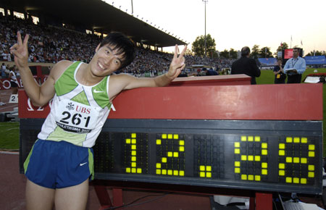
1.Ability (能力):
Liu Xiang can run the 110m hurdle race within 13 seconds.

Slide 6

can/could:
1. can 一般表示与生俱来的能力或者一种客观可能性,还可以表示请求和允许 。
Man can not live without air.
can
Learning English _____ be difficult.
Can
_______ I use your bike?

Slide 7

can/could:
2.在疑问句中，用could可表示请求，语气较委婉。
could
He asks if he ____ smoke here.
Could
— ____I have the television on?
— Yes, you _____.
/ No, you _____
can/may
can’t/I’m afraid not

Slide 8
can/could:
3.表示惊异、怀疑、不相信的态度。（主要用在否定句、疑问句或惊叹句中）
Can this be true?
He’s such a nice person that he ______ commit the crime.
can’t
How can you be so careless!
你怎么会如此地粗心！

Slide 9
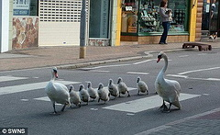
can/could:
4. can never/can’t……too表示“无论怎样…也不过分”，“越…越好” 。
You can’t be too careful while crossing the road.
你过马路的时候再小心也不为过。

Slide 10
Attention:
can/be able to区别:
Question: Are the two modal verbs interchangeable (互换) ? If not, why?
Can和 Be able to 都可以表示能力，意思上没有区别。但是，表示在过去某时的某一场合经过一番努力，终于做成某事，通常用was/were able to，相当于 managed to do 或 succeeded in doing。

Slide 11

Attention:
can/be able to区别:
A big fire broke out in ABC hotel yesterday. Luckily, everyone __________ run out of the building.
was able to
can
2. She _____ speak both English and French.

Slide 12
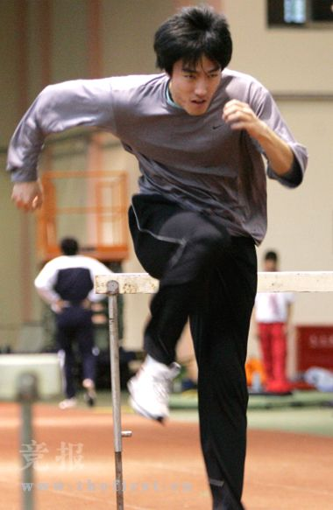
2.Obligation (义务):
I’m so tired! I have to do the training for at least 10 hours a day!
Although Liu Xiang is so gifted in hurdle race…
…yet he must work hard to win the gold medal.

Slide 13

Attention:
necessity
advisability
ought to/should
have to
must
Your mother brings you up and takes good care of you, so when she is old, you ___ look after her in return.
A.can B.may C.have to D.must

Slide 14
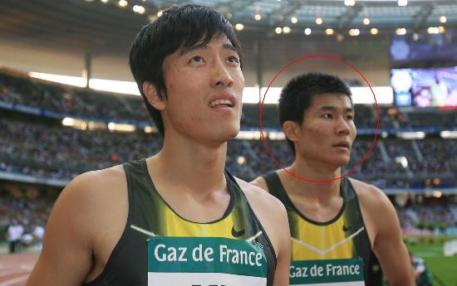
3.Certainty (可能性) :
Although the chance of winning a medal is small, I’ll try my best!
Shi Dongpeng might win a medal at the Olympic Games.

Slide 15
Attention:
very uncertain
almost certain
might
may
could
(can)
should
ought to
will
must
1.He _____ be at home.
A.may B.might C.must
2.He _____ be at home, for he just called me from his home 15 seconds ago.
A.may B.might C.must

Slide 16
must
must 表示肯定的猜测，译为“一定”，不能用于否定句或疑问句。
This must be your pen.
He must be doing his homework now.
He must have arrived already.

Slide 17
must
2. 表示“坚持”（常用于固定句型：if you must do sth. 如果你非得要做某事）
如果你真的要走，那就悄悄离开。
If you must leave, do it quietly.

Slide 18
Attention:
—They___ be doing the experiment in the lab.
—Why？
—Because the lights are still burning.
A.could B.can
C.must D.would

Slide 19

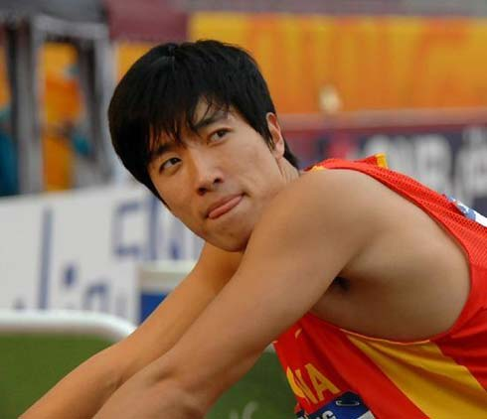
4.Permission (允许):
May I eat KFC if I win the gold medal?

Slide 20
may/might:
1. 表示许可。表示请求、允许时，might比may的语气更委婉一些。
— Might/May I use your computer?
— Yes, you can.
/No, you can’t/mustn’t.

Slide 21
may/might:
2.用于祈使句中表示祝愿。
May you be happy all your life.
May you succeed.
祝你成功！
3.表示推测、可能（只用于肯定句，疑问句则要用can或could）。
He may be very busy now.

Slide 22
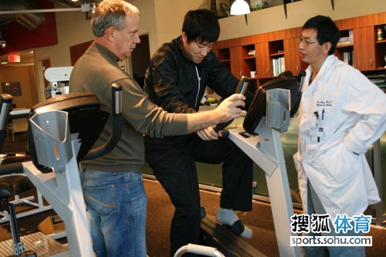
5.Making requests (提出要求):
formal
informal
will can could would
I don’t know how to use this equipment!
Can you help me with my training?

Slide 23
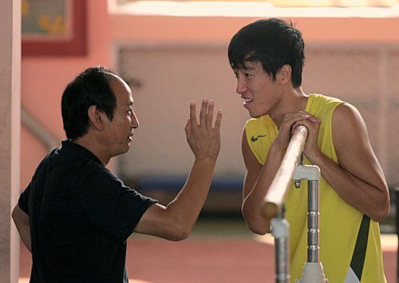
6.Making suggestions (提出建议):
It’s too hot to take exercise in the afternoon.
Shall we do the training in the morning?

Slide 24
shall:
1.Shall用于第一、第三人称疑问句中，表示说话人征求对方的意见、向对方请示或提供帮助 。
1.Shall we begin our lesson?
2.When shall he be allowed to leave hospital?
3.Shall I carry this bag for you?

Slide 25
shall:
2.Shall用于第二、第三人称，表示说话人给对方命令、警告、允诺或威胁。
You shall fail if you don‘t work harder.
He shall be punished according to the rule.
等我读完这本书，就会给他的。
警告
威胁
允诺
He shall have the book when I finish it.

Slide 26
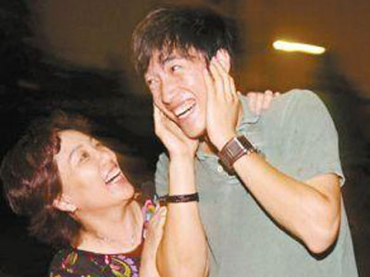
7.Making offers (提供帮助):
Mom, my dirty clothes have been piled up! I don’t have time……
Don’t worry, dear, I will wash them right away.

Slide 27
will/would:
1. 表示请求、建议等，would比will委婉客气。
Would you like…
Would you please…
sentence
pattern
Would you mind…
Would rather…

Slide 28
will/would:
2.表示意志、愿望和决心。
I will never do that again.

Slide 29
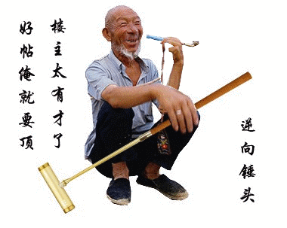
will/would:
3.可表示经常性、习惯性、倾向性。翻译为“经常、惯于、总是”。
1).The old man _____have a smoke under a big tree every afternoon after he finished his farm work.
would

Slide 30
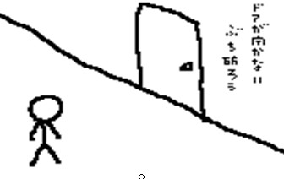
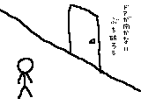
The door won’t open.
2).门就是打不开 !

Slide 31
will/would:
Attention:
Question: Are they the same?
I will go to the park with you tomorrow if you will offer me lunch.
情态动词
表示 “意愿”

Slide 32
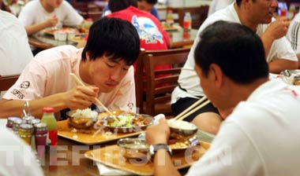
8.Giving advice (提出意见):
How delicious!!!
You should not/ought not to eat so much before running.

Slide 33
should:
1.Should表示劝告、建议、命令，其同义词是ought to；在疑问句中，通常用should代替ought…to。
Should I open the window?
We should learn from each other.
我们应当要相互学习。

Slide 34
should:
2.情态动词should用于第一人称时可以表示说话人的一种谦逊、客气、委婉的语气。
Rose—Sure. By the way, who is your idol?
Jack—Liu Xiang, I should say.
I should advise you not to do that again.

Slide 35
should:
3. should表示意外或惊讶 常译为
“居然，竟然”。
I can’t believe such a gentleman should be so rude to the old.
我不敢相信这样一个绅士居然对老人如此无礼。

Slide 36
should:
4. should 表示猜测时，一般指按经验或逻辑判断，翻译成“照说应该，估计，想必”
---When can I come for the photos ? I need them tomorrow afternoon.
---They _____be ready by 12 : 00 .
A. can B. should
C. might D. need

Slide 37

To be continued

Slide 38
三. “情态动词+have done”的用法
（1）must have done对过去某事的十分肯定猜测
（2）may/might have done对过去某事的可能性猜测
（3）can’t/couldn’t have done对过去某事的否定猜测
（4）should/ought to have done过去应该做而未做
（5）shouldn’t/oughtn’t to have done
过去不应该做而实际上做了
（6）needn’t have done 本没有必要做的事实际却做了
（7）could have done
本来能够做的（有能力做）事实际却未做到

Slide 39
Let's have a try!

Slide 40
Practice
With so much work on hand, you ____to see the game last night.
A. mustn’t go B. could have gone
C. shouldn’t go D. shouldn’t have gone
2. There was plenty of time. She ____.
A. mustn’t have hurried B. couldn’t have hurried
C. must not hurry D. needn’t have hurried

Slide 41
Practice
3. –I saw Mary in the library yesterday.
--You_____ her. She is still abroad.
A. mustn’t see B. can’t have seen
C. mustn’t have seen D. couldn’t see
4. Aunt Mary______the train, otherwise she would have arrived here by now.
A. must have missed
B. should have missed
C. had missed
D. might miss

Slide 42
四. 可兼做行为动词的情态动词：need 、 dare
情态动词 (+动词原形)
行为动词
1.无人称和数的变化;
多用于肯定句;
(sb.) need to do
dare to do
(sth.) need to be
done
(sth.) need doing
2.尤其用于：
need
*否定句及疑问句中;
*在if/whether之后;
*或与hardly, never,
no one, nobody连用;
3.常以needn’t 和daren’t
的形式出现;
dare
4.dare有其过去时dared.

Slide 43
判断正误:
He daren’t to speak English before such a crowd, did he?
He daren’t speak English before such a crowd, dare he?
These dishes need be cleaned carefully.
These dishes need to be cleaned carefully.
These dishes need cleaning carefully.

Slide 44
五. 表示否定的情态动词的用法:
部分情态动词的否定式是情态动词中的考点
之一。
mustn’t 不准, 禁止
needn’t 没必要 ( = don’t have to )
can’t 不能; 不可能
may not 不可以; 可能不
shouldn’t 不应该 ( = ought not to )

Slide 45

Thinking
How can we deal with exercises concerning modal verbs?
Functions & usage of modal verbs
Functions & usage of modal verbs
Language context (上下文、语境)
Language context (上下文、语境)

Slide 46
Homework
Review the usage of modal verbs and finish the exercise paper

