Slide 1
美文背诵1-9

Slide 2
My father
One of my earliest memories of dad is that he would often leave the house at dawn to go jogging. He was a traditional Chinese father, which means that he didn't show his affection for his kids easily. And he and I didn't talk much.
Some time ago, he made me go jogging with him. I hated it because I didn't know what to say to him. Needless to say, I didn't enjoy exercising with dad. However, as time went by, he and I began to talk while jogging. Later, he even began to tell me jokes! It was a side of him that I had never seen before. I am glad that he made me go jogging with him because our relationship has greatly improved as a result.

Slide 3


Slide 4
My neighbor
Next to us lives Mr.Zhang, who is a street-sweeper. He is in his early sixties and looks quite stern but, in fact, he is easy to get along with and is always considerate of others. Even though he is uneducated, he is a pleasant man to talk to.
Rain or shine, he goes out to work in the early morning when there is little traffic on the road. Because uncaring people litter the streets with so much garbage, he cannot take a rest until noon. To my surprise, he never complains about his hard and dirty work. In a word, I don't look down upon him just because he is a street-sweeper. Instead, I respect my kind neighbor.

Slide 5
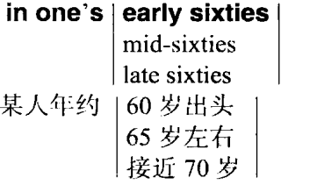



Slide 6
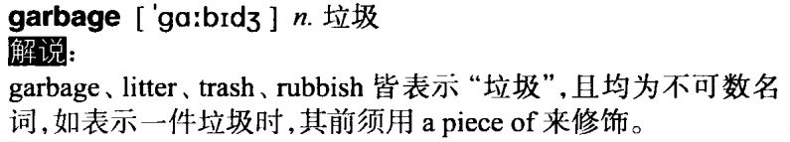

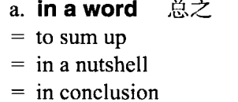

Slide 7
My mother
My mother was an elementary school teacher until she retired two years ago. She devoted herself to teaching for forty-five years. That is, she spent the best part of her life educating her students. Although she isn't a teacher now, she is still very much concerned about the development of education in Taiwan.
Though Mom is no longer a career woman, she is busy all the time. Each day she gets up early to prepare our breakfast and does all the housework. In addition, she goes to a temple and volunteers to help the priests and worshippers with little chores.
As teacher's day is drawing near, I wish her eternal health and happiness. After all, mothers are the world's greatest educators.

Slide 8
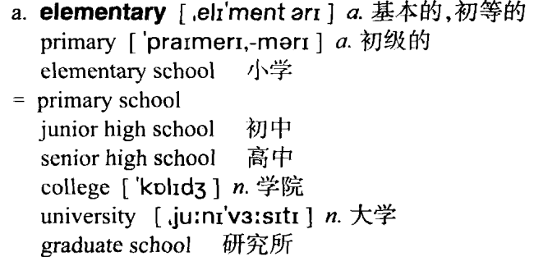
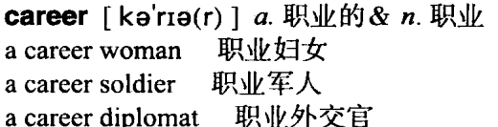

Slide 9
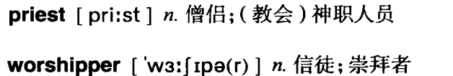


Slide 10
4. My brother
In his teachers’ and my parents’ eyes, my youngest brother is side-tracked young man, but in mine, he is a musical genius. He has a terrible attendance record at school and actually quit going twice. The fact is that it’s music which really interests him. Indeed, he has a musical band. He sings well. He’s gifted at composing songs and even formed a band with his buddies. I enjoy listening to the songs he writes and although the lyrics are sort of immature, they come straight from the heart. He says his dream is to make music his career. Who knows if he is on the right track or not? But I do know whatever he does, music will always be a part of his life.

Slide 11
On a crowded bus
I am a senior high student who has to commute from home to school every day. It is always an ordeal for me to try to get on a crowded bus. I am often squeezed so hard that I can't breathe.
Once I felt someone pushing me very hard, and then he touched my rear. I couldn't turn around to see who did it because I was sandwiched between two tall men. I was so angry that when the bus arrived at my school, I clenched my fists and elbowed my way through the crowd and got off. Then, to my dismay, I found that my purse had been stolen from my school bag.

Slide 12
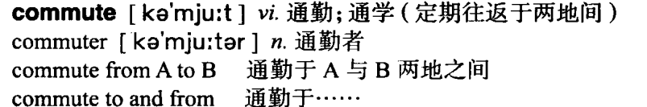
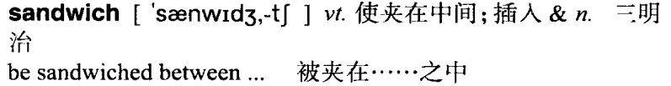

令…惊愕的是

Slide 13
Seeing a doctor
Seeing a doctor is the last thing I want to do. I hate waiting long hours in a hospital, only to spend five minutes with an indifferent doctor. Most of them just ask a few questions and then give you a prescription. In my opinion, they are more like machines than sympathetic people.
I had a severe pain in my right shoulder a few months ago. I had no choice but to see a doctor. To my surprise, the doctor was very kind. He asked me some questions and thoroughly examined my shoulder. He said I would have to take some medicine for two months and get plenty of rest. Now I have fully recovered and feel great. Although I was at first reluctant, I'm glad I went to see the doctor.

Slide 15
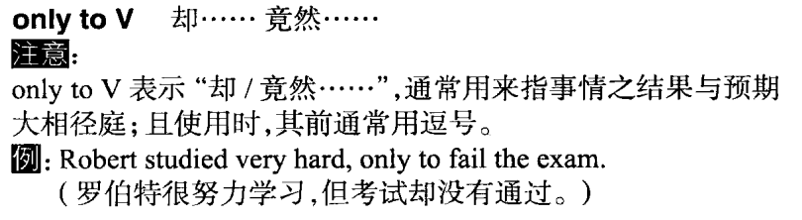
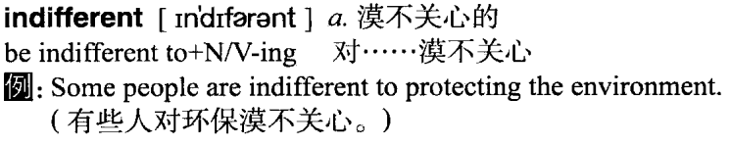
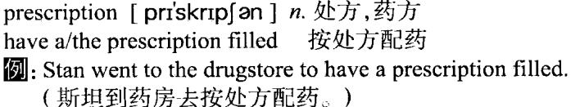

Slide 16

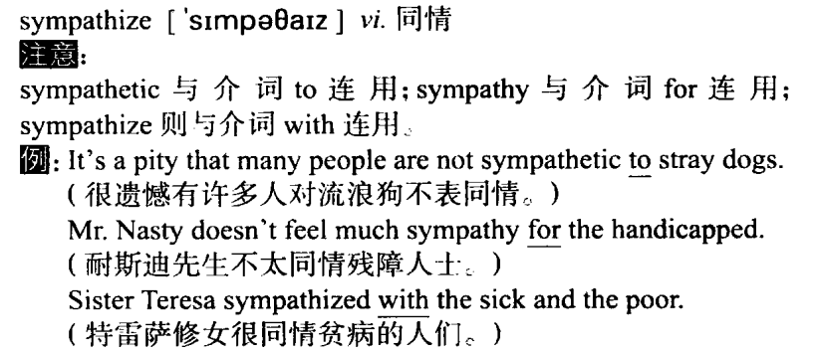

Slide 17
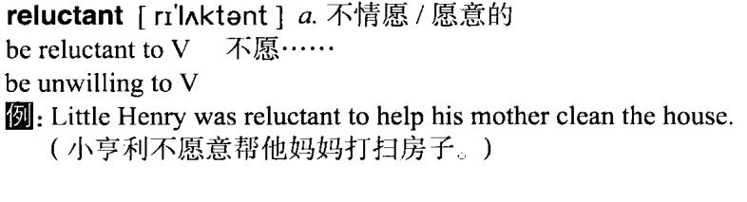

Slide 18
A valuable lesson
Last Mid-Autumn Festival was an unforgettable day for me. Partly because I ate too many moon cakes and partly because the moon cakes had spoilt. had a bad stomachache. Not only did I vomit, but I had the runs. Subsequently, I was sent to the hospital.
This unfortunate experience taught me a valuable lesson. That is, one should eat moderately. As the old saying goes, "Don't bite off more than you can chew." You can be sure that I will keep that in mind from now on.

Slide 19
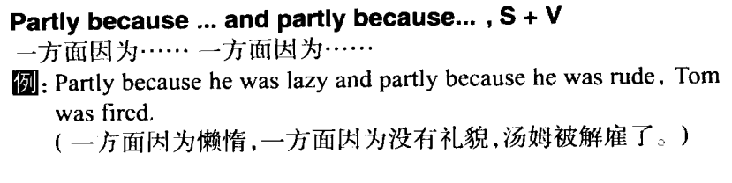
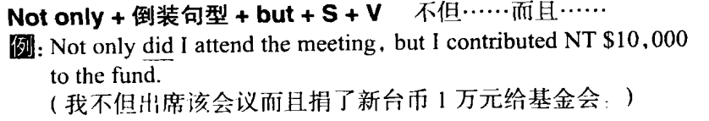
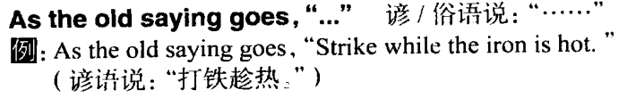

Slide 20
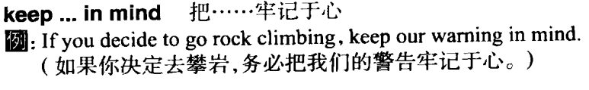
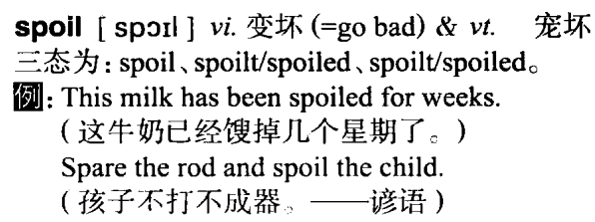
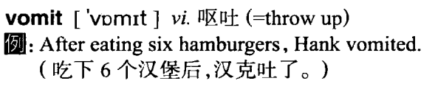

Slide 21
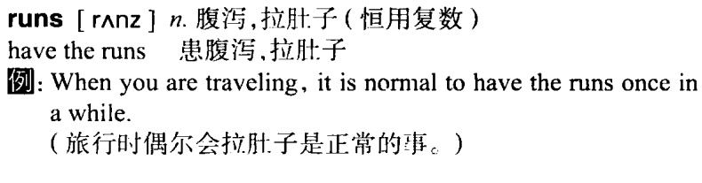
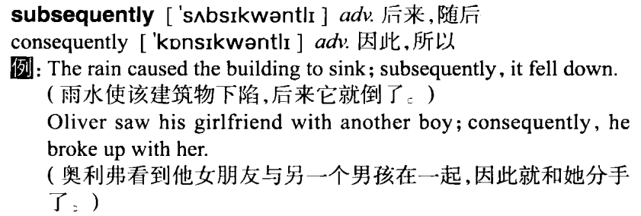

Slide 22
