Slide 1
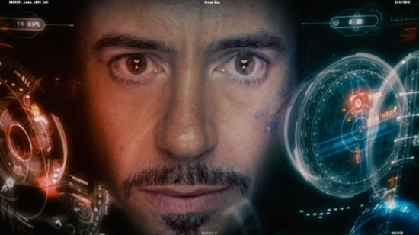
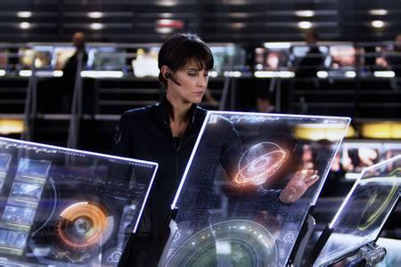
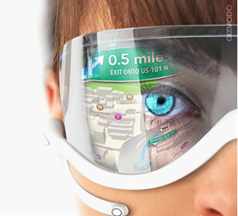
Computers

Slide 2
Words and
Expressions
simplify
sum
operator
logical
logically
technology
technological
revolution
vt. 简化
n. 总数；算术题；金额
n. (电脑)操作员；接线员
adj. 合逻辑的；合情理的
adv. 合逻辑地；有条理地
n. 工艺；科技；技术
adj. 科技的
n. 革命

Slide 3
Words and
Expressions
artificial
intelligence
intelligent
solve
from…on
reality
personal
personally
adj. 人造的；假的
n. 智力；聪明；智能
adj. 智能的；聪明的
vt. 解决；解答
从……时起
n. 真实；事实；现实
adj. 私人的；个人的；亲自的
adv. 就个人而言；亲自

Slide 4
Words and
Expressions
tube
as a result
total
totally
so…that
network
wet
n. 管；管子；电子管
结果
adj. 总的；整个的
n. 总数；合计
adv. 完全地；整个地
如此……以致于
n. 网络；网状网
n. 网

Slide 5
Words and
Expressions
application
finance
mobile
rocket
explore
anyhow
goal
happiness
n. 应用；用途；申请
n. 金融；财经
n. 可移动的；机动的
n. 火箭
vt. & vi. 探索；探测；探究
adv. 无论如何；即使如此
n. 目标；目的；球门；得分
n. 幸福；快乐

Slide 6
Words and
Expressions
human race
download
virus
signal
type
in a way
coach
arise
n. 人类
v. 下载
n. 病毒
vt. & vi. 发信号 n. 信号
vt. & vi. 打字 n. 类型
在某种程度上
n. 教练
vi. 出现；发生

Slide 7
Words and
Expressions
with the help of
electronic
appearance
character
mop
deal with
watch over
niece
在……帮助下
adj. 电子的
n. 外观；外貌；出现
n. 性格；特点
n. 拖把
vt. 用拖把拖；擦
处理；安排；对付
看守；监视
n. 侄女；甥女

Slide 8
Match
from … on
as a result
so … that…
human race
从……到……
如此……以致于……
人类
从……时起
结果

Slide 9

Unit 3
Who am I?

Slide 10

1. To summarize the main idea of the passage
2. To know more about the development of computers
3. To learn some useful words, expressions and patterns in the passage

Slide 11
Focus on
Words:
simplify, sum, solve, reality, finance, explore, anyhow, goal
Expressions:
from … on, as a result, so … that … Patterns:
At that time …
I wonder if …
As time went by, …

Slide 12
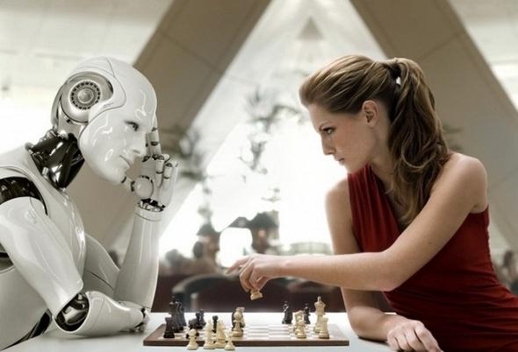
Skimming for general idea

Slide 13

(1) Answer the following questions.
1. Who is the speaker in this story?
A computer.
2. What’s the main idea of this passage?
A. The development of computers.
B. The development and use of computers.
C. A machine which is simple-minded.
D. Computers may replace human beings.

Slide 14
Scanning for specific information

Slide 15
1. Look at these inventions. Can you put them in an order according to the time when they appeared?
5
( ) analytical machine ( ) laptop
( ) calculating machine
( ) robot
( ) PC
( ) universal machine
2
1
6
4
3

Slide 16



1. My real father was Charles Babbage, who wrote a book and built me in 1936.
2. I began as a calculating machine
in Japan in 1642.
3. After 1936, I grew rapidly both in size
and in brainpower.
4. As time went by, I was made bigger.

Slide 17


(3) Choose the best answer.
1. When was the “universal machine” built?
A. In 1822. B. In 1642.
C. In 1936. D. In 1970.
2. When was the computer the biggest?
A. In 1642. B. In 1936.
C. In the 1940s. D. In the 1970s.

Slide 18
3. Which of the following is in the right
order of time?
The computer was connected with
other computers.
b. Alan Turing wrote a book about the
computer.
c. The computer has been sent to explore
the Moon and Mars.
d. The computer began to simplify
difficult sums.
A. a. b. c. d. B. b. c. a. d.
C. d. a. c. b. D. d. b. a. c.

Slide 19
(4) Finish the table below.
P19 1
1642
1822 | The analytical machine was made by Charles Babbage.
The computer began as a calculating machine.
The computer grew rapidly both in size and in brainpower.
1936

Slide 20
1940s
 | The first family of computers was connected to each other.
1970s
Now
The computer had grown as large as a room.
1960s
Computers were used in offices and homes.
Computers connect people all over the world together.

Slide 21
(5) Complete the chart below.
P19 2
 | Para-graph 1 | Para-graph 2 | Para- graph 3
Topic sentence
Supporting details |  | tubes | communica- tions finance

Slide 22
 | Paragraph 1
Topic sentence | Over time I have been changed quite a lot.
Supporting details | 1 calculating machine 2 analytical machine 3 universal machine 4 PC 5 laptop

Slide 23
 | Paragraph 2
Topic sentence | These changes only became possible as my memory improved.
Supporting details | 1 tubes 2 transistors 3 chips 4 network 5 World Wide Web

Slide 24
 | Paragraph 3
Topic sentence | Since the 1970s many new applications have been found for me.
Supporting details | 1 communications 2 finance 3 trade 4 robots 5 mobile phones 6 medical operations 7 space rockets 8 providing a life of high quality

Slide 25
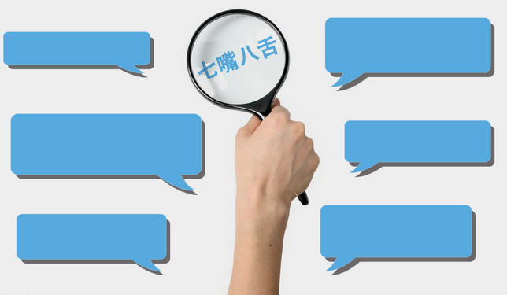
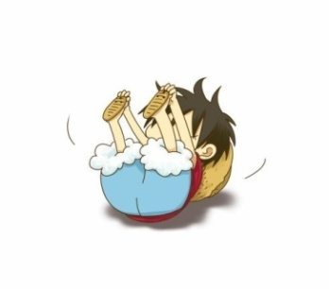
Discussion
Brainstorm a list of things that
you, your school and your family
use computers for.
Think about what you would
have to do if you could not use
computers any more.
P19 3

Slide 26
List of use of computers | What people did before computers
email | write letters
word processing | write by hand or typewriter
search for information | look in encyclopedia, library, etc
watch DVDs | go to the cinema
store information | write everything down into files and folders

Slide 27



Slide 28
I. Complete the passage with proper words, which will help you retell the text.
Computers, _________began as a calculating machine in 1642, have changed a lot over time. It took nearly two hundred years before the analytical machine was developed by Charles Babbage. In 1936 the computer grew _________(rapid) both in size and brainpower. By the 1940s the computer ___________(grow) as large as a room. With time ________ by, the computer was made smaller and the shape was totally changed.
which
rapidly
had grown
going

Slide 29
First as a PC and then as a laptop, these changes only became possible as its memory improved. In ________early 1960s the first family of computers was connected _____each other by a network. _______ the 1970s computers have been used in offices and homes and many new _____________(apply) have been found. Now computers connect people all over the world together. They play _________ important part in our life and will provide humans __________a life of high quality.
the
to
Since
applications
an
with

Slide 30

A 15-year-old UK student Rebecca
Rickwood won (1) __________________ to find the best user of Microsoft’s spread-sheets software, Excel 2007. Competitors were required to perform (2) __________ to show their skills at making spreadsheets. Rebecca (3) ____ 78 students in the final round and won (4) _____________ at the competition in San Diego, California. Her teacher believes that she will have (5) _____________.
a world competition
II. Task-based reading.
timed tests
Read the passage and complete its summary.
beat
a $5,000 prize
a bright future

Slide 31

Homework
1. Look for more information
about the development of the
computer and its applications.
2. 发挥想象，连词成文(50-100字)。
simplify, sum, solve, from … on, as a result, so … that …, finance, explore, anyhow, goal.

