Slide 1
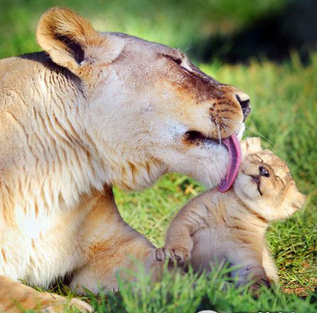
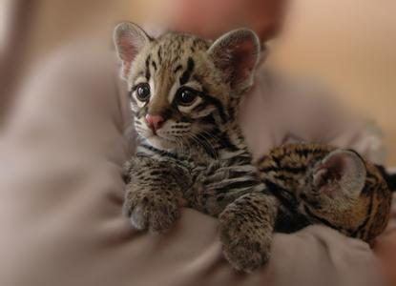
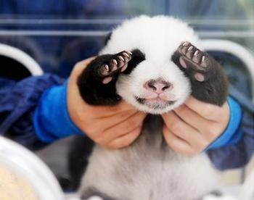
Unit 4
Wildlife protection

Slide 2

Words and
Expressions
carpet
respond
distant
fur
relief
in relief
burst into laughter
mercy
certain
n. 地毯
vi. 回答；响应；做出反应
adj. 远的；远处的
n. 皮毛；毛；软毛
n. (痛苦或忧虑)减轻或解除；
减轻痛苦的事物
如释重负；松了口气
突然笑起来；大声笑了起来
n. 仁慈；宽恕；怜悯
adj. 确定的；某一；一定

Slide 3
Words and
Expressions
importance
rub
protect…from
mosquito
insect
contain
powerful
affect
attention
pay attention to
n. 重要(性)
vt. 擦；摩擦
保护……不受……
n. 蚊子
n. 昆虫
vt. 包含；容纳；容忍
adj. 强大的；有力的
vt. 影响；感动；侵袭
n. 注意；关注；注意力
注意

Slide 4
Words and
Expressions
appreciate
succeed
secure
income
employ
harm
bite
dinosaur
come into being
inspect
vt. 鉴赏；感激；意识到
vi. 成功 vt. 接替；继任
adj. 安全的；可靠的
n. 收入
vt.雇用；利用
n. & vt. 损害；危害
vt. & vi. 咬；叮；刺痛
n. 恐龙
形成；产生
vt. 检查；视察

Slide 5
Words and
Expressions
incident
dust
according to
fierce
so that
ending
faithfully
n. 事件；事变
n. 灰尘；尘土；尘埃
按照；根据……所说
adj. 凶猛的；猛烈的
以致于；结果
n. 结局；结尾
adv. 忠诚地；忠实地

Slide 6
Match
in relief
burst into laughter
protect … from …
pay attention to
保护……不受……
（危害）
注意
解决
如释重负；松了口气
突然笑起来；大声笑
了出来

Slide 7
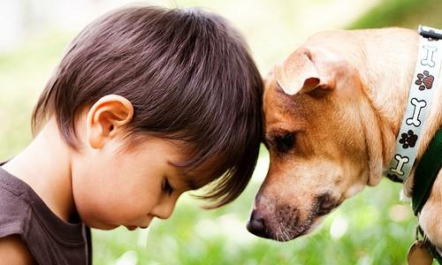
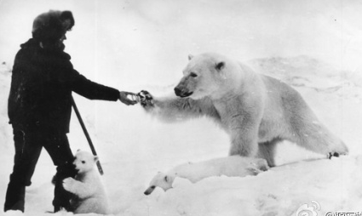
HOW DAISY LEARNED
TO HELP WILDLIFE

Slide 8

1. To summarize the main idea of the passage
2. To know more about the wildlife
protection
3. To learn some useful words and expressions in the passage

Slide 9
Focus on
Words:
respond, distant, certain, importance, contain, powerful, affect, appreciate
Expressions:
in relief, protect … from …, pay attention to
Patterns:
I’d like to …
It shows the importance of …

Slide 10
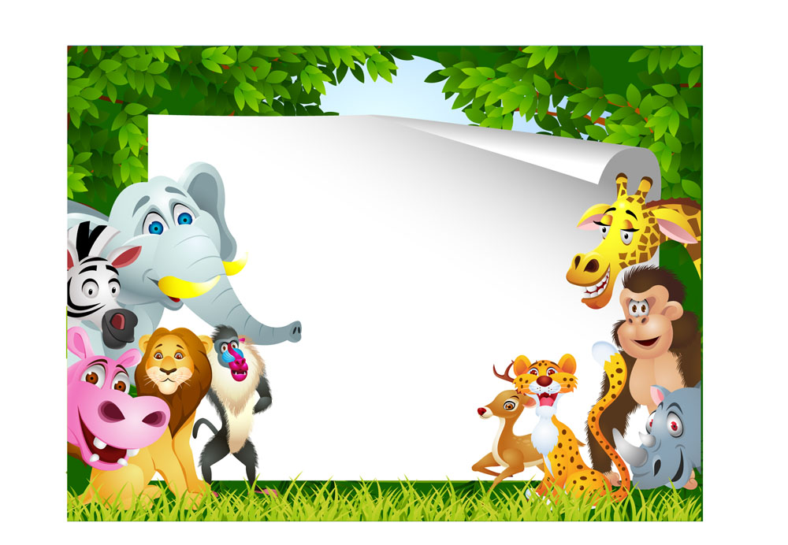
Skimming for general idea

Slide 11

(1) Choose the best answer.
The passage is about ______.
A. some protection of wildlife
B. a journey of a flying carpet
C. Daisy’s wonderful experience with
some animals

Slide 12

(2) Fill in the table. Test your reading speed.
 | Animals she met | Places she went
First visit
Second visit
Third visit
antelope
Tibet
elephant
Zimbabwe
monkey
Rainforest

Slide 13

Scanning for specific information

Slide 14
(1)Write down the main idea and the supporting details in the correct boxes.
P272
Paragraph | Main idea | Supporting details
1
1 Animal: Tibetan antelope
2 Situation: being hunted for the fur under its stomach
3 Result: numbers are decreasing rapidly
Why we need wildlife protection

Slide 15
Paragraph | Main idea | Supporting details
2
A good example of wildlife protection
1 Animal: elephants in Zimbabwe
2 Situation: previously hunted with numbers decreasing rapidly
3 Result: protection by farmers who make money from tourism

Slide 16
Paragraph | Main idea | Supporting details
3 and 4
1 Animal: a millipede from tropical rainforest
2 Situation: produces a drug naturally which can protect us from mosquitoes
3 Result: Daisy plans to tell WWF about the drug
What we can get from wildlife protection

Slide 17


(2) Choose the best answer.
1. What can be inferred from the elephant’s words “Have you come to take my photo”?
A. It thinks itself a beautiful animal.
B. Elephants are friendly to human beings.
C. Money from tourists went to the large
tour companies.
D. Now many more tourists come to take
its photos rather than hunt it.

Slide 18
2. What did Daisy learn from her experience?
A. Some animals were becoming
endangered as a result of humans’
hunting.
B. Wildlife should be helped and
protected by us.
C. Humans and wildlife can benefit
each other in many ways.
D. All of the above.

Slide 19
3. Which is the most probable reason why the monkeys in the rainforest are dying out?
A. There are too many tourists.
B. They are being hunted and killed.
C. Their habitats are being destroyed.
D. There is not enough food for them.

Slide 20
4. From the end of the story we can conclude that ______.
A. the WWF will help Daisy to make
the powerful drug
B. the WWF has done little to protect
wildlife
C. people will stop killing animals with
the help of the WWF
D. Daisy will continue to help protect
wildlife by working with the WWF

Slide 21
(3) Answer these questions below.
P271
Why has the antelope in Tibet become
an endangered species?
2. Why are elephant numbers increasing
in Zimbabwe?
3. How does the government of Zimbabwe help protect wild animals?
4. Why is it important to protect the
rainforest?

Slide 22
Why has the antelope in Tibet become an endangered species?
2. Why are elephant numbers increasing
in Zimbabwe?
Its fur is being used to make sweaters. As the sweaters become popular, more and more animals are killed. So very few antelopes are left.
The farmers stopped killing the elephants, so the numbers increased.

Slide 23
3. How does the government of
Zimbabwe help protect wild animals?
The government helps the farmers. It makes sure that the tour companies pay the farmers when tourists come
to visit and hunt a few animals.

Slide 24
4. Why is it important to protect the
rainforest?
Looking after the rainforest helps protect plants and animals we know nothing about. They may make it possible for us to produce medicines and drugs that we don’t yet know about.

Slide 25
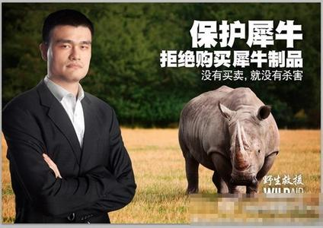
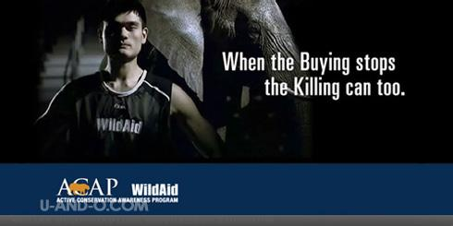
No buying, no killing.

Slide 26
Measures to protect the endangered
animals:
▪ reduce hunting, treat them as our friends
▪ protect our environment
▪ to set up nature reserves/protection zones
▪ make laws to prevent them from being caught and killed
▪ the governments should educate people to love nature and protect it
▪ raise money to help them

Slide 27



Slide 28
I. Complete the passage with proper words, which will help you retell the text.
One day, Daisy dreamed a strange dream. She asked a _______ (fly) carpet to take her to a _________(distance) land where she could find the animal that gave fur to make the sweater. The carpet took her to Tibet and she talked with _____antelope. The antelope told her they ________________
(hunt) because of their fur __________can be used to make sweaters for people like ________and that they were now dying out.
flying
distant
an
were being hunted
which/that
her

Slide 29
where
Later, she flew to Zimbabwe ______she talked with an elephant and got to know the farmers there no longer hunted them. That’s ________the government decided to help. At last she arrived at the thick rainforest where a monkey told her that more attention should be paid ______the rainforest and people should appreciate _______the animals live together. “No rainforest, no animals and no drugs.” said the monkey. Although finally everything was gone, she had learned so much.
because
to
how

Slide 30
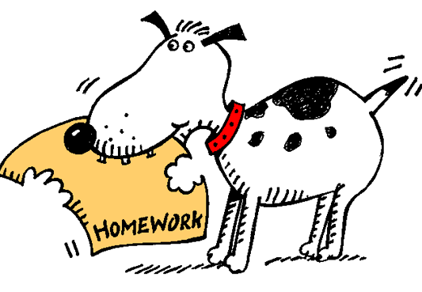
Homework
Collect more information about wildlife protection.
2. 发挥想象，连词成文(50-100字)。
respond, distant, in relief, certain, protect … from …, contain, powerful, affect, pay attention to, appreciate.

