Slide 1
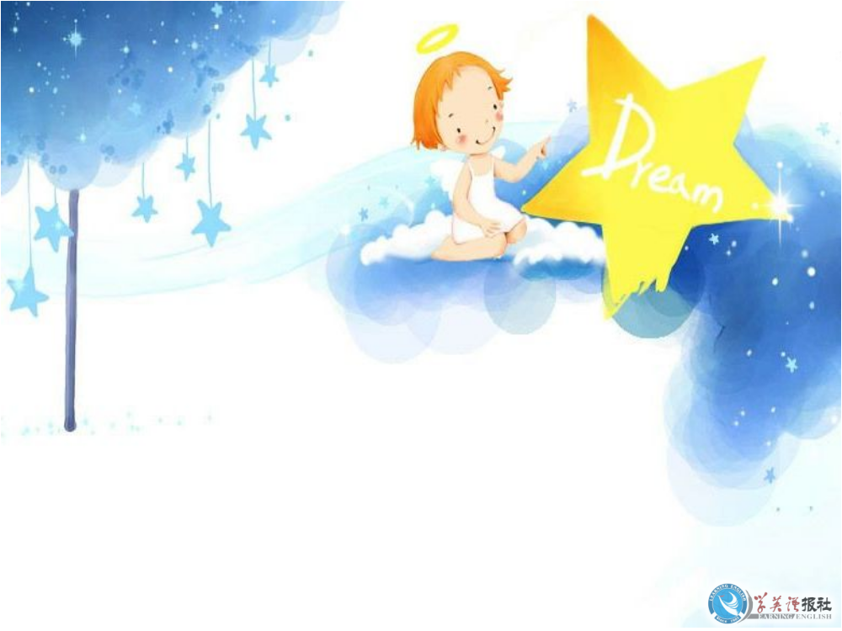
Using Language

Slide 2



Pre-reading:
Task 1:
Acting: Ss act out Scene 4.

Slide 3
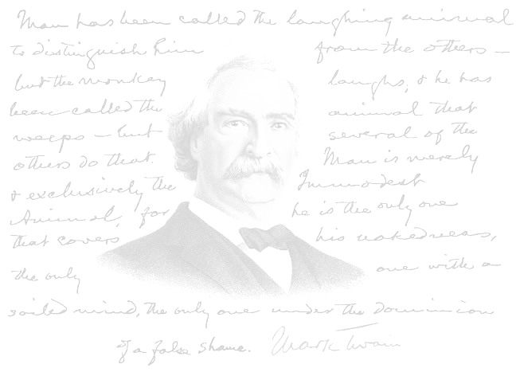
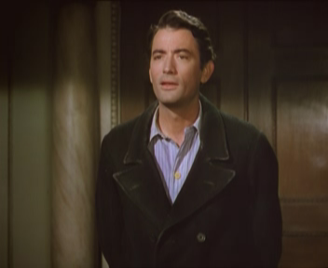
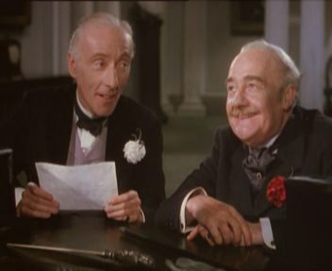
Characters （人物）：
Henry Adams :
a lost American businessman
in London
“Roderick” and “Oliver” :
two brothers and rich Englishmen

Slide 4
Pre-reading:
Task 2:
Prediction

Slide 5
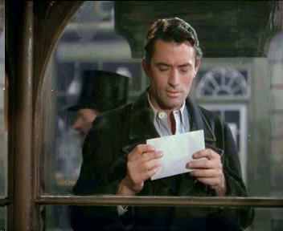
The first place I’d like to go?
restaurant

Slide 6
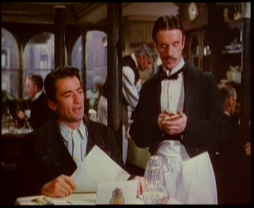
What would happen to
Henry at the restaurant?
He was not taken
seriously.
He was treated
politely.

Slide 7
While-reading:
Try to gain as much information
as possible from the story through
reading and train reading skills.

Slide 8
While-reading:
Task 1. Watching
Reading strategy: Watch the play
to understand the gist.

Slide 9

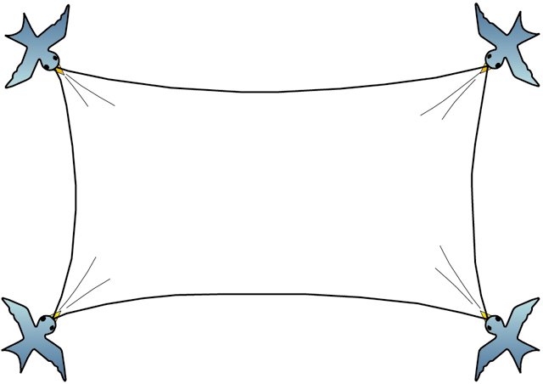
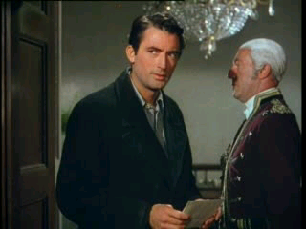
ActⅠ Scene 4

Slide 10
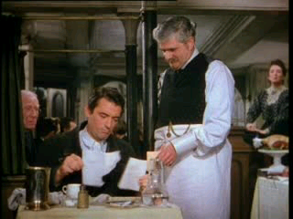
ActⅠ Scene 3

Slide 11
Task 2 : True or flase
T
1.The owner looked down upon Henry when
he noticed Henry’s appearance.
2. Henry asked for more of the same food because he is an American who like to eat a lot.
3.When Henry saw the million pound bank- note, he was happy and proud of it.
4.The owner didn’t believe that the bank- note was real and he asked Henry to get out of the restaurant.
F
F
F

Slide 12
While-reading:
Task 3. Watch again
Reading strategy: Pay much attention to the different
attitude towards Henry.

Slide 13
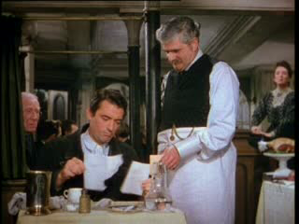
ActⅠ Scene 3

Slide 14


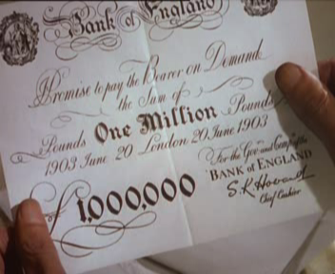
The great change of their attitude
Rude
Respectful
?
how

Slide 15
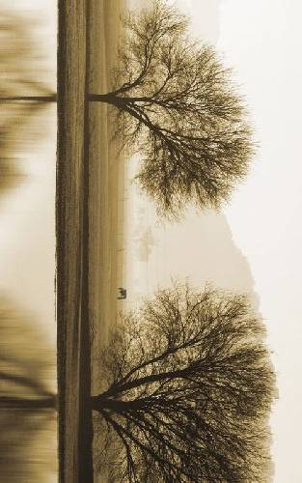
Before Henry shows his million pound bank-note
Owner
Hostess
Waiter
That one’s reserved.
Well, we will have to take a chance.
…if you pay the bill…
My goodness! He eats like a wolf.
It’ll cost a tiny bit.
Again, everything?
What’s there to wait for?

Slide 16

After Henry shows his million pound bank-note
Owner
Hostess
Waiter
I’m so sorry, sir, so sorry.
Oh, please, don’t worry, sir. Doesn’t matter at all.
Just having you sit here is a great honour! …bow… …
Screams
And you put him in the back of the restaurant!
bow
...bow…

Slide 17
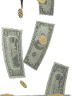
The great change of their attitude
Rude
Respectful
?
why

Slide 18

Retell the story
With the __________ in hand, Henry decided to enter a _________ for a meal. He ordered some _____ and _____ and a nice big _______ together with a tall glass of _____. The waiter told him the meal would cost him __ _____ ____. After eating his first order, Henry asked for more of _____ ________.
envelope
restaurant
ham
eggs
steak
beer
a tiny bit
the same

Slide 19
When Henry opened the letter, he found it was a _______ ______ _________. He was ________ but the owner and the waiter were _______. The own was not sure if it was ________ or _______. They couldn’t believe Henry who was ___ ____ could be so rich. At last, the note was proved to be real.
million pound bank-note
surprised
shocked
genuine
fake
in
rags

Slide 20
After knowing that the bill is genuine, the owner _______ Henry again and again for his coming to his little eating place and even asked Henry to forget the ______. The owner, hostess and waiter all ______ together as Henry left.
thanked
bill
bow

Slide 21
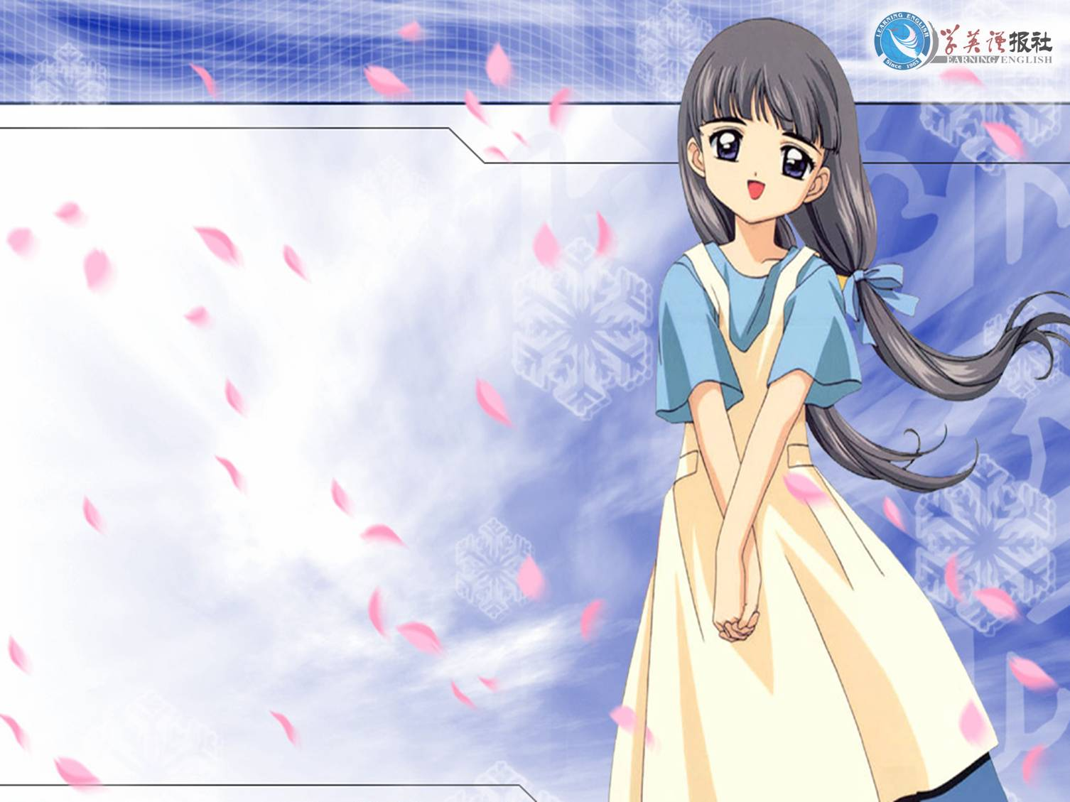
Thank you.

