Slide 1
Shoes

Slide 2
Impossible is nothing

Slide 3



Adidas is one of the world’s top sporting brands.It is based in Germany and includes other brands like Reebok in its group. The three parallel bars that from its logo is known worldwide.

Slide 4
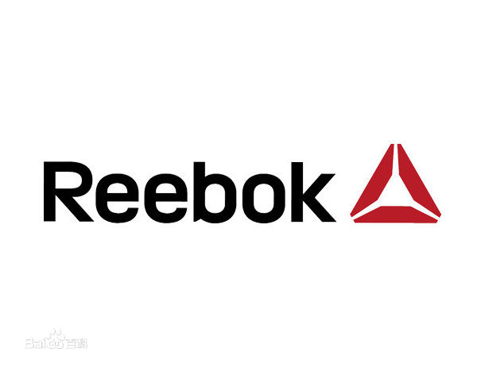
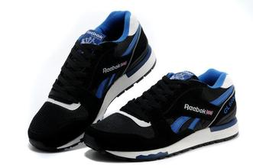
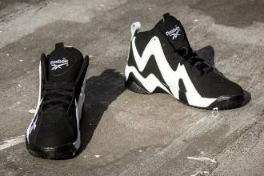

Slide 5
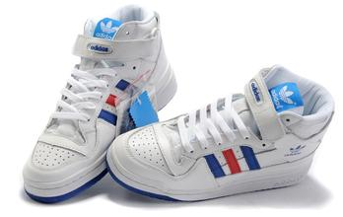
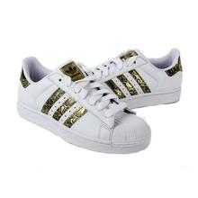
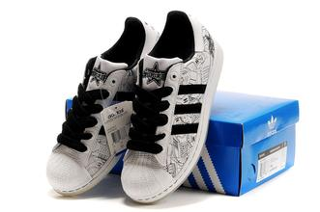

Adidas has provided quality sporting goods for decades. They crate a very strong brand loyalty among consumers.

Slide 6
Just do it

Slide 7

Nike leads the world in sales of athletic shoes. The company was founded in 1964 by Bill Bowerman and Phlip Knight. It is first name was Blue Ribbon Sports but that change to Nike in 1978.

Slide 8
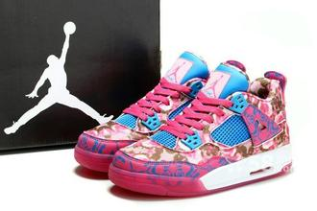
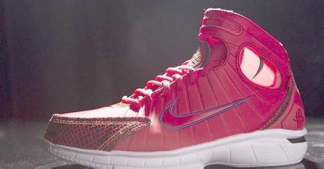
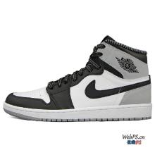
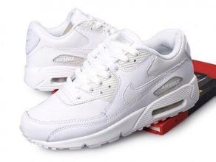
Many basketball players choose Nike and Air jordan because it is really nice.

Slide 9


Slide 10
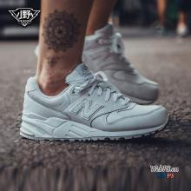
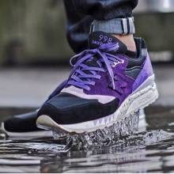
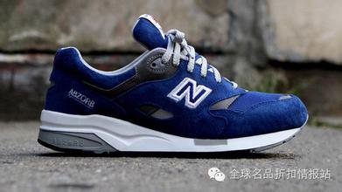
New balance, which William J Riley founded in Boston in 1906, is another well-known brand.

Slide 11




Slide 12
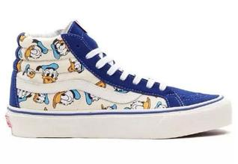
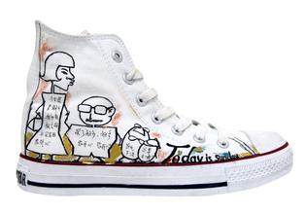
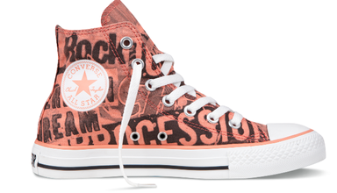

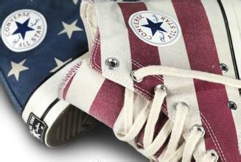
In addition, Vans and Converse are concentrate on canvas shoes. This style of shoes attract many girls from all over the world.

Slide 13

How to choose a pair of shoes?
What should we consider when choosing shoes?

Slide 14



