Slide 1

The World’s Most Dangerous Creature
2015.10.01

Slide 2
When you think of the most dangerous creature,
What would most likely come into your mind?
Who is No.1?

Slide 3
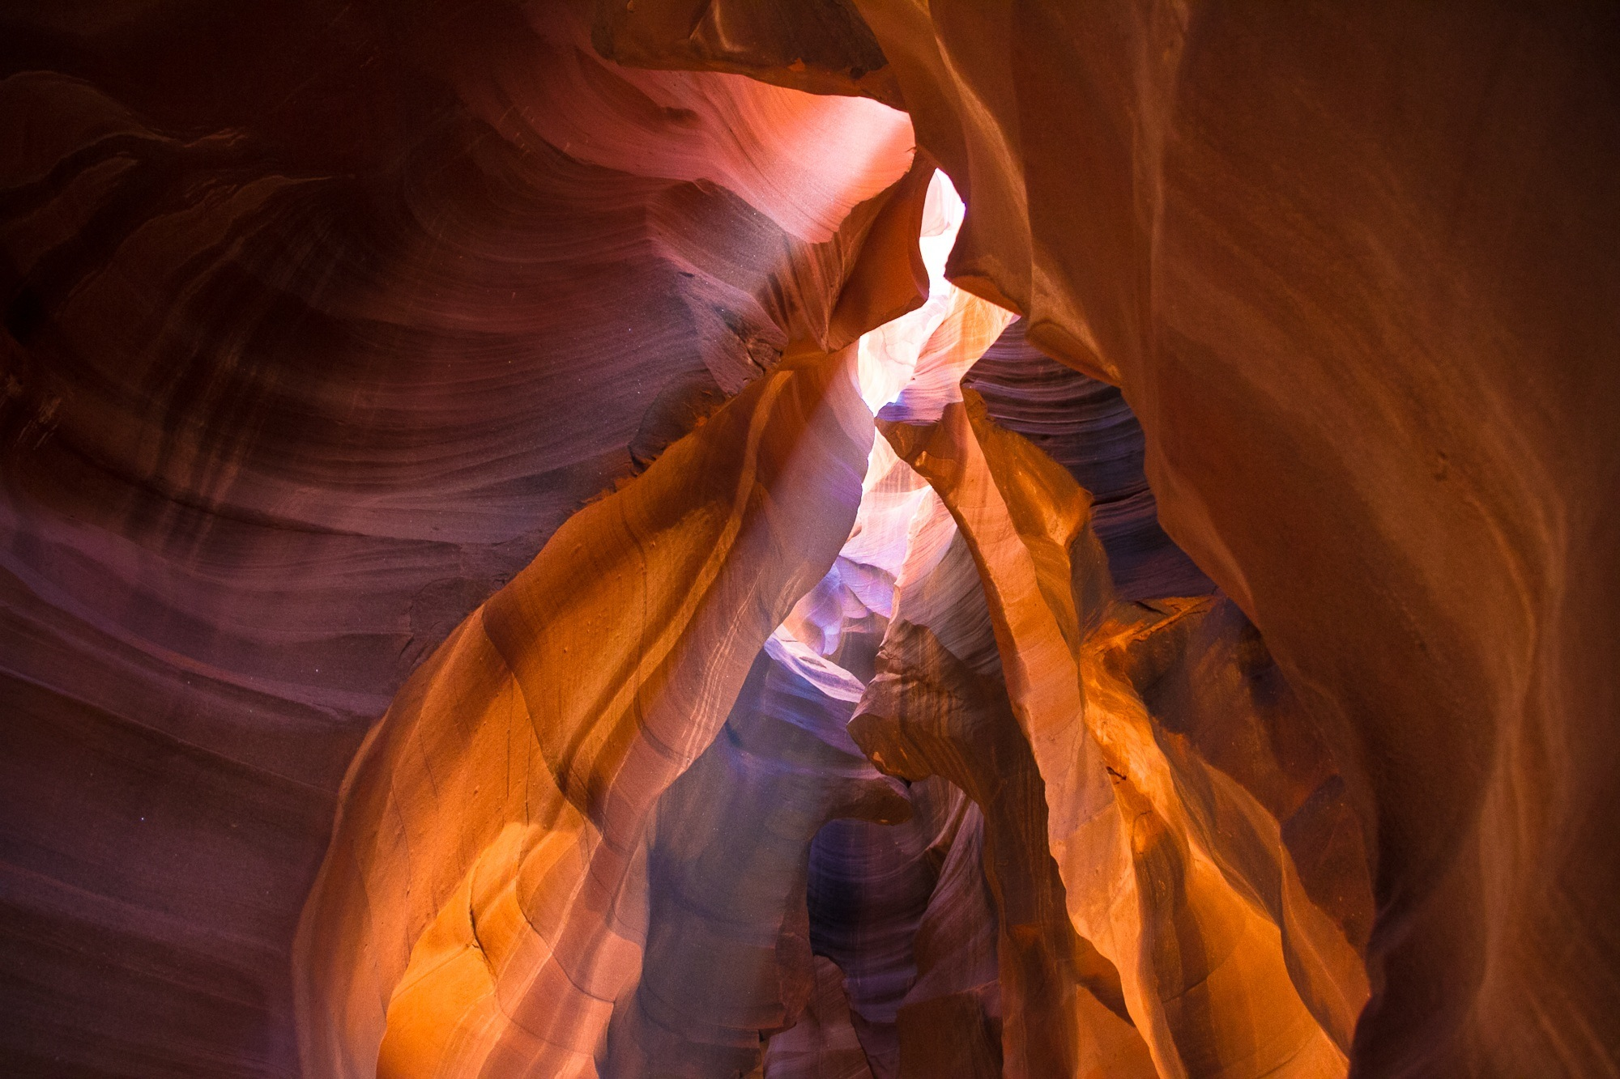
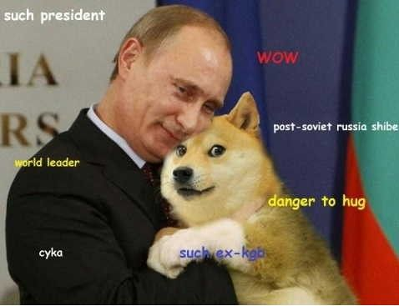
Maybe it is
A dog can be a dangerous creature.Though a dog can be your best friend,sometimes a dog attacks a human or other animals as a result of a lack of care.
The Dog!!!
Notes:
https://ununsplash.imgix.net/photo-1416862291207-4ca732144d83?q=75&fm=jpg&s=df8c00463528dcbff9e2f80eb9c09516
https://ununsplash.imgix.net/photo-1416949929422-a1d9c8fe84af?q=75&fm=jpg&s=f53cfc09b4e1acf0c5faa0e5962d27d1
在本页面，你可以放置两张图片，并在下方的色块中写明标题，以此进行辅助说明。而左下角的色块则是预留给你放置公司LOGO或是联系方式的地方

Slide 4

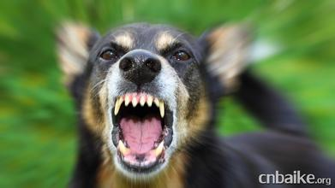
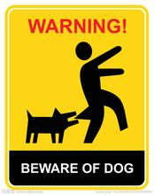
The dog could be really dangerous!
Look at this:

Slide 5

More people are killed every year by dogs in the United States than people killed annually by crocodiles in Africa.

Slide 6
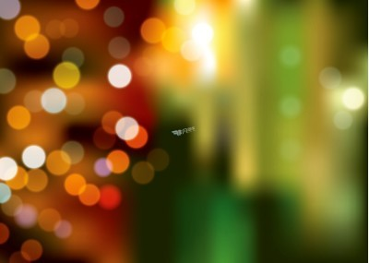
Or,it is
The shark

Slide 7
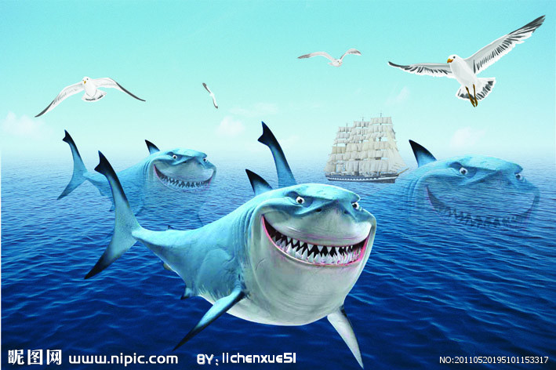

The shark
Many people think that the sharks are really dangerous.
Notes:
https://ununsplash.imgix.net/photo-1416949929422-a1d9c8fe84af?q=75&fm=jpg&s=f53cfc09b4e1acf0c5faa0e5962d27d1
在本页中，左上角留出用来放置公司LOGO

Slide 8
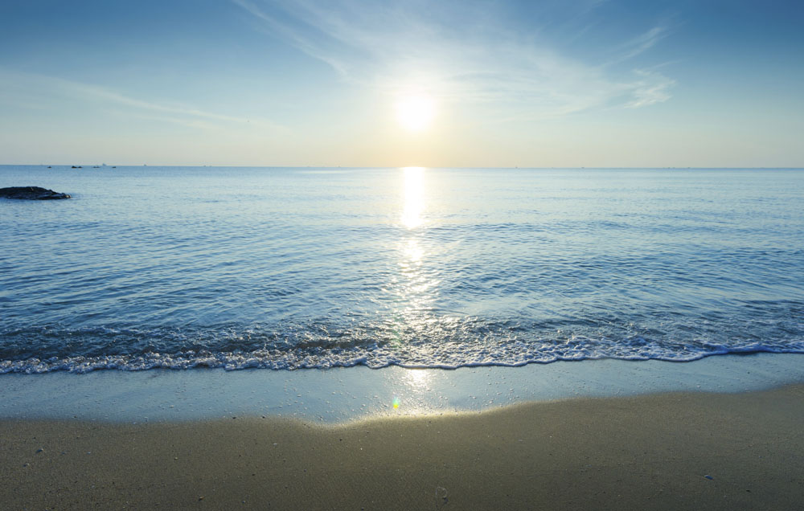
Actually...
They are afraid of human and rarely attack humans.The more difficult it will be to tear the body of human which is much bigger than their mouth down.

Slide 9
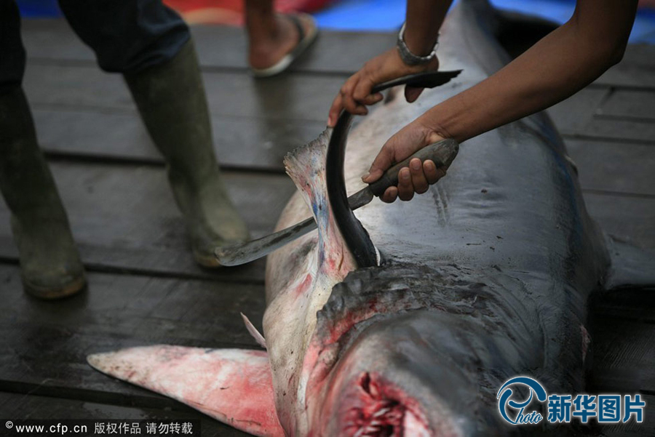
Shark fin soup isn’t that tasty,neither effective.But humans cut of their fins and then throw them into the sea.

Slide 10
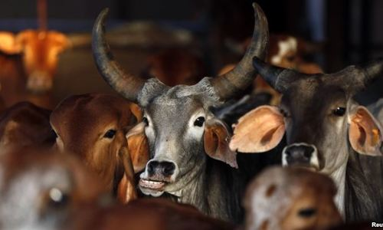
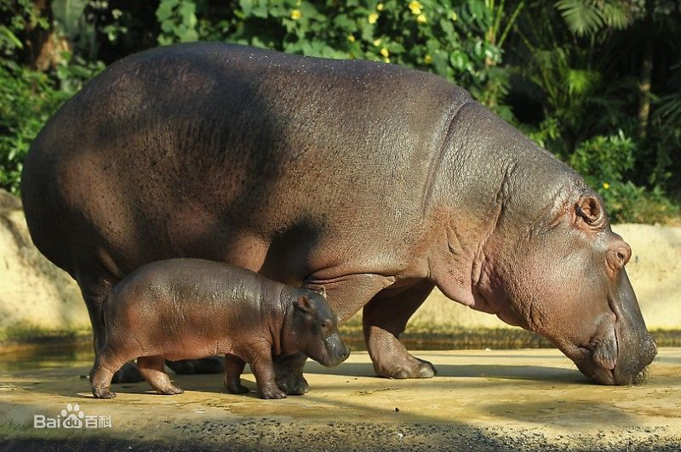
The buffaloes&hippopotamus
The buffaloes
The hippopotamus

Slide 11
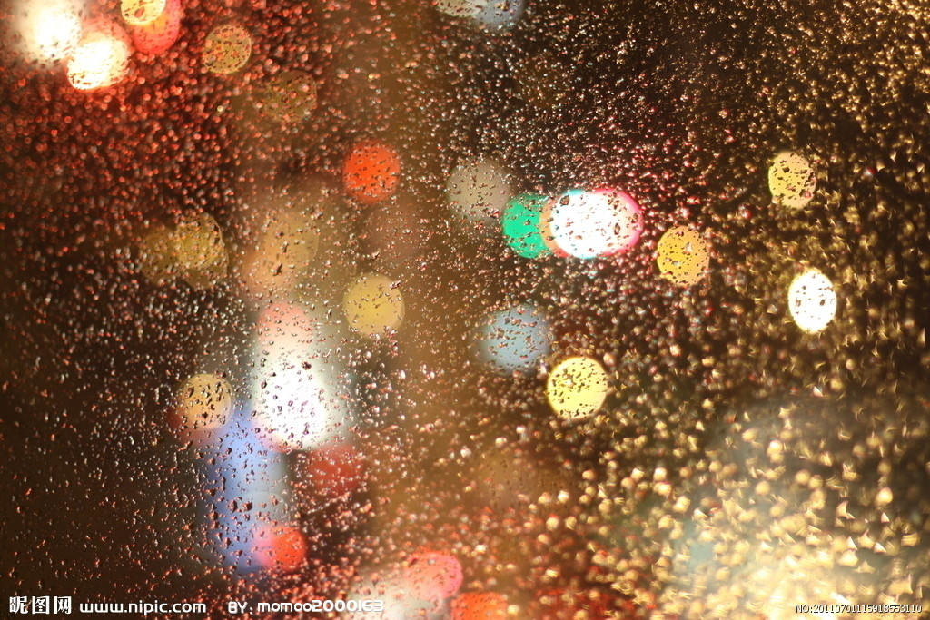
Large,fierce buffaloes are very dangerous and kill many people in Africa each year.But African people say that the hippopotamus is the dealiest wild animal in Africa.

Slide 12
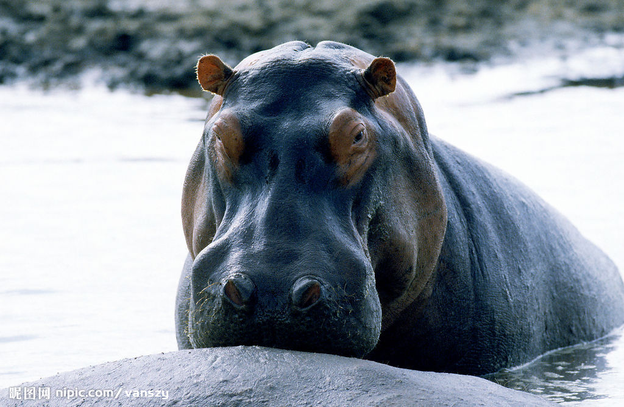
Hippos are big and violent-tempered animals.They attack both crocodiles and humans.Although there are no reliable statistics,Africans says that more people are killed by hippos each year than those killed by crocodiles,lions,and buffaloes combined.

Slide 13

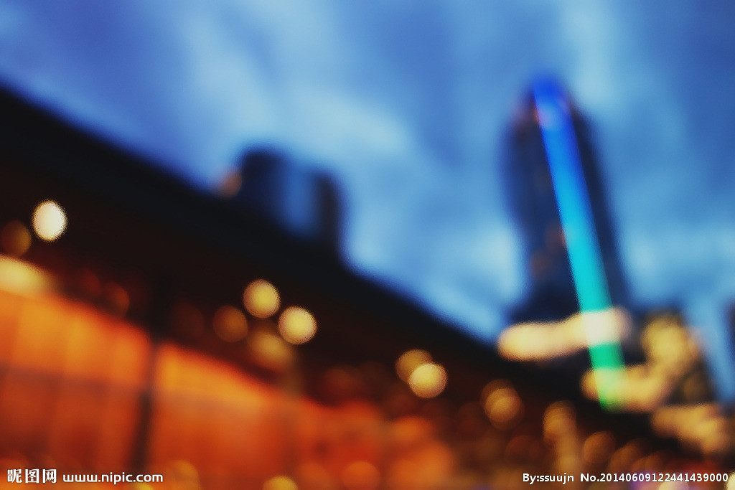
Human
Nevertheless,the human is the most dangerous creature on the Earth. Through murder,brutality,and war,humans have killed more people than any other creatures.

Slide 14

It is estimated that during the 20th century,between 167 and 188 million people were killed in wars.
Notes:
https://ununsplash.imgix.net/photo-1416949929422-a1d9c8fe84af?q=75&fm=jpg&s=f53cfc09b4e1acf0c5faa0e5962d27d1
https://unsplash.imgix.net/photo-1415889678233-eb900aeee9e1?q=75&fm=jpg&s=a41f4d6b1848cd673323fa4ee17da470
你能看到在页面的顶端与底部有两个颜色不同的平行四边形色块。你可以在底部放上网址，在顶端放上公司口号等。当然，不加也是可以的。

Slide 15
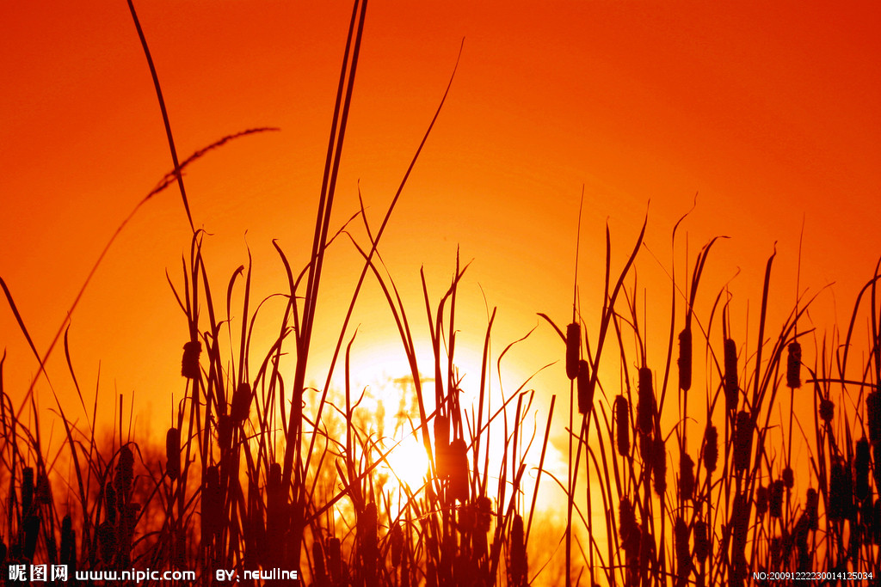
To conclude:
1.We should beware of wild animals when we go to natural habitat.
2.We should protect the animals and encourage others to do so.

Slide 16

THANKS
G O O D B Y E
http://www.bilibili.com/video/av1645837/

