Slide 1
考点串讲讲练互动
[单词精研]
1.stress n．重压,逼迫,压力;重音;重点
vt.强调;重读
(2012·高考陕西卷·阅读理解C)The authors of both studies stress that these risks are relatively small for healthy people. 两篇论文的作者都强调对于健康的人来说这些风险相对较小.

Slide 2
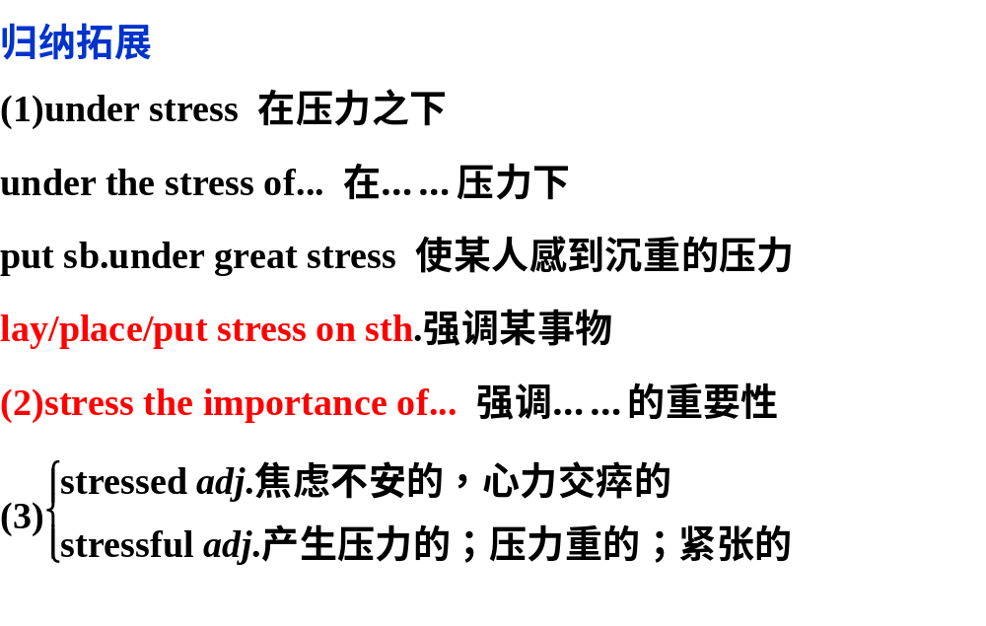

Slide 3
①(牛津P₁₉₉₇)Things can easily go wrong when people are under stress.人在压力之下,办事情容易出差错。
②(牛津P₁₉₉₇)I think the company places too much stress on cost and not enough on quality.
我认为公司对成本强调有余,而对质量重视不足。
③As has been stressed many times, learning English well is of great importance to your career development in future.
正如多次强调的那样,学好英语对你们今后的职业发展非
常重要。
④Cooperation or teamwork, the importance of which is often stressed, plays an important part in football matches.
合作或协作,在足球比赛中起着重要作用,这一点经常被强调.

Slide 4
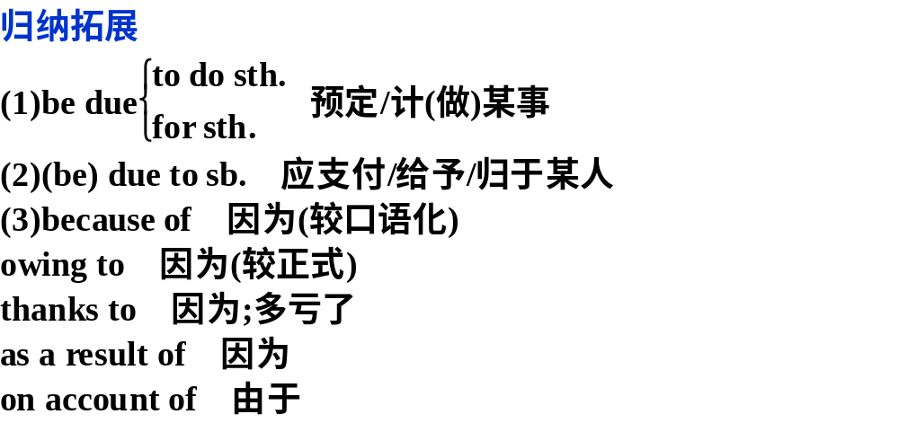
2.due adj.欠款的;预定的;到期的
(教材P₁₈)I think my long and active life must be due to the healthy life I live. 我想我之所以长寿而且精力充沛,要归功于我的健康生活。

Slide 5
①The water shortage is severe mainly due to global warming, environmental pollution and the ever-increasing population.水资源严重短缺主要是由全球变暖、环境污染和人口持续增长造成的。
②Either you or one of your students is to attend the meeting that is due tomorrow.
你或者你的一名学生要参加明天的会。
③Any money that is due to you will be paid before the end of the month.欠你的钱将在月底之前全部支付给你。
④If the trip is a success, a lot of this will be due to Mr.Green’s efforts.如果说这次旅行获得了成功,那很大程度上要归功于格林先生的努力。

Slide 6
3. effect n. 结果，影响，效力
When I was young, I didn’t know much about the harmful effects of smoking.
归纳拓展：
have an effect on… 对…有影响
bring/carry/put sth. into effect 实施，使生效
come/ go into effect = take effect 生效
in effect 事实上， 在实施中
of great/ no effect 有效，无效
The new law on drunk driving came into effect last year, and it has had a great effect on our life. In effect, all of us hope to put more such laws into effect to make sure of the safety of drivers and road users. So far the new law has been of great effect.

Slide 7
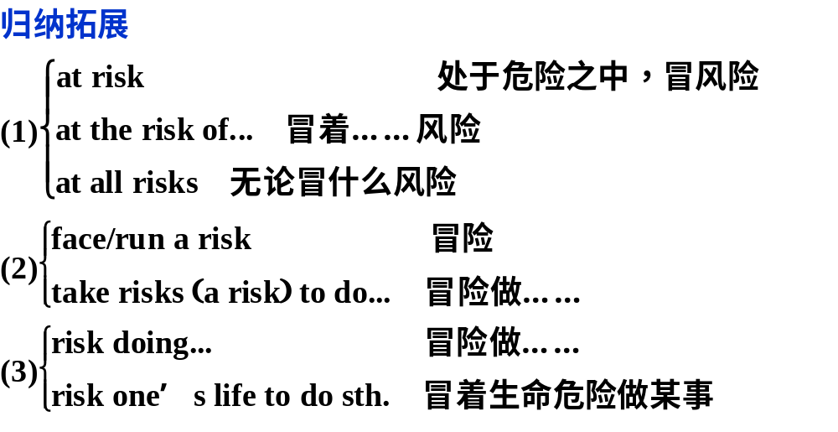
4.risk n．危险;风险 vt.使冒险;冒……风险
(教材P₂₀)He felt he had to make up his mind on every step instead of taking risks.
他认为他必须决定每一步而不冒险。

Slide 8
[短语精释]
1.get into 陷入;染上(坏习惯)
(2012·高考江西卷)I’ve got into the habit of calling in on my grandparents on my way home from school.
我已经养成了从学校回家时顺路拜访我祖父母的习惯。
归纳拓展
get across (使)通过;(使)被理解;(把……)讲清楚
get along 进展;相处
get away 逃脱;离开
get down to 认真工作
get over 爬过;越过;克服困难;痊愈
get through 穿越(马路);通过;接通电话;经历

Slide 9
①Many homeless people get into the habit of begging to get enough money to stay alive.
许多无家可归的人开始养成乞讨谋生的习惯。
②Hi,Bob,how are you getting along with your spoken
report？嗨,鲍勃,你的口头报告准备得怎么样了？
③It took me a very long time to get over the shock of her death.
得知她去世的消息我惊愕不已,很长时间才缓过劲来。
④A smile can help us get through difficult situations and find friends in a world of strangers.
微笑可以帮助我们渡过难关,在陌生人中找到朋友。

Slide 10
2.in spite of 不顾,不管;尽管,虽然
(教材P₂₀)In spite of all his efforts he failed.He was so upset about himself that he felt like crying.
尽管他很努力还是失败了,他伤心地想哭。
①In spite of the fact that doctors have warned that smoking does harm to health,people still keep on smoking.
尽管医生已经警告说吸烟有害健康,人们还是继续吸烟。
②In spite of her good salary, she measured out every dollar needed for household expenses.她的工资尽管不错,但在家务开支上每一块钱她也要算一算。

Slide 11
【温馨提示】
(1)in spite of与despite同义,常可换用。in spite of为普通用语, despite多用于书面语言,despite不与of连用。
(2)although/though也是“尽管;不管;不顾”的意思,但用作从属连词,后面接让步状语从句。in spite of/despite＋n.＝although＋从句。体会：
③In spite of/Despite the fact that how much it will cost, we must take every measure to save the old man’s life.
＝Although it costs too much, we must take every measure to save the old man’s life.
不管费用多少,我们必须采取一切措施抢救这位老人。

Slide 12
[句型精析]
1.(教材P₁₈)I do hope so because I want you to live as long and healthy a life as I have. 我的确希望这样,因为我想让你过上和我一样长寿而健康的生活。
[句法分析]
(1)此句式为as＋adj.＋a/an＋单数可数名词＋as。
①We wanted him to have as full a life as possible, no different from what we want for our other two sons.
我们想让他尽可能地过充实的生活,与我们对其他的两个孩子的期望没有区别。
②The man hopes to live as simple a life as his grandpa.
这个小伙子希望和他爷爷一样过着俭朴的生活。

Slide 13
【温馨提示】类似此句型的用法too/so/how＋adj.＋a/an＋n..
③I have never met so young a body with so wise a head.
我从来没见过这么年轻又这么聪明的人。
④This is too difficult a problem for the beginners to solve.这个问题对于初学者来说太难解决了。

Slide 14
(2)do/does/did＋动词原形
归纳拓展
“do/does/did＋动词原形”构成强调句,意为“确实,的确”,用来加强谓语动词的语气,但须符合以下条件：
(1)句子是肯定句;
(2)句子的时态为一般现在时或一般过去时。

Slide 15
⑤To my great joy, the plant did look exactly like what we were looking for.使我高兴的是,这棵植物看起来的确像是我们正在寻找的那种。
⑥He does work hard and finish the job in time.
他工作的确努力,及时完成了任务。

Slide 16
2.(教材P₁₉)Every time you feel like smoking a cigarette, remind yourself that you are a non-smoker. 每当你想要吸烟的时候,你就提醒你自己,你(已经)是不抽烟的人了.
[句法分析]
every time可以用来引导时间状语从句。表示经常性的动作, “每次”的意思。该从句中也用一般时态代替将来时。
①Every time you smile at someone, you give a gift to that person.
每次你向某人微笑的时候,你就给了那人一件礼物。
②Every time we made mistakes in our homework, he would ask us to correct them.
每次我们在作业中出错,他总是要我们改正。

Slide 17
归纳拓展
(1)下列名词词组可以起连词作用：
the first/last time
next/any/every/each time
the moment/instant/minute
(2)directly, instantly, immediately等也可用来引导时间状
语从句。

Slide 18
③Be careful！The machine starts the moment you press the button.小心！你一按按钮机器就启动了。
④ Immediately she offered/put forward the suggestion, a storm broke about her ears.
她一提出那建议,立刻就引起了一场轩然大波。

