Slide 1

同步教学辅助课件
必修5

Slide 2



Unit 4
Making the news
Language points

Slide 3

Objective
To learn some useful words and expressions in the passage
Focus on
Words:
delighted, assist, eager, concentrate, acquire, assess, inform, meanwhile, accuse, demand
Expressions:
concentrate on, depend on, accuse … of, so as to (do sth)
Patterns:
not only … but …, only if …

Slide 4

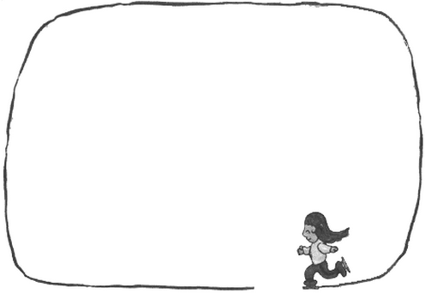
conj. 如果，假设
vt. 猜想，认为
suppose
_________ you were to be a journalist for China Daily, …
Supposed
be supposed to do sth
be supposed to be sth
suppose (that)
supposed

Slide 5
be supposed to do sth
被期望做……; 应该……
you're supposed to tell the teacher if you want to leave the classroom.
be supposed to be sth
被相信是；被认为……
The castle is supposed to be haunted (闹鬼的).
suppose (that)
猜测；认为
Do you suppose (that) Gillian will marry him?
suppose…
假定；假设
Look, suppose you lost your job tomorrow, what would you do?
supposed adj. 据说的，假定的

Slide 6
delighted
adj. 快乐的；欣喜的
We are ________ to know that you’re coming to work with us.
delighted
delighted with sth
delighted by/at sth
delighted that…
delighted to do sth

Slide 7
delighted with sth
We're delighted with our new house.
我们对新房子非常满意。
delighted by/at sth
I was delighted at/by your news.
你带来的消息让我很高兴。
delightful
adj. 令人愉快的，讨人喜欢的
a delightful young man
delighted that…
I'm absolutely delighted that you can come.
你能来我特别高兴。
delighted to do sth
We'd be delighted to come to dinner on Friday.
我们很愿意来参加星期五的晚宴。

Slide 8
assist
vi./vt. 帮助；协助；援助
I was employed to _______ the manager with his duties.
assist
assist (sb) with/in
assist somebody to do sth
assistant
assistance

Slide 9
assist (sb) with/in
You will be expected to assist the editor with the selection of illustrations for the book.
希望你能帮助编辑为本书挑选插图。
The army arrived to assist in the search.
军队赶到协助搜寻。
assistant
n. 助手；助理；售货员
assistance
n. 帮助；援助

Slide 10


Translate the following sentences.
practice
Please assist her in moving the furniture.
请帮助她搬家具。
他要我们帮助他实施他们的计划。
He asked us to assist him in carrying out their plan.

Slide 11
concentrate
vi./vt. 集中；聚集
Keep the noise down, will you? I’m trying to __________.
concentrate
be concentrated on/in/around
concentrate on
concentrated

Slide 12
be concentrated on/in/around
Italian industry is concentrated mainly in the north of the country.
意大利的工业主要集中在该国北部。
concentrate on
集中；全神贯注于
The company is concentrating on developing new products.
公司正在集中力量开发新产品。
concentrated
adj. 浓缩的；全神贯注的
He made a concentrated effort to improve his work.
他集中精力改进自己的工作。

Slide 13
acquire
vt. 获得；取得；学到
I look on it as an opportunity to __________________.
我把这当做是一次学习新技能的机会。
He _________________ in 1978.
他于1978年收购了这家公司。
The team has _______a fearsome reputation.
这支队伍赢得了令人生畏的名声。
acquire fresh skills
acquired the firm
acquired

Slide 14
assess
vt. 评估；评定
It’s difficult to ______ the effects of the new legislation just yet.
assess
assess what/how etc + clause
assess sth at
assessment

Slide 15
assess what/how etc + clause
We need to assess whether the project is worth doing.
我们需要评估一下这个项目是否值得去做。
assess sth at
They assessed the cost of the flood damage at £1500.
他们估定洪水造成的损失为1500英镑。
assessment
n. 评估；估价
Would you say that is a fair assessment of the situation?
你认为那是对形势的合理评估吗？

Slide 16
inform
vt. 告知；通知
They must use research to ________ themselves of the missing parts of the story.
inform
inform sb (of/about sth)
inform sb that…

Slide 17
inform sb (of/about sth)
Why wasn't I informed about this earlier?
为什么不早点儿将这事通知我？
Please inform us of any change of address as soon as possible.
地址如有变更，请尽早通知我们。
inform sb that…
I informed my boss that I was going to be away next week.
我告诉老板下周我不在。

Slide 18
accuse
vt. 指责；谴责；控告
"It wasn't my fault." "Don't worry, I'm not _________ you."
accusing
accuse sb of (doing) sth
stand accused of sth
accused

Slide 19
accuse sb of (doing) sth
Are you accusing me of lying?
你是在指责我撒谎吗？
He's been accused of robbery/murder.
他被指控犯有抢劫／谋杀罪。
stand accused of sth
被正式指控
The government stands accused of eroding freedom of speech.
政府受到侵犯言论自由的谴责。

Slide 20


of
accuse sb. ___ sth./doing sth.
控告、指责某人某事
with
charge sb. ____ sth./doing sth.
控告、指责某人某事
注意
blame sb. ___ sth./doing sth.
因某事指责某人
for

Slide 21
提醒某人某事
通知某人某事
使某人信服某事
说服某人某事
抢劫某人某物
使某人摆脱某事
警告某人某事
remind sb. of sth.
inform sb. of sth.
convince sb. of sth.
persuade sb. of sth.
rob sb. of sth.
rid sb. of sth.
warn sb. of sth.

Slide 22
demand
vt. 强烈要求
The car workers' union is __________ a 7% pay rise this year.
demanding
demand sth
demand to do sth
demand that…

Slide 23
demand sth
I demanded an explanation.
我要求给我一个解释。
demand to do sth
demand n. 要求；需求
You can't give in to children's demands all the time.
There was little demand for tickets.
demands （困难的）要求
I demand to see the manager.
我要求见经理。
demand that…
She demanded that he return the books he borrowed from her.
她要求他把从她那里借走的书还回来。

Slide 24

Review
1. delight (vt.) 使高兴 →
delighted (adj.) 快乐的；欣喜的
2. admire (vt.) 钦佩；赞美 →
admiration (n.) → 钦佩；赞赏；赞美
admirable (adj.) 值得赞扬的；令人钦佩的
3. profession (n.) 职业；专业 →
professional (adj.) 专业的；职业的
4. accuse (vt.) 指责；谴责；控告 →
accusation (n.) 指责；谴责；控告
5. deliberate (adj.) 故意的 →
deliberately (adv.) 故意地

Slide 25
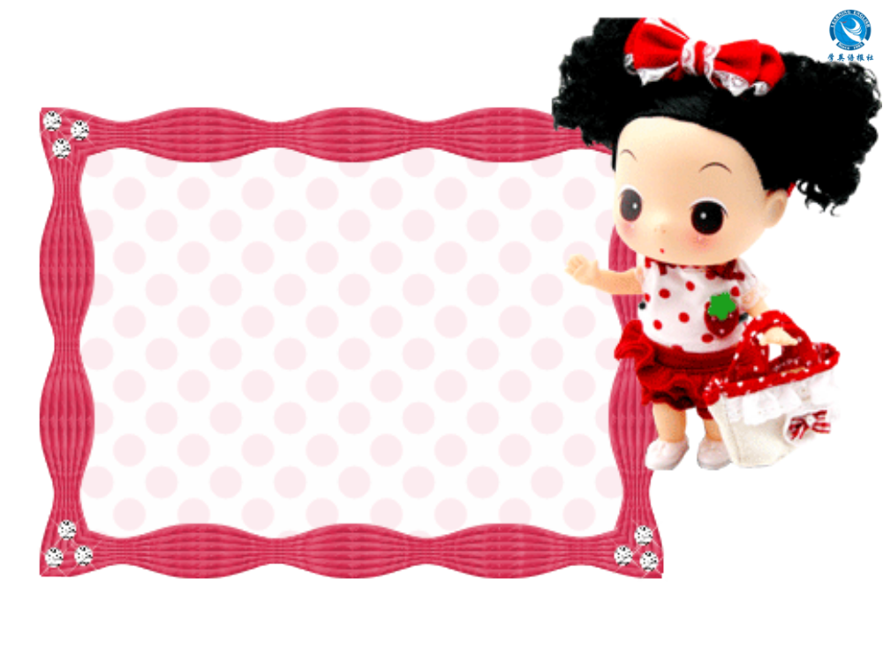


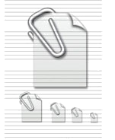
注: 另附 word 文档。
点击此处链接
Individual activity

Slide 26

Quiz I: Fill in the blanks.
delighted
1. I was _________ (very pleased) at/by
your news.
2. I think you showed __________ (值得赞
扬的) self-control in your answer.
3. It's un_____ to have an adult conversation
like that with such a young child.
4. The army arrived to _____ (help) in the
search.
5. You must ________ (offer) your
application before January 1st.
admirable
unusual
assist
submit

Slide 27
6. Chris, you're a nurse, so can I ask your
___________ (专业的) opinion on
bandaging ankles?
7. She sounded very ______ (热切的) to
meet you.
8. Most of the country's population is
___________ (聚集) in the north.
9. This tennis tournament is open to both
a________ and professionals.
10. We should ________ (取得) more
firsthand information.
professional
eager
concentrated
amateurs
acquire

Slide 28
11. Examinations are not the only means
of as_______ a student's ability.
12. There's no way I can meet that
________ (最后期限).
13. "It wasn't my fault." "Don't worry,
I'm not ________ (指责) you."
14. I'm sure he says these things
__________ (intentionally) to annoy me.
assessing
deadline
accusing
deliberately

Slide 29
sceptical
15. Many experts remain _________
(doubting) about/of his claims.
16. I feel so ______ (内疚的) about
forgetting her birthday.
17. She faces the di______ of disobeying
her father or losing the man she loves.
18. She was only 19 when her first novel
was _________.
guilty
dilemma
published

Slide 30
Quiz II: Translation.
1. __________________________________ (对摄影我不仅只是感兴趣), but I took an amateur course at university to update my skills.
2. __________________________________ (你只有提出了许多不同的问题之后) will you acquire all the information you need to know.
Not only am I interested in photography
Only if you ask many different questions

Slide 31
3. I can't _____________ (全神贯注于) my
work when I'm tired.
4. You can __________ (依靠) him.
5. He _____________ (被指控) giving false
witness.
6. The book will be indexed (编索引) in
the next edition _______ (为了) make it
more useful.
concentrate on
depend on
was accused of
so as to

