Slide 1
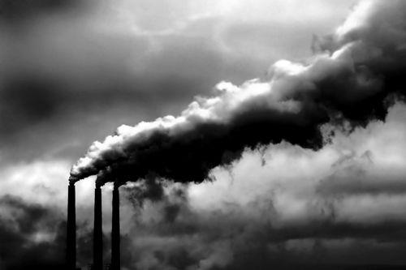
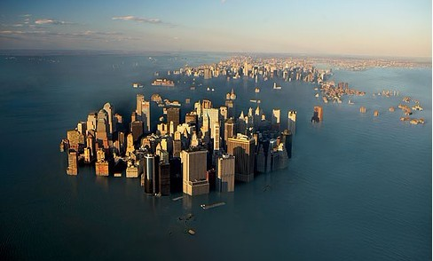
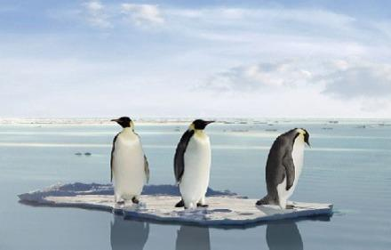
Global warming

Slide 2
Words and
Expressions
come about
graph
random
subscribe
subscribe to
fuel
quantity
quantities of
tend
发生；造成
n. 图标；坐标图；曲线图
adj. 胡乱的；任意的
vi. 同意；捐赠；订阅
vt. (签署)文件；捐助
同意；赞成；订购
n. 燃料
n. 量；数量
大量的
vi. 趋向；易于；照顾
vt. 照顾；护理

Slide 3
Words and
Expressions
go up
per
data
result in
trend
catastrophe
flood
oppose
opposed
be opposed to
mild
上升；增长；升起
prep. 每；每一
n. 资料；数据
导致
n. 趋势；倾向；走向
n. 大灾难；浩劫
n. 洪水；水灾
vt. 反对；反抗；与(某人)较量
adj. 反对的；对立的
反对
adj. 温和的；温柔的；淡的

Slide 4
Words and
Expressions
consequence
state
range
even if
keep on
glance
steady
tendency
widespread
on the whole
n. 结果；后果；影响
vt. 陈述；说明
n. 种类；范围
即使
继续
vi. 看一下；扫视 n. 一瞥
adj. 平稳的；持续的；稳固的
n. 倾向；趋势
adj. 分布广的；普遍的
大体上；基本上

Slide 5
Words and
Expressions
average
existence
outer
on behalf of
advocate
commitment
put up with
pollution
growth
electrical
as long as
adj. 平均的
n. 生存；存在
adj. 外部的；外面的
代表……一方；作为……的代言人
vt. 拥护；提倡；主张
n. 承诺；交托；信奉
忍受；容忍
n. 污染；弄脏
n. 增长；生长
adj. 电的；与电有关的
只要

Slide 6
Words and
Expressions
casual
circumstance
microwave
refresh
educator
contribution
presentation
nuclear
disagreement
adj. 随便的；漫不经心的；偶然的
n. 环境；情况
n. 微波炉；微波
vt. 使恢复；使振作
n. 教育工作者；教育家
n. 贡献
n. 显示；演出
adj. 核的；核能的；原子核的
n. 分歧；不一致

Slide 7
a picture which shows how two sets of information or variable amounts are related, usually by lines or curves
n. 图表; 坐标图; 曲线图
graph
happening, done or chosen by chance rather than according to a plan
adj. 胡乱的; 任意的
random
sth. that exists and can be seen, felt, tasted, etc., esp. sth. which is unusual or interesting
n. 现象
phenomenon

Slide 8
to agree with or support an opinion, belief or theory; to pay money regularly to be a member of an organization or to support a charity; to pay an amount of money regularly in order to receive or use sth.
vi. 同意; 捐赠; 订阅
subscribe
vt. (签署)文件; 捐助
a substance which is used to provide heat or power, usually by being burned
n. 燃料
fuel

Slide 9
the amount or number of sth., esp. that can be measured or is fixed
n. 量; 数量
quantity
to be likely to behave in a particular way or have a particular characteristic; to care for sth. or someone
vi. 趋向; 易于; 照顾
tend
vt. 照顾; 护理

Slide 10
used when expressing rates, prices or measurements to mean for each
prep. 每; 每一
per
information, esp. facts or numbers, collected to be examined and considered and used to help decision-making, or information in an electronic form that can be stored and processed by a computer
n. 资料; 数据
data

Slide 11
a general development or change in a situation or in the way that people are behaving; a new development in clothing, make-up, etc.
n. 趋势; 倾向; 走向
trend
a sudden event that causes very great trouble or destruction
n. 大灾难; 浩劫
catastrophe
to cause to fill or become covered with water, esp. in a way that causes problems
n. 洪水; 水灾
flood

Slide 12
to disagree with sth. or someone, often by speaking or fighting against them
vt. 反对; 反抗; 与(某人)较量
oppose
to disagree with a principle or plan; completely different
adj. 反对的; 对立的
opposed
not violent, severe or extreme; gentle and calm; describes food or a food flavour that is not very strong
adj. 温和的; 温柔的; 淡的
mild

Slide 13
a result of a particular action or situation, often one which is bad or not convenient
n. 结果; 后果; 影响
consequence
to say or write sth., esp. clearly and carefully
vt. 陈述; 说明
state
a set of similar things; the amount, number or type of sth. between an upper and a lower limit
n. 种类; 范围
range

Slide 14
There is no doubt that the earth is becoming
warmer and that it is human activity that has
caused this global warming rather than a random
but natural phenomenon.
2. All scientists subscribed to the view that the increase
in the earth's temperature is due to the burning of
fossil fuels like coal, natural gas and oil to produce
energy.
3. Without the ‘greenhouse effect’, the earth would be
about thirty-three degrees Celsius than it is.
4. It means that more heat energy tends to be trapped
in the atmosphere causing the global temperature to
go up.

Slide 15
6. Others who agree with her think there may be a rise
of several meters in the sea level, or predict severe
storms, floods, droughts, famines, the spread of disease
and the disappearance of species.
7. On the other hand, there are those, like George
Hambley, who are opposed to this view and believe that
we should not worry about high levels of carbon dioxide
in the air.
8. It will make plants grow quicker; crops will produce
more; it will encourage a greater range of animals---all
of which will make life for human beings better.

Slide 16
The burning of ___1___ like coal, natural gas and oil to
produce ___2___ results in the rise of the earth’s temperature.
Some ___3___ of this process are called ___4___ gases, the
most important of which is ___5___. There is a natural
___6___ that scientists call the “greenhouse effect”. This
is when small amounts of gases in the atmosphere, like carbon
dioxide, methane and water vapor, ___7___ heat from the sun
and therefore ___8___ the earth. ____9____ the ‘greenhouse
effect’, the earth would be about 33 degrees Celsius ___10___
than it is. So, we need those gases. The problem begins when …

Slide 17
All scientists agree that it is the burning of more and more fossil
fuels __1__ has resulted in this increase in carbon dioxide. Over the
next 100 years the amount of warming could be as low as 1 to 1.5
degrees Celsius, ___2___ it could be as high as 5 degrees. However,
the attitudes of scientists ___3___ this rise are completely __4___.
On the one hand, some think that any trend in which the
temperature increases by 5 degrees would lead to a ___5___.
Others who agree think there may be a rise of several meters in
the ___6___, or predict severe storms, floods, droughts, famines, the
spread of diseases and the extinction of __7__. On the other hand,
there are those who __8__this view and believe that we should
not worry about high levels of carbon dioxide in the air. The predict
that any warming will be __9__ with few bad environmental
consequences. Some even believe more carbon dioxide is a ___10___
thing that will make human life better.
PLEASE list out 3 points to support this belief.

