Slide 1
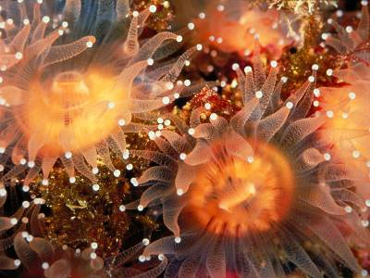
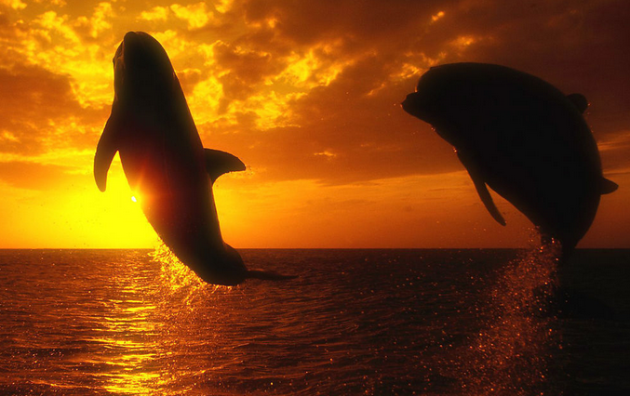
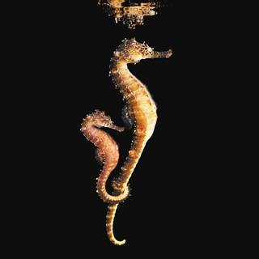
Unit 3
Under the sea

Slide 2
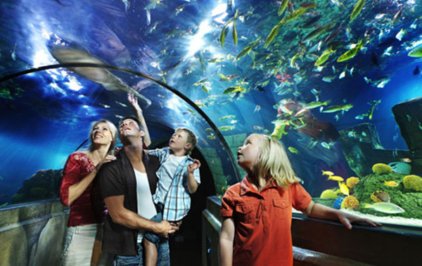
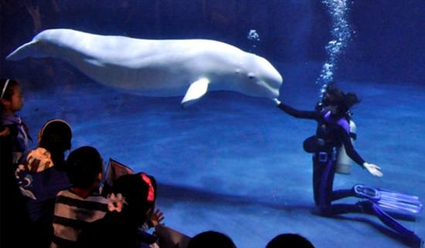
at an aquarium

Slide 3
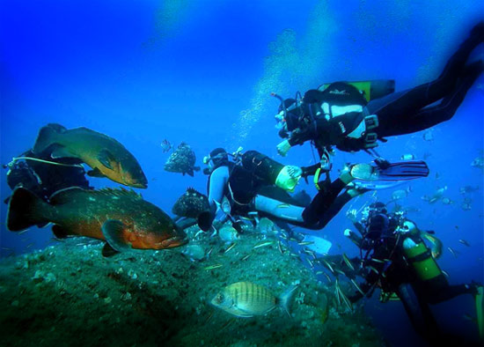
on a snorkeling trip

Slide 4
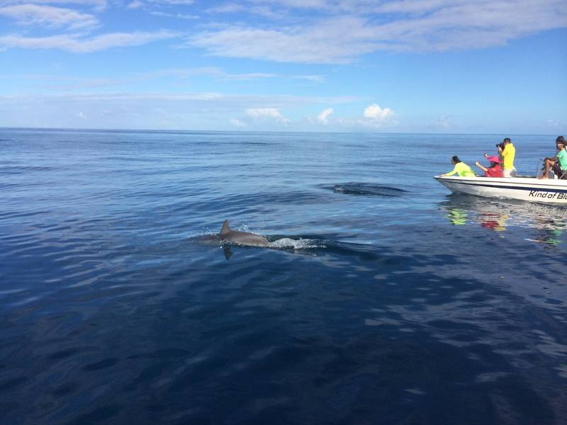
on a boat tour

Slide 5
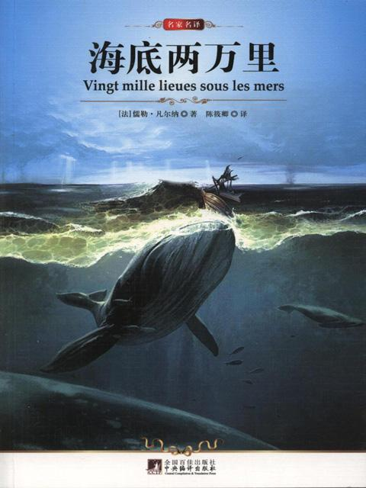

in books

Slide 6
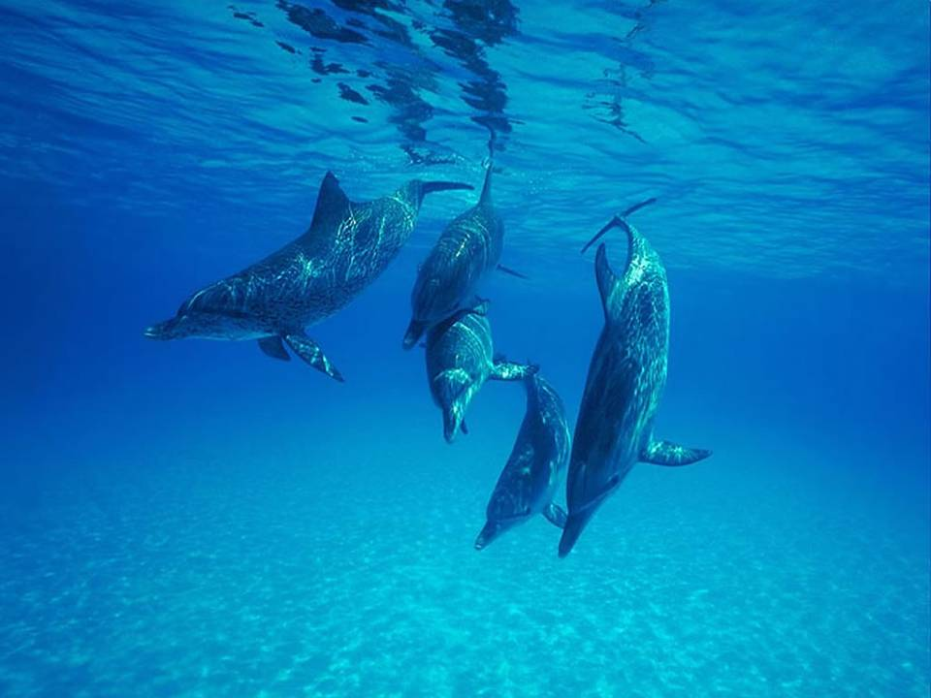
Now let’s see some animals that live under the sea? What are they?
Dolphins 海豚

Slide 7
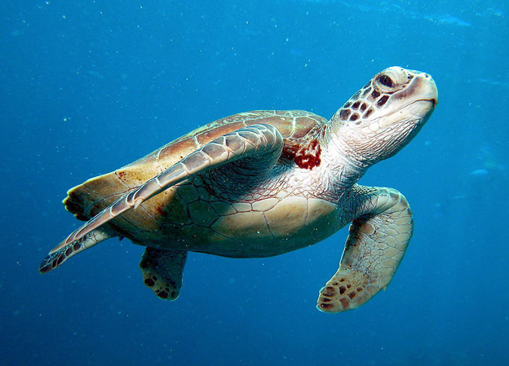
turtle 海龟

Slide 8
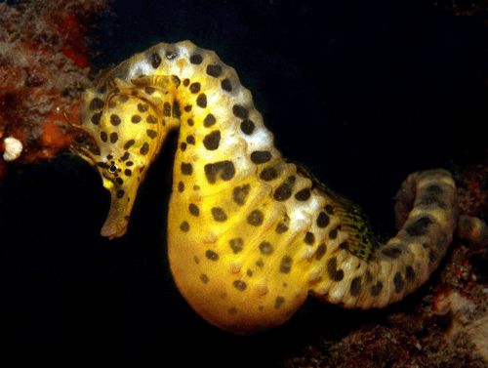
sea horse
海马

Slide 9
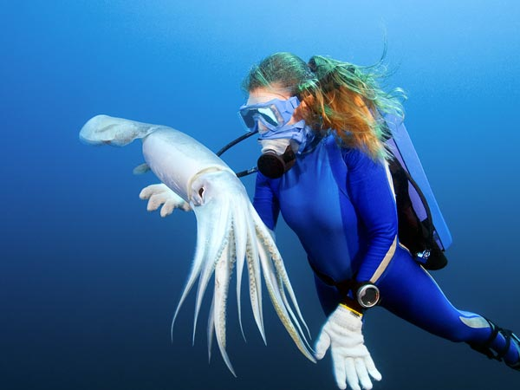
squid 鱿鱼

Slide 10
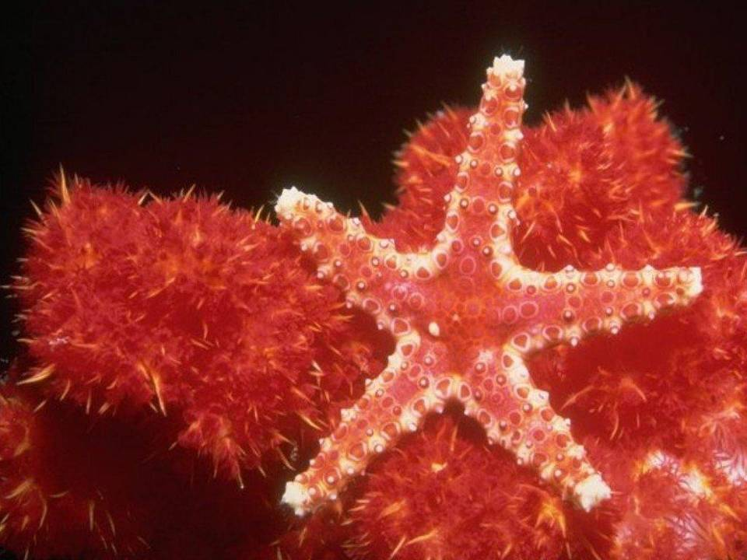
Sea star 海星

Slide 11
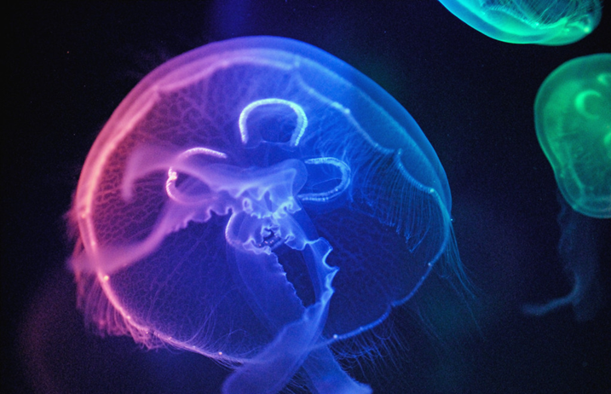
jellyfish 水母

Slide 12
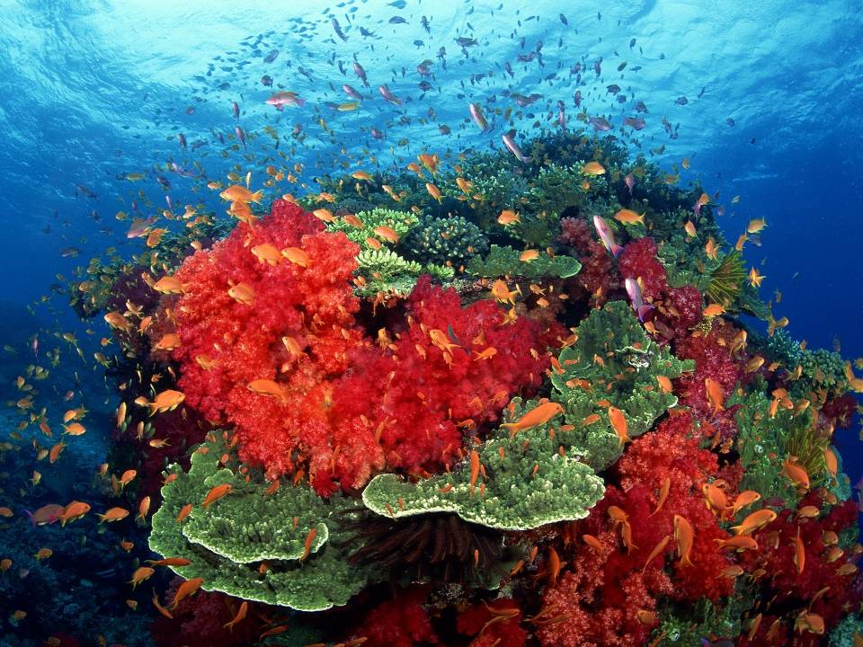
coral 珊瑚

Slide 13
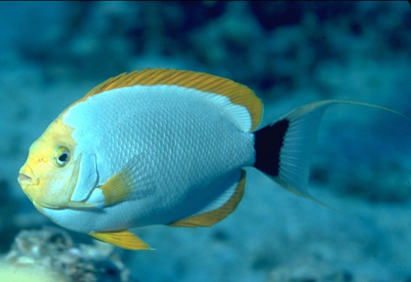
different kinds of little fish
angel fish 天使鱼

Slide 14
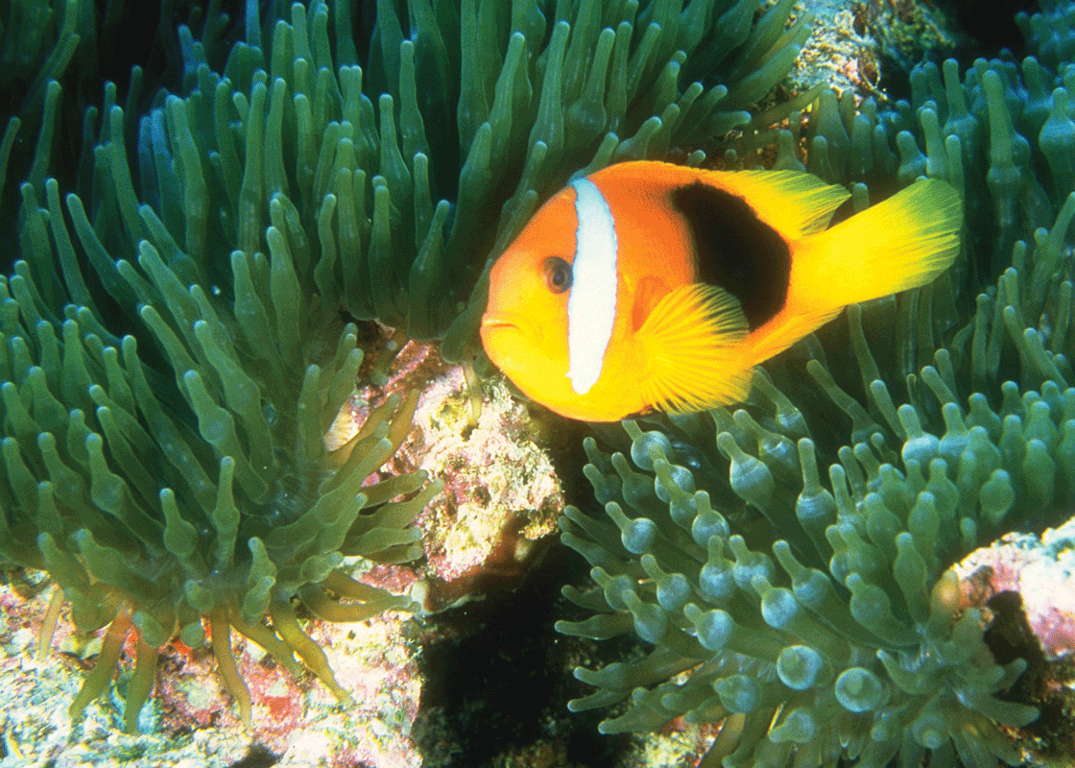
anemone fish 海葵鱼

Slide 15
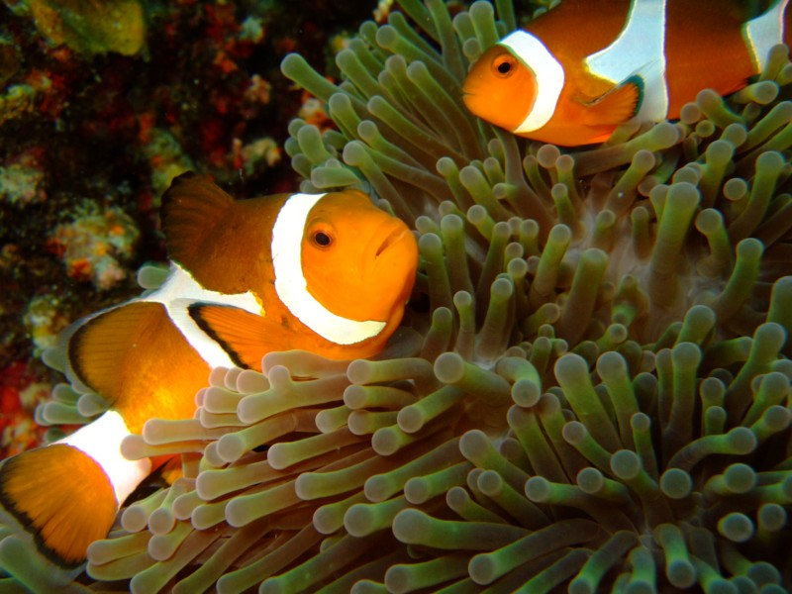
clown fish 小丑鱼

Slide 16
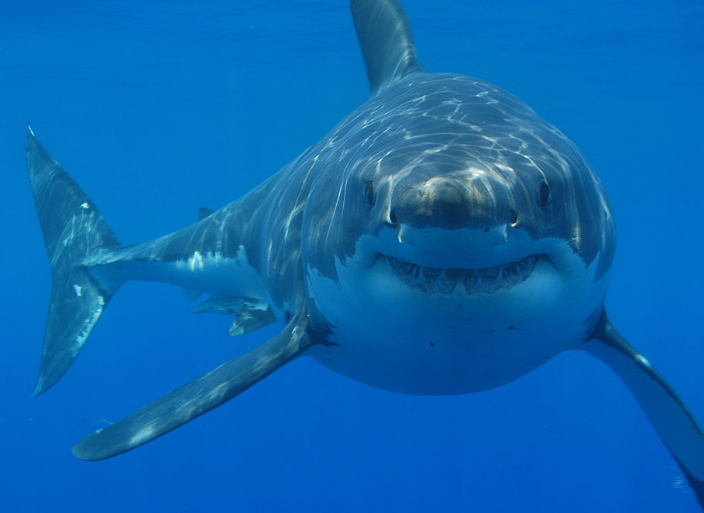
shark

Slide 17
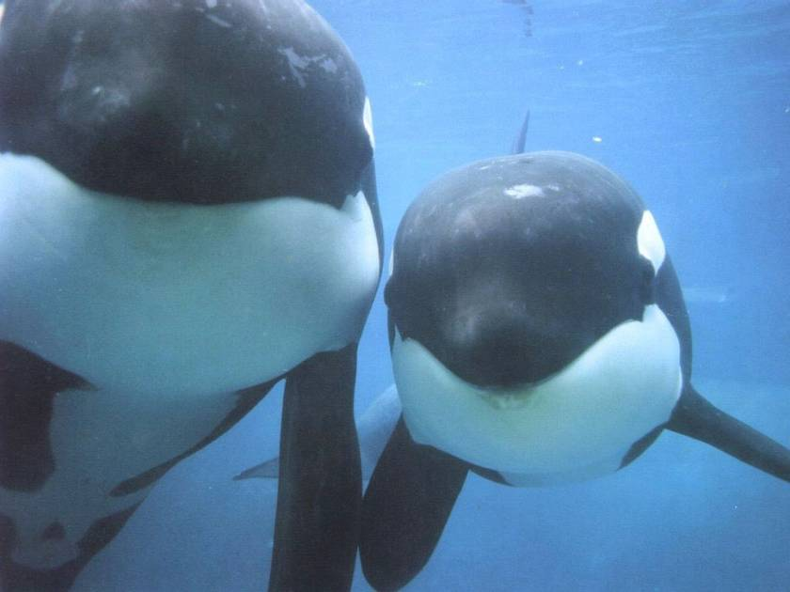
killer whales

Slide 18

What is a whale?
Whales are huge, intelligent sea
mammals (哺乳类动物).
They breathe air through blow-holes into lungs (unlike fish that breathe using gills).
Whales have smooth, shiny, streamlined (流线型) bodies that move easily through the water.

Slide 19

Classification of whales
There are two types of whales alive today:
toothed whales (齿鲸类) and baleen whales (须鲸类).
Toothed whales have teeth and a single blowhole. They feed on fish and other sea mammals.
Baleen whales are larger than toothed whales. They are filter feeders (滤食者) that use baleen to sieve (过滤) food, and have two blowholes.

Slide 20
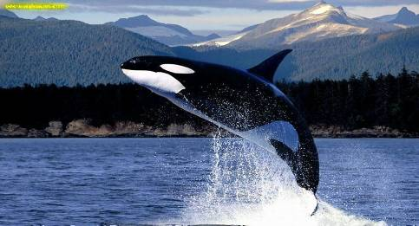
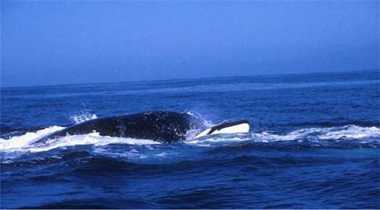
Killer whales (虎鲸) belong to toothed whales, which are the largest of the dolphins and king of the sea, biggest carnivore (食肉动物) of the sea, killing all kinds of animals in the sea, even the huge blue whale, working in a team.

Slide 21
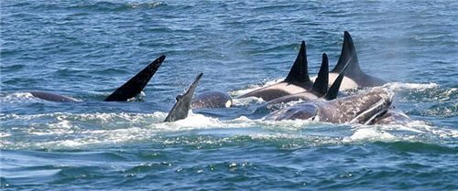
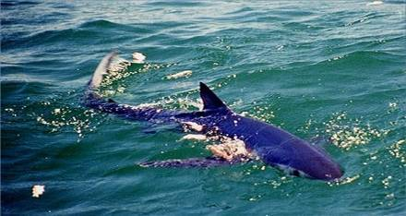
Average lifespan: 50 to 80 years
Size: 7 to 9.7 m
Weight: about 9 tons

Slide 22
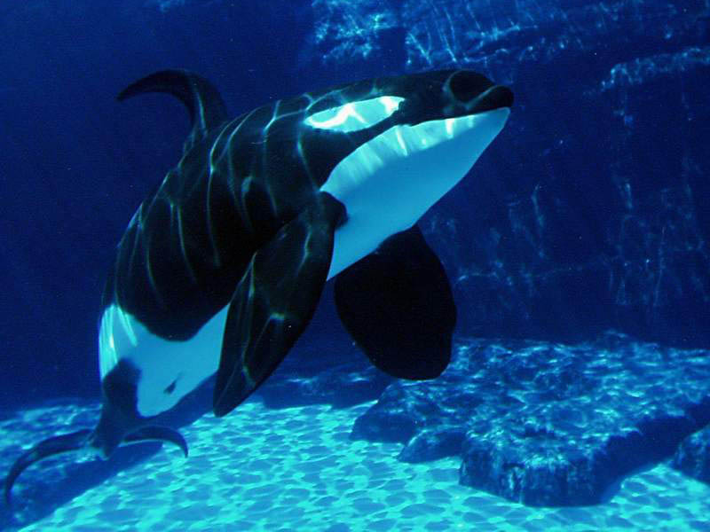
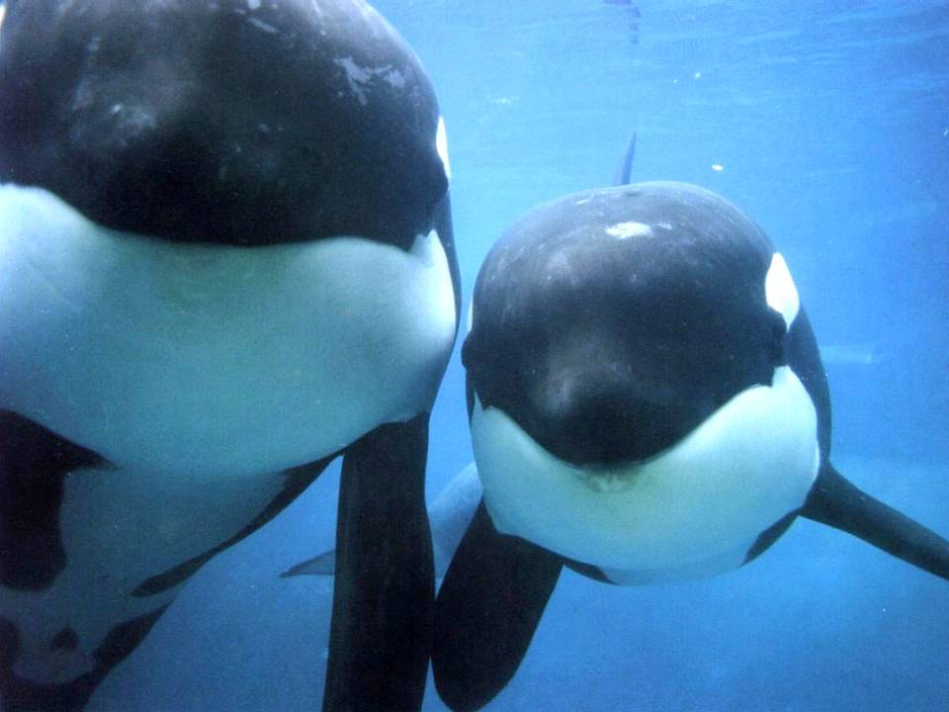

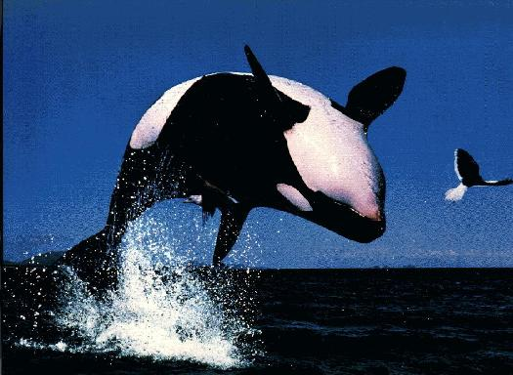
Killer whales

