Slide 1
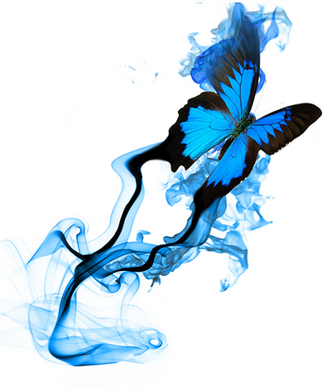


Slide 2
What is a poem?
A poem is a piece of writing in which the words are arranged in separate lines, often ending in rhyme, and are chosen for their sound and for the images and ideas they suggest.

Slide 3
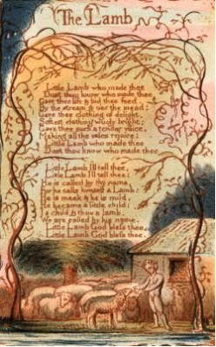
Poet Percy Bysshe Shelly defined poetry as “the expression of the imagination.” Robert Frost said that a poem forms when
“an emotion has found its
thought and the thought
has found words.”

Slide 4
Why do people write poems?
People write poems
to tell a story
to express feelings
to make others laugh
to tell the life or friendship
to delight the kids
to describe the seasons or scenes
as the lyric of a song …
Do you have your favorite poem in English or in Chinese?

Slide 5
Have you read the two poems below?
A Grain of Sand
William Blake
To see a world in a grain of sand,
And a heaven in a wild flower,
Hold infinity in the palm of your hand,
And eternity in an hour.

Slide 6

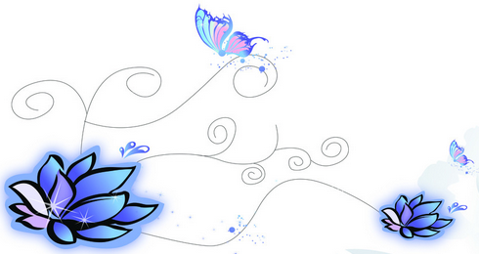
一粒沙
一沙一世界，
一花一天堂，
掌中无极限，
永恒刹那间。
威廉·布莱克

Slide 7
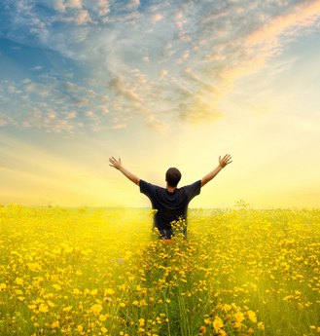
Dreams
By L. Hughes
Hold fast to dreams
For if dreams die
Life is a broken-winged bird
That can never fly
Hold fast to dreams
For when dreams go
Life is a barren field
Frozen only with snow

Slide 8

梦想
兰斯顿·休斯
紧紧抓住梦想，
千万别让它消亡，
否则生活就像鸟儿断了翅膀，
再也不能飞翔。
紧紧抓住梦想，
千万别让它消亡，
否则生活就像严冬的荒野，
遍地布满冰霜。

Slide 9
She Walks in Beauty
Lord Byron
She walks in beauty, like the night
Of cloudless climes and starry skies;
And all that’s best of dark and bright
Meet in her aspect and her eyes:
Thus mellow’d to that tender light
Which heaven to gaudy day denies.
…

Slide 10
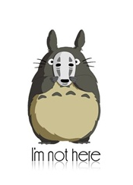
This Little Bag by Jane Austen
This little bag I hope will prove
To be not vainly made —
For, if you should a needle want
It will afford you aid.
And as we are about to part
T'will serve another end,
For when you look upon the Bag
You'll recollect your friend

Slide 11
characteristics of poems
Poems have beats. They may rhyme(押韵) or may not rhyme — but they have to have rhythms (节奏).
This beat is not always obvious, but it’s usually there.

Slide 12
What is rhythm in poetry?
Think of a song you like. What is it about that song that makes you tap your feet or want to dance? It is the rhythm of the song. In a similar way, all poems that are not written in free verse have rhythm, or a beat, as well.

Slide 13
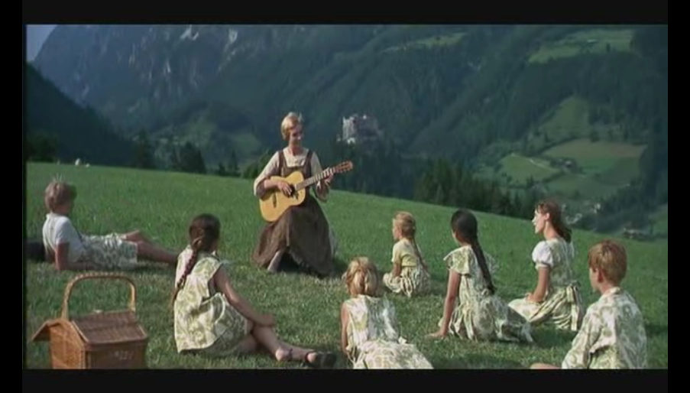

an English poem in the form of a song: Do-Re-Me and try to find out the rhymes and the rhythm.

