Slide 1








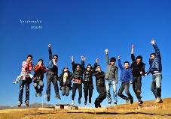
Unit 5
Traveling abroad

Slide 2







Around the world
Nowadays, Why do more and more Chinese enjoy traveling abroad?

Slide 3

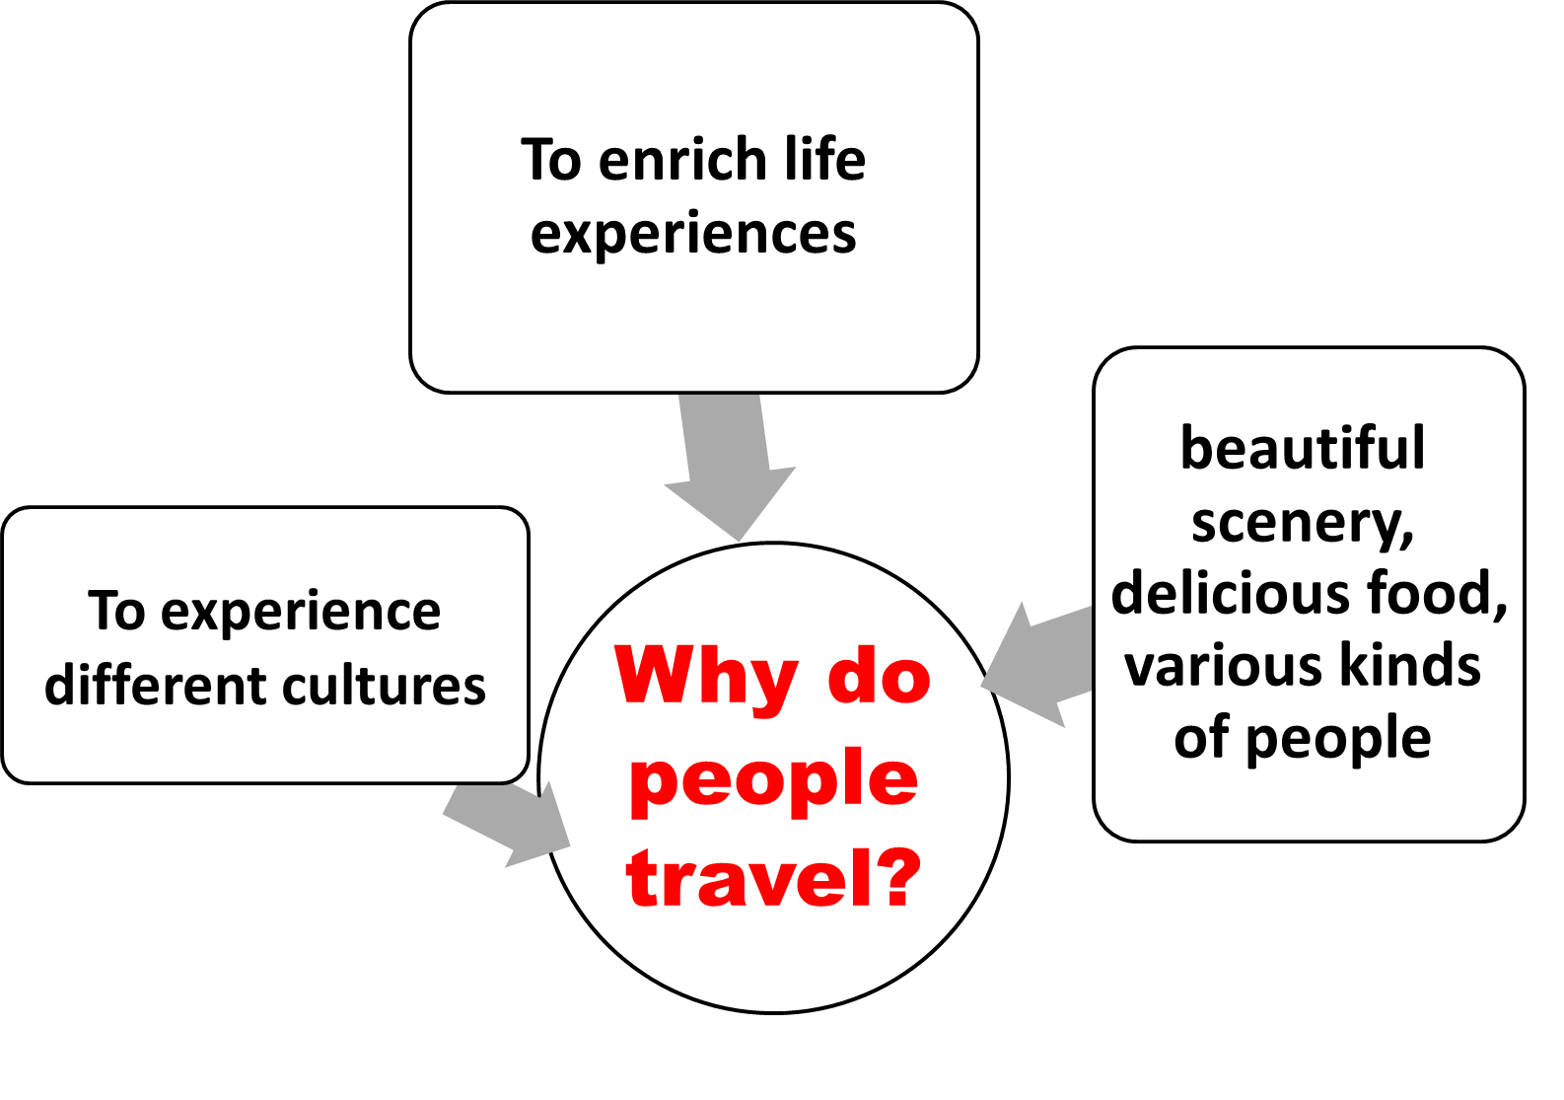


…

Slide 4



Discussion
1. Have you ever considered studying in a foreign country? Why or why not?
2. What are the advantages and disadvantages of studying in a foreign country?

Slide 5


Slide 6
Advantages
fun to live in a new country
help us to develop life skills and become independent
would be easier to learn a foreign language
learn advanced knowledge and technology
learn a lot about local customs and broaden our views
enjoy many new experiences
discover new strengths and abilities, conquer new challenges, and solve new problems

Slide 7
Disadvantages
Language barrier in the first few months
The overseas students who have weak self-control may give in to certain kinds of bad temptations so that they spend much less time and effort on their major goal – study.
The fierce competition among all the overseas students.
Long time being apart from their families may cause homesickness or even illnesses.
Difficult to adjust to local lifestyle (culture shock)

Slide 8




Slide 9

The world is getting smaller and smaller. We have more and more opportunities to travel and study in a foreign country.
Travelling helps us learn a lot about local customs and broaden our views. Besides, it is relaxing and we can get rid of our anxiety and stress.
Overseas study will help you develop skills and give you experiences a classroom setting will never provide. It's an opportunity to discover new strengths and abilities, conquer new challenges, and solve new problems.

Slide 10

Homework
1. look up the new words and expressions of the reading passage in the dictionary.
2. Preview the Reading:
KEEP IT UP, XIE LEI
Chinese student fitting in well

