Slide 1
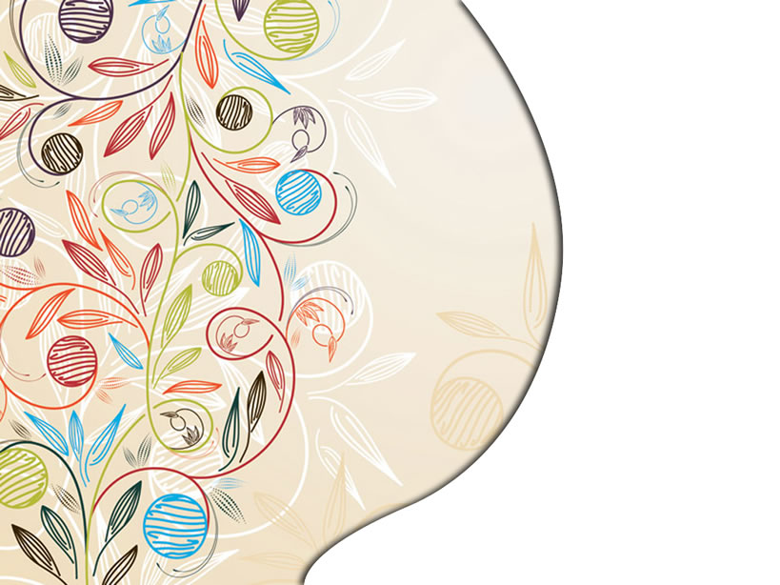
Should be careful:the pictures of my PPT have a lot of Chinese because of the situation,please forgive me.
My presentation

Slide 2

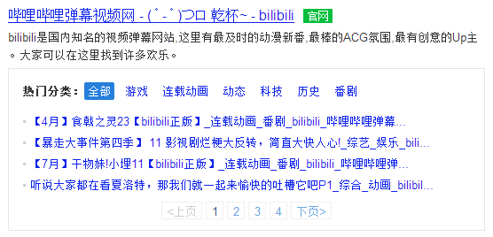
Topic

Slide 3
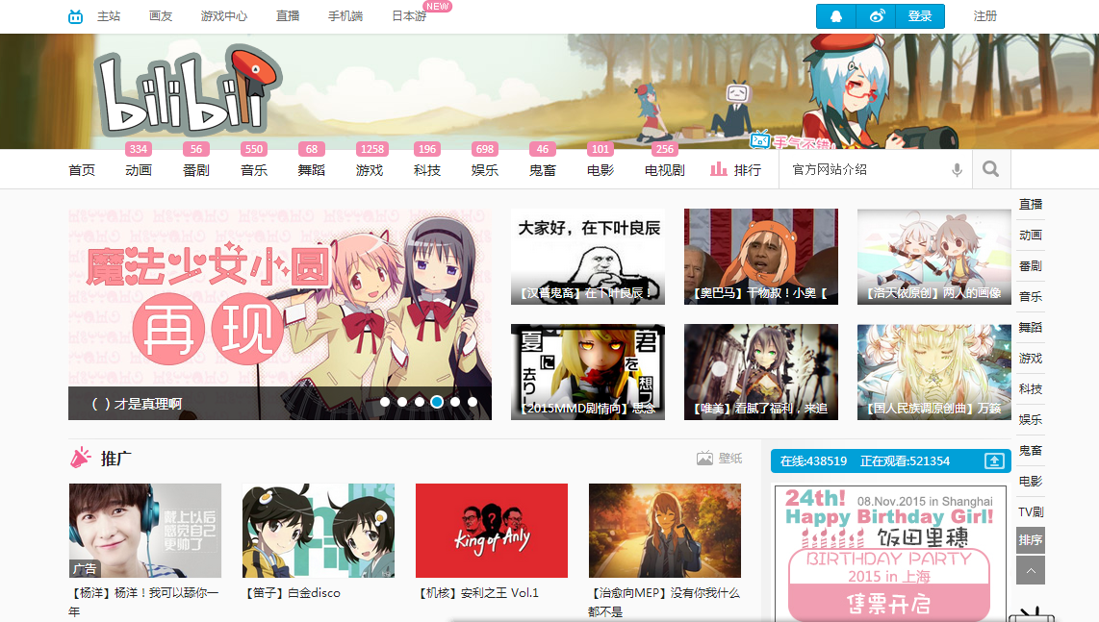
www.bilibili.com

Slide 4
Janpannese anime
dance
technology
music
games
......

Slide 5
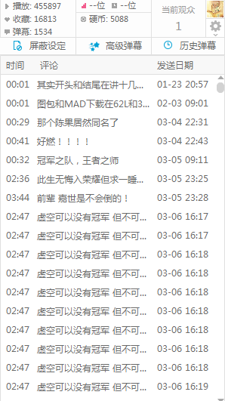
Barrage 弹(dan)幕
Please ignore the content of this picture.

Slide 6
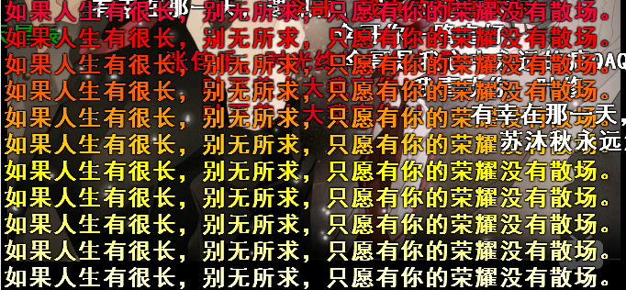
Please ignore the content of this picture.

Slide 7
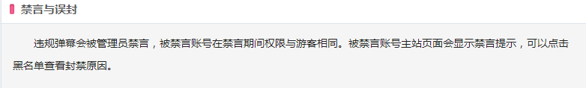
The culture and etiquette of barrages
礼仪

Slide 8
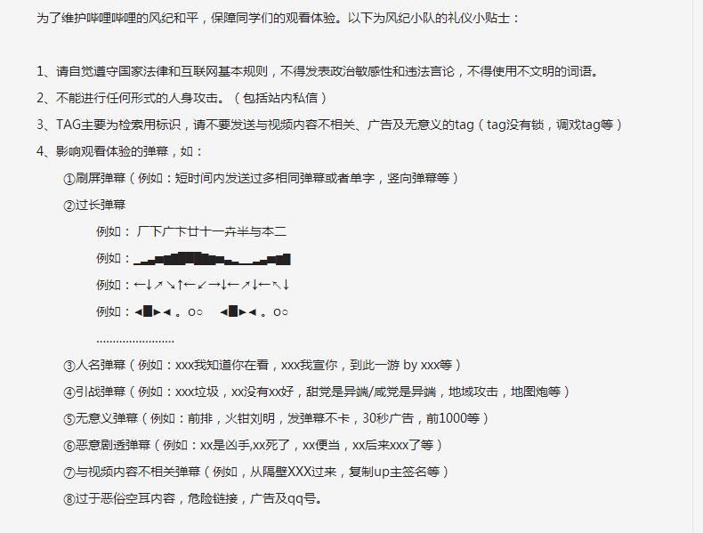

Slide 9

Now,let's watch a short video
to feel or enjoy the charm of the barrages.
http://www.bilibili.com/video/av2947570/
http://www.bilibili.com/video/av2789611/
I don't tell you what the videos about ,you can choose,good luck.XD

Slide 10
Conclusion
Finally,I want to say two points.
First,we can express our ideas or feelings through the barrages when we are watching a video.It's great and cool,isn't it?
Second,we should have the creative spirits that we can create something cool or something useful.The barrages are a good example.

Slide 11
That's all,thank you for listening.

