Slide 1
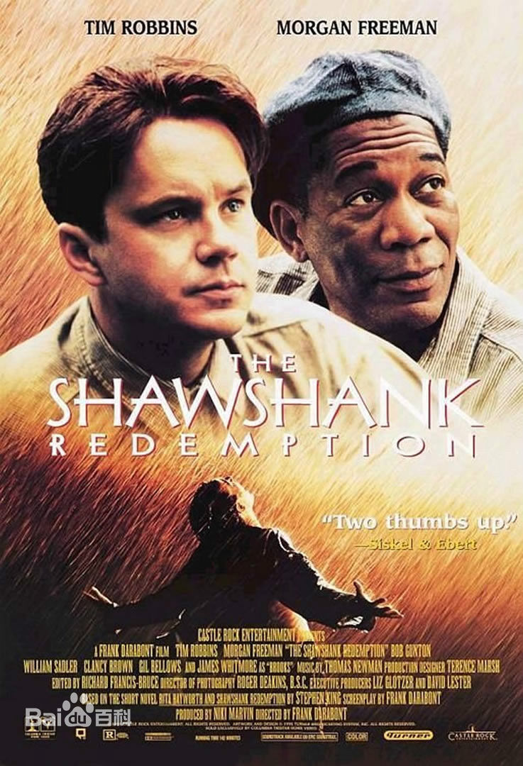
The Shawshank
Redemption

Slide 2
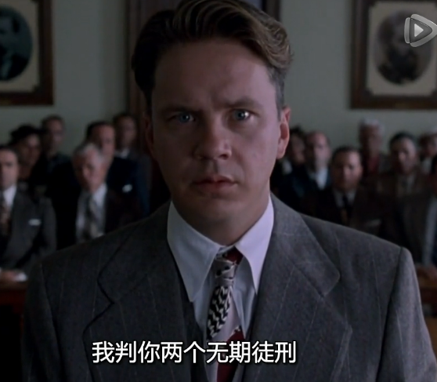
The story happened in 1947, the banker Andy because his wife had been having an extram-arital affair(婚外情), drunken（醉了的） to shoot and kill his wife and her lover, but he did not start. The coinci-dence(巧合) was that somebody shot his wife and her lover,he was
accused of murder, and was sentenced to life impris-onment. It meant that he would have to spend the rest of his life in the Shawshank prison. When he knew the truth 20 yeas later, he decided to redeem his freedom.

Slide 3
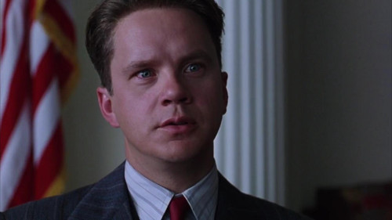
Andy Dufresne
Rich
Handsome Smart
A banker High EQ Erudite
(博学的，有学问的)

Slide 4
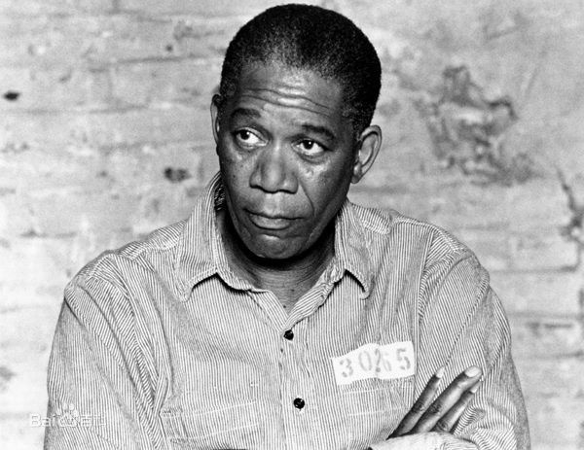
Ellis Boyd Red
-A prisoner
-A trader in the prison
-Andy's friend
-Finally applied to parole(假释)
-And met with Andy by the sea

Slide 5
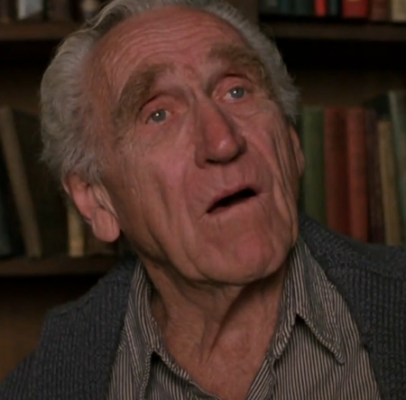
Brooks Hatlen
-A long-standing(长期的) prisoner
-Kind
-Finally applied to parole but could not get used to the society outside the prison
-Suicided(自杀) in an apartment

Slide 6
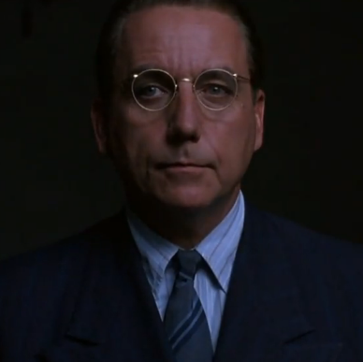
Sam Norton
-avaricious（贪婪的）
-The warden(监狱长) of the Shawshank
-Utilized(利用) Andy to do money laundering
-Cruel
-Finally suicided before being caught

Slide 7
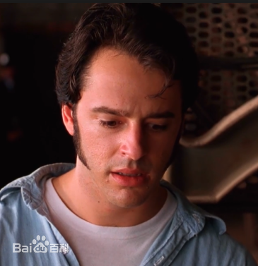
Tommy Williams
-A young man
-Told Andy the truth and would like to be the evidence(证人)
-Was killed by the warden because the warden
wanted Andy to be in the prison forever to help him

Slide 8

Three topics
Three topics
-Faith
-Hope
-Institutionalize(体制化)

Slide 9

Faith and hope
In the movie, what Andy had done shows us that faith and hope would never be obliterated(消灭，磨灭). He kept his faith and hope in his heart and made an effect on Red.
This tells us that we should have faith and hope in our daily life so that we won't be easily beaten by difficulties.
While there is life, there is hope.
留得青山在，不怕没柴烧。

Slide 10

I guess it comes down to a simple choice:get busy living or get busy dying.
生命可以归结为一种简单的选择：忙于生存，或者等死。
Here’s where it makes the most sense. You need it so you don’t forget. Forget that there are places in the world that aren’t made out of stone . That there’s something inside that’s yours, that they can’t touch.
这就是意义所在。你需要它，就好像自己不要忘记。忘记世上还有不是用石 头围起来的地方。忘记自己的内心还有你自己的东西，他们碰不到的东西。

Slide 11
Hope is good thing, mabye the best of things. And no good thing ever dies.
希望是件美好的东西，也许是最好的东西。美好的东西是永远不会死的。
Fear can hold you prisoner. Hope can set you free.
恐惧让你沦为囚犯。希望让你重获自由。
I hope I can make it across the border, I hope the Pacific is as blue as I dreamed it is; I hope to see my friend again, and shake his hand; I hope.
我希望我能越过边境，我希望太平洋同我梦想的一样蔚蓝，我希望再见我的朋友，同他握手，我希望。

Slide 12

When Red was released on parole, he found a gift Andy left him, and overcomed the parole of psychological（心理的，危机的） crisis（危机）, found Andy on Zihuatanejo. Two friends eventually（最终地） met.

Slide 13
http://v.qq.com/

