Slide 1
What is chemistry?

Slide 2
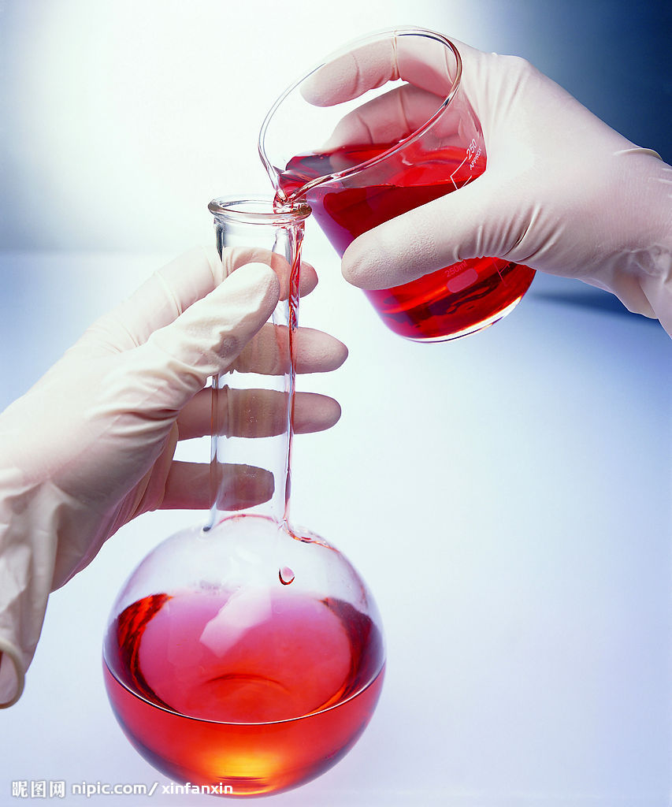
the
sign
for ‘scientist’
Notes:
What’s the first image come out of your mind when somebody mention about scientist?
The American symbol society said the sign of scientist is the gesturing as if you are mixing liquids from flask.
This is the most common movement in chemistry.
Yes, today I want to talk about my major – chemistry.

Slide 3
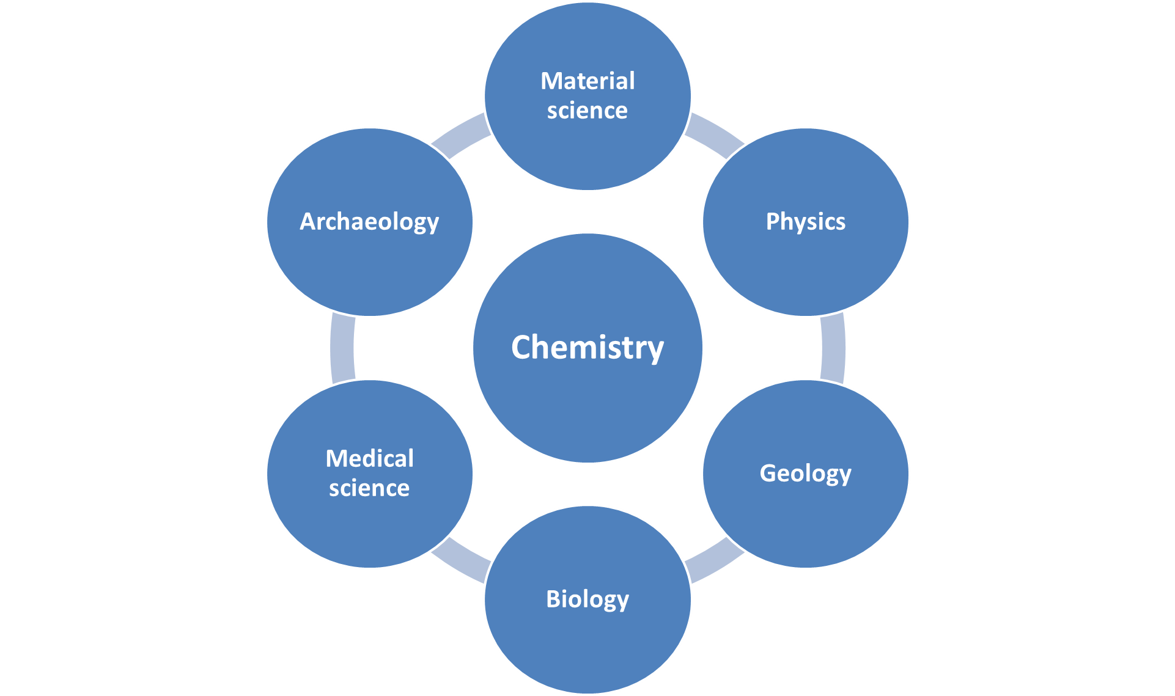
Notes:
As just mention about the symbol of scientist, chemistry is always thought of the “central science”. Because it bridges other natural sciences like physics, geology, material science, medical science, biology and even archaeology with each other.^{[3][4]}Chemistry is a branch of physical science, but distinct from other ‘discovery’ science, chemistry can create its object by synthesis.

Slide 4
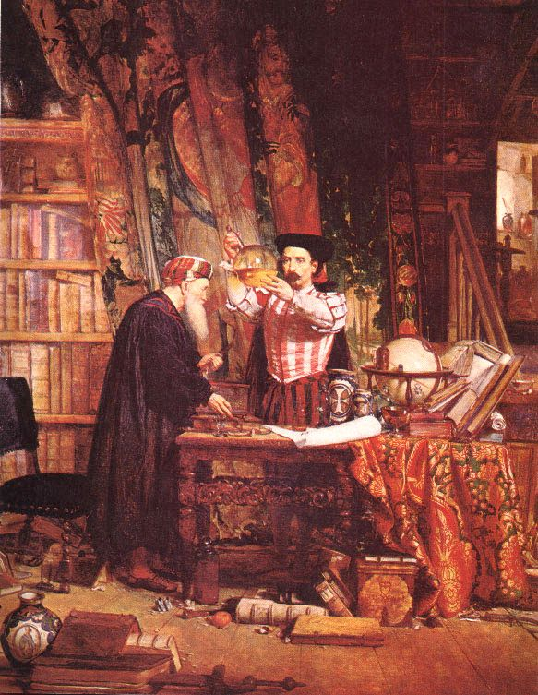
the
origin
of
Chemistry
Notes:
Chemistry is one of the oldest sciences, and it has certainly be the most productive in improving human life.
The origin of chemistry can be traced to certain practices, known as alchemy, which had been practiced for thousands of years in various parts of the world, particularly the Middle East and ancient China.

Slide 5
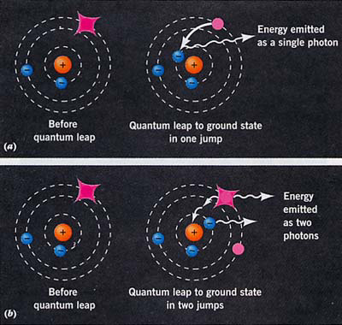
Notes:
Then, what is chemistry? Chemistry, is the study of molecules. Their structures, properties and the most important, change.
Electrons, they receive energy and change their energy levels to emit photon or induce reactions. Therefore, atoms combine together become molecule. And the molecules change their bonds to form new matters. All these changes make elements combine together and become every things in the world.

Slide 6
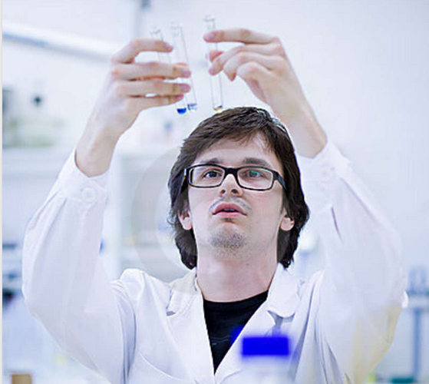
Researcher

Slide 7
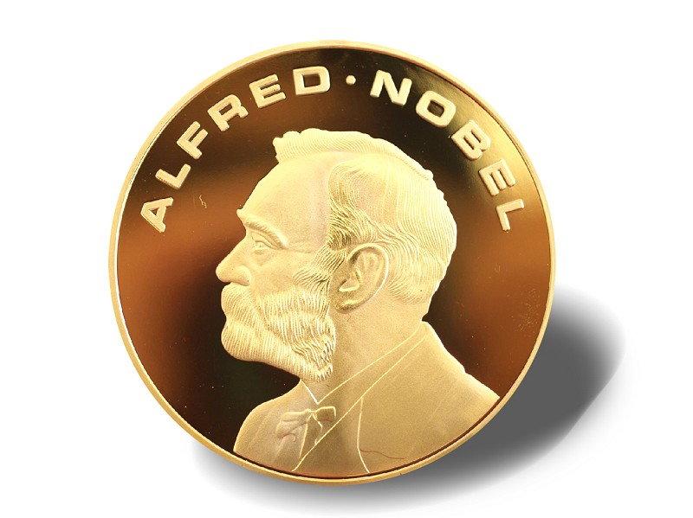
Great Scientist
Notes:
And return to our dairy life, what can we do as a chemistry student. It’s the most frequently question asked by others. Here is the answers, some of us become chemistry researchers, a small number of researchers will become great scientist, just like Nobel, print his head in a goal coin and give millions dollars to others each year.
But most of us are going to find a job in chemical company, work as a researcher or technical support. Some of us become high school chemistry teacher. And if you are tired of answering these question, you can just say, “I will be an alchemist, I change stone to gold.”

Slide 8

Work in chemical company

Slide 9
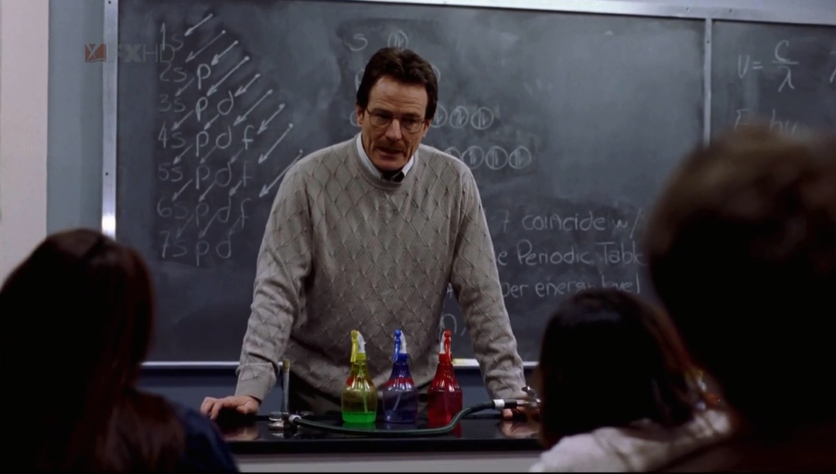
High school teacher

Slide 10
http://v.pps.tv/play_3CRGJZ.html?ptag=vsogou

Slide 11
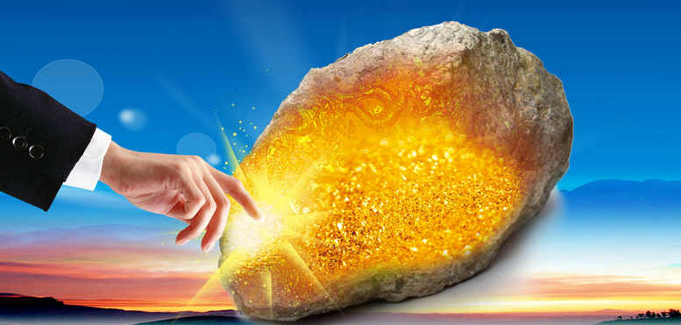
Thank you!!

