Slide 1
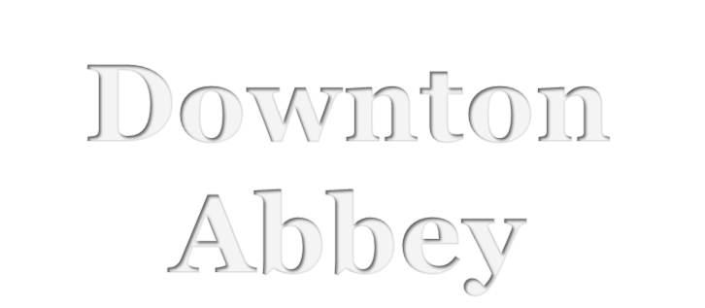
2015.10

Slide 2
INTRODUCTION 1
English drama at the hero implemented on the relentless exaggerated gloom technique, not warm, not sensational, no matter for people to own without hesitation, nonsensical and surreal to a shocking degree, read good English drama, is neither painful nor itching, where they create a unique artistic atmosphere and want to get out, just can't.

Slide 3
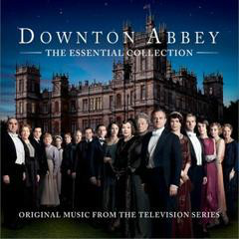
Downton Abby
Downton Abbey is a British period drama television series created by Julian Fellowes.
The series, set in the fictional Yorkshire country estate of Downton Abbey, depicts the lives of the aristocratic Crawley family and their servants in the post-Edwardian era —with the great events in history having an effect on their lives and on the British social hierarchy.

Slide 4
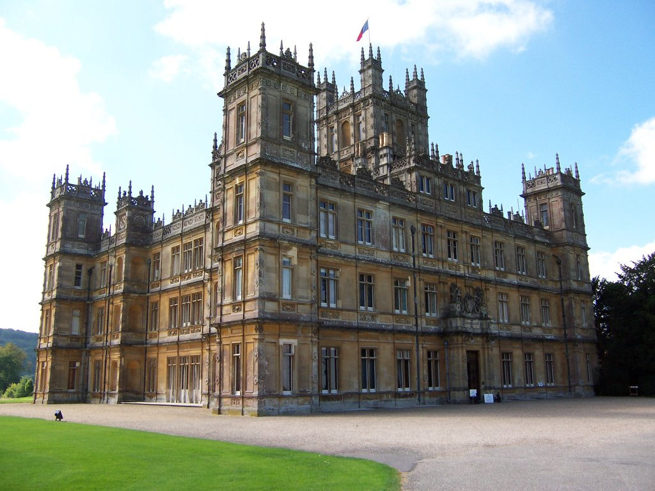

Slide 5
Social level
贵族等级 aristocracy
国王KING
贵族NOBLES 伯爵COUNT /EARL
（Grantham伯爵一家)
骑士KNIGHTS
资产阶级Capitalist class
商人MERCHANTS
手工业者CRAFTSMEN
农民PEASANTS
自由农FREEMEN
农奴SERFS

Slide 6
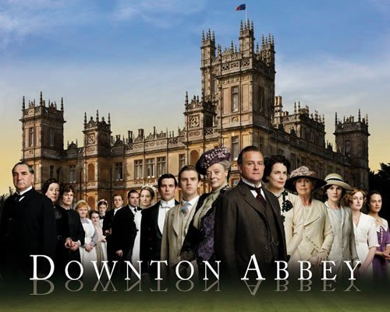
main characters

Slide 7
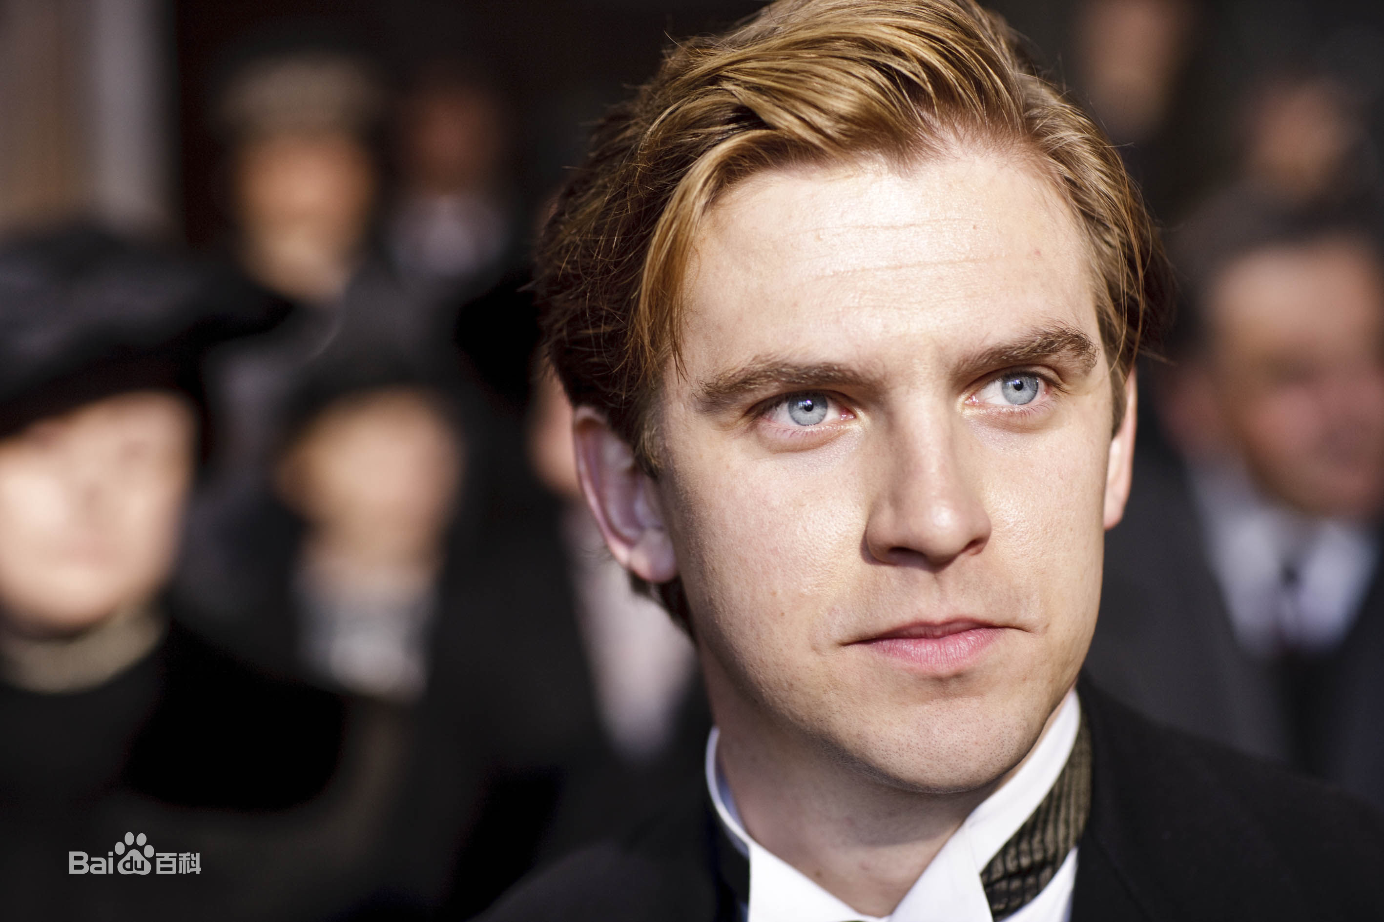

Slide 8
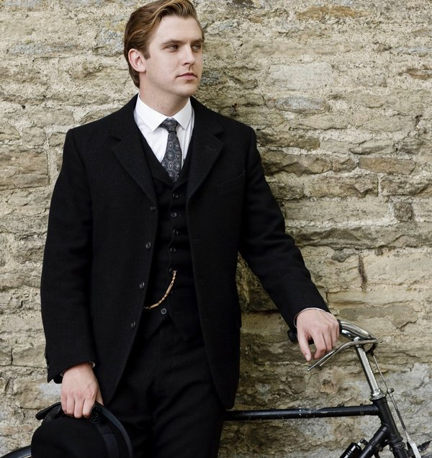
TAIL COAT (燕尾服 )
Over the years tailcoats of varying types have evolved into forms of formal dress for both day and evening wear

Slide 9
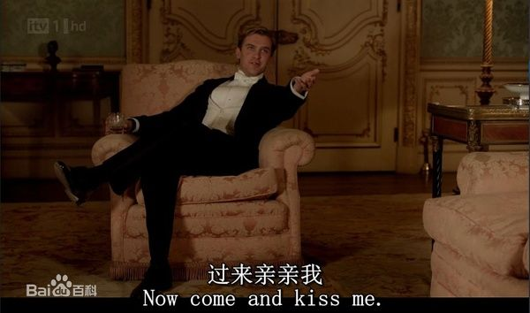


Slide 10
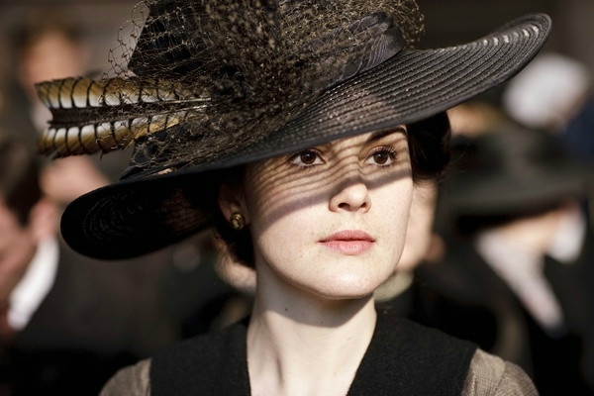
Lady Mary Crawley

Slide 11
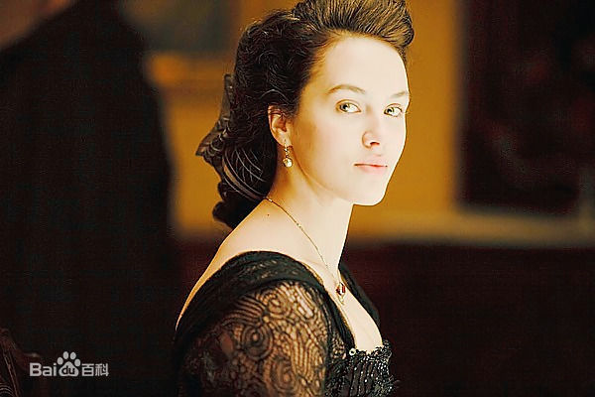

Slide 12
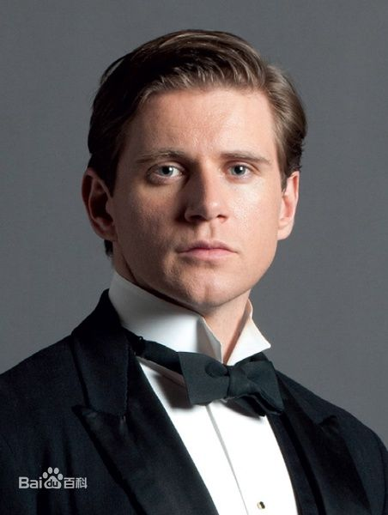
Car driver
Earl's son-in-law
Communist
（共产党员）

Slide 13
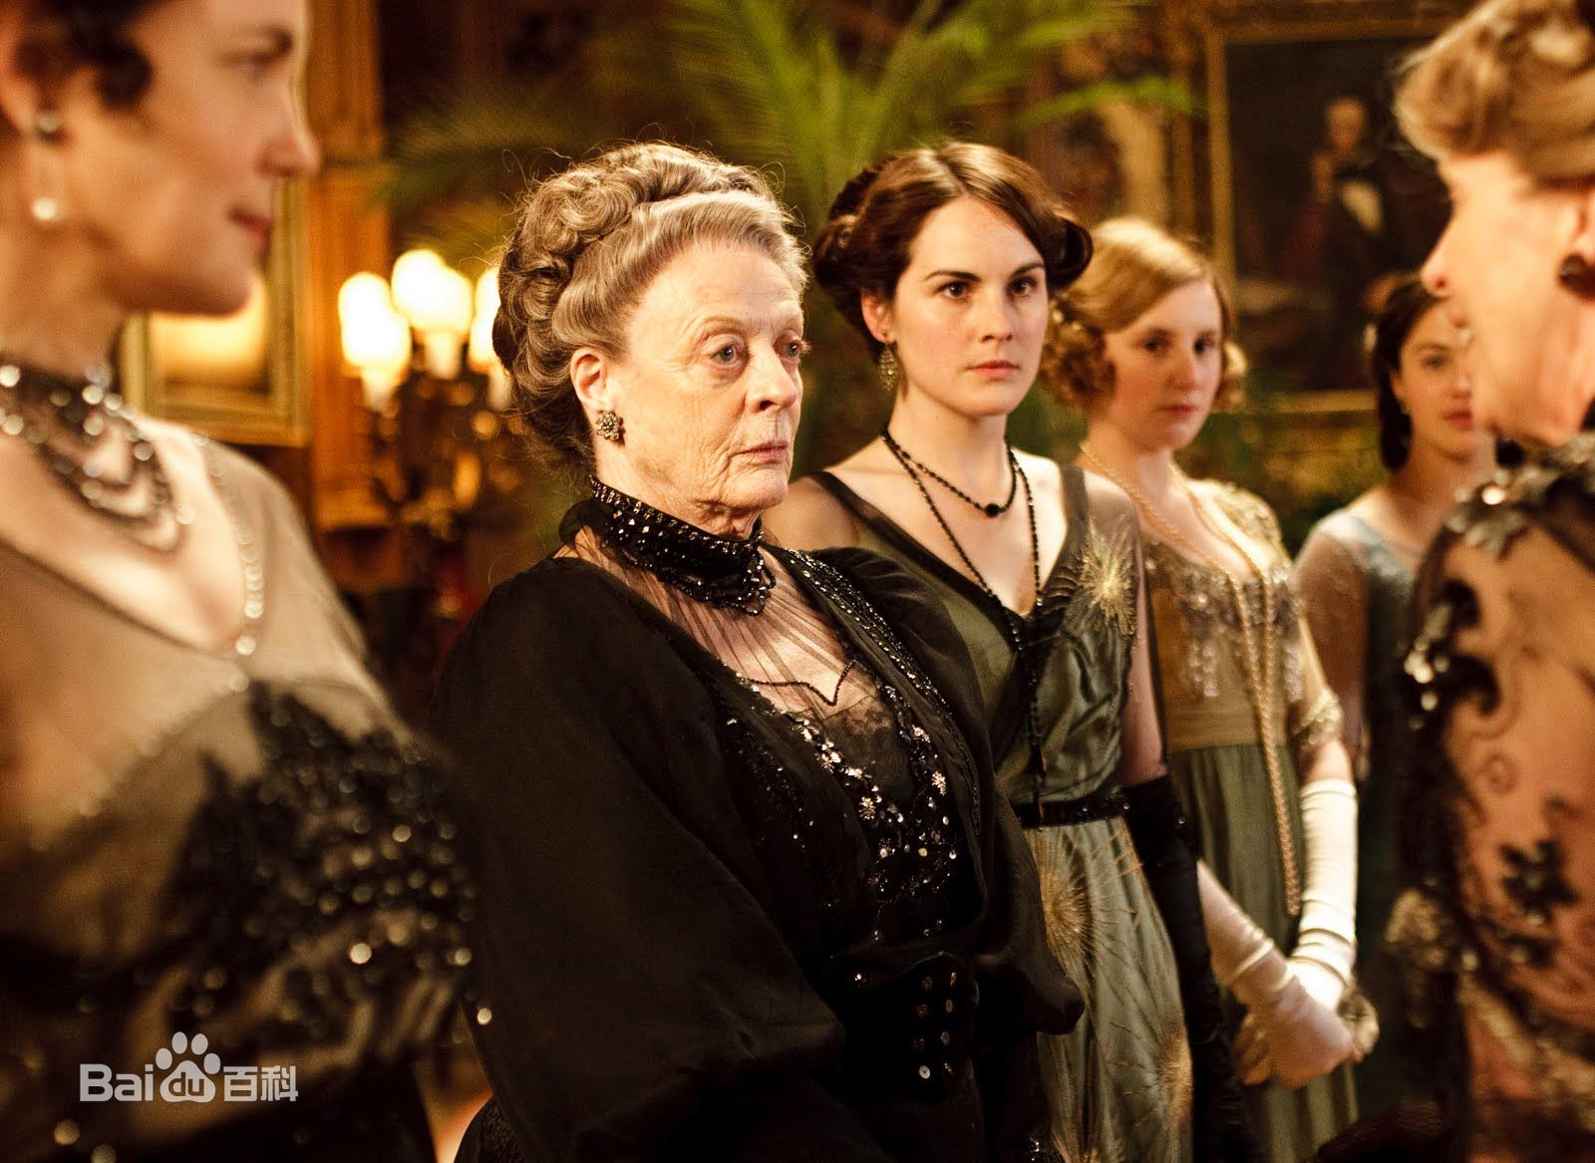

Slide 14
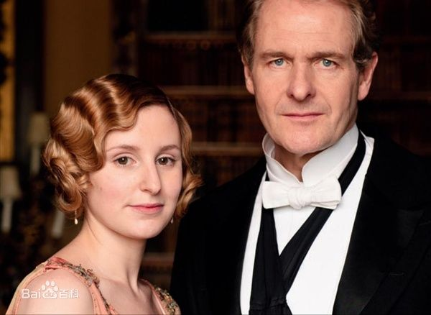

Slide 15
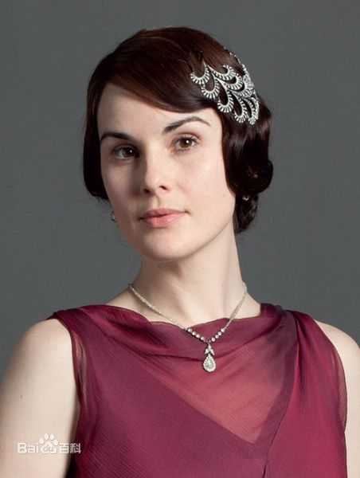
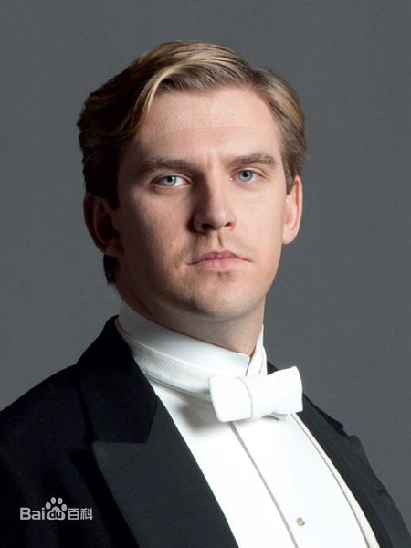

Slide 16
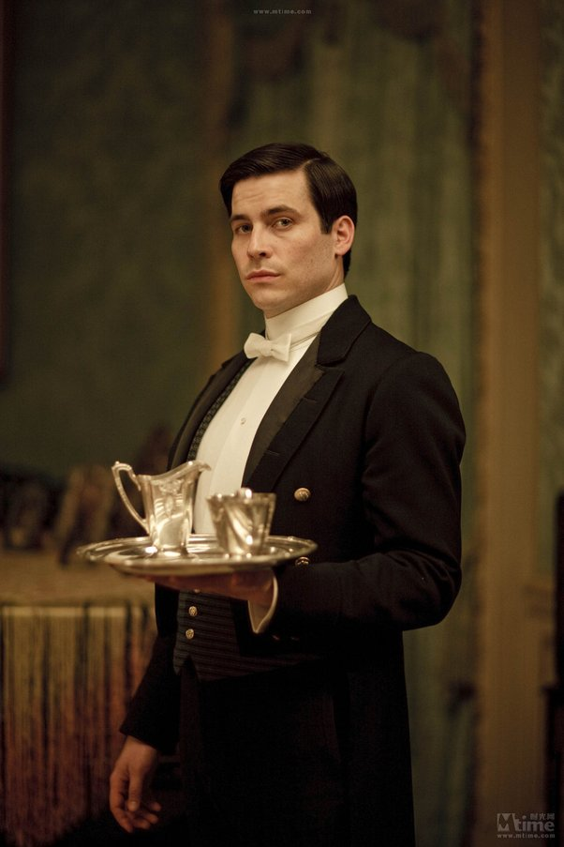
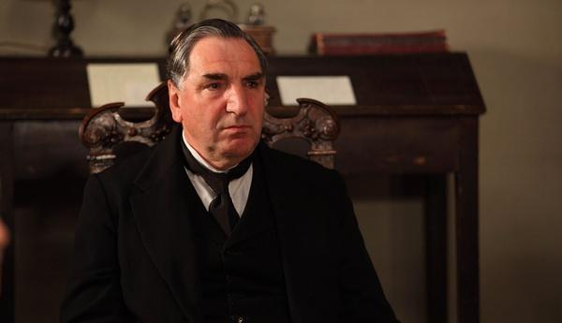
staff

Slide 17
why do I like this TV drama program?
Beautiful British accent
Classy clothes
Beautiful house
Delicate food
Elegant gesture and genteel words
The great humanity
The love to the family, the land, the country
Real aristocratic temperament（气质）

Slide 18
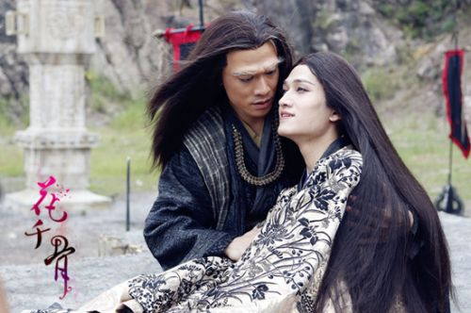

Compare with some Chinese TV series

Slide 19
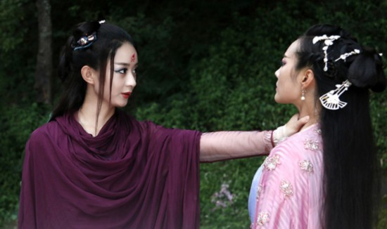

Slide 20
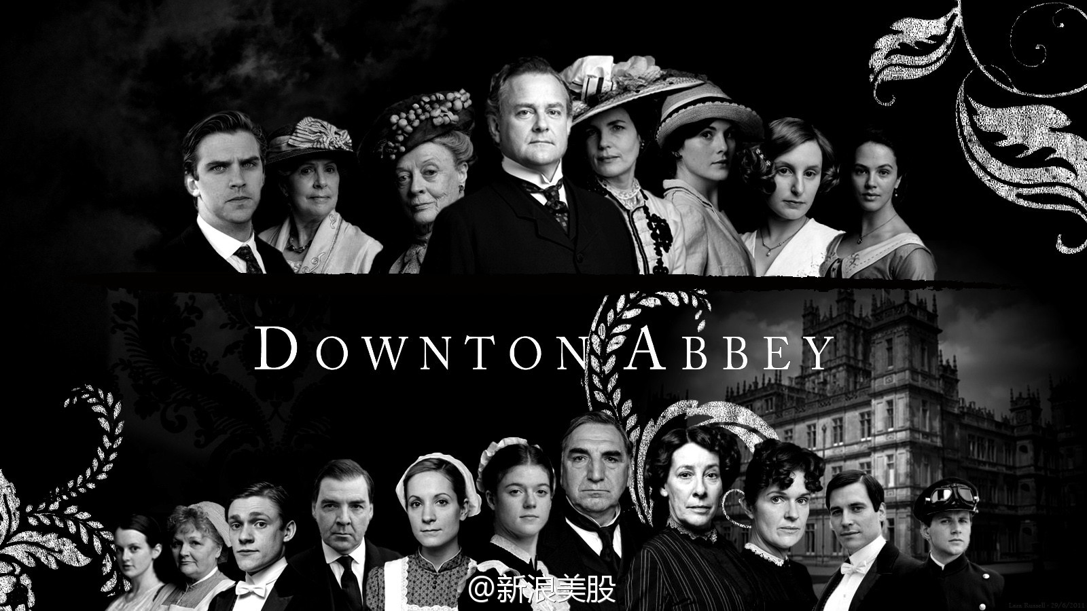
conclusion

Slide 21


