Slide 1
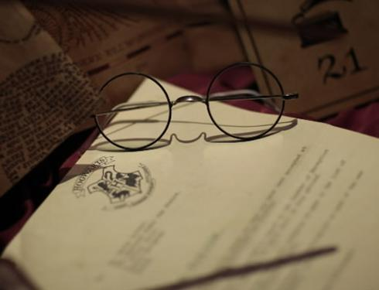
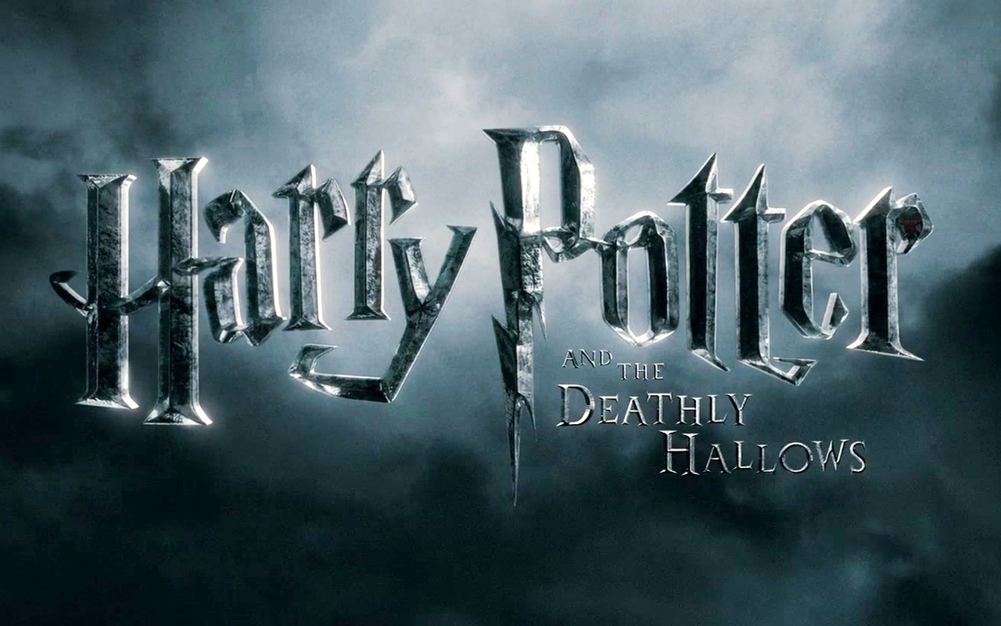

Slide 2
Introduction
Harry Potter is a series of seven fantasy novels written by British author J. K. Rowling.

Slide 3
Seven steps of 《Harry Potter》
Harry Potter and the Philosopher's Stone
Harry Potter and the Chamber of Secrets
Harry Potter and the Prisoner of Azkaban
Harry Potter and the Goblet of Fire
Harry Potter and the Order of Phoenix
Harry Potter and the Half-Blood Prince
Harry Potter and the Deathly Hallows

Slide 4
It won a lot of prize.
It has a large ,new world outlook.The world is really fantastic and lots of main roles in this movie became child stars.

Slide 5
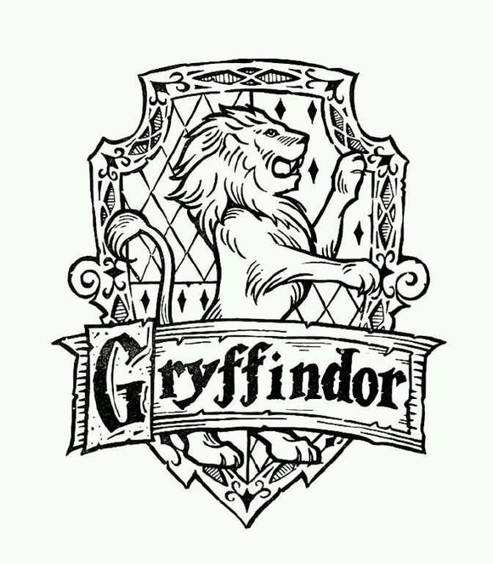
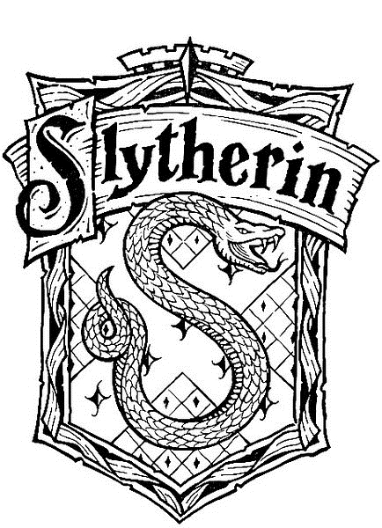
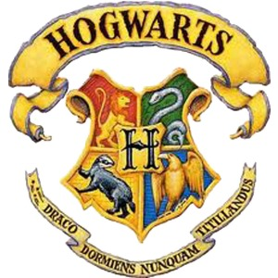

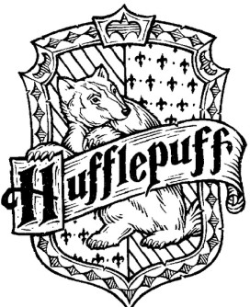
The four academy
http://www.bilibili.com/video/av2213822/

Slide 6
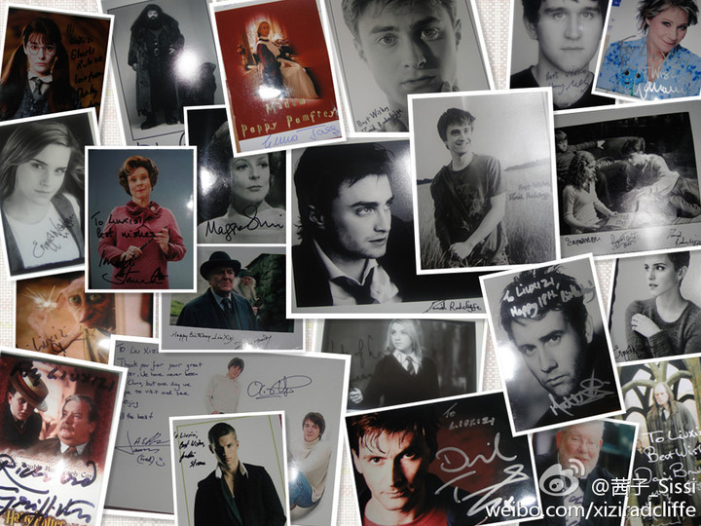

Slide 7
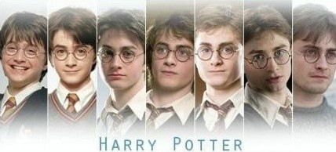
Actor:Daniel Radcliffe
The character of the story;a brave,strong and smart boy,loved by lots of people; Parents were killed by Lord Voldemort ,a evil wizard who scares everybody in the world of wizardry .Lived with his aunt’s family when he was a child. A Gryffindor student in hogwarts.

Slide 8
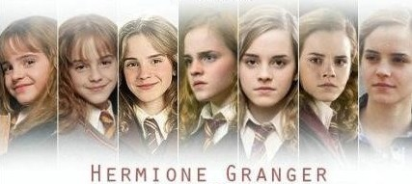
Actor:Emma Watson
Harry’s good friend，a smart and beautiful girl but was Mud bloods（泥巴种),whose parents are muggle(麻瓜) .Be good at study, called as Mrs.Know-All.(万事通).Helpful、enthusiasm,but sometimes has Perfect socialist tendency.Married to Ron Billius Weasley when in the end.

Slide 9
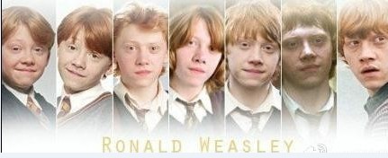
Actor:Rupert Grint
Come from a wizard family, Harry’s best friend.A gentle boy who has red hair, humor、lovely and understanding very much. Sincere but indecisive sometimes. Married to Hermione Jean Granger at last.

Slide 10
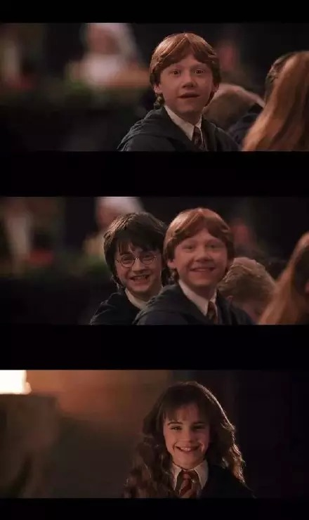
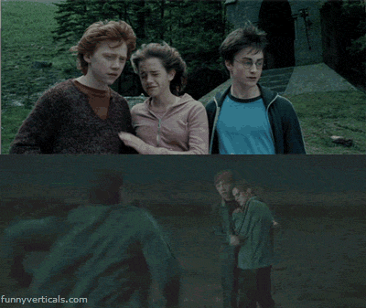
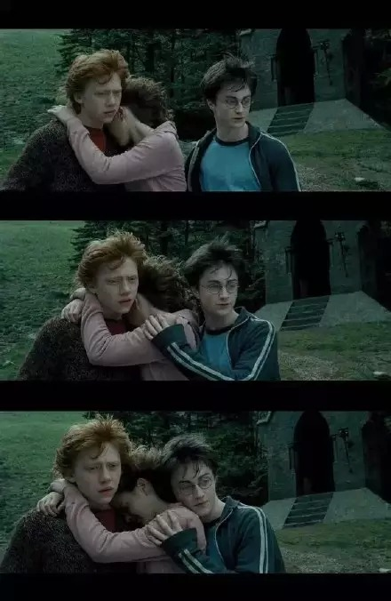

Slide 11
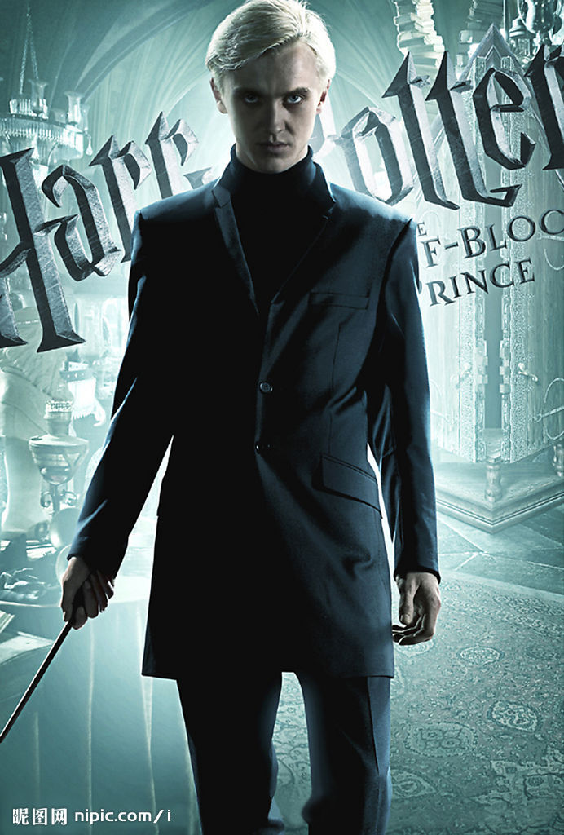
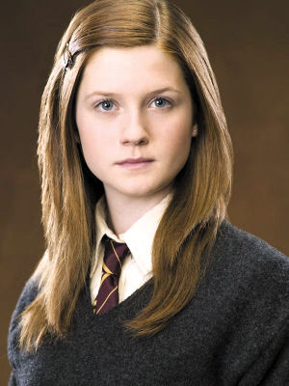
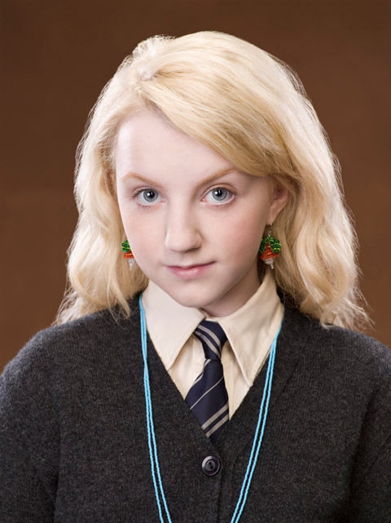
Ginny Weasley
Draco Malfoy
Luna Lovegood

Slide 12
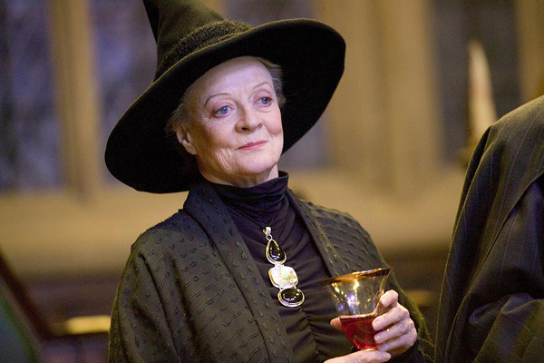
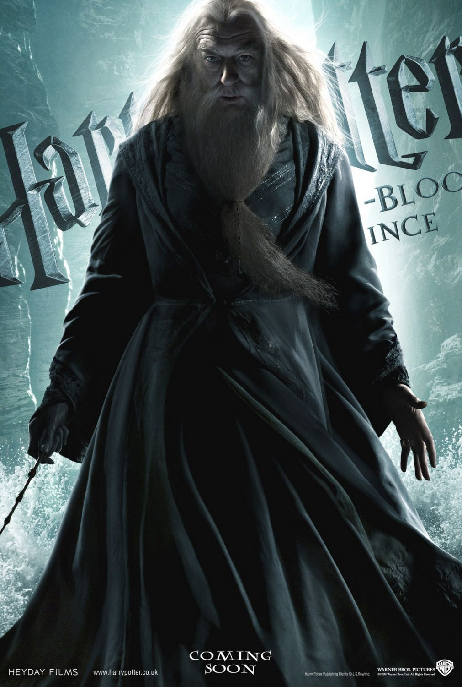
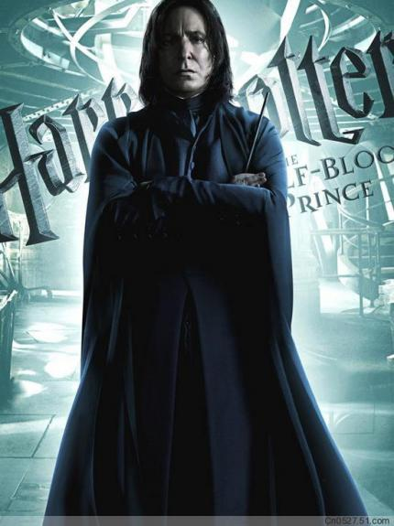
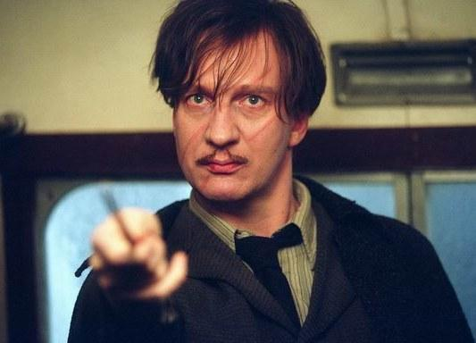
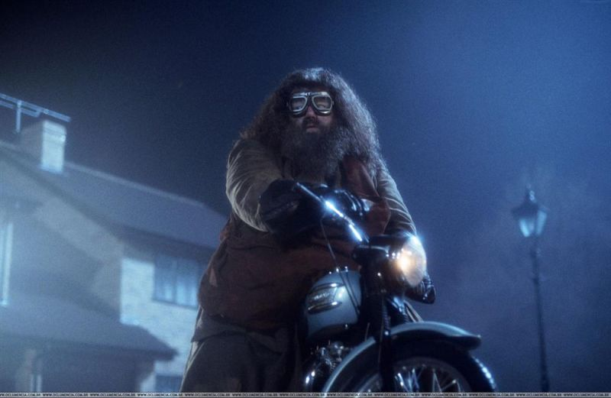
Severus Snape
Professor Minerva McGonagall
Remus John Lupin
Rubeus Hagrid
Albus Dumbledore

Slide 13
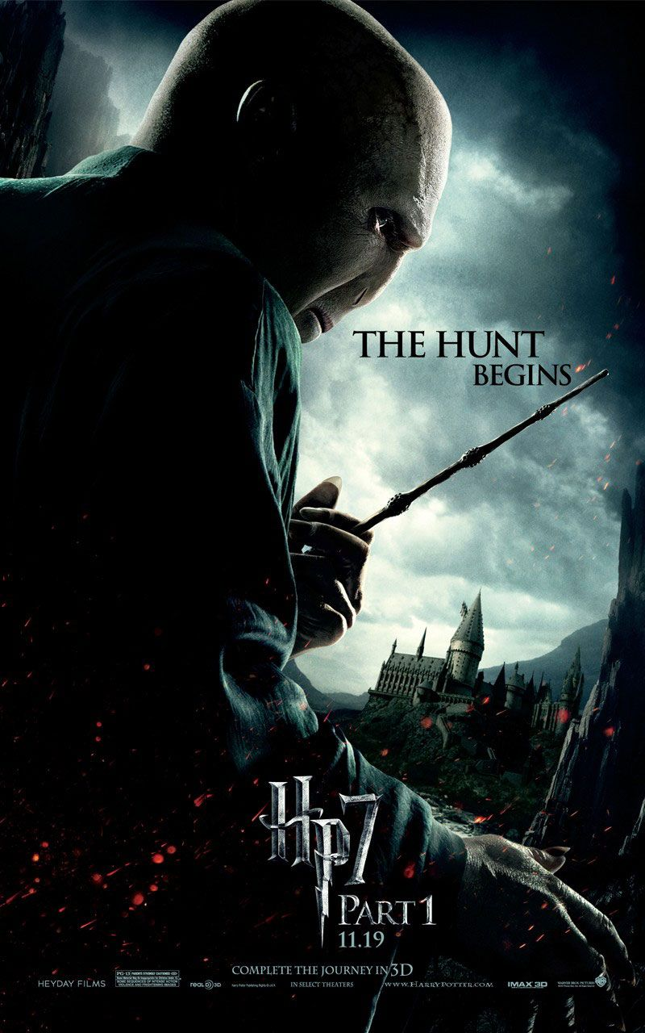
Lord Voldemort
His real name is Tom Riddle.
Harry’s perfect enemy
killed Harry’s Parents when Harry was still a little baby. followed by a crowd of
Death Eaters (食死徒). plan to kill Harry delibrately, but die of his own Curse carelessly at last.
He's a crazy and dangerous man.

Slide 14
