Slide 1

Scott
13-14学年第28期总第547期
Elvis Aron Presley
代表作品： 《Heartbreak Hotel》，《Hound Dog》，《Jailhouse Rock》，etc.
For Senior 2

Slide 2
“猫王”(The Hillbilly Cat)
这个绰号是狂热的南方歌迷为他取的昵称。猫王从未录制过外语歌曲，并且除了在三个城市的五场演出，他也从未在美国国外举办过演唱会。英俊不凡的容貌，天赋的音乐灵性，不羁天性而富有感召力的舞台表现力成为了猫王的标签，也使他成为世人狂热崇拜的明星，猫王在Graceland的家中，奖品陈列馆放满了金唱片和白金唱片，以及各种各样来自全世界各个国家的荣誉.

Slide 3
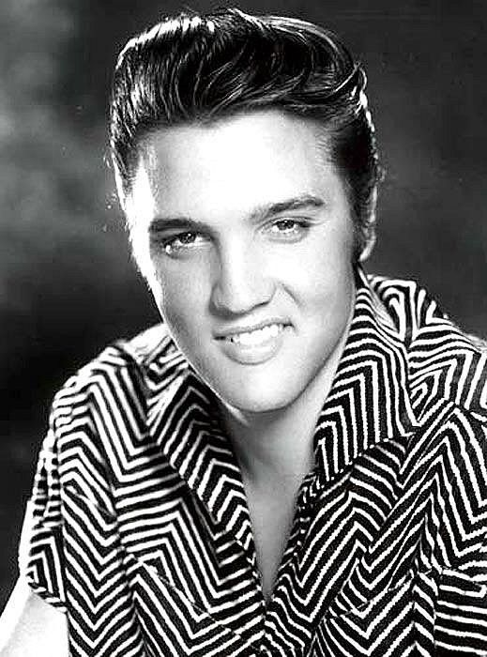


Slide 4
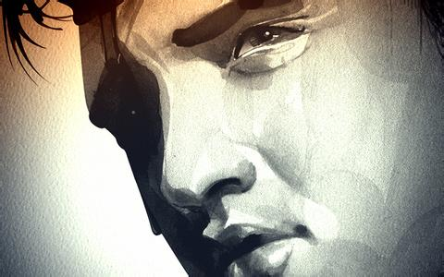
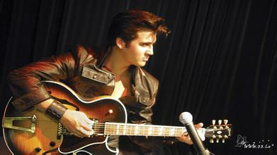
猫王，世界摇滚乐史上影响力最大的歌手，有摇滚之王的誉称。
20世纪50年代，猫王的音乐开始风靡世界。他的音乐超越了种族以及文化的疆界，将乡村音乐、节奏布鲁斯以及山地摇滚融会贯通，形成了具有鲜明个性的独特曲风，强烈的震撼了当时的流行乐坛，并让摇滚乐开始如同旋风一般横扫了世界乐坛。

Slide 5
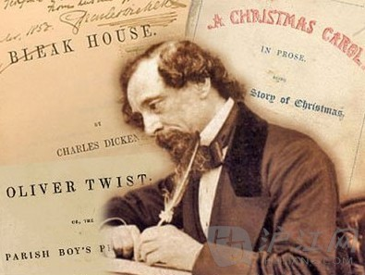
Scott
13-14学年第28期总第547期
Influence of Dickens(P4)
For Senior 2

Slide 6
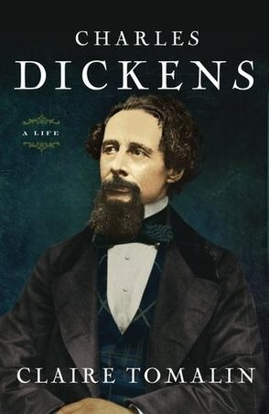
Warming up
How much do you know
about Charles Dickens?
2. Have you ever read Dickens’ novels? Would you please introduce one to the class?

Slide 7

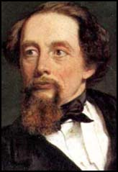
Charles Dickens
1 Oliver Twist
2 Hard Times
3 A Tale of Two Cities
4 Great Expectations
5 David CopperfieldC
66opperfield
6 A Christmas Carol
7 The Pickwick Papers
8 Little Dorrit
9 Our Mutual Friend

Slide 8
Brief Introduction
Charles Dickens is one of England’s most famous novelists. He described life in the middle of the 19th century, a period that is now called Victorian, as it was when Queen Victoria ruled Britain.

Slide 9
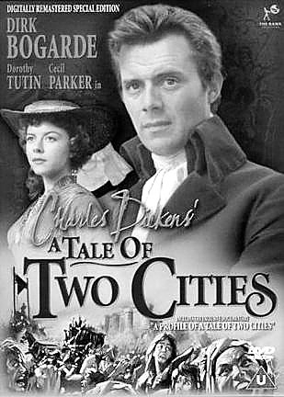
Dickens’ works

Slide 10


Slide 11
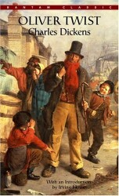
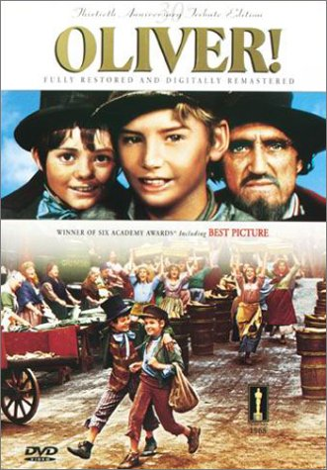

Slide 12
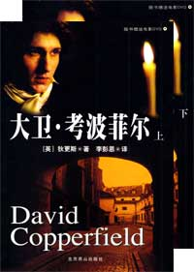

Slide 13
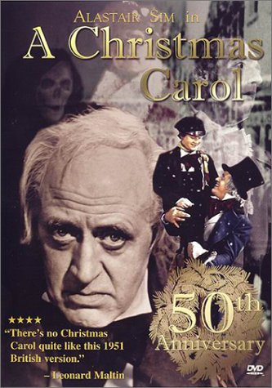

Slide 14
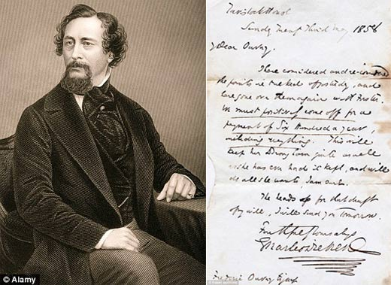
Fast reading
Why did Dickens hate the idea of statues?
Key: He wanted to be remembered for his work alone.

Slide 15
2. What is Dickens’ influence on the world according to the passage?
Key:
1) As the most famous novelist, his works are still being read and studied constantly.
2) As a celebrity, he influenced people’s way of living with his publicity. For instant, he invented the way Christmas is celebrated.
3) As the conscience of 19th century England, he tried to speaks for the poor in his novels.

Slide 16
Careful reading
1. Why did the author tell of the biographer’s mentioning the report of a child?
Key:
to prove that Dickens, as a famous novelist and celebrity, had a great influence on the world back then, even on the way people lived.

Slide 17
Translate the sentence into Chinese:
Think of the publicity that a film star receives today and you’ll get a sense of what the name Charles Dickens meant back then.
Key:
想想现在电影明星的知名度，你就能体会到在当时狄更斯这个名字的影响了。

Slide 18
If he were to rise from the dead, although he might be disappointed that his wishes had been dishonored, he would certainly see that his writing has a unique and lasting power.
Key:
假如狄更斯复活的话，尽管他可能会因为自己的愿望被忽视而失望，但是他也一定会看到自己的作品如今获得如此独特而持久的影响力。

Slide 19
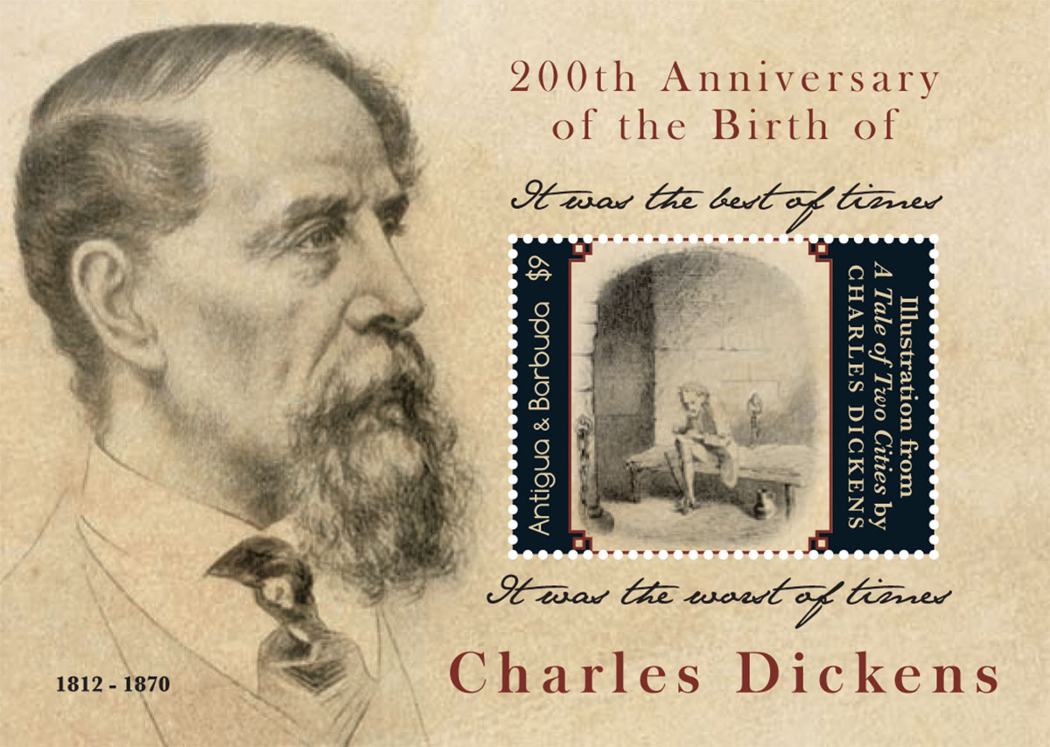

Slide 20
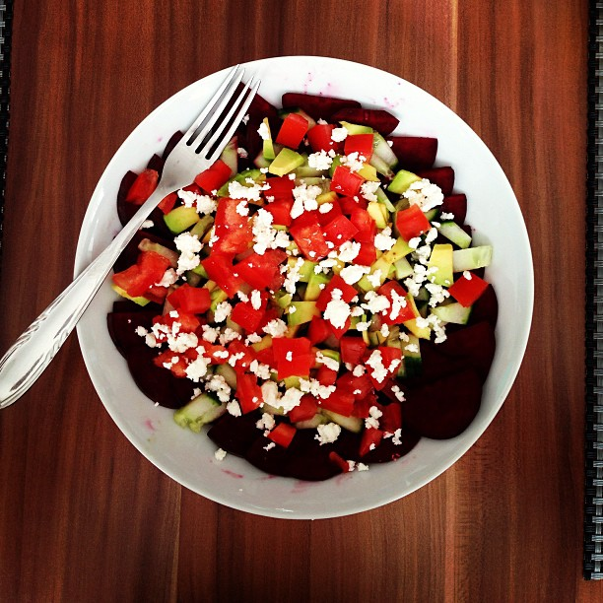
Scott
13-14学年第28 期总第547期
Watch Grandma’s diet(P5)
For Senior 2

Slide 21
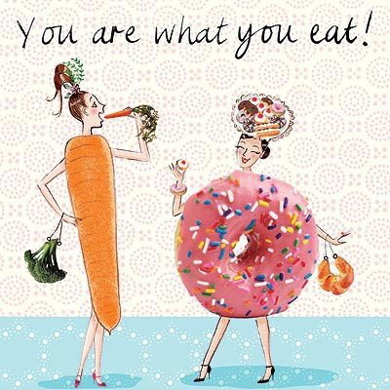
Warming up
人如其食, 即饮食习惯反映一个人的性格与生活环境.
1. What should we do to keep fit?
2. Do you think good health is determined by a good diet?
3. Are there any other
factors that influence
one’s health?

Slide 22

Fast reading
1. What finding did the new study reach?
Key:
You are also what your mom – and even your grandma – used to eat.

Slide 23

Fast reading
2. Why is a child’s birth weight determined by her grandmother’s diet?
Key:
A person’s health at birth is governed by a long history of health and nutrition going back more than a generation.

Slide 24
Careful Reading
True or False
1. They studied more than 3,000 women and their children’s children over a period of 30 years.
2. What a mother ate as an adult seems to have more of an impact than what grandma did on a child’s birth weight.
T
F

Slide 25
Careful Reading
3. Birth weight can show the condition of a baby’s health.
4. The fetus’ experiences during those nine months are only related to what she is eating during pregnancy.
5. The new studies also found that women born during the famines of World War II tended to have smaller babies 20 or 30 years later.
T
F
F

Slide 26


Slide 27

For Senior 2
Scott
2013-1014学年第 28 期总第 547 期
Learning to laugh (P6)
21ST

Slide 28
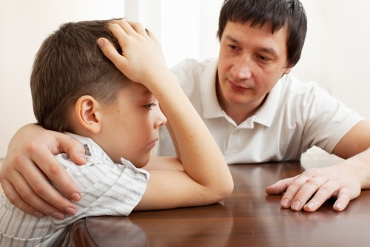
Warming up
Have you ever
lost any of your personal belongings
, like a wallet, a watch or a bike?
2. How did you feel?
Did anyone help
you get over the
loss?

Slide 29
Scanning
1. What happened to the author when he went back home after the Christmas holiday?
He parked the car in the driveway and found that it had been stolen the next morning.
Why was the author’s wife so upset after she found that the was car missing?
The car was full of things that brought back family memories.
3. What kind of message does the author want to convey in the article?
It's not what happens to you, but how you react to it that matters.

Slide 30
True or False questions
1. ___ The author was interested in buying a high-tech security system after he lost his car.
2. ___ The stolen car was a Christmas gift from the author’s grandmother.
3. ___ In the face of losses, the author and his wife helped each other.
4. ___ The author got in an accident on his way to pick up his stolen car.
F
F
T
F

Slide 31
Language practice
1. I awoke feeling rested and __________.
2. A number of them have ______ formal complaints against the police.
3. The doctor told my wife I had a fifty-fifty chance of __________.
4. I put a few personal ___________ in a bag.
5. They gave us a _______ welcome.
refreshed
filed
survival
belongings
hearty

Slide 32
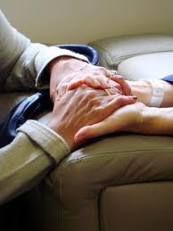
Exploration:
Use all the information available to you in the text to write a description of the type of person the author is. Support what you say with evidence from the text.

