Slide 1
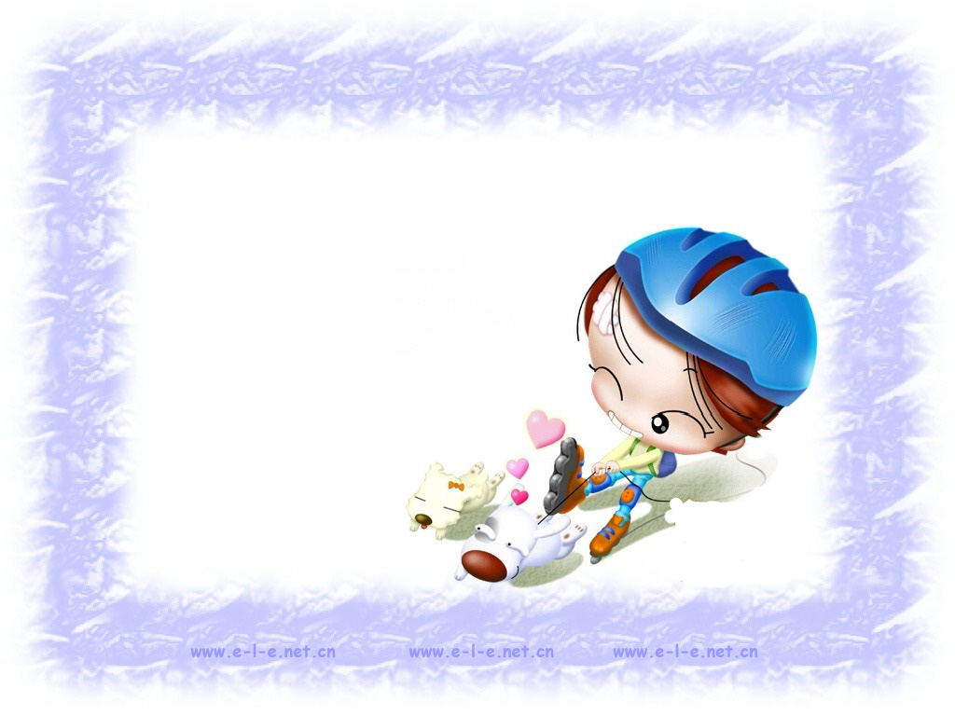
Listening

Slide 2

Listening on page 55
In pairs discuss what you think will happen in the tailor’s shop, after Henry shows the salesman and the owner the bank note.

Slide 3
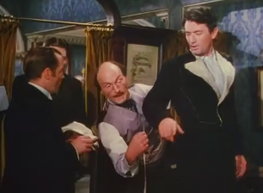
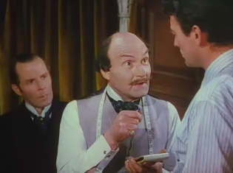

Slide 4

Listen to the tape. Write down the three
things that happen in this scene.
1 They take him to anther part of the shop and offer him many suits to buy.
2 They explain that he need not pay until it is convenient and they will deliver his suits to his hotel.
3 They offer to arrange his hotel accommodation for him.

Slide 5
Listen again and answer these questions
in groups.
Why doesn’t the salesman give Henry
his change right away?
2. Is the owner really angry at the
salesman or does he just pretend to
be angry? How do you know?
3. Is Henry glad to get more than one coat?
How do you know?

Slide 6
4. Henry tells the owner that he is moving. Give two reasons why the owner is not surprised to hear this news.
5. What does the owner offer to do for Henry? Why?

Slide 7
1. Why doesn’t the salesman give Henry his change right away?
The salesman is shocked after
receiving such a huge sum of money.

Slide 8
2. Is the owner really angry at the salesman
or does he just pretend to be angry? How
do you know?
The owner is pretending to be angry at
the salesman. We know this from the way
he talks to him. Actually, the owner and
all of the salesmen feel a bit foolish. The
owner is also trying to save face.

Slide 9
3. Is Henry glad to get more than one coat? How do you know?
No, Henry wants only one coat and
complains that the others are
unnecessary.

Slide 10
4. Henry tells the owner that he is moving. Give two reasons why the owner is not surprised to hear this news.
First, the owner believes rich men often
change their address. Also, Henry is a
foreigner, so he is likely to be a tourist
who would be expected to change his
address.

Slide 11
5. What does the owner offer to do for Henry? Why?
He offers to help Henry get a room in the
“Ritz”, one of the best hotels in London,
as a way to show special favour and gain
more of Henry’s business in return.

Slide 12

Listening text
N=Narrator O=Owner
S=Salesman H=Henry
Act Two, Scene 2
N: The salesman drops Henry’s coat. Then he looks at the bank note again and again. He cannot believe his eyes.

Slide 13
O: Well, what seems to be the trouble?
H: I’m still waiting for my change.
O: Come, come, give him his change,
Todd. Get going. (looks at the bank
note) Could it be the one I saw in the
papers last week? I think it must be.
You’re a born fool, Todd, to bring
this fine gentleman into this part of
our shop.

Slide 14
S: Sorry, Mr Reid.
O: He’ll think we’ve never dealt with a rich man before. Oh, take off this coat, sir. Why, it’s only fit for a man in a circus. Well, don’t just stand there, go and get some others, Todd!
S: Right away, Mr Reid.
O: Allow me, sir! This way, sir. Look at
This coat. This is perfect!

Slide 15
It was made for a king. But he’ll just
have to wait. Now sir, you’ll need
many suits for many occasions. Yes,
indeed you will.
H: Now, wait a minute. I only came
here to get a coat .
O: Now, now sir.

Slide 16
H: But I can’t buy all these things. You
would have to wait a long time to get
paid.
O: A long time, sir? A long time? Why,
I’ll be glad to wait … forever!
C: Yes, we can wait forever!
H: Well, all right. I’ll take the coat now
and get the others later.
O: Fine, fine. Your address, sir?

Slide 17
H: I don’t have one yet. I’m…moving.
O: Of course you are! A busy man, I’m
sure. Well, take my advice and stay at
the “Ritz”. It’s the finest hotel in this
part of London. I’ll call them and tell
them to expect you. Leave it to me.

Slide 18

Writing

Slide 19
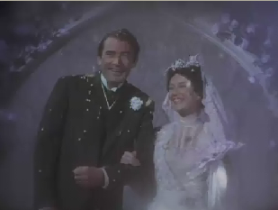
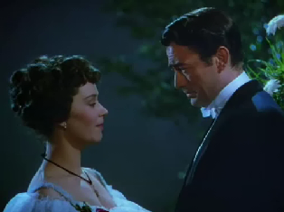

Slide 20

Imagine that after Henry marries Portia he has bad luck in business and becomes poor again. Now he must tell his wife the bad news. Before you write, however, discuss these questions with your partner:

Slide 21
How do you think Portia feels when she hears the bad news?
What do you think Henry plans to do to solve the crisis?
Do you think Portia will leave Henry?

Slide 22
Do you think they will get help
from the two brothers or
anybody else? Give reasons.
What will they finally decide
to do?
How do you think people’s
attitude will change towards
Henry and Portia.

Slide 23

Homework
    Work in groups. Go to the
    library or surf the internet
    to find out more about The
    Million Pound Bank Note.

