Slide 1
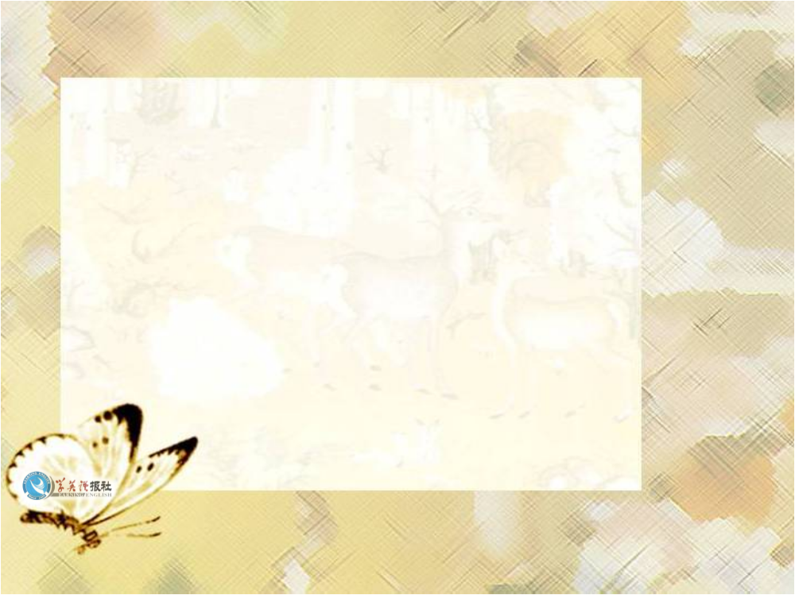
Using language

Slide 2

Words preview
steak
pineapple
dessert
amount
rude
manner
scream
n. 肉块；牛排；鱼排
n. 菠萝
n. 餐后甜点
n. 数量
adj. 粗鲁的；无理的
n. 礼貌；举止；方式
vi. 尖声叫
n. 尖叫声；喊叫声

Slide 3
Words preview
genuine
rag
indeed
bow
barber
adj. 真的；真诚的
n. 破布；碎布
adv. 真正地；确实；实在
vi&n. 鞠躬；弯腰
n. 理发师

Slide 4
Expressions preview
take a chance
in rags
as for
冒险
衣衫褴褛
关于；至于

Slide 5

Read Act1, Scene 4 on page 22 and then answer three questions below in small groups.

Slide 6
1 Whose behaviour changes the most during this scene? Give examples.
2 What kind of person is the owner of the restaurant?
3 Why do you think the owner of the restaurant gave Henry a free meal?

Slide 7
1 Whose behaviour changes the most during this scene? Give Examples.
The owner’s behaviour changes the most because he stops being rude and worrying if Henry can pay for the meal and becomes over-polite offering Henry a free meal.

Slide 8
2 What kind of person is the owner of the restaurant?
He is somebody who is only impressed
by how much money somebody has.

Slide 9
3 Why do you think the owner of the restaurant gave Henry a free meal?
He may be frightened Henry will not come
back. He may also worry that Henry will
tell his friends about the bad treatment he
got at the restaurant and they will not
return either.

Slide 10

Listen to the tape and role play the text. Remember that Henry has an American accent while the owner, the hostess and the waiters all have British accents. Pay attention to correct pronunciation and intonation.

Slide 11

Listening
Before listening, predict what do you think Henry will do or where he will go next. Give your reasons. Then listen to the whole tape and check your idea.

Slide 12
Listen to the tape again and answer
the following questions.
1 Why does Henry worry when he leaves the restaurant?
2 Why can’t he see the two brothers again?
3 What do the two brothers ask him to do?

Slide 13
1 Henry begins to worry that he got the bank note by mistake.
2 Unfortunately he cannot see the two brothers again as they have gone travelling.
3 They ask him to go back to their house in thirty days’ time.

Slide 14


Listening text
N=Narrator S=Servant H=Henry
Act 1: Scene 5
N: Henry feels happy only for a moment.
As he walks away from the restaurant,
he begins to worry that he has got the
bank note by mistake. He runs back to

Slide 15
the brothers’ home and knocks at the door. No one comes. He walks around to the side of the house and knocks at another door. The servant opens it.
S: May I help you, sir?
H: Yes. I need to see the two brothers
about…

Slide 16
S: They’ve gone, sir. Gone travelling.
H: But they were here just two hours
ago!
S: I’m sorry, sir. They’ll be back in a
month — a month from today.
H: A month? But I cannot believe…

Slide 17
S: Good day, sir.
N: Henry sits down on the stairs, and opens the envelope. He finds a letter in it and takes it out. The letter says: “You are an intelligent and honest man, as one may see by your face. We also believe you are poor and a stranger to this city.

Slide 18
Inside you will find a sum of money. The
Money is lent to you for a short time.
Come back to our home with it in exactly
30 days. I have a bet on you. If I win ,
you shall have any job that you can do
as my thanks.”
H: Well, how about that!

Slide 19

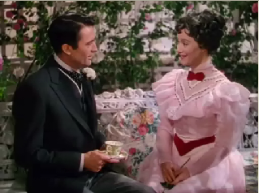
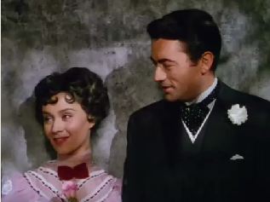
Discussion
What will he do with the bank note?
Can you guess the end of the story?
What happened on Henry?
Who will win the bet?

Slide 20
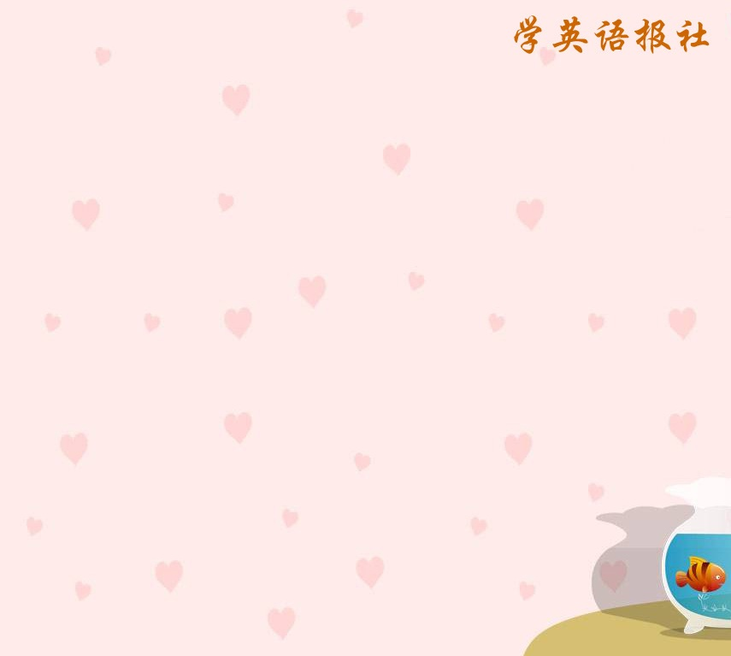
Homework
Write down what you have learned about “The Million Pound Bank Note”

